Slide 1
Python Programming
4.4 Hard Problems

Slide 2
Hard Problems
Using divide-and-conquer we could design efficient algorithms for searching and sorting problems.
Divide and conquer and recursion are very powerful techniques for algorithm design.
Not all problems have efficient solutions!

Slide 3
Towers of Hanoi
One elegant application of recursion is to the Towers of Hanoi or Towers of Brahma puzzle attributed to Édouard Lucas.
There are three posts and sixty-four concentric disks shaped like a pyramid.
The goal is to move the disks from one post to another, following these three rules:

Slide 4
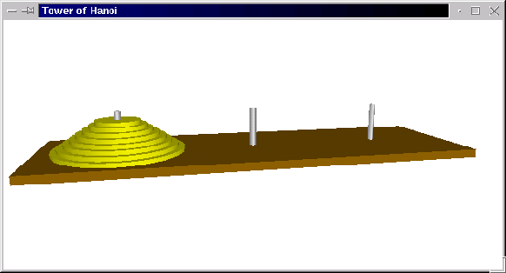
Towers of Hanoi
Only one disk may be moved at a time.
A disk may not be “set aside”. It may only be stacked on one of the three posts.
A larger disk may never be placed on top of a smaller one.

Slide 5
Towers of Hanoi
If we label the posts as A, B, and C, we could express an algorithm to move a pile of disks from A to C, using B as temporary storage, as: Move disk from A to C Move disk from A to B Move disk from C to B

Slide 6
Towers of Hanoi
Let’s consider some easy cases –
1 disk Move disk from A to C
2 disks Move disk from A to B Move disk from A to C Move disk from B to C

Slide 7
Towers of Hanoi
3 disks To move the largest disk to C, we first need to move the two smaller disks out of the way. These two smaller disks form a pyramid of size 2, which we know how to solve. Move a tower of two from A to B Move one disk from A to C Move a tower of two from B to C

Slide 8
Towers of Hanoi
Algorithm: move n-disk tower from source to destination via resting place move n-1 disk tower from source to resting place move 1 disk tower from source to destination move n-1 disk tower from resting place to destination
What should the base case be? Eventually we will be moving a tower of size 1, which can be moved directly without needing a recursive call.

Slide 9
Towers of Hanoi
In moveTower, n is the size of the tower (integer), and source, dest, and temp are the three posts, represented by “A”, “B”, and “C”.
def moveTower(n, source, dest, temp): if n == 1: print "Move disk from", source, "to", dest+".“ else: moveTower(n-1, source, temp, dest) moveTower(1, source, dest, temp) moveTower(n-1, temp, dest, source)

Slide 10
Towers of Hanoi
To get things started, we need to supply parameters for the four parameters: def hanoi(n): moveTower(n, "A", "C", "B")
>>> hanoi(3) Move disk from A to C. Move disk from A to B. Move disk from C to B. Move disk from A to C. Move disk from B to A. Move disk from B to C. Move disk from A to C.

Slide 11
Towers of Hanoi
Why is this a “hard problem”?
How many steps in our program are required to move a tower of size n?
Number of Disks | Steps in Solution
1 | 1
2 | 3
3 | 7
4 | 15
5 | 31

Slide 12
Towers of Hanoi
To solve a puzzle of size n will require 2^{n}-1 steps.
Computer scientists refer to this as an exponential time algorithm.
Exponential algorithms grow very fast.
For 64 disks, moving one a second, round the clock, would require 580 billion years to complete. The current age of the universe is estimated to be about 15 billion years.

Slide 13
Towers of Hanoi
Even though the algorithm for Towers of Hanoi is easy to express, it belongs to a class of problems known as intractable problems – those that require too many computing resources (either time or memory) to be solved except for the simplest of cases.
There are problems that are even harder than the class of intractable problems.

Slide 14
Factoring a number into primes.
It is the security provided by the lack of any efficient algorithm to solve this problem that allows RSA and public key encryption to be so widely accepted and successful.

Slide 15
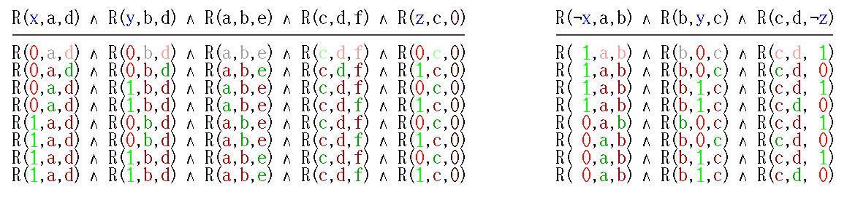
SAT
The satisfiability problem to test whether a given Boolean formula is satisfiable.

Slide 16
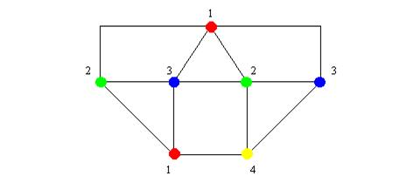
Graph coloring
How many colors do you need to color a graph?

