Slide 1
Python Programming
7.2 Pseudo Random Number Generators

Slide 2
Why are random numbers useful?
Random numbers are useful for a variety of purposes, such as
Generating data encryption keys
Simulating and modeling
Selecting random samples from large data sets
Gambling
Video games

Slide 3
Traits of random numbers
Random numbers should have a uniform distribution across a range of values
Every result should be equally possible
Each random number in a set should be statistically independent of the others

Slide 4
Pseudo-Random Number Generators
Called PRNGs for short
The numbers produced are not truly random
Use algorithms to produce a sequence of numbers which appear random
Efficient: fast
Deterministic: a given sequence of numbers can be reproduced if the starting values are known
Periodic: the sequence will eventually repeat

Slide 5
How PRNG Works
Uses a “seed” to determine values and a function to interpret the seed
The same seed always generates the same values in the same order
Deterministic
Flaw: If the seed and function are known, results can be predicted

Slide 6
Seeds in Action
Say we have a seed x and a PRNG function f:
f(x) = y, for all x ∈ {x}
It’s clear that this always generates the same number
PRNG functions may base the seed on a changing value, e.g. the computer clock

Slide 7
Linear Congruential Generator
X_{n+1} = (aX_{n} + c) mod m
modulus m, 0 < m
multiplier a, 0 < a < m
increment c, 0 < c < m
seed value X₀, 0 < X₀ < m
Used by java.util.Random, among others

Slide 8
PRNG in Cryptography
PRNG can be used to encrypt/decrypt data
Pro: Unique encryption can be performed each time
Con: If both the seed and random function are known, third parties can intercept/interfere with messages

Slide 9
Examples of PRNG applications
Simulation and Modeling applications
it is useful that the same sequence of numbers can be generated so simulations can be recreated with only one aspect modified each time
Video Games
it is useful that the numbers can be generated very quickly and it is not as important that the data be truly random

Slide 10
Chi-Square Test
A method often used to compare the randomness of random number generators
Involves producing sequences of 1000 random integers between 1 and 100
For a perfectly random distribution one would expect to have 10 occurrences of each integer (1-100), so the expected frequency is 10
The actual frequency for the generator is then calculated and the difference between the two can be used calculate the chi-square value
A value of 100 indicates uniform distribution

Slide 11
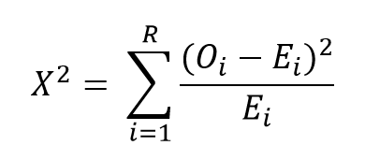

Chi-Square Test
Formula:
R = possible number of different random integers
O = observed frequency of integer i
E = expected Frequency of integer i
Can be reduced to:

Slide 12
A Comparison of Four PRNGs
WICHMANN AND HILL
Combines 3 linear congruential generators with c = 0
MITCHELL AND MOORE
Generates numbers based on the last 55 numbers
MARSAGLIA
Uses the last 2 numbers to generate the next; long period
L’ECUYER
Combines 2 linear congruential generators with c = 0

Slide 13
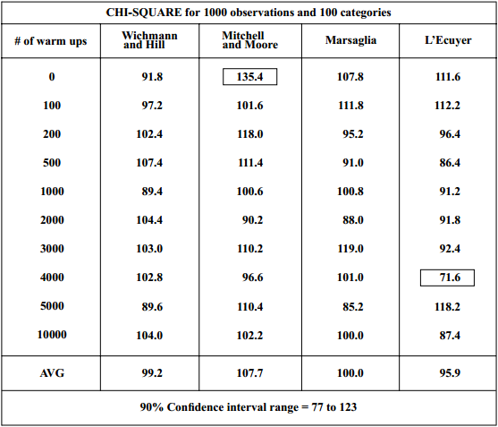
Results for Chi-Square

Slide 14
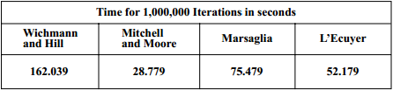
Timing Results

Slide 15
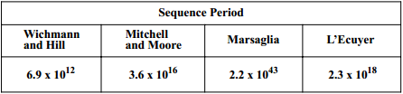
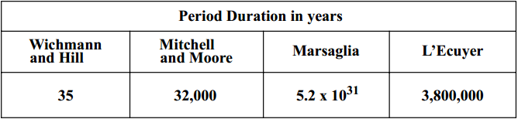
Periods
For a small (personal) computer:
Marsaglia has been used on supercomputers and has a period long enough for use in supercomputer applications

Slide 16
True RNG
There are ways to get around the predictability of PRNG
These involve generating the numbers outside of the computer
Usually use special equipment
Significantly slower than PRNG
Limit to how fast numbers can be “harvested”

Slide 17
Traits of True RNG
Inefficient: slow - must “harvest” numbers
Non-deterministic: numbers cannot be predicted by knowing certain values
Aperiodic: sequence of numbers does not repeat after a certain amount of time

Slide 18
Examples of True RNG
random.org: uses space noise to generate unpredictable random numbers
HotBits: times radioactive decay and reports back random numbers based on it

Slide 19
TRNG Applications
Lotteries and Draws
Gambling
Security
Some applications which require true randomness substitute pseudo randomness, occasionally to disastrous results

Slide 20
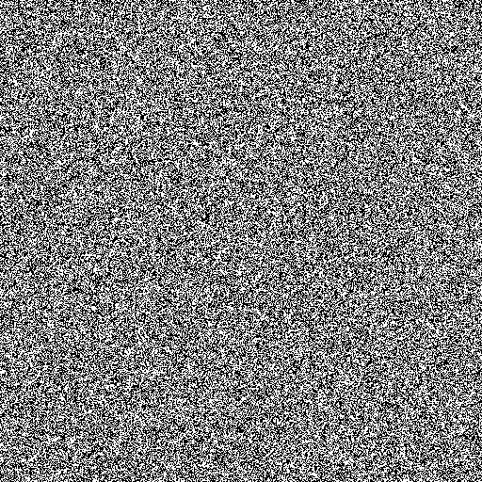
True RNG

Slide 21
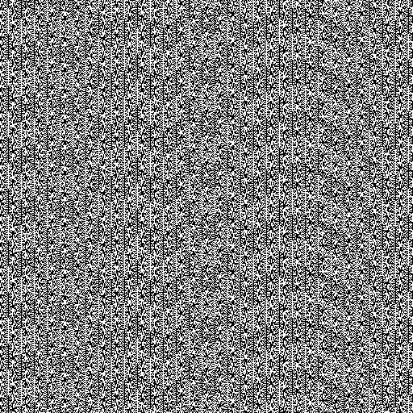
PRNG Failures: rand() function on windows:
PHP for Microsoft Windows
study conducted by Bo Allen in 2008 to test randomness of the rand() function in PHP on Microsoft Windows
Same issue not found on Linux

Slide 22
PRNG Failures
Cracking the lottery
Mohan Srivastava
Geological Statistician
In 2003 he cracked the number generation pattern on tic-tac-toe scratch off games
Could predict winning tickets correctly with 95% accuracy
Also able to break super bingo scratch off game and predict winners with 70% accuracy
Reported findings to Ontario Lottery and Gaming Corporation

Slide 23
PRNG Failures
Joan Ginther
Math professor with PhD from Stanford University
Won lottery scratchcard jackpots four times
Total winnings total more than $20 million
Does not admit to breaking code

