Slide 1
Python Programming
4.1 Searching

Slide 2
Searching
Searching is the process of looking for a particular value in a collection.
For example, a program that maintains a membership list for a club might need to look up information for a particular member – this involves some sort of search process.

Slide 3
A simple Searching Problem
Here is the specification of a simple searching function: def search(x, nums): # nums is a list of numbers and x is a number # Returns the position in the list where x occurs # or -1 if x is not in the list.
Here are some sample interactions: >>> search(4, [3, 1, 4, 2, 5]) 2 >>> search(7, [3, 1, 4, 2, 5]) -1
In the first example, the function returns the index where 4 appears in the list.
In the second example, the return value -1 indicates that 7 is not in the list.

Slide 4
Strategy 1: Linear Search
Pretend you’re the computer, and you were given a page full of randomly ordered numbers and were asked whether 13 was in the list.
How would you do it?
Would you start at the top of the list, scanning downward, comparing each number to 13? If you saw it, you could tell me it was in the list. If you had scanned the whole list and not seen it, you could tell me it wasn’t there.

Slide 5
Strategy 1: Linear Search
This strategy is called a linear search, where you search through the list of items one by one until the target value is found.
def search(x, nums): for i in range(len(nums)): if nums[i] == x: # item found, return the index value return i return -1 # loop finished, item was not in list
This algorithm wasn’t hard to develop, and works well for modest-sized lists.

Slide 6
Strategy 1: Linear Search
The Python in and index operations both implement linear searching algorithms.
If the collection of data is very large, it makes sense to organize the data somehow so that each data value doesn’t need to be examined.

Slide 7
Strategy 2: Binary Search
If the data is sorted, there is an even better searching strategy – one you probably already know!
Have you ever played the number guessing game, where I pick a number between 1 and 100 and you try to guess it?
Each time you guess, I’ll tell you whether your guess is correct, too high, or too low. What strategy do you use?

Slide 8
Strategy 2: Binary Search
Young children might simply guess numbers at random.
Older children may be more systematic, using a linear search of 1, 2, 3, 4, … until the value is found.
Most adults will first guess 50. If told the value is higher, it is in the range 51-100. The next logical guess is 75.

Slide 9
Strategy 2: Binary Search
Each time we guess the middle of the remaining numbers to try to narrow down the range.
This strategy is called binary search.
Binary means two, and at each step we are diving the remaining group of numbers into two parts.

Slide 10
Strategy 2: Binary Search
We can use the same approach in our binary search algorithm! We can use two variables to keep track of the endpoints of the range in the sorted list where the number could be.
Since the target could be anywhere in the list, initially low is set to the first location in the list, and high is set to the last.

Slide 11
Strategy 2: Binary Search
The heart of the algorithm is a loop that looks at the middle element of the range, comparing it to the value x.
If x is smaller than the middle item, high is moved so that the search is confined to the lower half.
If x is larger than the middle item, low is moved to narrow the search to the upper half.

Slide 12
Strategy 2: Binary Search
The loop terminates when either
x is found
There are no more places to look (low > high)

Slide 13
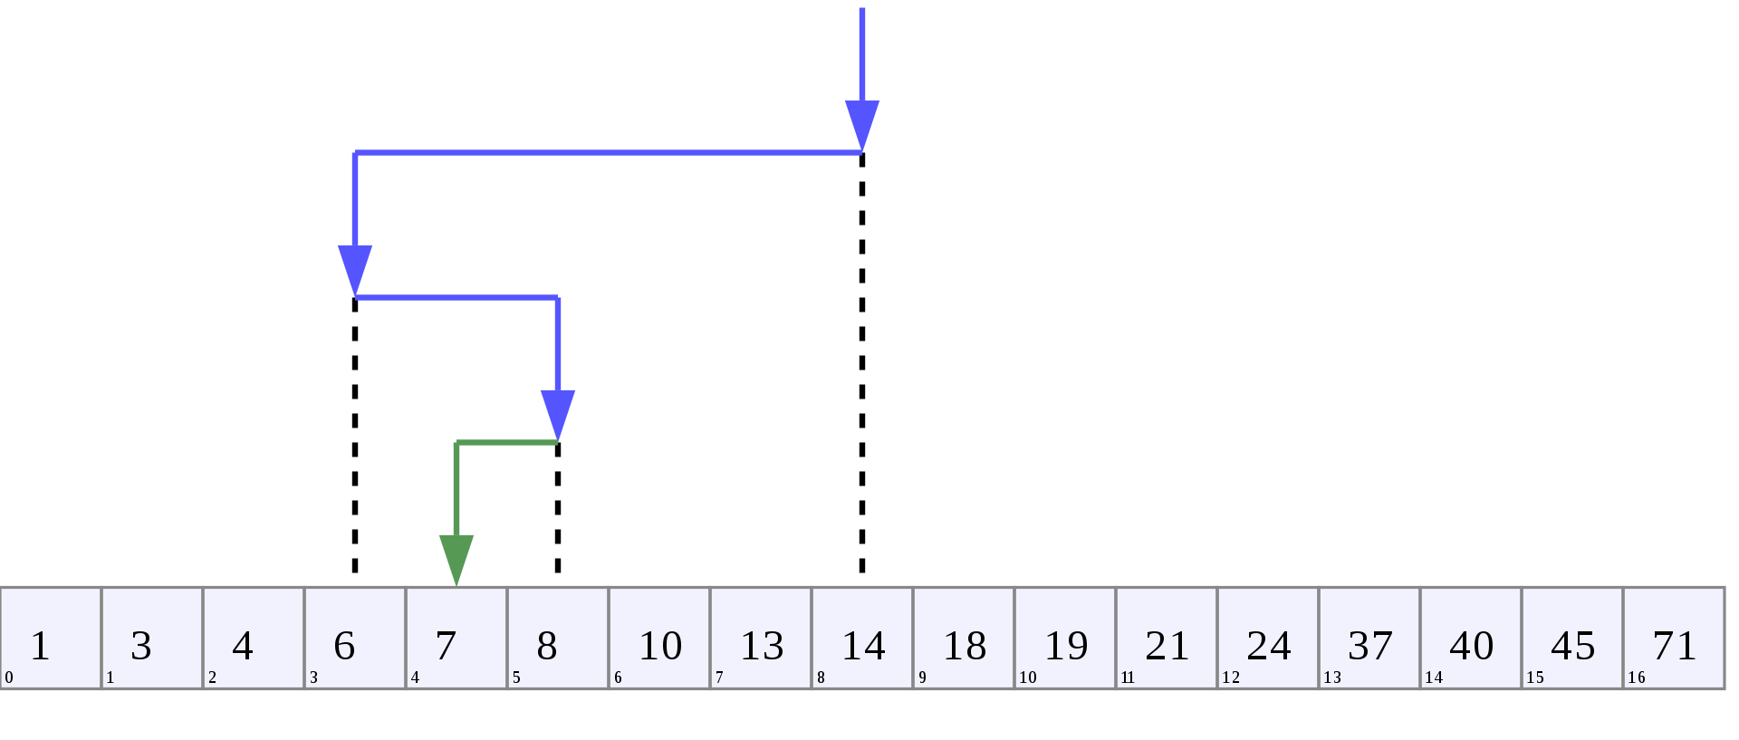
Looking for 7 in a sorted list
low: 0
High: 16
Mid: 8
low: 0
High: 7
Mid: 3
low: 4
High: 7
Mid: 5
low: 4
High: 4
Mid: 4

Slide 14
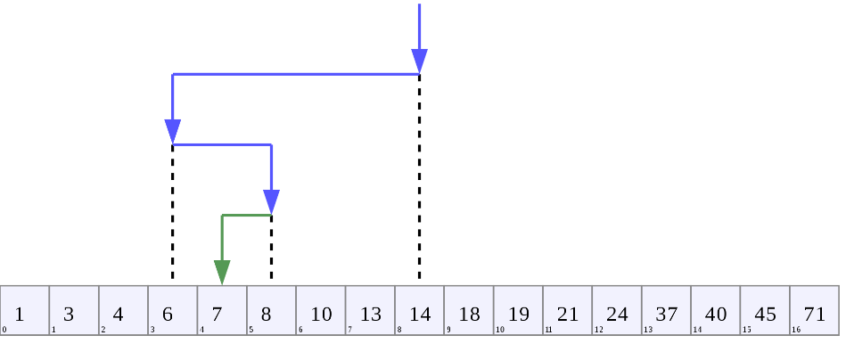
Strategy 2: Binary Search
def search(x, nums):
low = 0
high = len(nums) - 1
while low <= high: # There is still a range to search
mid = (low + high)/2 # Position of middle item
item = nums[mid]
if x == item: # Found it! Return the index
return mid
elif x < item: # x is in lower half of range
high = mid - 1 # move top marker down
else: # x is in upper half of range
low = mid + 1 # move bottom marker up
return -1 # No range left to search,
# x is not there

Slide 15
Comparing Algorithms
Which search algorithm is better, linear or binary?
The linear search is easier to understand and implement
The binary search is more efficient since it doesn’t need to look at each element in the list
Intuitively, we might expect the linear search to work better for small lists, and binary search for longer lists. But how can we be sure?

Slide 16
Comparing Algorithms
One way to conduct the test would be to code up the algorithms and try them on varying sized lists, noting the runtime.
Linear search is generally faster for lists of length 10 or less
There was little difference for lists of 10-1000
Binary search is best for 1000+
for one million list elements, binary search averaged .0003 seconds while linear search averaged 2.5 second

Slide 17
Comparing Algorithms
While interesting, can we guarantee that these empirical results are not dependent on the type of computer they were conducted on, the amount of memory in the computer, the speed of the computer, etc.?
We could abstractly reason about the algorithms to determine how efficient they are. We can assume that the algorithm with the fewest number of “steps” is more efficient.

Slide 18
Comparing Algorithms
How do we count the number of “steps”?
Computer scientists attack these problems by analyzing the number of steps that an algorithm will take relative to the size or difficulty of the specific problem instance being solved.

Slide 19
Comparing Algorithms
For searching, the difficulty is determined by the size of the collection – it takes more steps to find a number in a collection of a million numbers than it does in a collection of 10 numbers.
How many steps are needed to find a value in a list of size n?
In particular, what happens as n gets very large?

Slide 20
Comparing Algorithms
Let’s consider linear search.
For a list of 10 items, the most work we might have to do is to look at each item in turn – looping at most 10 times.
For a list twice as large, we would loop at most 20 times.
For a list three times as large, we would loop at most 30 times!
The amount of time required is linearly related to the size of the list, n. This is what computer scientists call a linear time algorithm.

Slide 21
Comparing Algorithms
Now, let’s consider binary search.
Suppose the list has 16 items. Each time through the loop, half the items are removed. After one loop, 8 items remain.
After two loops, 4 items remain.
After three loops, 2 items remain
After four loops, 1 item remains.
If a binary search loops i times, it can find a single value in a list of size 2^{i}.

Slide 22
Comparing Algorithms
To determine how many items are examined in a list of size n, we need to solve for i, or .
Binary search is an example of a log time algorithm – the amount of time it takes to solve one of these problems grows as the log of the problem size.

Slide 23
Comparing Algorithms
This logarithmic property can be very powerful!
Suppose you have the New York City phone book with 12 million names. You could walk up to a New Yorker and, assuming they are listed in the phone book, make them this proposition: “I’m going to try guessing your name. Each time I guess a name, you tell me if your name comes alphabetically before or after the name I guess.” How many guesses will you need?

Slide 24
Comparing Algorithms
Our analysis shows us the answer to this question is:
We can guess the name of the New Yorker in 24 guesses! By comparison, using the linear search we would need to make, on average, 6,000,000 guesses!

Slide 25
Comparing Algorithms
Earlier, we mentioned that Python uses linear search in its built-in searching methods. Why doesn’t it use binary search?
Binary search requires the data to be sorted
If the data is unsorted, it must be sorted first!

Slide 26
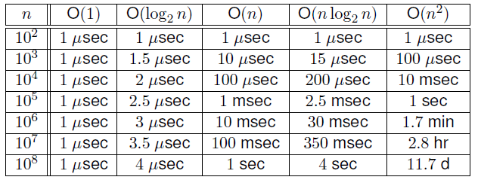
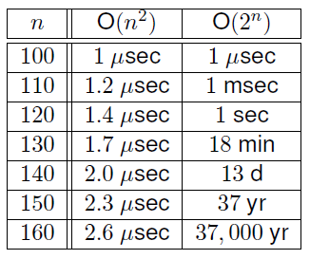
Time Complexity
measure of algorithm efficiency
has a big impact on running time.
Big-O notation is used.
To deal with n items, time complexity can be O(1), O(log n), O(n), O(n log n), O(n²), O(n³), O(2^{n}), even O(n^{n}).

Slide 27
Coding example #1
def example1(list):
m = 0
for i in range( len(list) ):
m += list[i]
return m
print ( example1([0,1,2,3,4,5,6,7,8,9]) )

Slide 28
Coding example #2
def example2(list):
m = 0
for i in range( len(list) ):
for j in range( len(list) ):
if(list[i] == list[j]):
m += 1
return m
print ( example2([0,1,2,3,4,5,6,7,8,9]) )

Slide 29
Coding example #3
def example3(list):
m = 0
for i in range( len(list) ):
for j in range(0, i - 1):
if(list[i] == list[j]):
m += 1
return m
print ( example3([0,1,2,3,4,5,6,7,8,9]) )

Slide 30
Coding example #4
def example4(list):
m = 0
n = len(list)
for i in range(n):
for j in range(n):
for k in range(n):
m += 1
return m
print ( example4([0,1,2,3,4,5,6,7,8,9]) )

Slide 31
Coding example #5
import math
def example5(list):
m = 0
n = len(list)
for i in range(n):
for j in range( int(math.sqrt(n)) ):
m += 1
return m
print ( example5([0,1,2,3,4,5,6,7,8,9]) )

Slide 32
Coding example #6
import math
def example6(list):
m = 0
for i in range( len(list) ):
for j in range( int(math.sqrt(1087)) ):
m += 1
return m
print ( example6([0,1,2,3,4,5,6,7,8,9]) )

Slide 33
Coding example #7
def example7(list):
m = 0
for i in range( len(list) ):
m += doThing(list)
return m
def doThing(list):
m = 0
for i in range( len(list) ):
m += 1
return m
print ( example7([0,1,2,3,4,5,6,7,8,9]) )

Slide 34
Coding example #8
def example8(list):
m = 0
for i in range( len(list) ):
m += doThing(list)
return m
def doThing(list):
return list[0]
print ( example8([0,1,2,3,4,5,6,7,8,9]) )

Slide 35
Coding example #9
def example9(list):
m = 0
i = 1
n = len(list)
while i < n:
m += 1
i = i * 2
return m
print ( example9([0,1,2,3,4,5,6,7,8,9]) )

Slide 36
Coding example #10
def example10(list):
m = 0
i = len(list)
while i > 1:
m += 1
i = i / 2
return m
print ( example10([0,1,2,3,4,5,6,7,8,9]) )

