Slide 1
Python Programming
9.3 Matplotlib

Slide 2
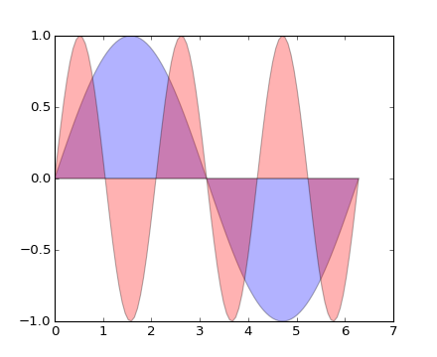
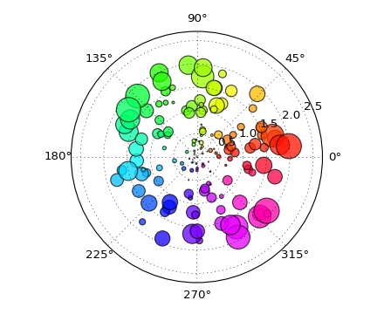
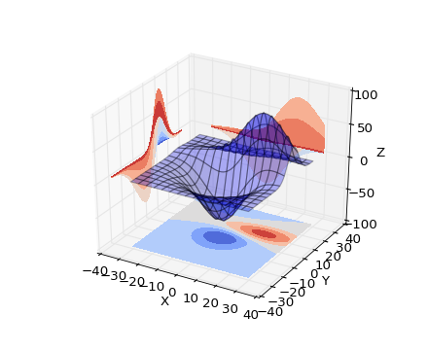
Matplotlib
We’re going to continue our discussion of scientific computing with matplotlib. Matplotlib is an incredibly powerful (and beautiful!) 2-D plotting library. It’s easy to use and provides a huge number of examples for tackling unique problems.

Slide 3
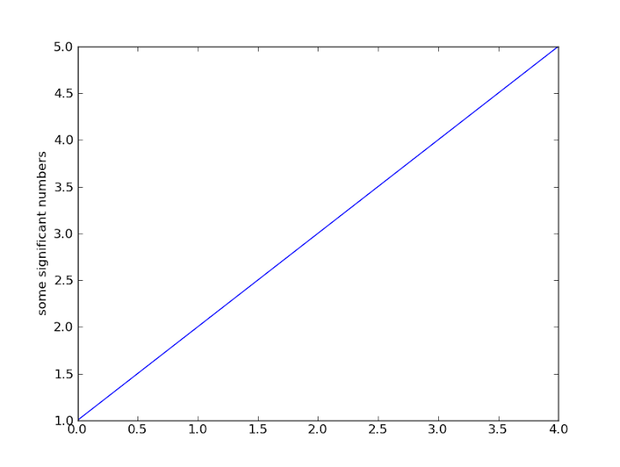
pyplot
At the center of most matplotlib scripts is pyplot. The pyplot module is stateful and tracks changes to a figure. All pyplot functions revolve around creating or manipulating the state of a figure.
import matplotlib.pyplot as plt plt.plot([1,2,3,4,5]) plt.ylabel('some significant numbers') plt.show()
When a single sequence object is passed to the plot function, it will generate the x-values for you starting with 0.

Slide 4
pyplot
The plot function can actually take any number of arguments. Common usage of plot: plt.plot(x_values, y_values, format_string [, x, y, format, ])
The format string argument associated with a pair of sequence objects indicates the color and line type of the plot (e.g. ‘bs’ indicates blue squares and ‘ro’ indicates red circles). Generally speaking, the x_values and y_values will be numpy arrays and if not, they will be converted to numpy arrays internally. Line properties can be set via keyword arguments to the plot function. Examples include label, linewidth, animated, color, etc…

Slide 5
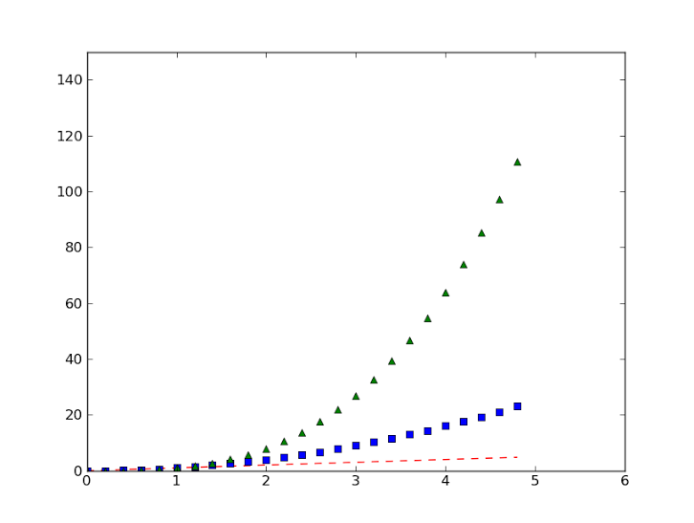
pyplot
import numpy as np import matplotlib.pyplot as plt # evenly sampled time at .2 intervals t = np.arange(0., 5., 0.2) # red dashes, blue squares and green triangles plt.plot(t, t, 'r--', t, t**2, 'bs', t, t**3, 'g^') plt.axis([0, 6, 0, 150]) # x and y range of axis plt.show()

Slide 6
Behind the scenes
It’s important to note that a figure is a separate idea from how it is rendered. Pyplot convenience methods are used for creating figures and immediately displaying them in a pop up window. An alternative way to create this figure is shown below.
import numpy as np import matplotlib.figure as figure t = np.arange(0, 5, .2) f = figure.Figure() axes = f.add_subplot(111) axes.plot(t, t, 'r--', t, t**2, 'bs', t, t**3, 'g^') axes.axis([0, 6, 0, 150])

Slide 7
pyplot
import numpy as np import matplotlib.pyplot as plt def f(t): return np.exp(-t) * np.cos(2*np.pi*t) t1 = np.arange(0.0, 5.0, 0.1) t2 = np.arange(0.0, 5.0, 0.02) plt.figure(1) # Called implicitly but can use # for multiple figures plt.subplot(211) # 2 rows, 1 column, 1st plot plt.plot(t1, f(t1), 'bo', t2, f(t2), 'k') plt.subplot(212) # 2 rows, 1 column, 2nd plot plt.plot(t2, np.cos(2*np.pi*t2), 'r--') plt.show()
A script can generate multiple figures, but typically you’ll only have one. To create multiple plots within a figure, either use the subplot() function which manages the layout of the figure or use add_axes().

Slide 8
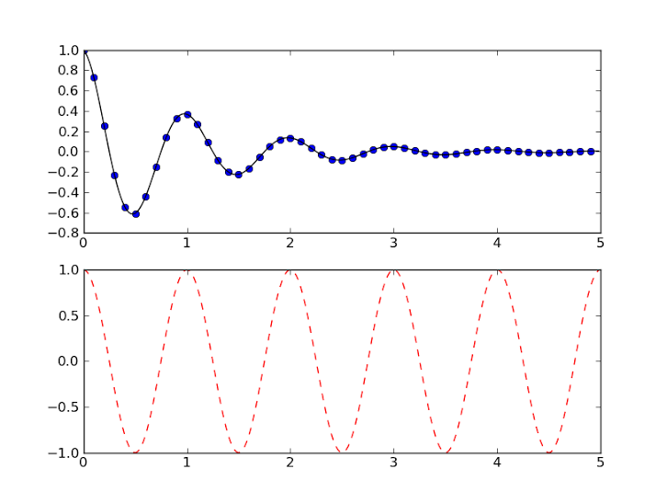
pyplot

Slide 9
pyplot
The text() command can be used to add text in an arbitrary location
xlabel() adds text to x-axis.
ylabel() adds text to y-axis.
title() adds title to plot.
clear() removes all plots from the axes.
All methods are available on pyplot and on the axes instance generally.

Slide 10
pyplot
import numpy as np import matplotlib.pyplot as plt mu, sigma = 100, 15 x = mu + sigma * np.random.randn(10000) # the histogram of the data n, bins, patches = plt.hist(x, 50, normed=1, facecolor='g', alpha=0.75) plt.xlabel('Smarts') plt.ylabel('Probability') plt.title('Histogram of IQ') plt.text(60, .025, r'$\mu=100,\ \sigma=15$') #TeX equations plt.axis([40, 160, 0, 0.03]) plt.grid(True) plt.show()

Slide 11
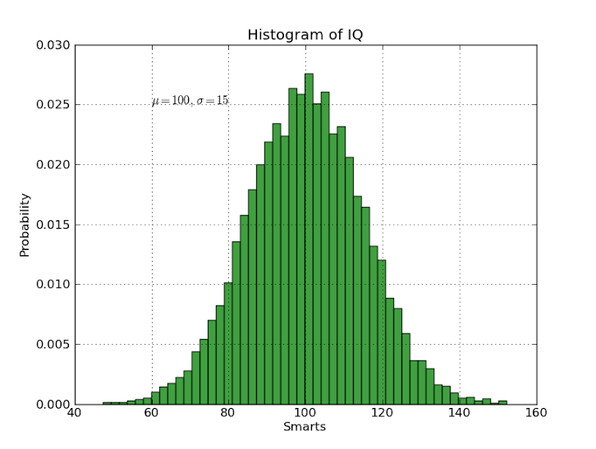
pyplot

Slide 12
plot gui
The two most important classes from matplotlib.backends.backend_qt4agg:
FigureCanvasQTAgg(fig): returns the canvas the figure fig renders into.
NavigationToolbar2QT(canvas, prnt): creates a navigation toolbar for canvas which has the parent prnt.
Furthermore, a canvas object has the following method defined:
canvas.draw(): redraws the updated figure on the canvas.

