Slide 1
Python Programming
7.3 Pi

Slide 2
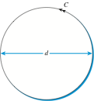
What is PI?
Ratio of circumference to diameter
3.14159265358979323846264338327950288419716939937510...
math.pi from the math module

Slide 3
Monte Carlo Simulation
Use random numbers to compute an approximation of pi
Simulation of a special game of darts
Randomly place darts on the board
pi can be computed by keeping track of the number of darts that land on the board

Slide 4
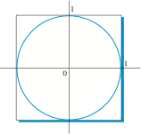
Formulate the problem
What is the area of this circle?

Slide 5
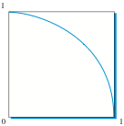
Formulate the problem
What is the area of this wedge?

Slide 6
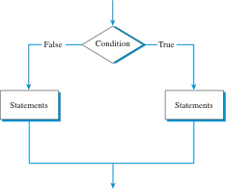
Accept / Reject
Ask a question (Boolean Expression)
Based on the answer, perform a task

Slide 7
Accept / Reject
import random
import math
def montePi(numDarts):
inCircle = 0
for i in range(numDarts):
x = random.random()
y = random.random()
d = math.sqrt(x**2 + y**2)
if d <= 1:
inCircle = inCircle + 1
pi = inCircle/numDarts * 4
return pi

Slide 8
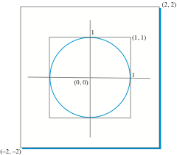
ShowMontePi

Slide 9
ShowMontePi
for i in range(numDarts):
x = random.random()
y = random.random()
d = math.sqrt(x**2 + y**2)
drawingT.goto(x,y)
if d <= 1:
circle = circle + 1
drawingT.color("blue")
else:
drawingT.color("red")
drawingT.dot()
pi = circle/numDarts * 4
wn.exitonclick()
return pi
import random
import math
import turtle
def showMontePi(numDarts):
wn = turtle.Screen()
drawingT = turtle.Turtle()
wn.setworldcoordinates(-2,-2,2,2)
drawingT.up()
drawingT.goto(-1,0)
drawingT.down()
drawingT.goto(1,0)
drawingT.up()
drawingT.goto(0,1)
drawingT.down()
drawingT.goto(0,-1)
circle = 0
drawingT.up()

Slide 10
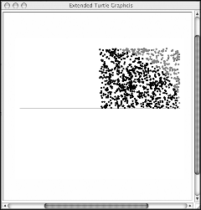
ShowMontePi

