Slide 1
Python Programming
7.4 Random Search

Slide 2
local search
Iterative improvement methods (aka local search) move from potential solution to potential solution until a goal is reached
Examples
Hill climbing
Simulated annealing
Local beam search
Genetic algorithms

Slide 3
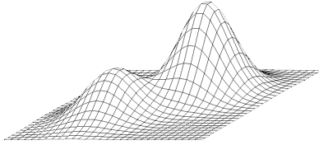
Hill Climbing
Extended current path with successor that’s closer to solution than end of current path
If goal is to get to the top of a hill, then always take a step that leads you up
Simple hill climbing: take any upward step
Steepest ascent hill climbing: consider all possible steps, take one that goes up most
No memory required

Slide 4
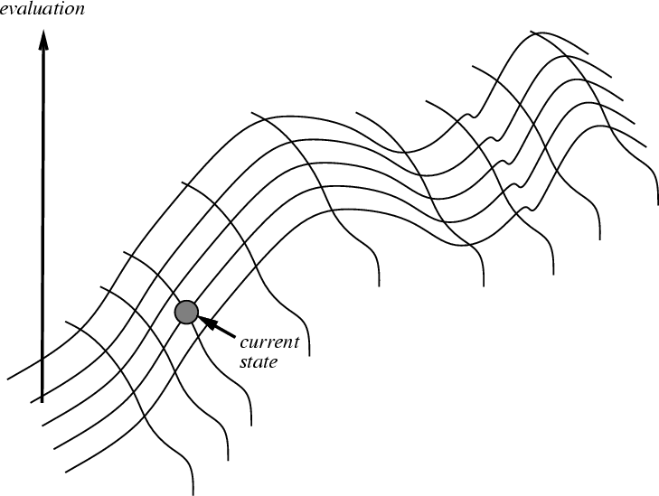
Hill climbing on a surface of states
Height defined by an evaluation function that takes a state & returns a number

Slide 5
Hill climbing for search
For informed search and many other problems (e.g., neural network training) we want to find a global minimum
Search evaluation function: measure of how far the current state is from a goal
This is an easy change to make in the algorithm, or we can just negate the evaluation function
We still call it hill climbing though

Slide 6
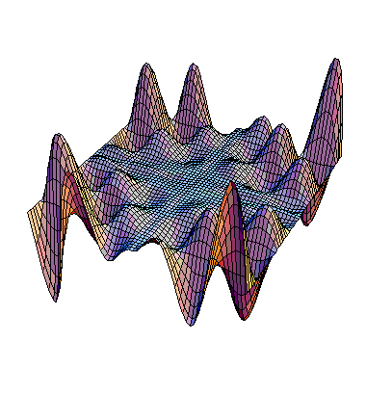
Exploring the Landscape
local maximum
Local Maxima: peaks not highest point in space
Plateaus: broad flat region that gives search algorithm no guidance (use random walk)
Ridges: flat like plateau, but with drop-offs to sides; steps to North, East, South and West may go down, but step to NW may go up
plateau
ridge
Image from: http://classes.yale.edu/fractals/CA/GA/Fitness/Fitness.html

Slide 7
Drawbacks of hill climbing
Problems: local maxima, plateaus, ridges
Possible remedies:
Random restart: keep restarting search from random locations until a goal is found
may require an estimate – how low can we go
Problem reformulation: reformulate search space to eliminate these problematic features
Some problem spaces are great for hill climbing and others are terrible

Slide 8
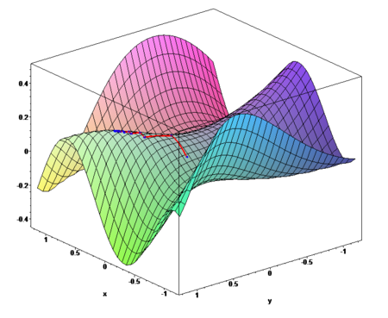
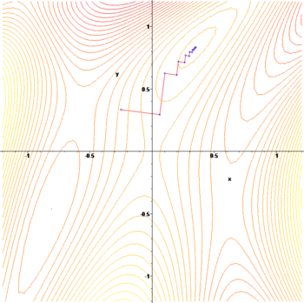
Gradient ascent / descent
Images from http://en.wikipedia.org/wiki/Gradient_descent
Gradient descent procedure for finding the arg_{x} min f(x)
choose initial x₀ randomly
repeat
x_{i+1} ← x_{i} – η f '(x_{i})
until the sequence x₀, x₁, …, x_{i}, x_{i+1} converges
Step size η (eta) is small (perhaps 0.1 or 0.05)
Often used in machine learning algorithms

Slide 9
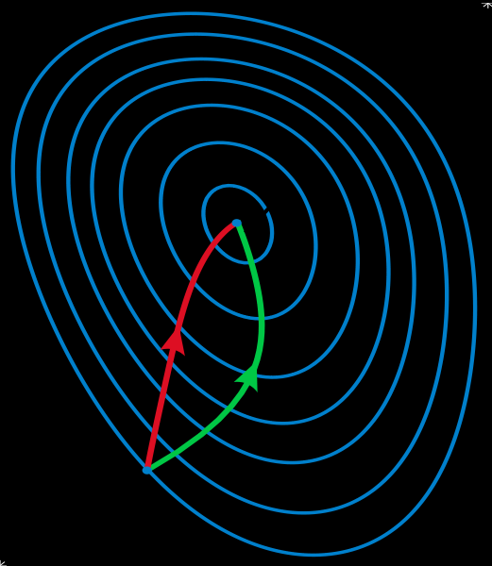
Gradient methods vs. Newton’s method
A reminder of Newton’s method from Calculus:
x_{i+1} ← x_{i} – η f '(x_{i}) / f ''(x_{i})
Newton’s method uses 2nd order information (e.g., 2nd derivative) to take a faster route to a minimum
Second-order info. is more expensive to compute, but converges quicker.
Contour lines of a function
Gradient descent (green)
Newton’s method (red)
Image from http://en.wikipedia.org/wiki/Newton's_method_in_optimization

Slide 10
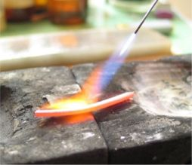
Annealing
In metallurgy, annealing is a technique involving heating & controlled cooling of a material to increase size of its crystals & reduce defects
Heat causes atoms to become unstuck from initial positions (local minima of internal energy) and wander randomly through states of higher energy
Slow cooling gives them more chances of finding configurations with lower internal energy than initial one

Slide 11
Simulated annealing (SA)
SA exploits analogy between how metal cools and freezes into a minimum-energy crystalline structure & search for a minimum/maximum in a general system
SA can avoid becoming trapped at local minima
SA uses random search accepting changes decreasing objective function f & some that increase it
SA uses a control parameter T, which by analogy with the original application, is known as the system temperature
T starts out high and gradually decreases toward 0

Slide 12
SA intuitions
Combines hill climbing (for efficiency) with random walk (for completeness)
Analogy: getting a ping-pong ball into the deepest depression in a bumpy surface
Shake the surface to get the ball out of local minima
Don’t shake too hard to dislodge it from global minimum
Simulated annealing:
Start shaking hard (high temperature) and gradually reduce shaking intensity (lower temperature)
Escape local minima by allowing some “bad” moves
But gradually reduce their size and frequency

Slide 13
Simulated annealing
A “bad” move from A to B is accepted with a probability
-(f(B)-f(A)/T)
e
The higher the temperature, the more likely it is that a bad move can be made
As T tends to zero, probability tends to zero, and SA becomes more like hill climbing
If T lowered slowly enough, SA is complete and admissible

Slide 14
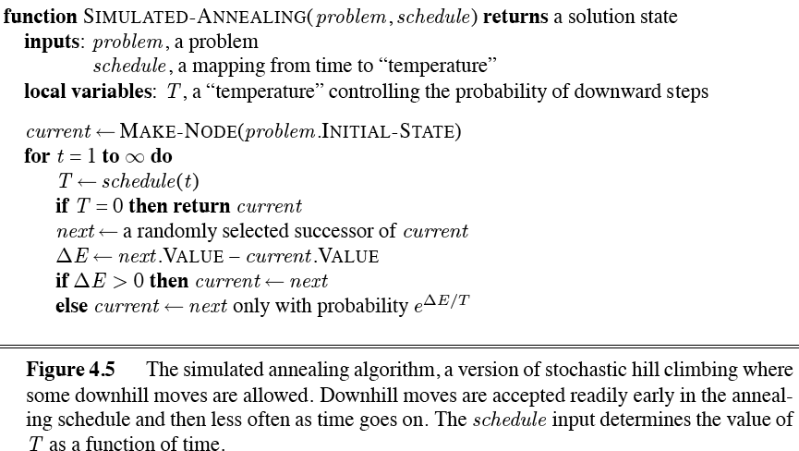
Simulated annealing algorithm

Slide 15
Local beam search
Basic idea
Begin with k random states
Generate all successors of these states
Keep the k best states generated by them
Provides a simple, efficient way to share some knowledge across a set of searches
Stochastic beam search is a variation:
Probability of keeping a state is a function of its heuristic value

Slide 16
Genetic algorithms (GA)
Search technique inspired by evolution
Similar to stochastic beam search
Start with initial population of k random states
New states generated by mutating a single state or reproducing (combining) two parent states, selected according to their fitness
Encoding used for genome of an individual strongly affects the behavior of search

Slide 17
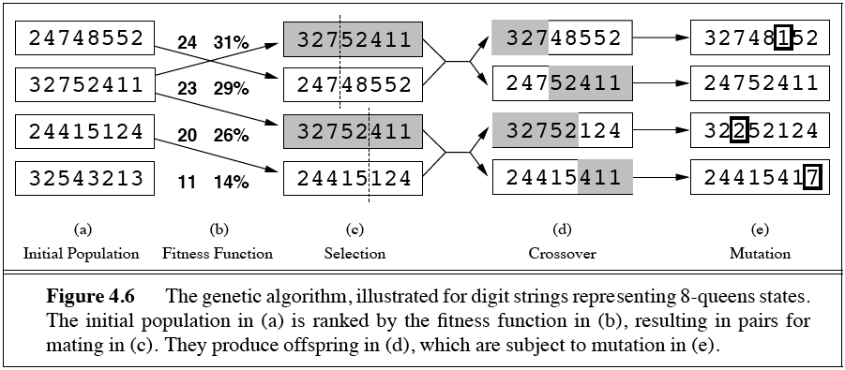
Genetic algorithms
Fitness function: number of non-attacking pairs of queens (min=0, max=(8 × 7)/2 = 28)
Probability of mating is a function of fitness score
Cross-over point for a mating pair chosen randomly
Resulting offspring subject to a random mutation with probability

Slide 18
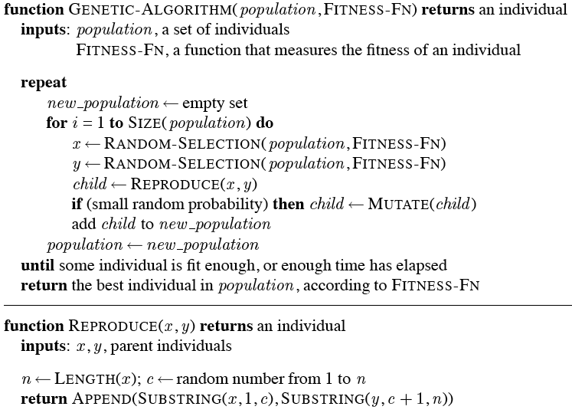
GA pseudo-code

Slide 19
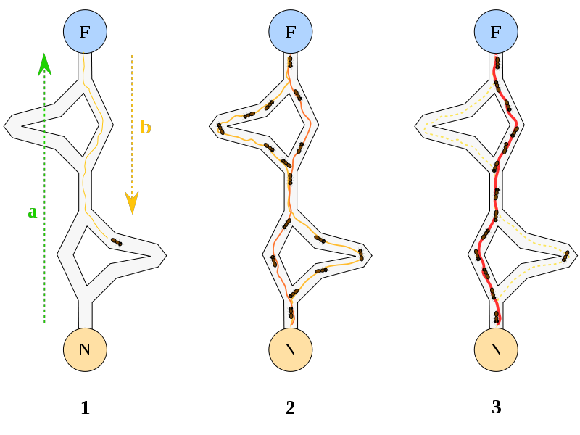
Ant Colony Optimization
A probabilistic search technique for problems reducible to finding good paths through graphs
Inspiration
Ants leave nest
Discover food
Return to nest, pre-ferring shorter paths
Leave pheromone trail
Shortest path is reinforced
An example of agents communicating through their environment

