Slide 1
Python Programming
9.2 Pandas

Slide 2
pandas
http://pandas.pydata.org
Rich relational data tool built on top of NumPy
Like R’s data.frame on steroids
Excellent performance
Easy-to-use, highly consistent API
A foundation for data analysis in Python

Slide 3
pandas
In heavy production use in the financial
industry, among others
Generally much better performance than
other open source alternatives (e.g. R)
Hope: basis for the “next generation”
statistical computing and analysis environment

Slide 4
Simplifying data wrangling
Data munging / preparation / cleaning /
integration is slow, error prone, and time consuming
Python for data wrangling: pandas takes it to the next level

Slide 5
Battle tested
> 98% line coverage as measured by coverage.py
• Close to 10K test functions

Slide 6

Series
index
values
•
•
•
•
Subclass of numpy.ndarray
Data: any type
Index labels need not be ordered
Duplicates are possible (but result in reduced functionality)
A
5
6
12
-5
6.7
B
C
D
E

Slide 7

DataFrame
•
•
•
•
NumPy array-like
Each column can have a different type
Row and column index
Size mutable: insert and delete columns
columns index
foo bar baz qux
A
0
4
8
-12
16
x
2.7
6
10
NA
18
True
True
False
False
False
B
y
C
z
D
w
E
a

Slide 8
DataFrame
In [10]: tips[:10] Out[10]:
 | total_bill | tip | sex | smoker | day | time | size
1 | 16.99 | 1.01 | Female | No | Sun | Dinner | 2
2 | 10.34 | 1.66 | Male | No | Sun | Dinner | 3
3 | 21.01 | 3.50 | Male | No | Sun | Dinner | 3
4 | 23.68 | 3.31 | Male | No | Sun | Dinner | 2
5 | 24.59 | 3.61 | Female | No | Sun | Dinner | 4
6 | 25.29 | 4.71 | Male | No | Sun | Dinner | 4
7 | 8.770 | 2.00 | Male | No | Sun | Dinner | 2
8 | 26.88 | 3.12 | Male | No | Sun | Dinner | 4
9 | 15.04 | 1.96 | Male | No | Sun | Dinner | 2
10 | 14.78 | 3.23 | Male | No | Sun | Dinner | 2

Slide 9
DataFrame
Axis indexing enable rich data alignment,
joins / merges, reshaping, selection, etc.
day sex | smoker | Fri | Sat | Sun | Thur
Female | No | 3.125 | 2.725 | 3.329 | 2.460
 | Yes | 2.683 | 2.869 | 3.500 | 2.990
Male | No | 2.500 | 3.257 | 3.115 | 2.942
 | Yes | 2.741 | 2.879 | 3.521 | 3.058

Slide 10
Axis indexing, the special pandas-flavored sauce
Enables “alignment-free” programming
Prevents major source of data munging
frustration and errors
Fast data selection
Powerful way of describing reshape / join /
merge / pivot-table operations

Slide 11

Data alignment
Binary operations are joins!
A | 0
B | 1
C | 2
D | 3
A | NA
B | 2
C | 4
D | 6
E | NA
B | 1
C | 2
D | 3
E | 4
+
=

Slide 12


GroupBy
Split Apply
Combine
A | 0
A | 5
A | 10
A | 0
B | 5
C | 10
A | 5
B | 10
C | 15
A | 10
B | 15
C | 20
sum
B | 5
B | 10
B | 15
A | 15
B | 30
C | 45
sum
Key
C | 10
C | 15
C | 20
sum

Slide 13


Hierarchical indexes
Semantics: a tuple at each tick
Enables easy group selection
Terminology:“multiple levels”
A 1
2
3
B 1
Natural part of GroupBy and
2
reshape operations
3
4

Slide 14
Hierarchical indexes
{
{ 3
Semantics: a tuple at each tick
Enables easy group selection
Terminology:“multiple levels”
A 1
2
3
B 1
Natural part of GroupBy and
2
reshape operations
4

Slide 15
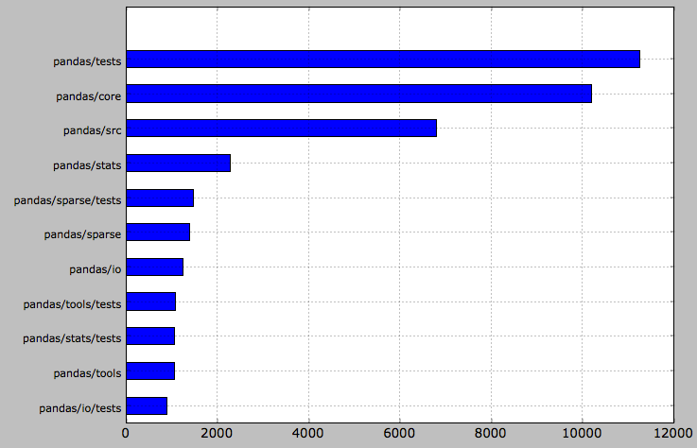
What’s in Pandas?
A big library: 40k SLOC

Slide 16
pandas.core
Data structures
Series (1D)
DataFrame (2D)
Panel (3D)
NA-friendly statistics
Index implementations / label-indexing

Slide 17
pandas.core
GroupBy engine
Time series tools
Date range generation
Extensible date offsets
Hierarchical indexing stuff

Slide 18
Elsewhere
Join / concatenation algorithms
Sparse versions of Series, DataFrame...
IO tools: CSV files, HDF5, Excel
Moving window statistics (rolling mean, ...)
Pivot tables
High level matplotlib interface

Slide 19
pandas/src
~8000 lines of mostly Cython code
Fast data algorithms that power the library and make it fast

Slide 20
Pandas for “Big Data”
Quite common to need to process larger-
than-RAM data sets
Alternate DataFrame backends are the
likely solution
Ripe for integration with MapReduce
frameworks

