Slide 1
Oscillating Cantilever Magnetometry in High Magnetic Fields
By Andrew Ammerlaan
Supervisor: Prof. Dr. Uli Zeitler
2020-09-07

Slide 2
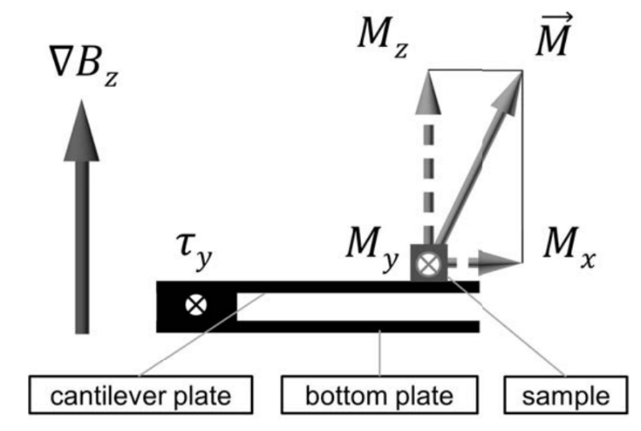
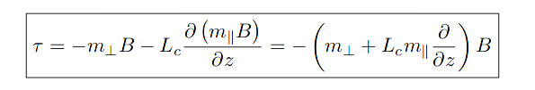

Introduction: Torque and Cantilever magnetometry
Notes:
- Magnetized sample exerts torque
- Measure torque e.g. with capacitance bridge

Slide 3
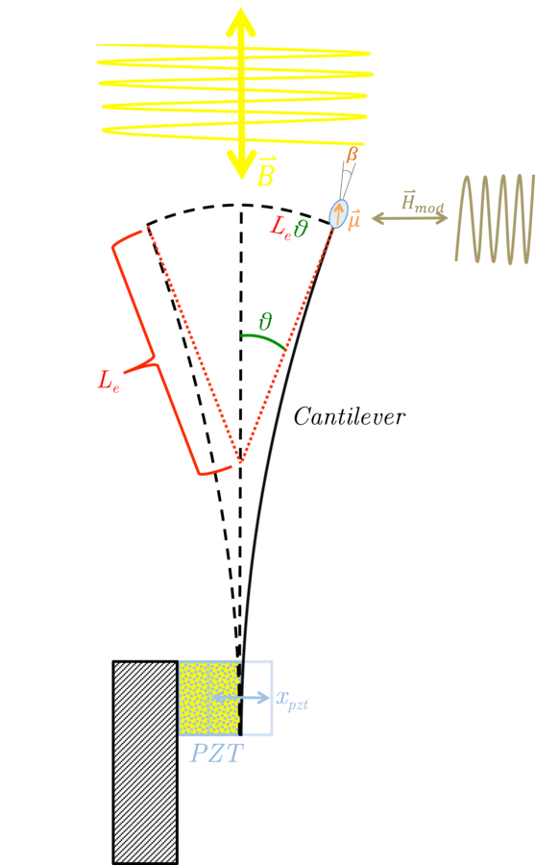

Terminology: Two confusingly similar terms
Torque Magnetometry:
Measure the resulting torque caused by the sample’s magnetization (e.g. using capacitance)
Cantilever Magnetometry:
Measure the change in
oscillation of the cantilever
caused by the sample’s
magnetization
AIM
Notes:
- AIM: Turn torque magnetometry into cantilever magnetometry (DC to AC)
- Note the technically unnecessary adjective “oscillating” in the title, it is there to prevent this confusion.

Slide 4






oscillating Cantilevers: a slightly more complex problem
Newton’s second law:
Ansatz:
Solution:
Notes:
- Note that the F_1 dependency is only expressed through the derivative of F_1
- Effective resonant frequency shift!!

Slide 5
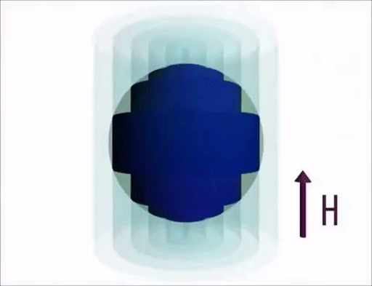
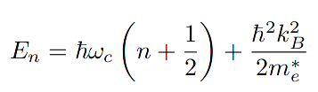


intermezzo: Quantum oscillations
Notes:
- See Fermi surface of atom
- B → division into Landau Levels
- Energy of Landau Level depends on B
- When energy crosses the Fermi Energy electrons redistribute → oscillations in properties of material
- 1/B periodic

Slide 6
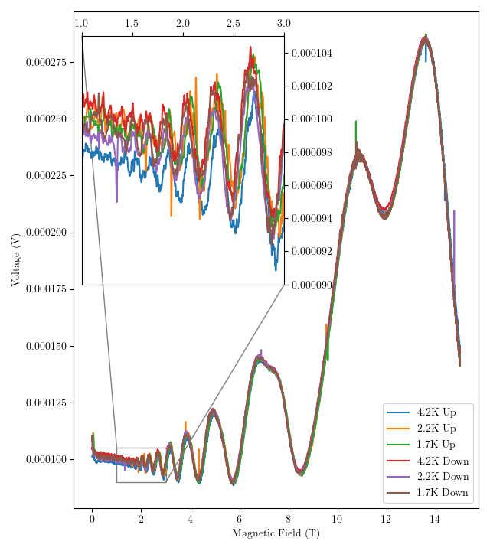
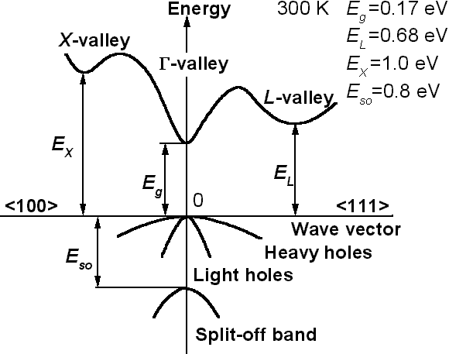
Measurement: Transport
n-doped InSb:
  Small direct bandgap (0.23 eV)
  Parabolic bands around Γ-point
  Near-spherical Fermi surface
Clear SdH oscillations
Notes:
- InSb, small direct bandgap semiconductor
- with parabolic bands around the centre of the BZ
- Fermi surface is well approximated by a sphere
- n-doping → Fermi energy in parabolic conduction band → ideal to study quantum oscillations
- We have measured QO in conductivity (SdH)
- spin splitting, first Landau level is beyond graph
- Want to use new technique to measure same oscillations in magnetization (dHvA)

Slide 7


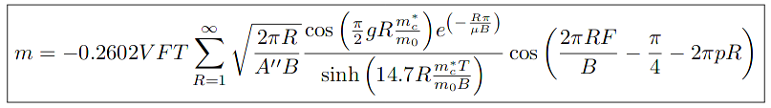

Simulating de-Haas-van-alphen oscillations
Spherical Fermi surface
Carrier density: Hall effect
Effective Cyclotron mass
Frequency:
Parabolic band
Electron mobility
Notes:
- Parabolic dispersion relation (phase factor = 0.5)
- Spherical Fermi Surface (A’’ = 2pi)

Slide 8
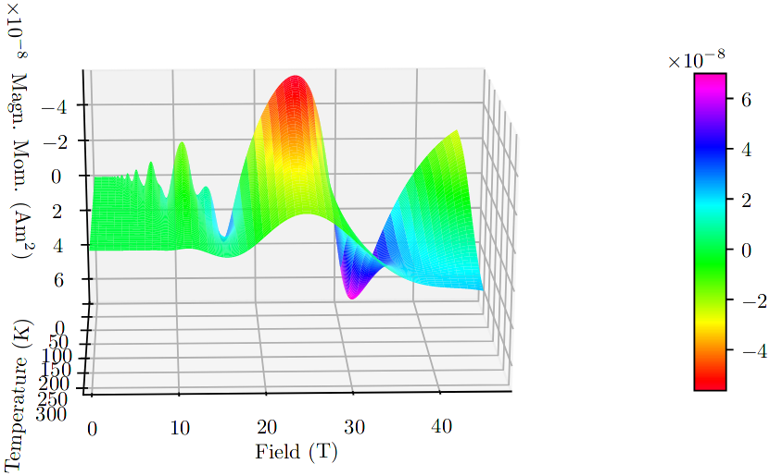
Simulating de-Haas-van-alphen oscillations
Notes:
- Note that z-axis is flipped for clarity
- point out 1/B periodicity
- point out corresponding peaks at 14,11,7 and 5 T
- point out spin splitting at around 7T

Slide 9
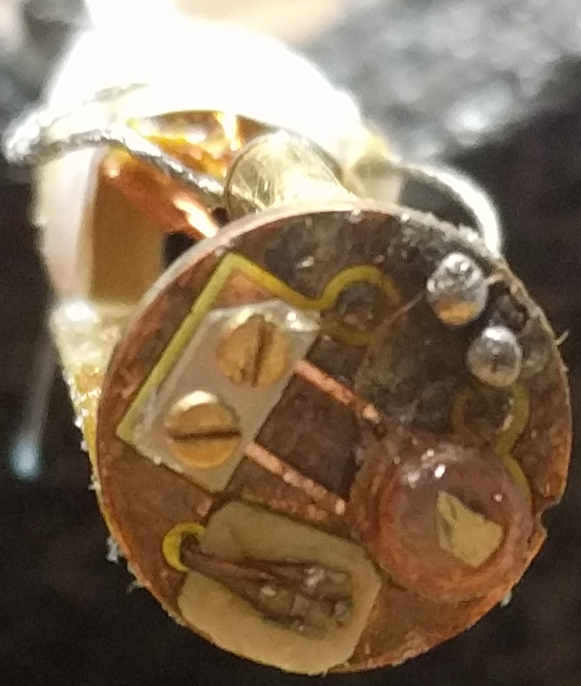
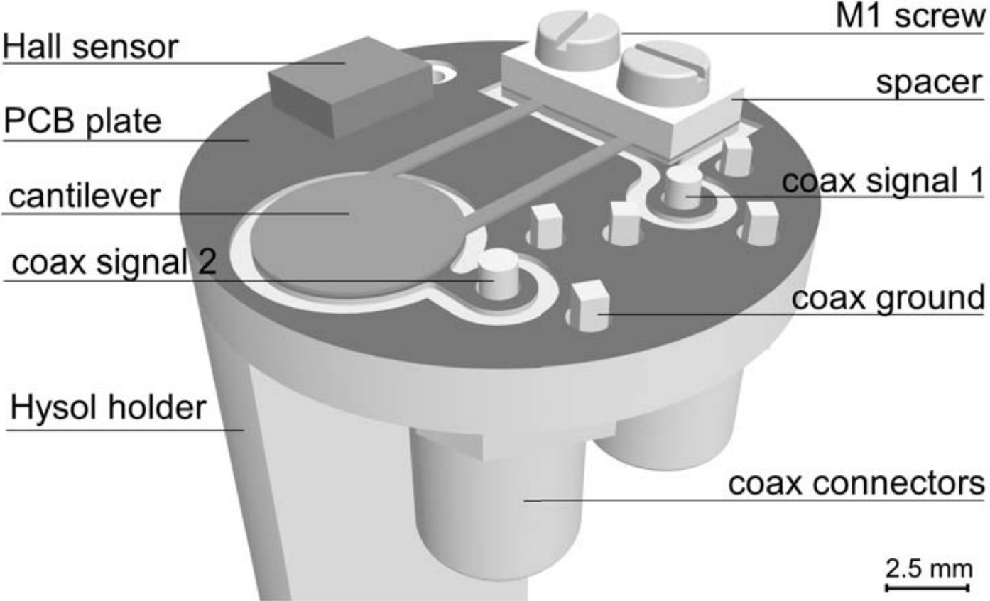
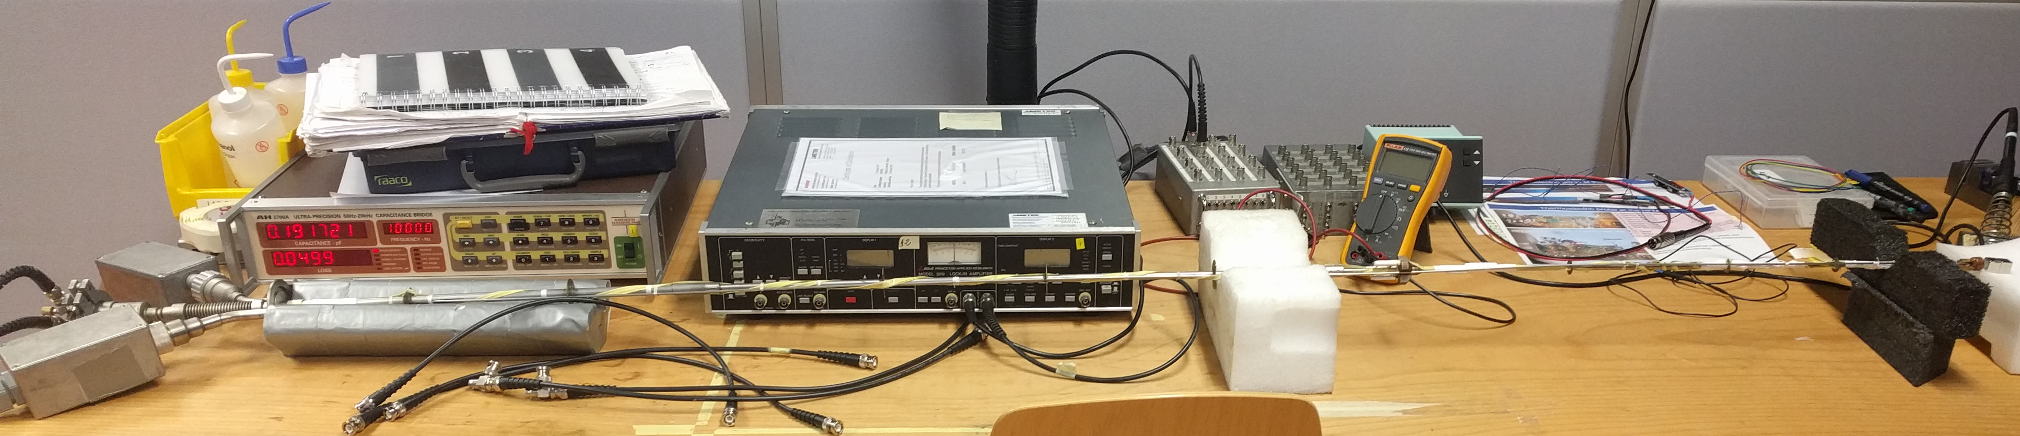
oscillating cantilevers: measurement setup
Notes:
- Hall bar – Lock-in Amplifier
- Thermometer – Lakeshore
- Copper-beryllium Cantilever – Capacitance Bridge
- Copper Coil – AC Current source

Slide 10
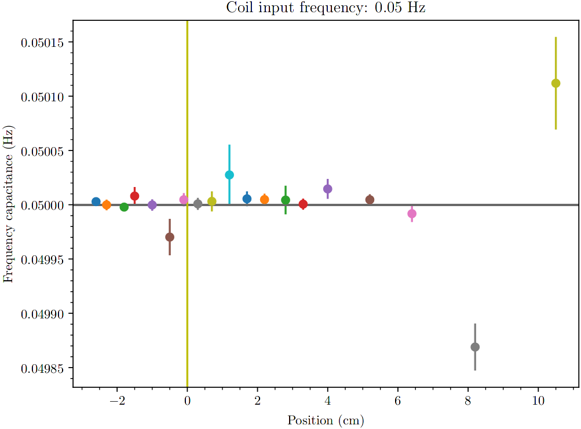
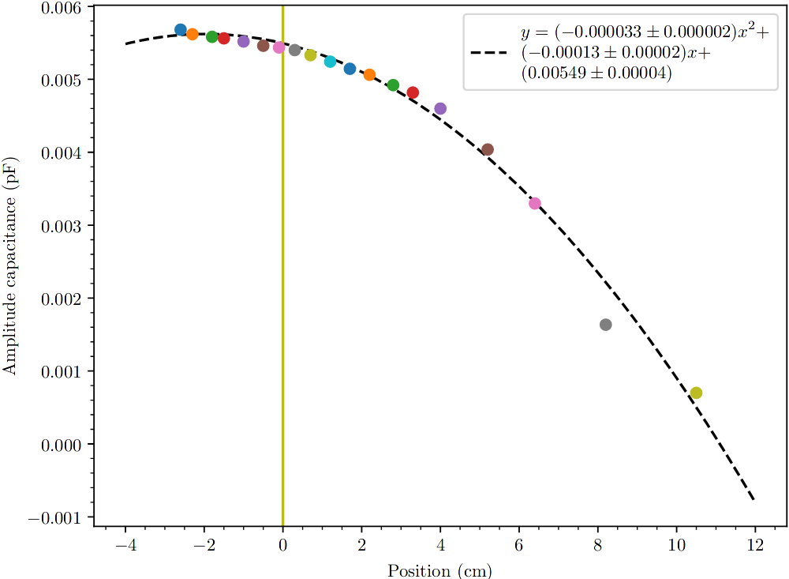
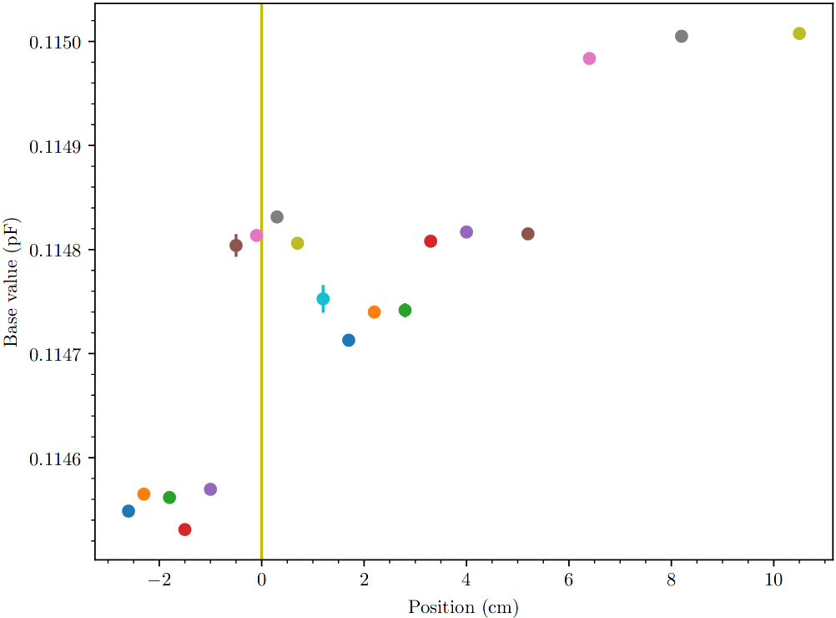
Setup Characterization: position dependence
Notes:
- 1000 windings of 30um copper wire

Slide 11





Setup Characterization: position dependence
Notes:
- we find the angle and calibration parameter

Slide 12
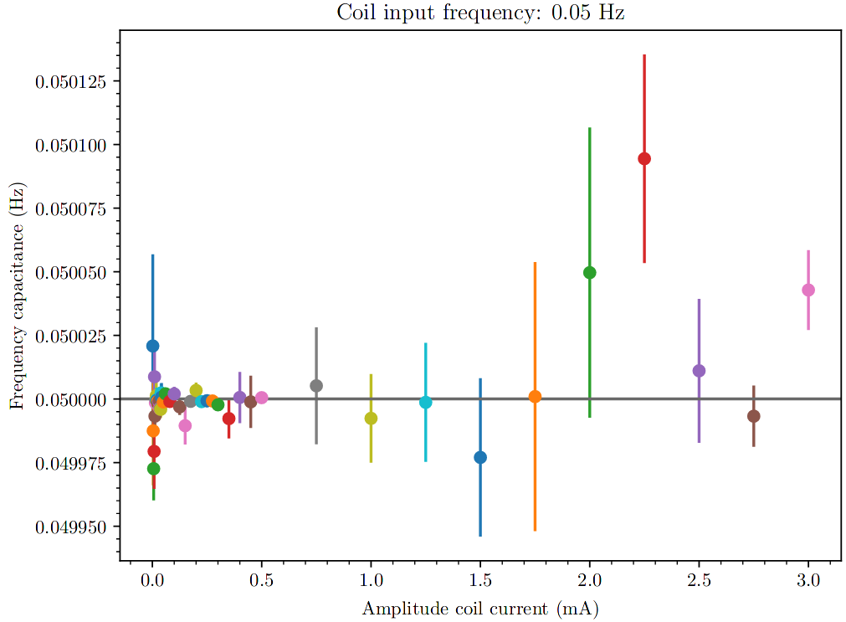
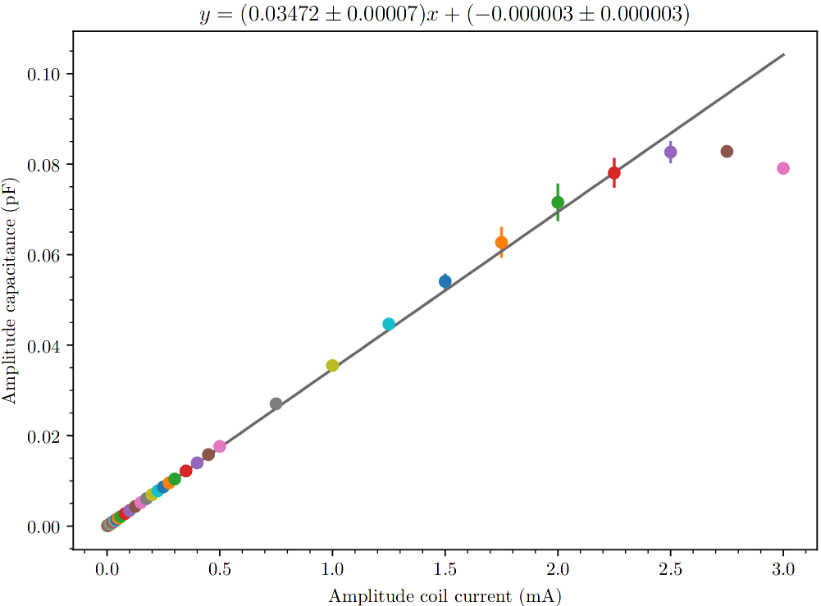
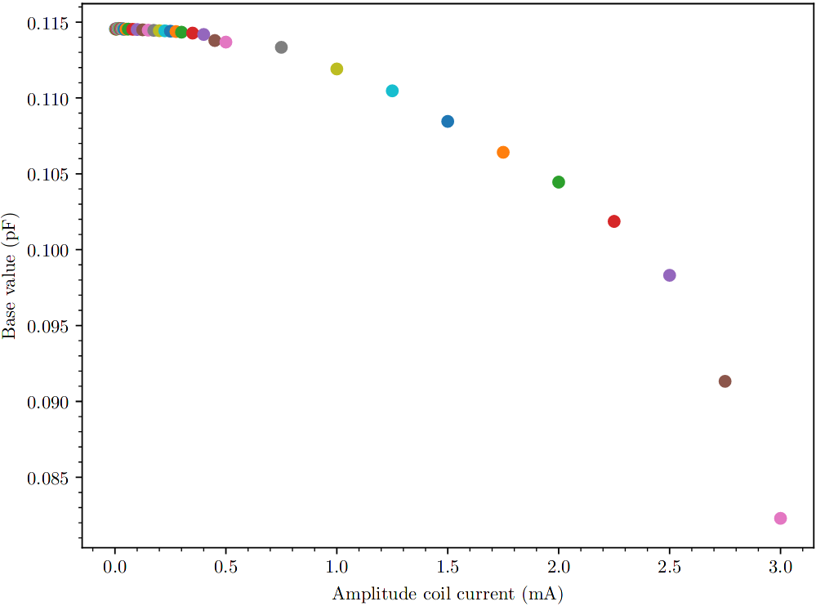
Setup Characterization: Current dependence
Notes:
- only linear up to certain point: cantilever’s linear regime

Slide 13

Setup Characterization: Current dependence
Position dependence: 67
Current dependence: 1.5e3
What happened?
Notes:
- well we broke the cantilever
- no longer aligned
- arms deformed

Slide 14
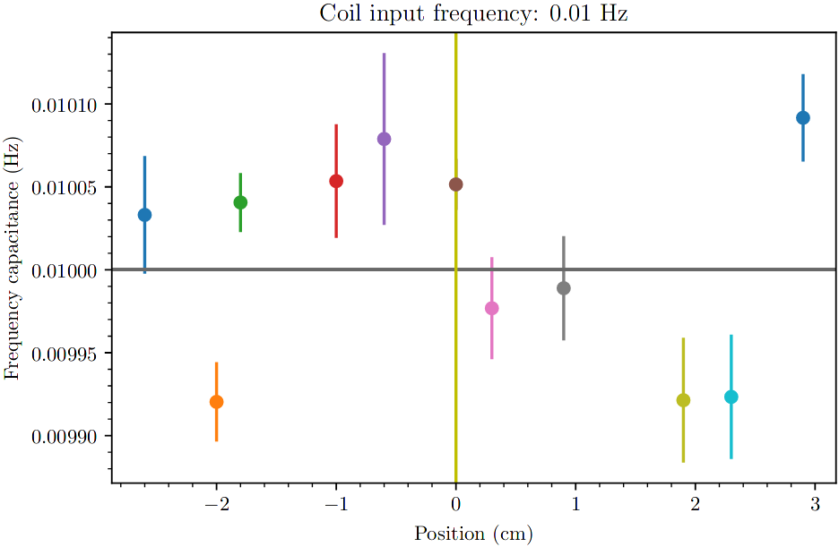
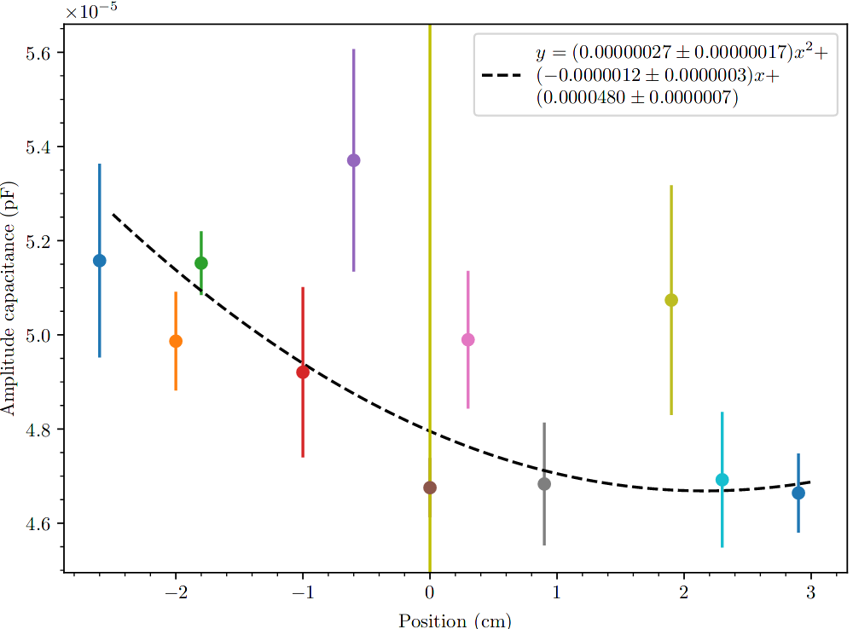
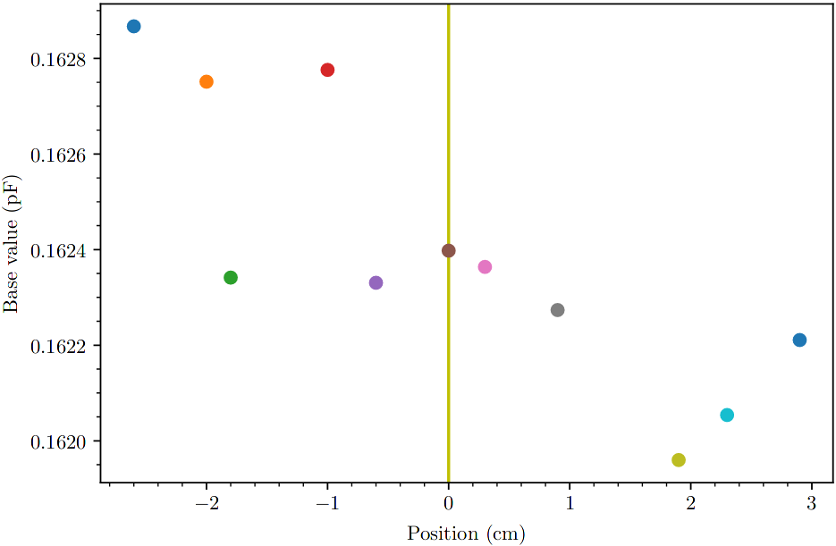
smaller coils: position dependence
Notes:
- 50 windings
- about same magnetic moment as sample of InSb
- fit is wrong, trend is correct left higher then right
- no parameter can be extracted

Slide 15
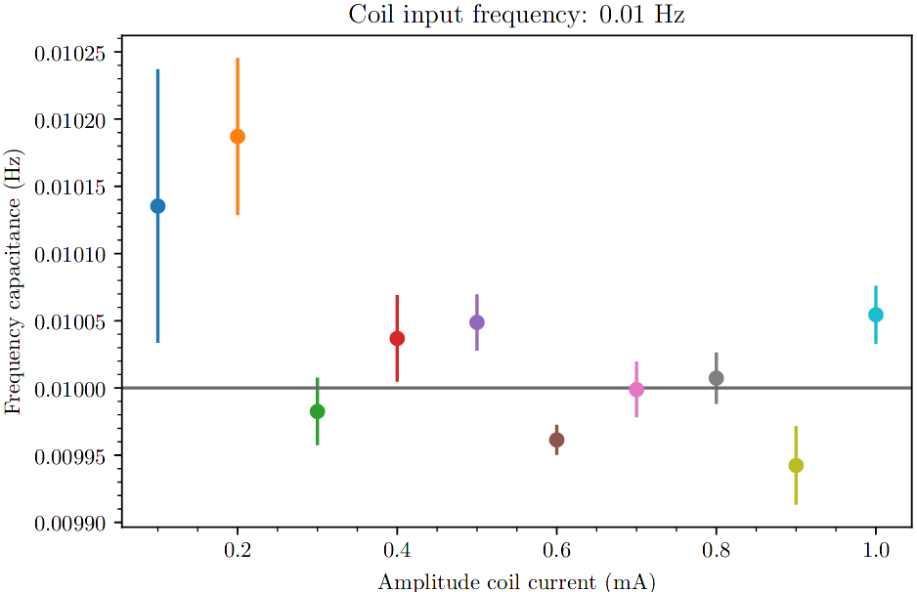
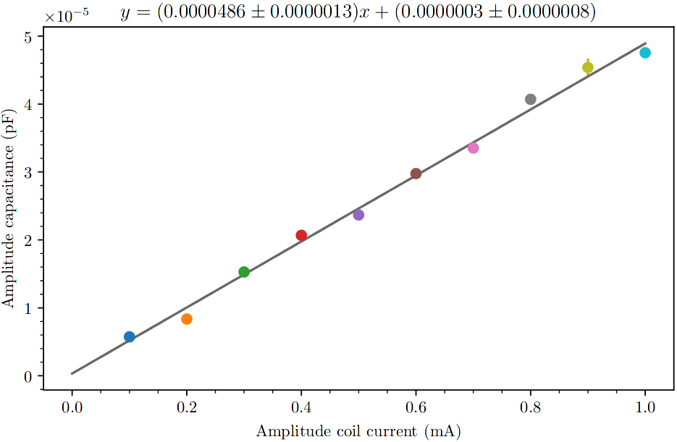
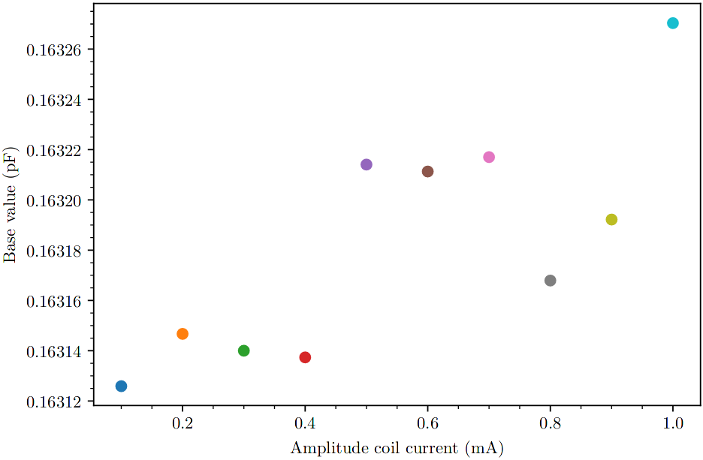
smaller coils: amplitude dependence
Notes:
- measurement is plagued by drifts and jumps

Slide 16

Measurement: smaller coils
5.4 times more sensitive
20 times smaller coil
Notes:
- the smaller coil is way lighter, less distortion by gravity

Slide 17
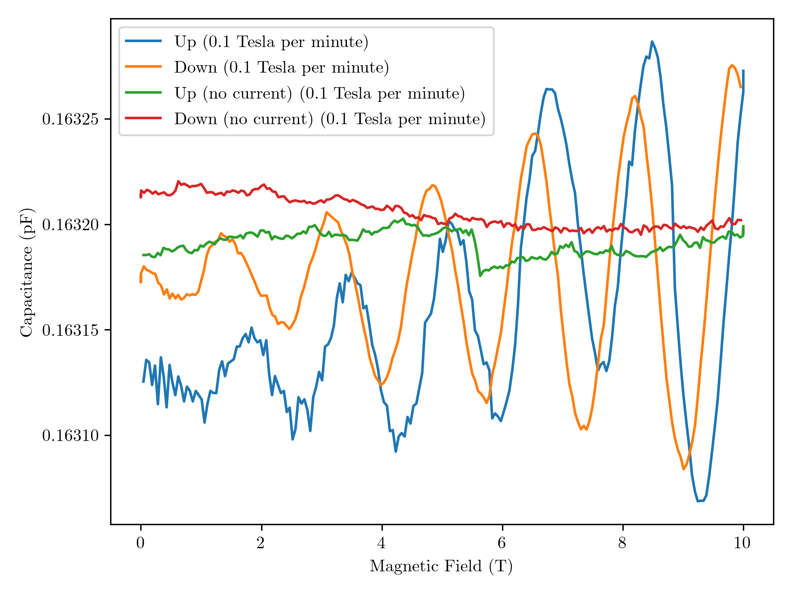
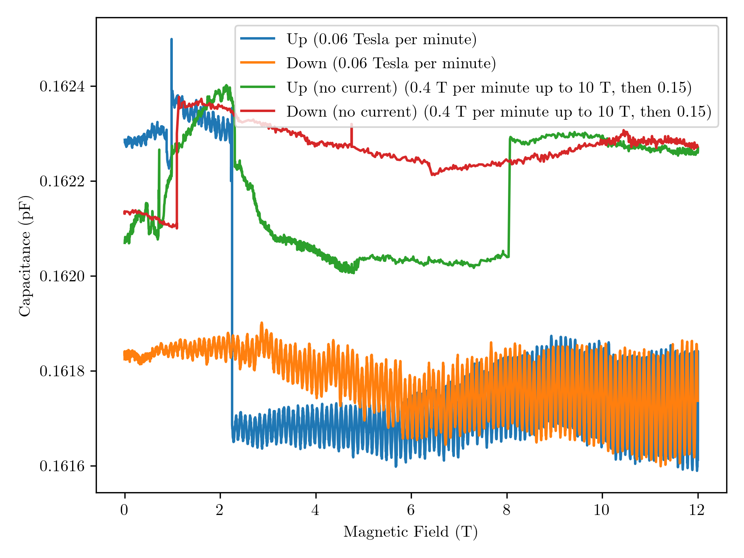
Measurement: Field sweeps
With and without 10 mHz 1mA through the coil
No clear dHvA oscillations
Notes:
- jumps and drifts: a disaster
- oscillatons that are visible result from the coil and not the dHvA effect

Slide 18
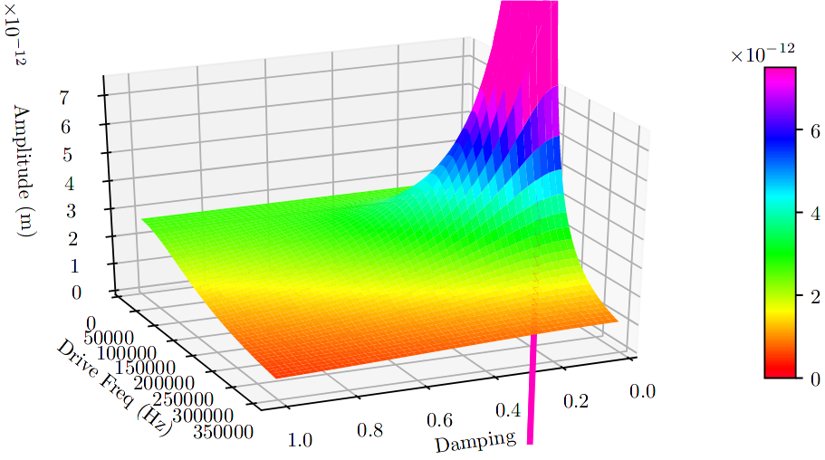
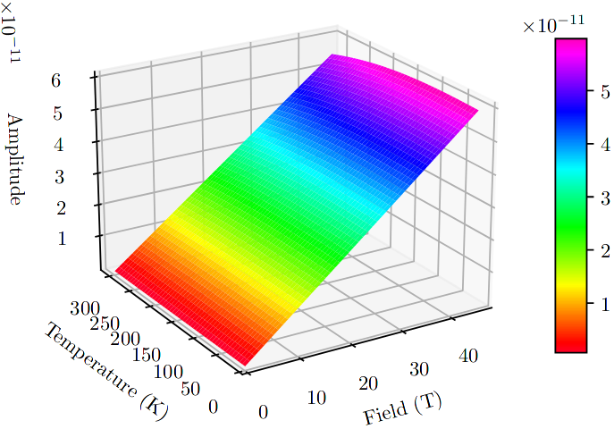
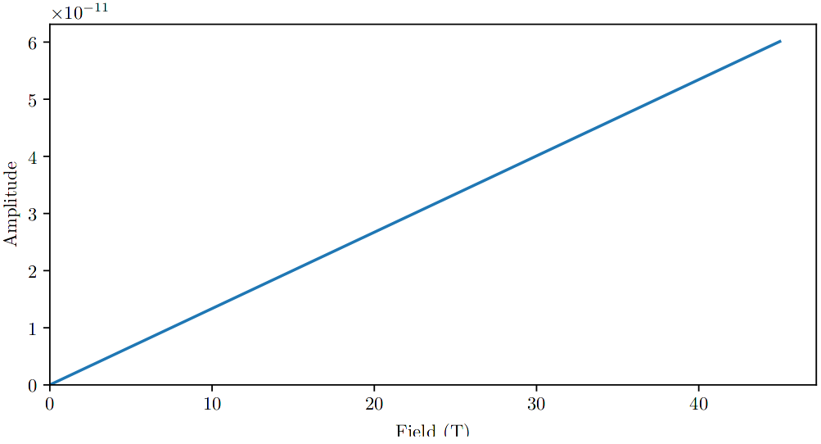
Simulating oscillating cantilevers: Amplitude
4K, 10T, 0.1cm
ω(0K), 0.1, 1cm
ω(0K), 0.1, 1cm, 4.2K
Notes:
- F_1 dominated by linear F_0 from the coil

Slide 19
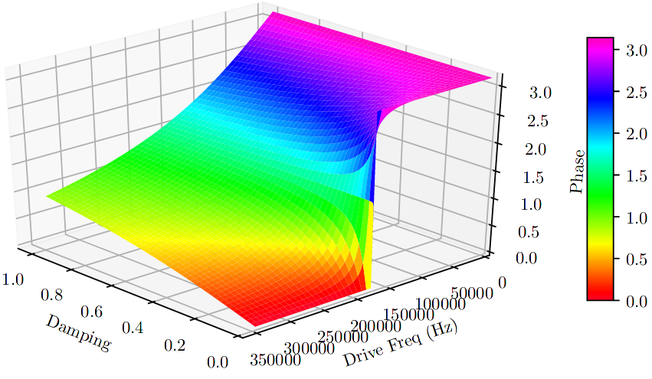
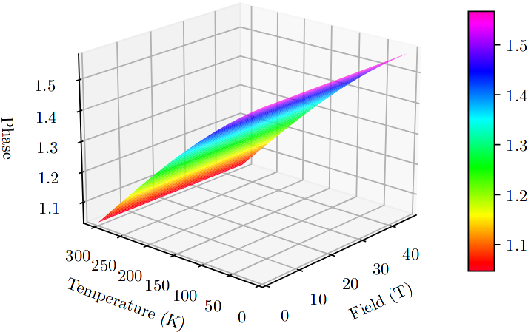
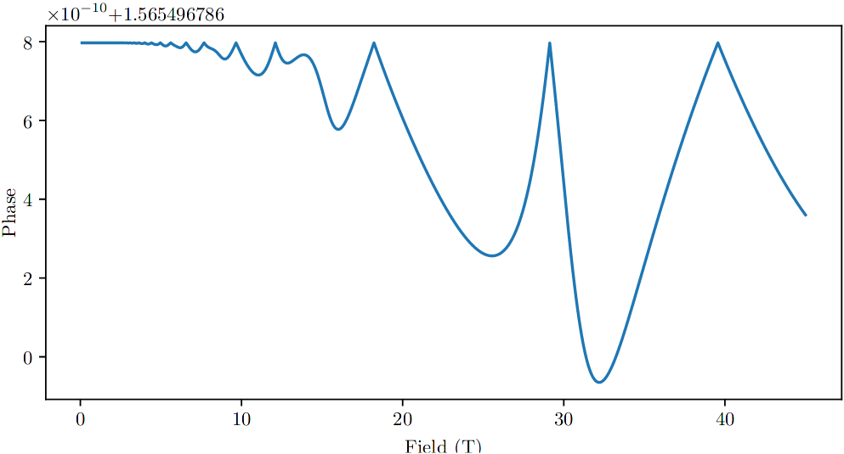
Simulating oscillating cantilevers: Phase
4K, 10T, 0.1cm
ω(0K), 0.1, 1cm
ω(0K), 0.1, 1cm, 4.2K
Notes:
-

Slide 20
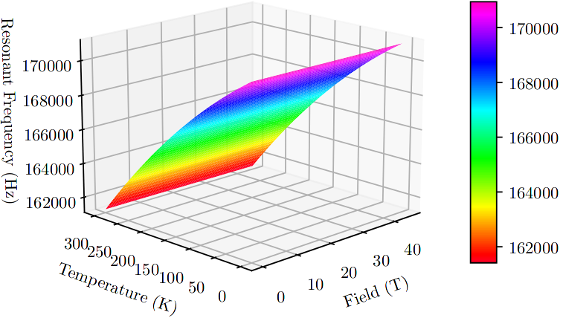
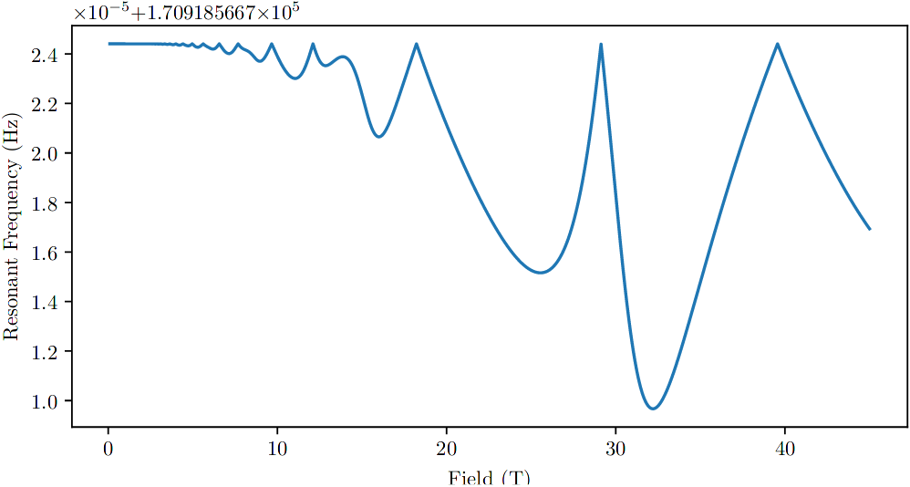
Simulating oscillating cantilevers: Resonant Frequency
ω(0K), 0.1, 1cm
ω(0K), 0.1, 1cm, 4.2K
Notes:
- Dominated by temperature dependent change of elasticity

Slide 21
Conclusion
Cantilever can now be made to oscillate.
The system reacts way stronger to changes in the oscillating force from the coil, than to changes in the force resulting from the sample’s magnetization.
The amplitude change in field sweep is dominated by the coils magnetic moment, even for a coil with a similar magnetic moment to the sample.
Notes:
- can make the cantilever oscillate, and can measure these oscillations
- F_0 versus dF_1

Slide 22
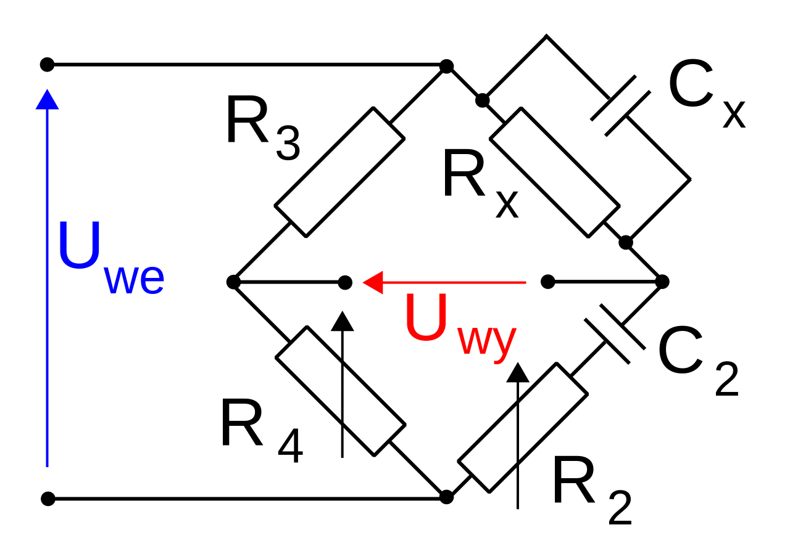
Discussion: What is still to be done?
Noise, Drifts and Jumps: Measurement needs to be done at higher frequencies, allowing faster sweeps.
  To allow higher frequencies we need an alternative to the AH 2700A Capacitance Bridge:
    Simple Wien Bridge circuit plus Lock-In Amplifier?
Amplitude changes dominated by the coil:
  Phase sensitive measurements?
  Resonant frequency shift measurements?
    Different materials for cantilevers to tune
    resonant frequency?
    Frequency versus amplitude measurements?
      More accurate amplitude measurements: Lasers?
Notes:
- Cap Bridge needs large averaging to be accurate, and we need a couple of points in each oscillations → low input frequencies of 10 mHz
- we aren’t actually interested in the actual value of the capacitance
- Phase shift is small (1e-10) can we measure this?
- Accurate distance(=amplitude) measurements with lasers?

Slide 23
Acknowledgements
Thanks to:
  Uli Zeitler
  Maurice Bal
  And everyone else at HFML
Questions?

