Slide 1
INFORMATION LITERACY

Slide 2
Information Literacy is an important skill in life. An individual who is literate in the location, access, evaluation, and use of information also displays a certain sense of critical literacy. When you are information literate, you are able to evaluate what information you need, what to discard, and how to use the information you selected.

Slide 3
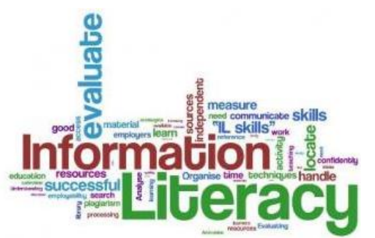
Why do we need information?
Where do we need information?
How do we acquire and store information?
How do we use the information that we have?
How will we communicate the information that we have acquired?

Slide 4
Answer the following questions
As a student, what do you think are the usual instances and reasons for your need of information?
What tasks have you done in the past that required searching information for you to complete them?

Slide 5
Literacy and Empowerment
Literacy is widely known as the ability to read and write. The advent of modernity and the expansion of access to general education has enabled societies to produce literate populations. Literacy always associated with a set of tangible skills, particularly the skills of writing and reading. Its counterpart is the concept of numeracy, which is the skills associated with basic mathematical operations involving numbers.

Slide 6
Literacy and Empowerment
The United Nations Educational, Scientific, and Cultural Organization (UNESCO) cites the importance of literacy in the modern world: “Literacy is a fundamental human right and the foundation for lifelong learning. It is fully essential to social and human development in its ability to transform lives. For individuals, families, and societies alike, it is an instrument of empowerment to improve one’s health, one’s income, and one’s relationship with the world.” (UNESCO, 2003)

Slide 7
Literacy and Empowerment
Empowerment is very significant in our appreciation of how literacy provides us with means to access the world of knowledge so we can lead better lives. Empowerment is an idea of power, as linked on the idea that power can change, that the ownership of power can shift form one entity to another. Empowerment is also possible because power can expand or diminish as the case may be. “Let us first review our notions of power.

Slide 8
Literacy and Empowerment
Power is often related to our ability to make others do what we want, regardless of their own wishes or interests (Weber, 1946). Power is not always relational. One needs to cultivate a notion of power within to fully realize. True enough, power can reside inside, you given the opportunity to access the knowledge, skills, and attitudes.

Slide 9
Information and Internet
Information literacy is best understood on how we navigate the complex and networked world of the internet. The internet has more than practical uses in our lives. It has been transformed to be the primary source for research, complementing what can be found in school libraries.
Today, we live in a knowledge-based society surrounded by cutting-edge technology that makes every aspect of our lives faster and easier. The internet arose in 1968, but it was in 1989 when a fully developed World Wide Web (WWW) arose and turned it into the global platform for knowledge-sharing, communication, and achieving.

Slide 10
Information and Internet
The Internet is an increasingly important part of everyday life for people around the world. But if you've never used the Internet before, all of this new information might feel a bit confusing at first. The Internet is a global network of billions of computers and other electronic devices. With the Internet, it's possible to access almost any information, communicate with anyone else in the world, and do much more.
You can do all of this by connecting a computer to the Internet, which is also called going online. When someone says a computer is online, it's just another way of saying it's connected to the Internet.

Slide 11
Information and Internet
The World Wide Web—usually called the Web for short—is a collection of different websites you can access through the Internet. A website is made up of related text, images, and other resources. Websites can resemble other forms of media—like newspaper articles or television programs—or they can be interactive in a way that's unique to computers.
The purpose of a website can be almost anything: a news platform, an advertisement, an online library, a forum for sharing images, or an educational site.

Slide 12
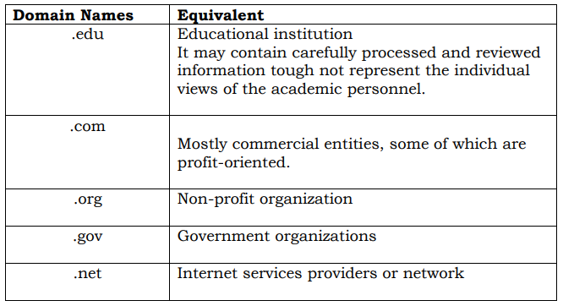
Who Puts Information on the Internet?
There are many kinds of Internet sites that you might find during the course of a search – sites created by different people or organizations with different objectives. The three-letter code preceded by a dot (.), simply known as the domain, gives you a fairly good idea of who is publishing the internet site.

Slide 13
What Determines Your Need for Information?
Information seeking is relatively synonymous to the idea of research. When you locate information. You employ the necessary skills to engage in the research process. Your need for information depends on your prior knowledge and experience, as well as your goals and objectives.
Your information needs to rely on what questions or problems you would like to solve or, simply, what you need the information for. These needs also depend on the relevance of the information you seek to the task you are supposed to accomplished. Ask yourself who will consume and/ or benefit from the information you are trying to locate. You must also identify how much information you need and its adequacy to address your task. Consult your personal knowledge base so that you can plan what else to search to augment what you already know.

Slide 14
Sources of Information
Popular Publications:
Most of what rules in the print and non-print media are popular publications with the general public as its target audience. Included under this category are journalistic articles, features articles, manuals, flyers, fact sheets, and even blogs by netizens. They serve to both inform and entertain the general public.

Slide 15
Sources of Information
2. Scholarly Publications:
These are well-researched articles found mostly in academic journals and published for the specialists of a specific field. The language is very technical because it is geared toward the consumption of specialists, scholars, and those seeking research-based information on a particular area of knowledge such the social science, the natural sciences, and the arts and humanities.

Slide 16
Sources of Information
3. Trade Publication:
These are also highly specialized materials meant for the players and specialists of a specific industry. Some good examples are publications on motoring or publications on construction. Trade Publications combine popular appeal and specialized knowledge because it also needs to attract the non-specialist who are the potential consumers of users of a particular product.

Slide 17
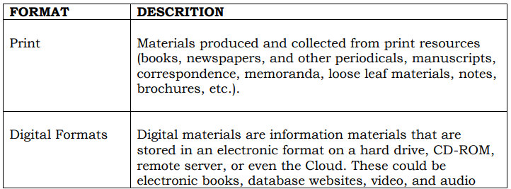
Format of Information

Slide 18
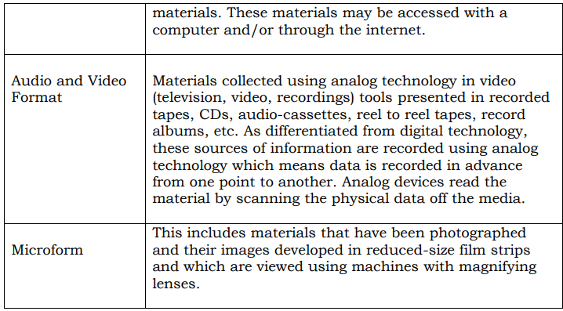
Format of Information

Slide 19
Go back the time when you were learning how to read and write. Ask yourself the following questions:
How did you learn to read and write?
How did you gain the skills that enabled you to read and write?
What are the five most important and meaningful things you can do with your ability to read and write?
How did these skills stay with you through the years?
What did you do to enhance these skills?
Do you think there is still room to enhance these skills?

Slide 20
A. True or False: Write True if the statement is correct otherwise, write False on your answer sheet.
_____ 1. Literacy is a fundamental human right and the foundation for lifelong learning.
_____ 2. Empowerment is not significant in our appreciation of how literacy provides us with means to access the world of knowledge so we can lead better lives.
_____ 3. Power is often related to our ability to make others do what we want, regardless of their own wishes or interests.
_____ 4. Information literacy is best understood on how we navigate the complex and networked world of the internet.
_____ 5. The Internet is an increasingly important part of everyday life for people around the world.

Slide 21
A. True or False: Write True if the statement is correct otherwise, write False on your answer sheet.
______ 6. The three-letter code preceded by a dot (.), simply known as the “search engine site”.
______ 7. Information seeking is relatively synonymous to the idea of research.
______ 8. Books, newspapers, and other periodicals are example of Print format information.
______ 9. When you are information literate, you are able to evaluate what information you need, what to discard, and how to use the information you selected.
_____ 10. When you are able to judge the “ Potential value of Information,” you will not be able to maximize its use.

