Slide 1

iCursor: Human-Computer Interaction through Assistive Arduino-Based Eye-Tracking Technology for the Physically Impaired

Slide 2
Objectives
The primary objective of the study is to design and develop an eye-tracking and Human-Computer Interface system to facilitate the Human-Computer Interaction of people with physical impairments.

Slide 3
Objectives
Specifically, it aims to:
Implement an efficient, low-cost, add-on system for Human-Computer Interaction
Provide an assistive tool that empowers a person with physical impairments

Slide 4
Objectives
Create an Arduino-based eye tracker that allows the person to use, command, and manipulate electronic gadgets just by using their gaze and blinking
Develop an algorithm for the eye-gaze user interface.
Test and evaluate the system.

Slide 5




Significance of the Study
Physically impaired people
School
Government
Future Researchers

Slide 6
Scope and Limitation
This study aims to empower the physically impaired in their personal computer usage with an assistive system consisting of an eye-tracking device and Human-Computer Interface. The prototype for the eye-tracker and the HCI will be built by the Researchers remotely in City of General Trias for the months of May until June 2021. Signals from the prototype's sensors are the primary source of input to be processed by the HCI wherein an algorithm is made to have corresponding controls to eye gaze and blinking.

Slide 7
Scope and Limitation
Data acquisition from the eye-tracker will happen in real-time for efficient and responsive manipulation by the user. The Researchers are limited to the available features in their chosen software for creating the HCI. Other technology apart from the personal computer, such as mobile phones and tablets, will not be included in the making and testing of the assistive system.

Slide 8
Time and Place
Time
Research making will take place from May 2021 to June 2021.
Place
The study will be conducted in the City of General Trias, Cavite.

Slide 9
RRL
According to Borgestig, et al. (2017), computers as an assistive technology have been found to be an effective intervention for children with profound impairments because they can alleviate participation restrictions and functional limitations in childhood activities, especially in the areas of play, education, and communication.

Slide 10
RRL
As eloquently stated by Anacan et.al. (2013), an eye detection device is a connectivity tool and control system designed for physically disabled people to interact with technology considering the fact that a lot of researchers have found its functionality to be applied in one of the fields of analyzing eye-movements, including the Human-Computer Interface (HCI). Consequently, eye tracking makes the manipulation of the mouse cursor with the eyes possible, obviating the need for a virtual mouse, which can be mainly helpful for people with disabilities.

Slide 11
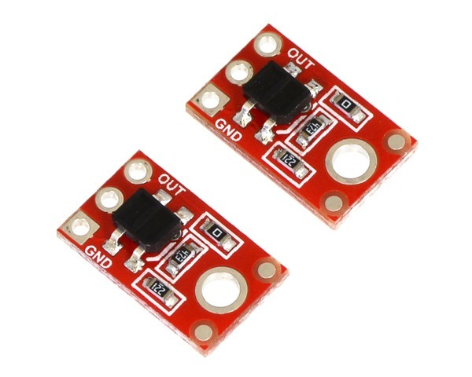
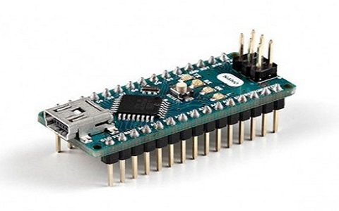
Materials
QTR-1A reflectance sensor
12.7 by 7.6 mm module that is composed of an infrared LED and phototransistor and the reflectance is an output as an analog voltage
Arduino Nano R3 Microcontroller
an 18 by 44 mm microcontroller board based on Atmega328p

Slide 12

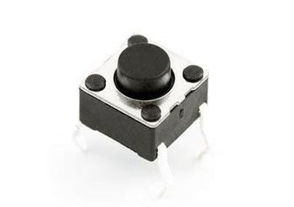
Materials
9V Lithium Battery
power supply for the microcontroller unit
Button
connects two points in the circuit when it is pressed

Slide 13
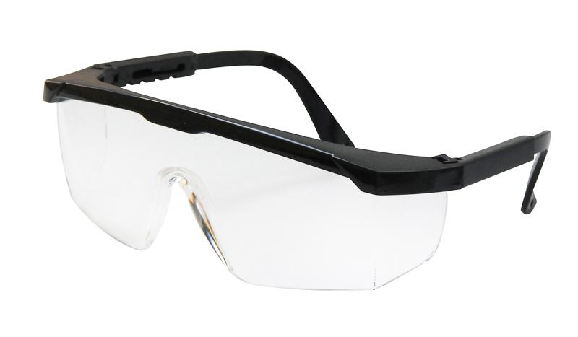
Materials
Safety glasses
eyewear that is used for protective purposes, will mainly be used as a frame for the reflectance sensors

Slide 14
Methods
Using Canva, design and construct an Arduino-based eye tracker that successfully tracks and detects eye gaze and blinking;

Slide 15
Methods
Design a Human-Machine Interface according to the aim to empower a person with disabilities.

Slide 16
Methods
Develop an algorithm for the eye-gaze based HMI using MatLab and from the acquisition performed by the eye-tracker, generate responses for controlling the computer ;

Slide 17
Methods
Establish a new way of communicating with technology that trains cognitive skills of the physically impaired in terms of:
sustaining attention
speed of processing information;
executing more than one actions while paying attention to details at the same time

Slide 18
Methods
Test and evaluate the system in an experimental set-up composed of the computer and the user with the head-mounted iCursor.

Slide 19


System Diagram
TRANSMITTER
RECEIVER
MCU
INTERFACE
The figure shows the block diagram of the system.

Slide 20
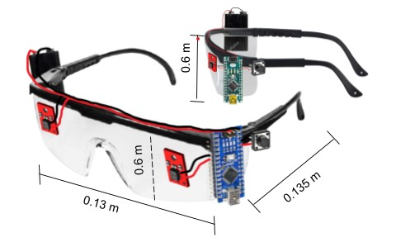
Expected Output
The figures show the 3D Model of the proposed design.

Slide 21
Budgetary Estimate
Quantity | Description | Unit Cost (Php) | Total Cost (Php)
2 1 1 1 1 | QTR-1A reflectance sensor Safety glasses Arduino Nano R3 Microcontroller 9V Battery Button | P128.50 P50.00 P85.00 P99.00 P15.00 | P257.00 P50.00 P85.00 P99.00 P15.00
TOTAL COST |  |  | P506.00
The table shows the list of estimated prices that will be used in the study.

Slide 22
Test and Evaluation
In an experimental set-up, the iCursor eye-tracking device will be head-mounted on the user and the personal computer is placed in front of them. The following will be done to test and evaluate both the device and the human-computer interface.

Slide 23
Test and Evaluation
Eye-Tracker and Eye Gaze
The responsiveness of iCursor to eye movement will initially be observed. If responsive and consistent;
The accuracy of the device will then be evaluated. When the sensor output values are congruent to that of the direction or blinking of the eyes; it is working properly.

Slide 24
Test and Evaluation
Human-Computer Interface
It will be tested if the signal is successfully sent to, and received by the user interface.
Evaluation of the responsiveness of the cursor movement based on the HCI's algorithm will be done, it will be sought whether the response occurs in real-time or not.

Slide 25
Test and Evaluation
For computer use, they then will be given a set of activities on the interface such as navigating the screen in specific directions, clicking on specific regions, and typing words.

Slide 26
Test and Evaluation
Cognitive Skills
Before initiating computer use, the user must first get a hang of the device and determine its comfortability for eye, head, and body movement so they sustain attention on giving commands with their eye gaze.

Slide 27
Test and Evaluation
Their speed while interacting and familiarizing with the software will also be identified.
For computer use, they then will be given a set of activities on the interface such as navigating the screen in specific directions, clicking on specific regions, and typing words.

Slide 28
Test and Evaluation
These experiences will be measured of their effectivity, responsiveness and efficiency through answering a survey questionnaire.

Slide 29
Thanks!
Any questions ?
Proponents:
Dela Cruz, Dale George
Serrano, John Paul
Catanaoan, Radha Juliana
Mabansag, Shaina Jen
Sugue, Zylei

