Slide 1












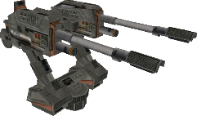


3
20
55
12

Slide 2

PLAY
OPTIONS
EXIT

