Slide 1
Spend Smart
SMART FINANCIAL MANAGEMENT WITH REAL-TIME ANALYTICS

Slide 2


Our Team
Mohammad Mustafa Shafaq
Nafia Nowrin

Slide 3
The Idea
01
02
03
Simplifying personal expense tracking with an intuitive interface
Real-time data visualization and insights
Accessible, client-side solution using modern web technologies

Slide 4
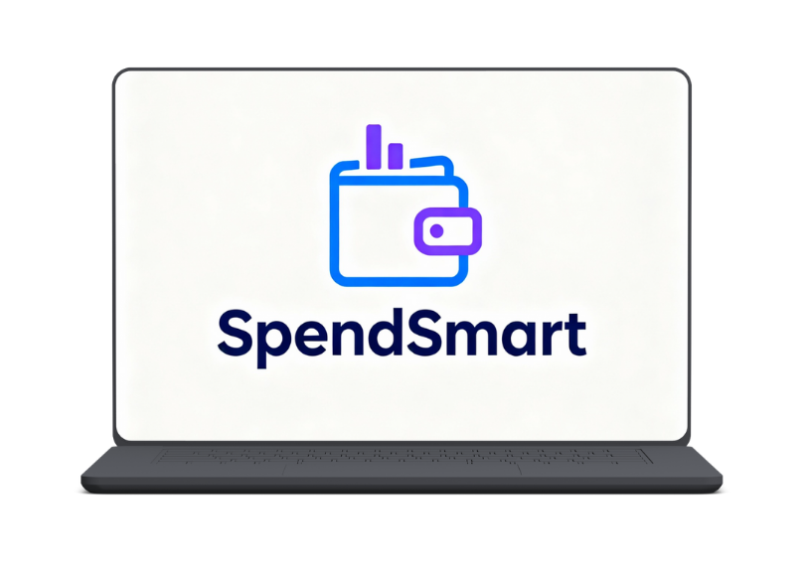
SpendSmart at a Glance
01
A responsive expense tracking dashboard
02
Interactive charts for spending analysis
03
Add, edit, and manage expenses seamlessly

Slide 5
Key
Features
Feature 1
A responsive expense tracking dashboard
Feature 2
Feature 3
Feature 4
Interactive charts for spending analysis
Add, edit, and manage expenses seamlessly
Individuals wanting control over their finances

Slide 6

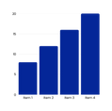


Tech Stack
React
Component-based UI architecture
Chart.js
Chart Libraries Beautiful data visualizations
localStorage API Client-side data storage
CSS3
Modern styling and layouts

Slide 7

Why These Technologies?
React
01
Built modular, reusable UI components that manage state and re-render on data changes.
Chart.js / React-chartjs-2
02
Created interactive line charts to visualize spending trends over time with weekly/monthly views
localStorage API
03
Stored expenses client-side so data persists across browser sessions without a backend.
CSS3
04
Styled the dashboard with Flexbox, Grid layouts, gradients, and responsive design for a professional UI.

Slide 8

Challenges
Managed multiple React states (expenses, filters, theme, profile) with useState and useEffect.
Added persistent expense storage using localStorage with a dummy data fallback.
Designed a responsive dashboard with sidebar navigation and light/dark themes
Built year, month, and category filters that work together smoothly
Used Chart.js to show weekly and monthly spending trends.

Slide 9

Learning
  Applied React Hooks to build a real SpendSmart expense tracker.​
  Designed reusable components to keep the dashboard UI clean and scalable.​
  Analyzed my own dummy expense data with filters and charts.​
  Used localStorage so my expenses persist like a real user app.​
  Styled the dashboard to look modern and responsive on any screen.​
  Got better at debugging by tracing data flow in DevTools

Slide 10



Future Roadmap
Mobile app with React Native
Budget categories and spending goals
Cloud sync with Firebase or Supabase
Launch

Slide 11

Thank You
FOR YOUR TIME
SpendSmart

