Slide 1


Daffodil International University
Metro Rail Management System
Prepared By
Nowrin Islam Nishat
ID : 193-35-483
Software Engineering(DIU)
Instructed By
Mohetuzzaman Mobin

Slide 2
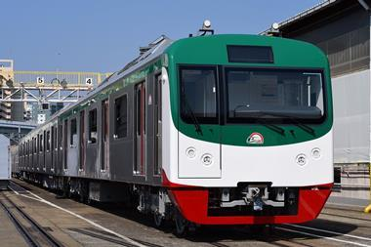
Metro Rail is the second largest transportation project of Bangladesh after the Padma bridge. The system is called MRT, Mass Rapid Transit.

Slide 3
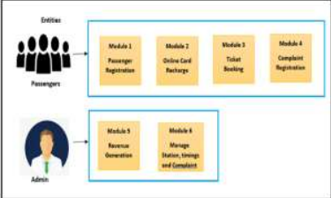
There are mainly two entities:
a. Passengers:
Under this entity there are four modules namely:
• Registration
• Online card recharge
• Online ticket booking
• Complaint registration
b. Admin:
• Revenue generation
• Manage stations, timings and complaints.

Slide 4
APPLICATION
BOOK TICKET
MY BOOKINGS
APPLICATION
WALLET
LOGIN
FEEDBACK
MANAGE USER
USER
LOGOUT
VIEW GRAPH
Fig : Use-case for user
VIEW REVINUE
ADMIN
LOGOUT
Fig : Use-case for admin
Use-case diagram

Slide 5
User Section
a. Registration: In this module, the user will enter the details like Name, Password, Email, Phone etc to store the data into the server, which will be used by the user to enter into application.
b. Login: Login is the process where the user can input his / her credentials where it will be verified from the
database for the reason of access the information from the application.
c. Ticket Booking: Ticket Booking is the course of action where the user can input his / her data to the
application to book tickets. User have to enter data like source, and destination. Once he enters all this
data, he/she gets the ticket price and can proceed with their bookings
Implementation

Slide 6
Admin Section
User Management: In this module, the registered users will be managed by the admin. The admin can view or delete the registered users based on the requirement.
b. View Graph: In this module, admin can view graph to know the revenue based on dates.
Implementation

Slide 7
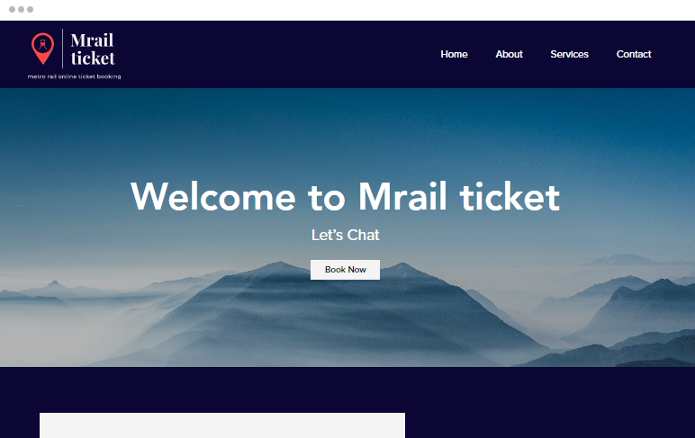
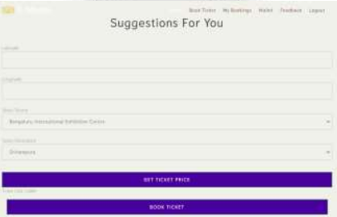
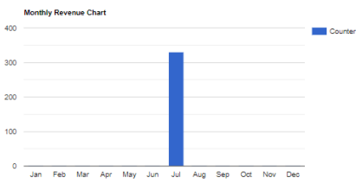
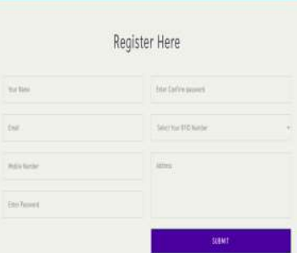
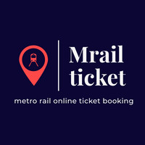
CONCLUSION
Home page
The goal of this system's development is to create an Android application for metro train management. The entire system is more secure, efficient, and time efficient. This project is highly useful in everyday life and can be implemented or worked on quickly. The operation would be totally automated, efficient, upgraded, and cost-effective in the planned online metro ticketing system.
Gender-wise graph
Monthly revenue chart
Bookings
Logo
Register page
Demo Site home-page create with wix.com

Slide 8
Thank You

