Slide 1
Link State Routing Algorithm in python
A Dynamic Network Simulation with Visual Interactivity
Course code: CCE-314
Course title: Computer Networks
Sadia Homayra Nowshin
ID: 2102014
Reg. 10141

Slide 2
Introduction: Navigating Network Dynamics
This presentation introduces our Link State Routing (LSR) simulation in Python, designed to visualize complex network behaviors.
Project Goal
Relevance
To build an interactive simulation of the Link State Routing protocol, featuring a graphical user interface, shortest-path visualization, and dynamic handling of link updates.
Link State Routing is fundamental to modern internet protocols like OSPF and IS-IS, ensuring efficient and robust data delivery across dynamic networks.

Slide 3
Background Theory: Link State Routing Fundamentals
Link State Routing protocols ensure every router has a complete map of the network, enabling optimal path calculations.
Link State Packets (LSPs)
Link State Database (LSDB)
Routers broadcast LSPs containing information about their directly connected links. Each LSP includes a sequence number to prevent the use of outdated information.
Each router collects LSPs from all other routers to form a comprehensive topological map of the entire network.
Dijkstra's Algorithm
Routing Tables
Using the LSDB, each router independently runs Dijkstra's algorithm to compute the shortest path to all other destinations in the network.
The results from Dijkstra's algorithm populate the routing table, dictating the next hop for any given destination.

Slide 4






System Architecture: Components of the Simulation
Our simulation comprises three core modules, each handling a specific aspect of the LSR process and user interaction.
Network Simulator
Manages network topology, floods LSPs, simulates link changes, and tracks convergence.
Routers
Individual network nodes maintaining LSDBs, computing routing tables, and exchanging LSPs.
GUI (Tkinter)
Provides visual representation of the network, interactive controls, and real-time logs.

Slide 5
Router Module: The Brains of the Network
Each simulated router acts as an autonomous agent, diligently maintaining its network knowledge and adapting to changes.
1
2
Link State Database (LSDB)
Sequence Numbers
Stores a complete map of the network topology based on received LSPs from all other routers.
Critical for preventing the processing of stale LSPs, ensuring that only the most recent network state is considered.
3
4
Routing Table Computation
LSP Exchange
Utilizes Dijkstra's Algorithm to determine optimal paths to all network destinations.
Routers actively exchange Link State Packets to disseminate network topology information.

Slide 6
Network Simulator: Orchestrating Network Events
The simulator controls the network environment, introducing dynamic elements and monitoring the system's response.
Topology Management: Adds and removes routers and links dynamically.
LSP Flooding: Efficiently propagates Link State Packets across the network until all routers converge.
Link Cost Changes: Simulates variations in link costs to observe how the network adapts.
Event Logging: Records all significant updates and convergence events for analysis.

Slide 7
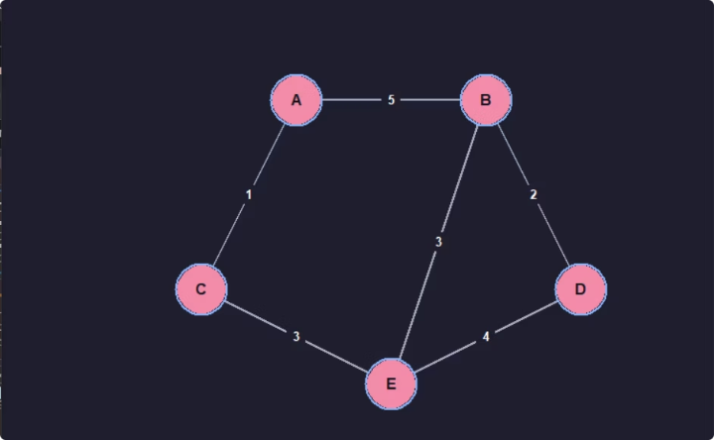
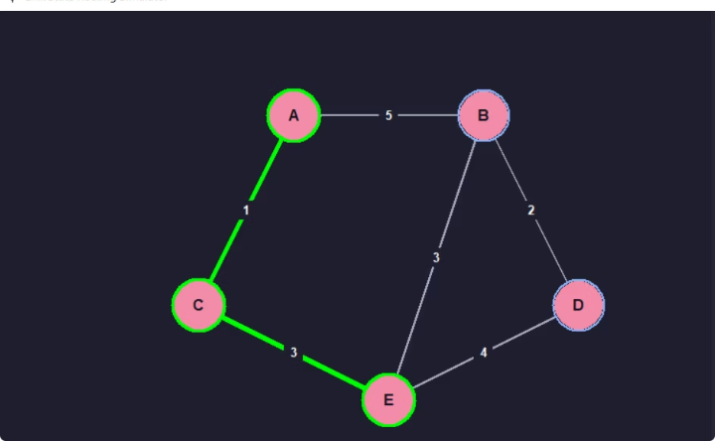
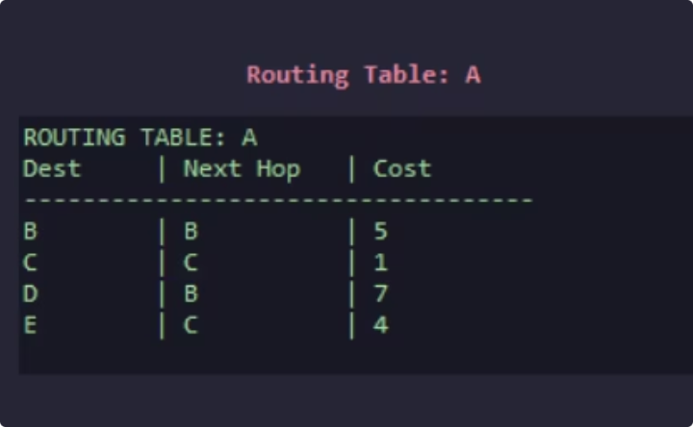
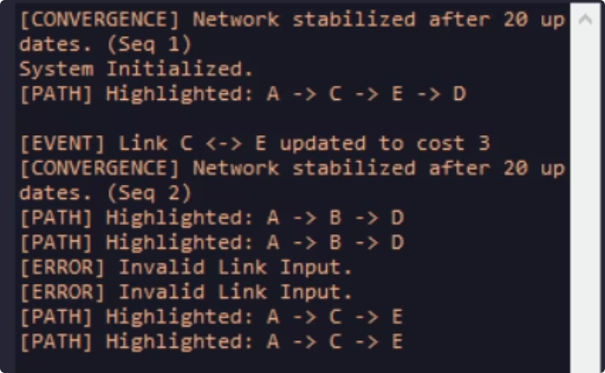
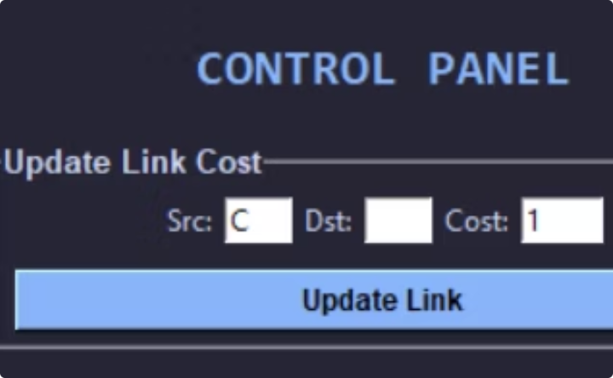
Graphical User Interface (GUI): Interactive Network Visualization
Visual Topology Display
Highlighted Shortest Path
Routing Table Viewer
Clearly shows network nodes, their interconnections (edges), and active data paths.
Visually emphasizes the optimal route between any two selected nodes.
Displays the current routing table for any selected router, showing next hops and path costs.
Live Simulation Logs
Dynamic Link Cost Panel
Provides a real-time stream of network events, including LSP exchanges and convergence notifications.
Allows users to modify link costs in real-time and observe immediate network reactions.

Slide 8
Core Algorithms: The Engine of Routing
Underpinning the simulation are fundamental algorithms that manage path finding and network consistency.
Dijkstra’s Algorithm
The cornerstone for calculating the shortest paths from a source router to all other destinations.
Flooding Mechanism
Ensures reliable dissemination of LSPs throughout the network to maintain consistent LSDBs.
Full-Path Reconstruction
Logic to trace and display the complete path taken by data packets based on routing table entries.
Dynamic LSDB Synchronization
Mechanisms to keep each router's Link State Database current and synchronized with the latest LSPs.

Slide 9





Simulation Workflow: From Setup to Interaction
The user-driven workflow demonstrates the full capabilities of our LSR simulation.
Initialize Network
Set up routers and define the initial network topology.
Generate & Flood LSPs
Routers begin exchanging link state information.
Update LSDBs & Compute Tables
Each router builds its LSDB and runs Dijkstra to create routing tables.
User Interaction
Users update link costs, highlight paths, or inspect tables via GUI.
Network Convergence
Observe the network adapt and reconverge after changes.

Slide 10
Conclusion: Enhancing Network Understanding
Our Link State Routing simulation provides a powerful tool for academic study and practical understanding.
Visual Learning
Dynamic Interaction
Robust Implementation
Intuitive GUI with path visualization clarifies complex routing concepts.
Real-time updates and convergence tracking enhance engagement.
Accurate application of Dijkstra's, flooding, and LSDB synchronization.
This project successfully simulates and visualizes the intricate mechanisms of Link State Routing, offering a dynamic and interactive learning experience.

