Slide 1
Single Deep CNN Features to Detect Neurodegenerative Diseases and Context Behind the Detection: Alzheimer's, Parkinson's, Dementia

Slide 2

Capstone Project (CSE 498)
Supervised by
Milon Biswas Assistant Professor Department of CSE Bangladesh university of Business and Technology (BUBT)
Submitted by
Mohammad Sabbir Ahmed | 17183103004
Syeda Nowshin Ibnat | 17183103020
Rakibul Ahasan | 17183103022
Sheikh Abu Hanif | 17183103043
Nusrat Jahan Anka | 17183103008
Intake: 39(1), Dept. of CSE, BUBT
Presented Date: 21-11-2021

Slide 3
01.
06.
11.
02.
07.
12.
03.
08.
13.
04.
09.
14.
05.
10.
15.
Contents
Introduction
Literature Review
Impact of Society
Sustainability
Problem Statement
Gantt Chart
Problem Background
Problem Analysis
Research Flow
Motivation
Research Methodology
Conclusion
Objectives
Ethics
Reference

Slide 4
Introduction
Neurodegenerative diseases occur when nerve cells in the brain or peripheral nervous system lose function over time and ultimately die. Alzheimer's disease, Parkinson's disease, and dementia are most common examples of degenerative neurodegenerative disease. Through our work we are willing to detect these three diseases at a time by a DL model.

Slide 5
Problem Statement
Identifying neurodegenerative diseases with proper explanation using one model is quite challenging.

Slide 6
Problem Background
The present neurodegenerative diseases detection system only detects one disease.
Identifying neurodegenerative diseases and behind the reason of appearing is a deadly problem that needs to be solved.
Due to the similarities in disease phenotypes, accurate detection of neurodegenerative diseases, including the context behind the detection is problematic.

Slide 7






Motivation
Detect the disease in early stage.
Detect three disease at a time.
To reduce wasting time & cost.

Slide 8
Objectives
Identifying present difficulty to work with neuroimaging data.
Build a new DL model to detect three Neurodegenerative
Diseases named Alzheimer's, Parkinson's and Dementia.
Get decent accuracy using a suitable MRI dataset.
Use XAI to know the context behind the detection.
Comparing the existing architectures with the proposed
one for neurodegenerative diseases detection.

Slide 9
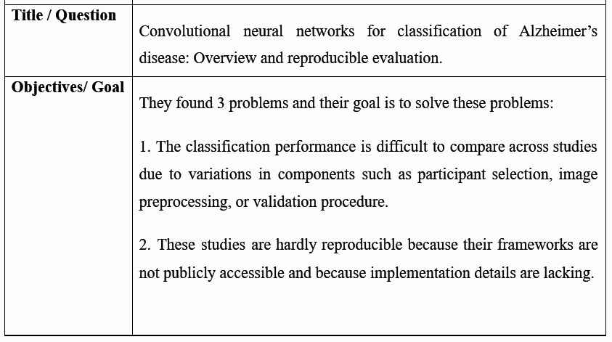
Literature Review

Slide 10
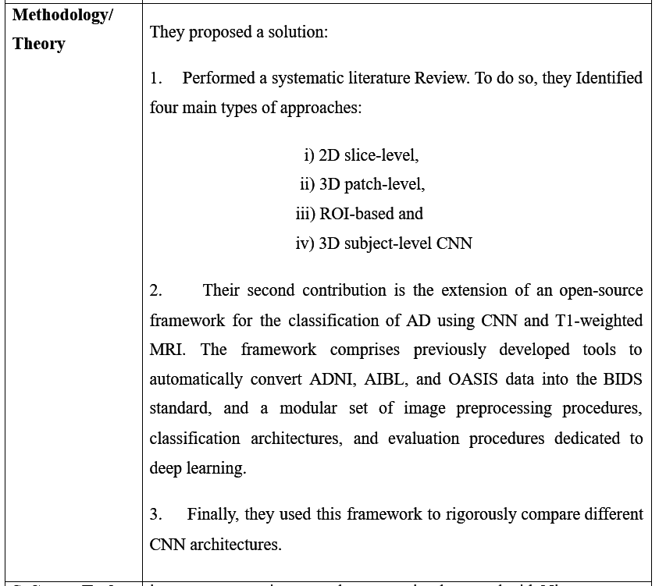
Literature Review cont.

Slide 11
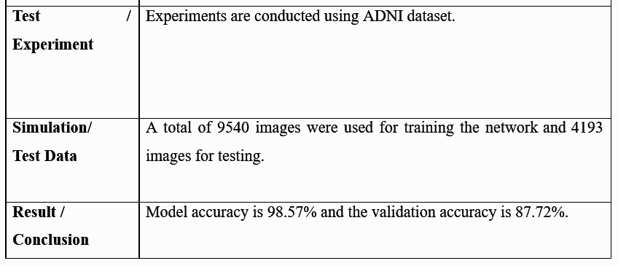
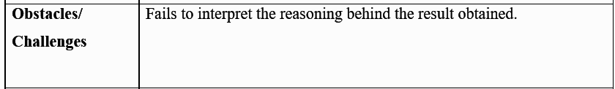
Literature Review cont.

Slide 12
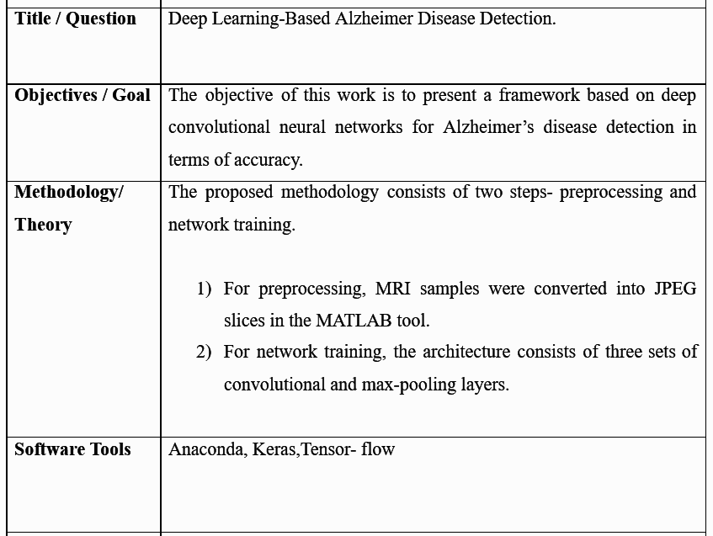
Literature Review cont.

Slide 13
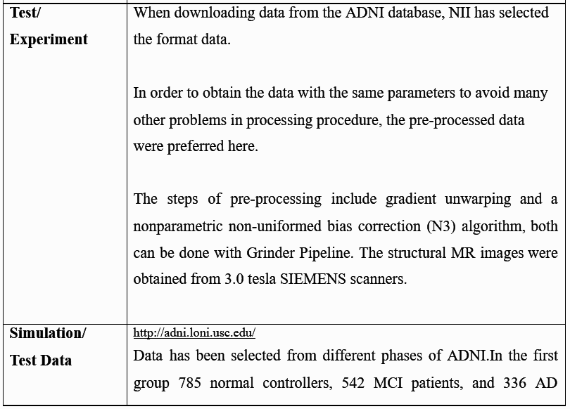
Literature Review cont.

Slide 14
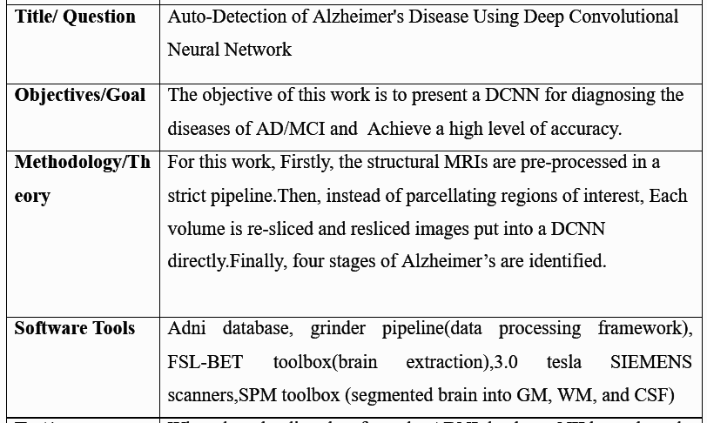
Literature Review cont.

Slide 15
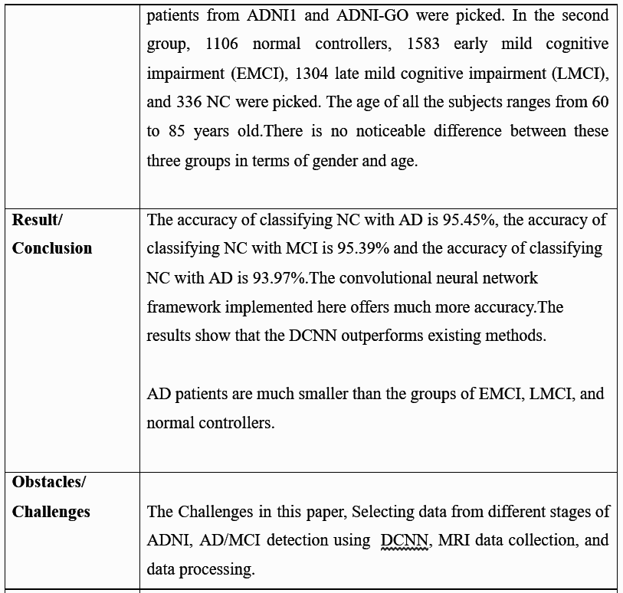
Literature Review cont.

Slide 16
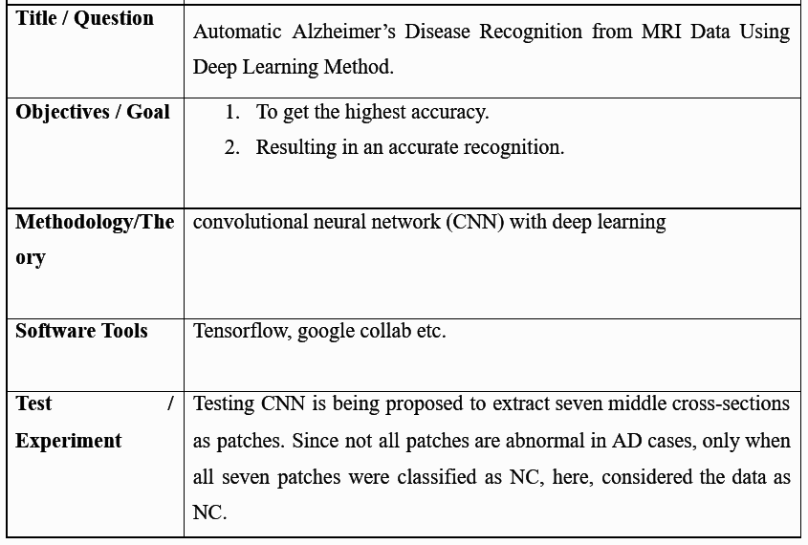
Literature Review cont.

Slide 17
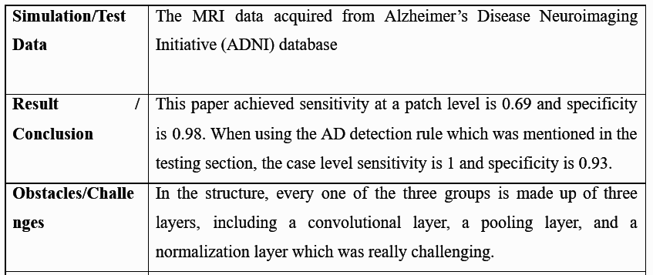
Literature Review cont.

Slide 18
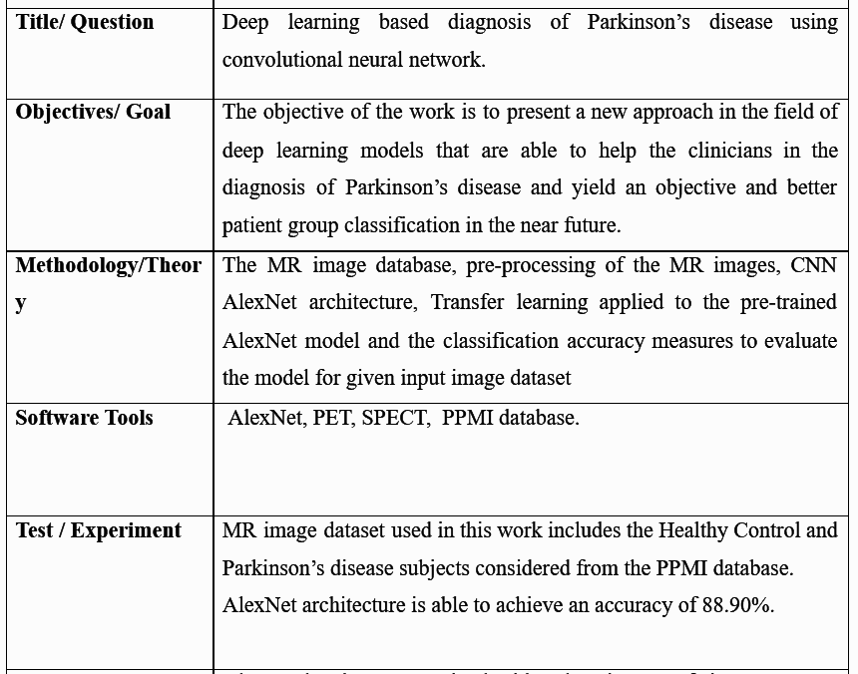
Literature Review cont.

Slide 19
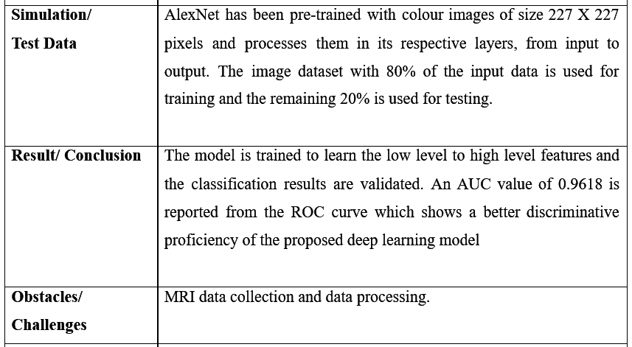
Literature Review cont.

Slide 20
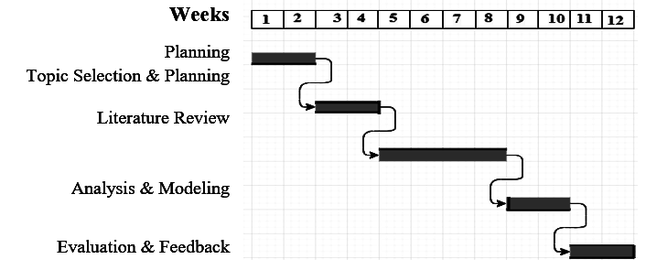
Gantt Chart

Slide 21
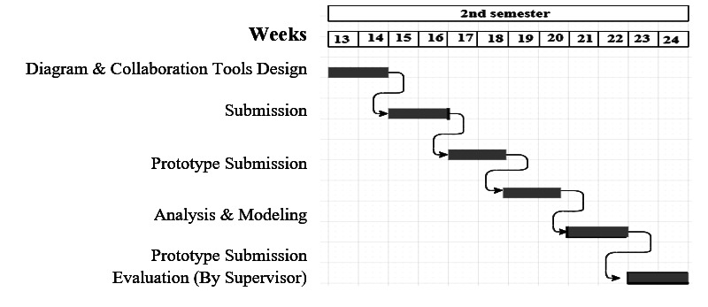
Gantt Chart Cont.

Slide 22




Problem Analysis
The existing approaches can detect one disease at a time.
Costly and time consuming.
Accuracy rate wasn’t satisfactory.

Slide 23
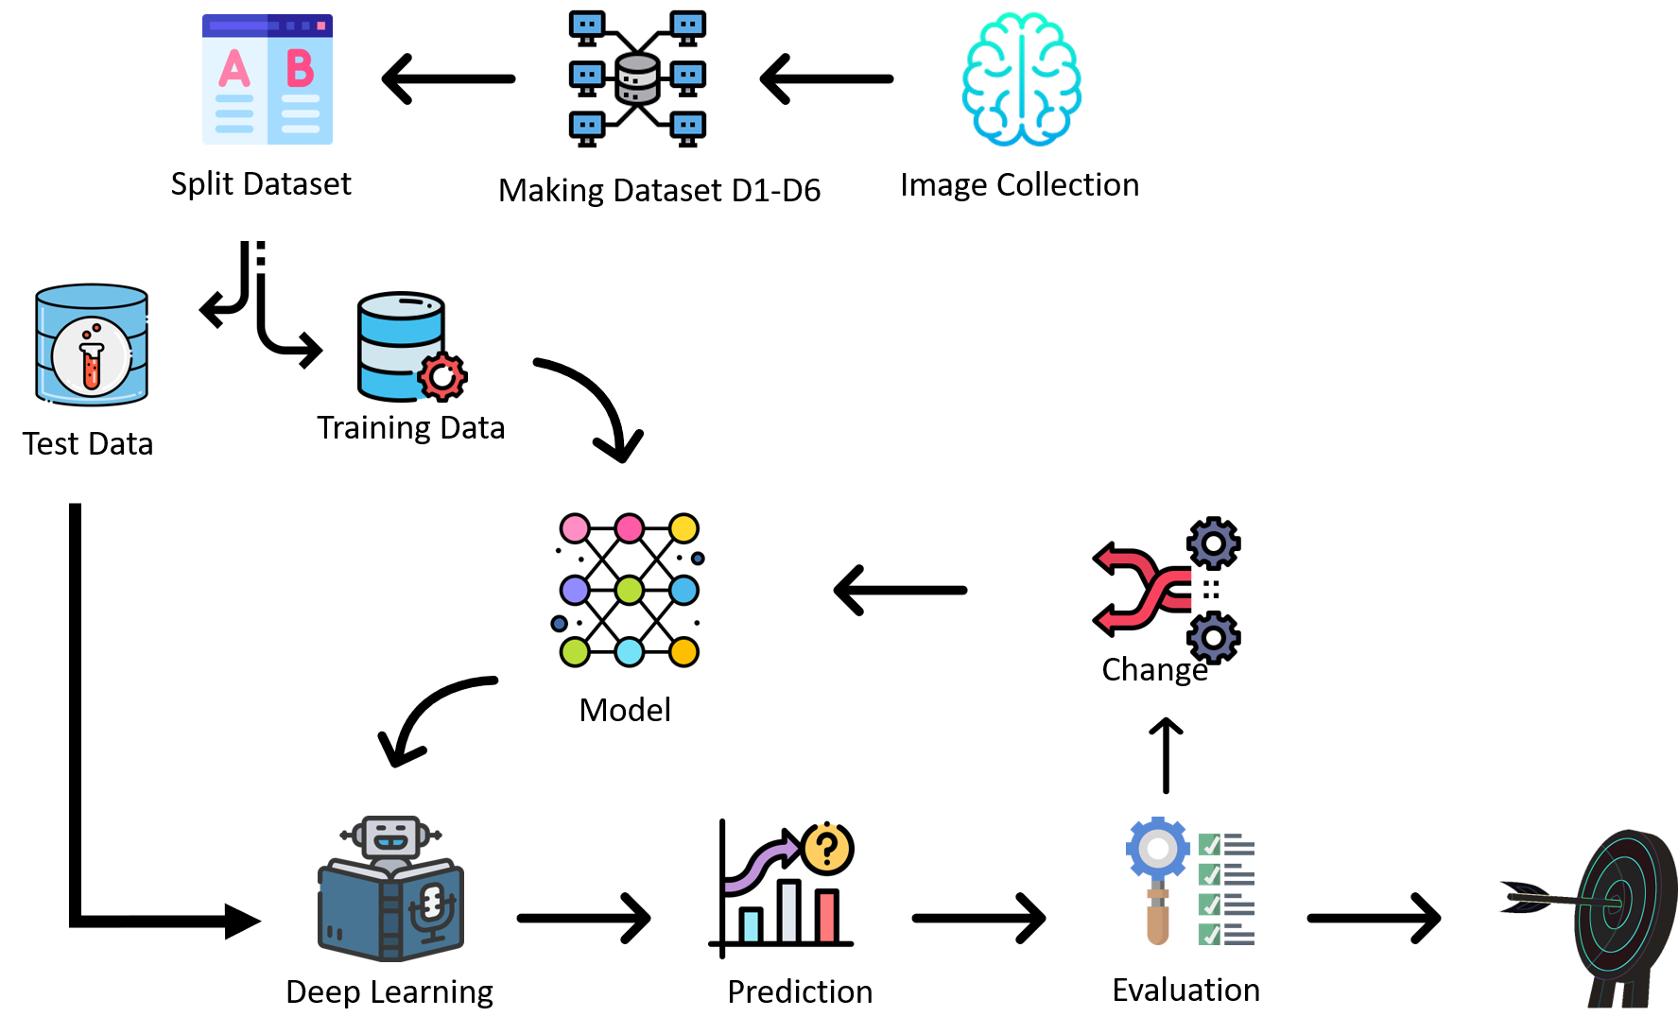
Research Methodology

Slide 24
Ethics
We are working on detecting neurodegenerative diseases: Alzheimer's, Parkinson's, Dementia, and the context behind the detection. We got our datasets from Oasis, Kaggle & PPMI. Our collected datasets are open source. From their written description these datasets were approved to show openly.

Slide 25
Impact of Society
It is essential in order to treat patients at an early stage.

Slide 26
Sustainability
From previous works obtaining highest result we took inspiration and made a decision of using Deep Learning to get better result.
Through our proposed approach we are willing to detect three diseases which wasn’t been done yet so with huge hope, we think our work will fulfill the sustainability.

Slide 27
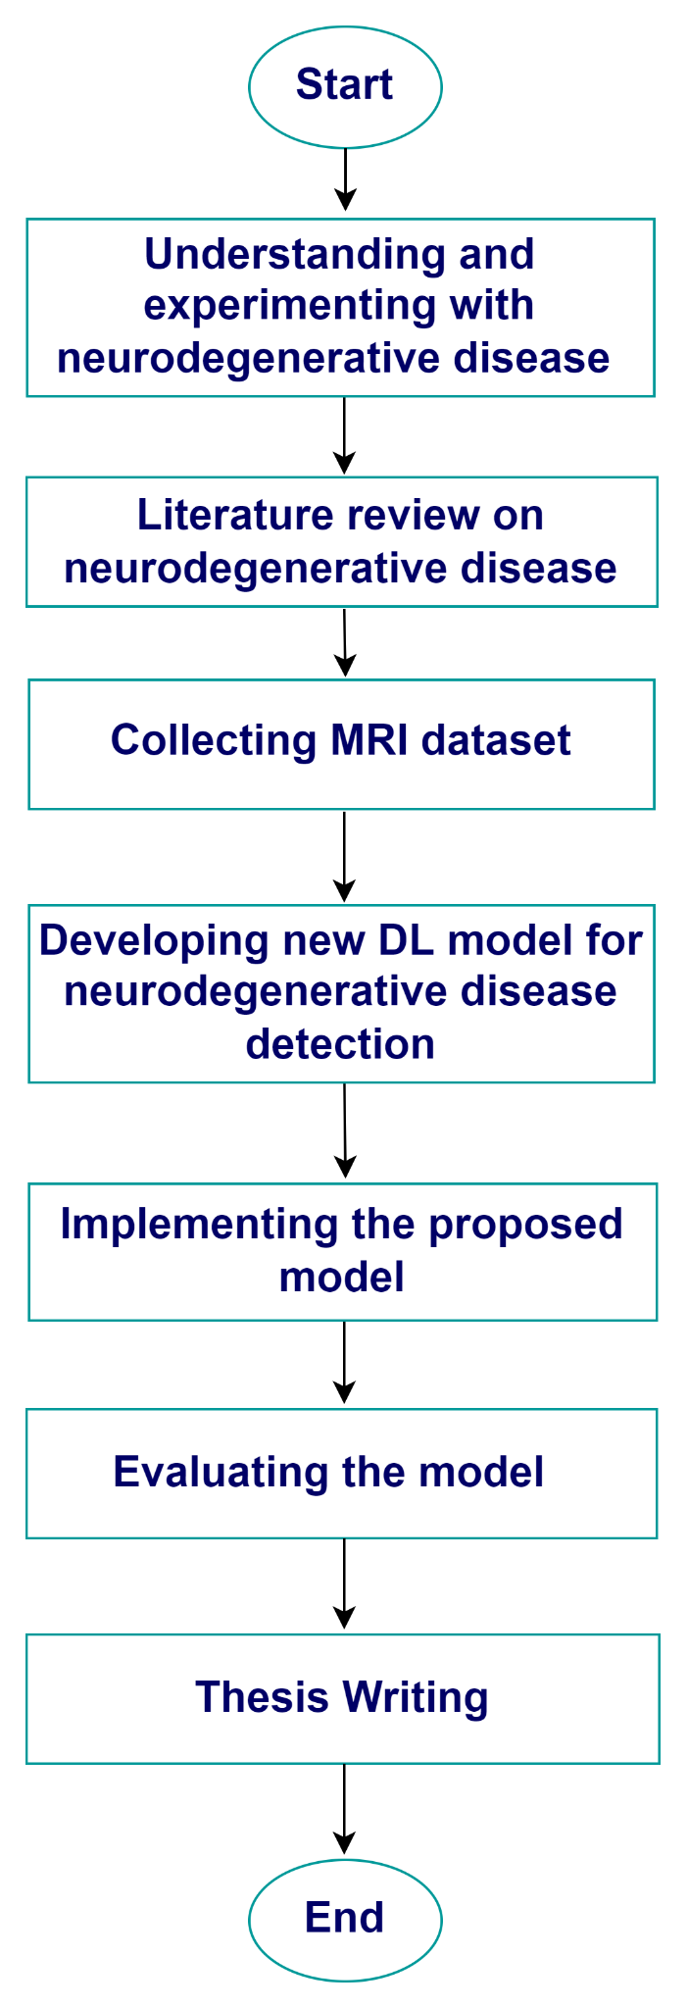
Research Flow

Slide 28
Conclusion
In our society, there are a significant number of senior persons who suffer from neurodegenerative diseases. By this work, we will be able to detect three diseases at a time which will be beneficial for medical professionals.

Slide 29
Reference
[1] J. Wen et al., “Convolutional neural networks for classification of Alzheimer’s disease: Overview and reproducible evaluation,” Med. Image Anal., vol. 63, p. 101694, 2020, doi: 10.1016/j.media.2020.101694.
[2] S. S. Kundaram and K. C. Pathak, Deep Learning-Based Alzheimer Disease Detection, vol. 673. Springer Singapore, 2021.

Slide 30
Reference cont.
[3] L. Yue et al., “Auto-detection of alzheimer’s disease using deep convolutional neural networks,” ICNC-FSKD 2018 - 14th Int. Conf. Nat. Comput. Fuzzy Syst. Knowl. Discov., pp. 228–234, 2018, doi: 10.1109/FSKD.2018.8687207.
[4] Suhuai Luo, Xuechen Li, Jiaming Li, “Automatic Alzheimer’s Disease Recognition from MRI Data Using Deep Learning Method”, Journal of Applied Mathematics and Physics, 2017, 5, 1892-1898

Slide 31
Reference cont.
[5] S. Sivaranjani and C. M. Sujatha, “Deep learning based diagnosis of Parkinson’s disease using convolutional neural network,” 2019, [Online]. Available: https://doi.org/10.1007/s11042-019-7469-8.

Slide 32
Thank You

