Slide 1
Ch. 3: Information Systems Development
Objectives:
Describe the motivation for a system development process in terms of the Capability Maturity Model (CMM) for quality management.
Differentiate between the system life cycle and a system development methodology.
Describe 10 basic principles of system development.
Define problems, opportunities, and directives—the triggers for systems development projects.
Describe the PIECES framework for categorizing problems, opportunities, and directives.
Describe the essential phases of system development. For each phase, describe its purpose, inputs, and outputs.
Describe cross life cycle activities that overlap multiple system development phases.
Describe typical alternative “routes” through the basic phases of system development. Describe how routes may be combined or customized for different projects.
Describe various automated tools for system development.
Notes:
No additional notes

Slide 2
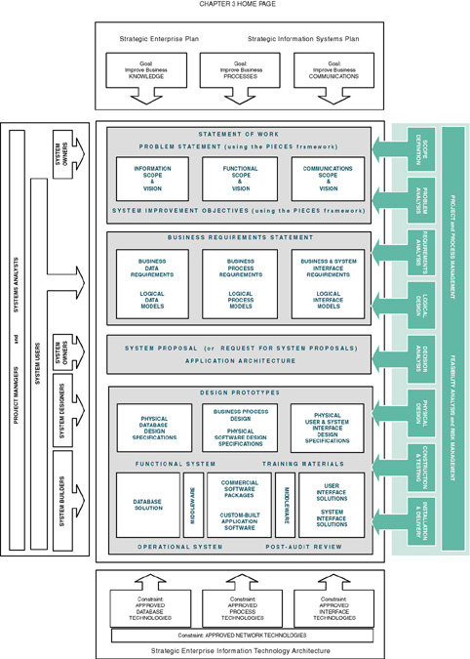
Notes:
Teaching Notes
This slide uses the framework taught in chapter 2 and emphasizes how the 8 FAST methodology phases relate to it. FAST is a representative methodology used throughout the remainder of the textbook. Each chapter will focus on one or more aspects of the framework.

Slide 3
Process of System Development
System development process – a set of activities, methods, best practices, deliverables, and automated tools that stakeholders (Chapter 1) use to develop and continuously improve information systems and software (Chapters 1 and 2).
  Many variations
  Using a consistent process for system development:
    Create efficiencies that allow management to shift resources between projects
    Produces consistent documentation that reduces lifetime costs to maintain the systems
    Promotes quality
Notes:
Teaching Notes
In teaching this course we sometimes begin by asking students to imagine they have to develop some complex information system, such as a new course registration system for the university. Then we ask them how they would proceed to determine what needs to be included in this information system. After a little discussion we ask them to compare this hypothetical process to what they have done with assignments in programming classes. The point is that programming assignments are not at all like real world information systems, which need a much more detailed development process. That sells why students need this course.
Some textbooks use the term systems development life cycle. We elected not to use that term because it invokes negative connotation for many instructors. Some associate it with a pure waterfall development approach (which we consider unfair).
We differentiate between development and operation (sometimes called production). This chapter focuses on development and different methodologies and strategies employed for system development.

Slide 4
CMM Process Management Model
Capability Maturity Model (CMM) – a standardized framework for assessing the maturity level of an organization’s information system development and management processes and products. It consists of five levels of maturity:
  Level 1—Initial: System development projects follow no prescribed process.
  Level 2—Repeatable: Project management processes and practices established to track project costs, schedules, and functionality.
  Level 3—Defined: Standard system development process (methodology) is purchased or developed. All projects use a version of this process.
  Level 4—Managed: Measurable goals for quality and productivity are established.
  Level 5—Optimizing: The standardized system development process is continuously monitored and improved based on measures and data analysis established in Level 4.
Notes:
Teaching Notes
We feel that CMM is very important. CMM is the information technology response to the total quality management initiative. CMM breathed new life into the importance of a system development process. The term “process” in CMM is equivalent to the term “methodology” as popularized in systems analysis and design methods.
Recognize that each level is a prerequisite for the next level.
Most organizations pursuing the CMM are targeting Level 3, that is, consistently using a standardized process or methodology to develop all systems.
CMM Level 2 deals with project management. CMM Level 3 deals with what has come to be known as process management.

Slide 5
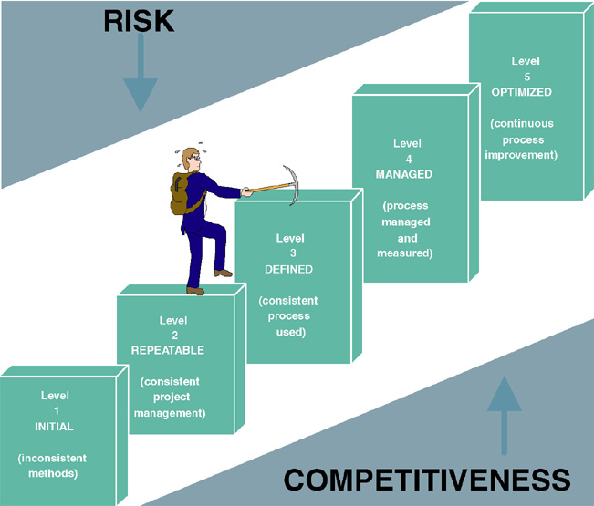
Capability Maturity Model (CMM)
Notes:
Teaching Notes
This diagram makes clear that you reach any given CMM level only by first climbing through the other levels.

Slide 6
Impact of System Development “Process” on Quality
CMM Project Statistics for a Project Resulting in 200,000 Lines of Code
Organization’s CMM Level | Project Duration (months) | Project Person-Months | Number of Defects Shipped | Median Cost ($ millions) | Lowest Cost ($ millions) | Highest Cost ($ millions)
1 | 30 | 600 | 61 | 5.5 | 1.8 | 100+
2 | 18.5 | 143 | 12 | 1.3 | .96 | 1.7
3 | 15 | 80 | 7 | .728 | .518 | .933
Notes:
Teaching Notes
This table dramatically illustrates the value of following a methodology. Note the drop in project duration, person-months, defects, and costs as a result of following a consistent methodology

Slide 7
Life Cycle versus Methodology
System life cycle – the factoring of the lifetime of an information system into two stages, (1) systems development and (2) systems operation and maintenance.
System development methodology – a formalized approach to the systems development process; a standardized development process that defines (as in CMM Level 3) a set of activities, methods, best practices, deliverables, and automated tools that system developers and project managers are to use to develop and continuously improve information systems and software.
Notes:
Teaching Notes
Point out that these terms are not synonymous. A system life cycle just happens. A system development methodology is planned and purposely carried out during the development stage of the system life cycle.
A common synonym for system development methodology is system development process.

Slide 8
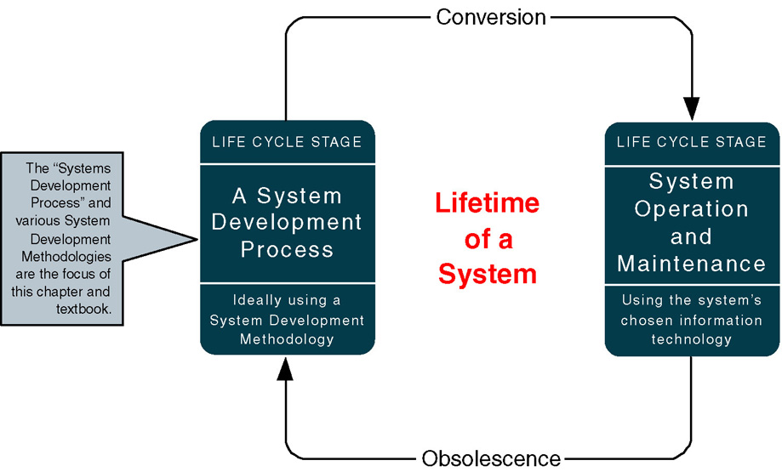
A System Life Cycle
Notes:
Teaching Notes
This slide formally differentiates between the life cycle and a systems development methodology that is used to execute the development stage of the life cycle.
A common synonym for “system operation” is “production.”

Slide 9
Representative System Development Methodologies
Architected Rapid Application Development (Architected RAD)
Dynamic Systems Development Methodology (DSDM)
Joint Application Development (JAD)
Information Engineering (IE)
Rapid Application Development (RAD)
Rational Unified Process (RUP)
Structured Analysis and Design
eXtreme Programming (XP)
Notes:
Teaching Notes
Structured Analysis and Design is old but still occasionally encountered
Note that many other commercial methodologies and software tools exist based on these general methodologies

Slide 10
Principles of System Development
Get the system users involved.
Use a problem-solving approach.
Establish phases and activities.
Document through development.
Establish standards.
Manage the process and the projects
Justify systems as capital investments.
Don’t be afraid to cancel or revise scope.
Divide and conquer.
Design systems for growth and change.
Notes:
Teaching Notes
Note that these principles apply regardless of which methodology is used.

Slide 11
Use a Problem-Solving Approach
Classical Problem-solving approach
  Study and understand the problem, its context, and its impact.
  Define the requirements that must be meet by any solution.
  Identify candidate solutions that fulfill the requirements, and select the “best” solution.
  Design and/or implement the chosen solution.
  Observe and evaluate the solution’s impact, and refine the solution accordingly.
Notes:
Teaching Notes
It can be useful to walk through a non-IS example of problem-solving, such as diagnosing a car problem or going to the restaurant because you are hungry.

Slide 12
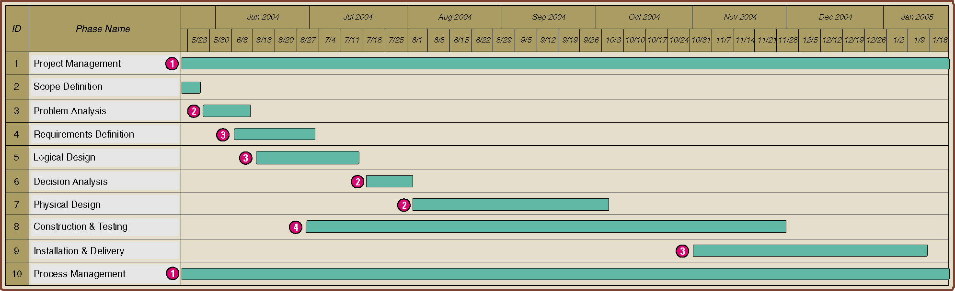
Establish Phases and Activities
Overlap of System Development Phases
Notes:
Teaching Notes
Every project is different depending on the size, complexity, and development methodology or route. The key point to emphasize in the figure is that the phases occur in parallel. It is important that students not misinterpret that the phases in this chapter are sequential.
Note that project and process management are illustrated as ongoing activities that last the duration of a project. (The next chapter will focus on project and process management as well as the construction and use of Gantt Charts such as the one above.)

Slide 13
Manage the Process and Projects
Process management – an ongoing activity that documents, manages, oversees the use of, and improves an organization’s chosen methodology (the “process”) for system development. Process management is concerned with phases, activities, deliverables, and quality standards should be consistently applied to all projects.
Project management is the process of scoping, planning, staffing, organizing, directing, and controlling a project to develop an information system at a minimum cost, within a specified time frame, and with acceptable quality.
Notes:
Teaching Notes
Most organizations pursuing the CMM are targeting Level 3, that is, consistently using a standardized process or methodology to develop all systems. CMM Level 2 deals with project management. CMM Level 3 deals with what has come to be known as process management.

Slide 14
Justify Information Systems as Capital Investments
Cost-effectiveness – The result obtained by striking a balance between the lifetime costs of developing, maintaining, and operating an information system and the benefits derived from that system. Cost-effectiveness is measured by a cost-benefit analysis.
Strategic information systems plan – a formal strategic plan (3-5 years) for building and improving an information technology infrastructure and the information system applications that use that infrastructure.
Strategic enterprise plan – a formal strategic plan (3-5 years) for an entire business that defines its mission, vision, goals, strategies, benchmarks, and measures of progress and achievement. Usually, the strategic enterprise plan is complemented by strategic business unit plans that define how each business unit will contribute to the enterprise plan. The information systems plan is one of those unit-level plans.
Notes:
Teaching Notes
The cost justification of system development projects is an ongoing activity. At any time during the process it could be discovered that the project no longer makes economic sense.

Slide 15
Don’t Be Afraid to Cancel or Revise Scope
Creeping commitment – a strategy in which feasibility and risks are continuously reevaluated throughout a project. Project budgets and deadlines are adjusted accordingly.
Risk management – the process of identifying, evaluating, and controlling what might go wrong in a project before it becomes a threat to the successful completion of the project or implementation of the information system. Risk management is drive by risk analysis or assessment.
Notes:
No additional notes.

Slide 16
Where Do Systems Development Projects Come From?
Problem – an undesirable situation that prevents the organization from fully achieving its purpose, goals, and/or objectives.
Opportunity – a chance to improve the organization even in the absence of an identified problem.
Directive - a new requirement that is imposed by management, government, or some external influence.
Notes:
Teaching Notes
Emphasize that problems, opportunities, and directives can either be planned or unplanned.

Slide 17
Where Do Systems Development Projects Come From?
Planned Projects
  An information systems strategy plan has examined the business as a whole to identify those system development projects that will return the greatest strategic (long-term) value to the business
  A business process redesign has thoroughly analyzed a series of business processes to eliminate redundancy and bureaucracy and to improve efficiency and value added. Not it is time to redesign the supporting information system for those redesigned business processes.
Notes:
No additional notes.

Slide 18
Where Do Systems Development Projects Come From?
Unplanned projects
  Triggered by a specific problem, opportunity, or directive that occurs in the course of doing business.
  Steering committee – an administrative body of system owners and information technology executives that prioritizes and approves candidate system development projects.
  Backlog – a repository of project proposals that cannot be funded or staffed because they are a lower priority than those that have been approved for system development.
Notes:
No additional notes.

Slide 19
The PIECES Problem-Solving Framework (Motivation)
P the need to improve performance
I the need to improve information (and data)
E the need to improve economics, control costs, or increase profits
C the need to improve control or security
E the need to improve efficiency of people and processes
S the need to improve service to customers, suppliers, partners, employees, etc.
Notes:
Teaching Notes
We really emphasize PIECES as a useful way to characterize all problems. Later, we teach our students to use PIECES to analyze requirements and solutions as well.
It can be useful to apply the PIECES framework to a project from the instructor’s professional background.
Refer to the figure in the text for the PIECES checklist.

Slide 20
Project Phases
FAST - (Framework for the Application of Systems Thinking ) a hypothetical methodology used throughout this book to demonstrate a representative systems development process.
Each methodology will use different project phases.
FAST Phases | Classic Phases (from Chapter 1)
 | Project Initiation | System Analysis | System Design | System Implementation
Scope Definition | X
Problem Analysis | X | X
Requirements Analysis |  | X
Logical Design |  | X
Decision Analysis | (a system analysis transition phase)
Physical Design and Integration |  |  | X
Construction and Testing |  |  | X | X
Installation and Delivery |  |  |  | X
Notes:
Conversion Notes
This is a new slide in the seventh edition
Teaching Notes
The classic SDLC phases were presented in chapter 1. Now we present the FAST phases. This switch often confuses students. FAST is taught for two reasons:
1. The classic SDLC phases are really two general for teaching.
2. FAST allows students to see a methodology in action.
It is important for students to see that FAST is a methodology and how it fits into the classic SDLC phases.

Slide 21
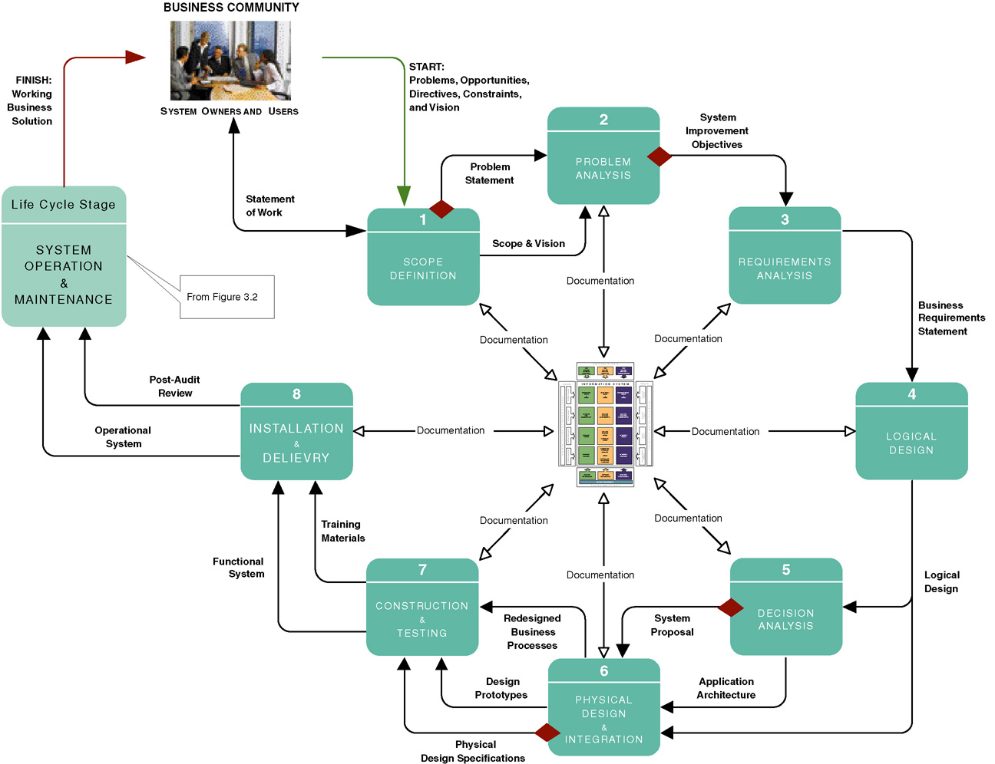
FAST Project Phases
Notes:
Teaching Notes
This is not meant to be interpreted as a “waterfall” model.
Make sure that the students recognize that this slide represents one methodology that the authors call FAST. There are many methodologies and variations on this slide.
Note that documentation goes on at every phase. These are the “deliverables” of the project.
The diamonds reflect typical “go” or “no go” feasibility checkpoints consistent with the creeping commitment philosophy.
At the center of the figure is the Building Blocks View of System Development, shown on the next slide.

Slide 22
Scope Definition Phase
Problem statement – a statement and categorization of problems, opportunities, and directives; may also include constraints and an initial vision for the solution. Synonyms include preliminary study and feasibility assessment.
Constraint – any factor, limitation, or restraint that may limit a solution or the problem-solving process.
Scope creep – a common phenomenon wherein the requirements and expectations of a project increase, often without regard to the impact on budget and schedule.
Statement of work – a contract with management and the user community to develop or enhance an information system; defines vision, scope, constraints, high-level user requirements, schedule, and budget. Synonyms include project charter, project plan, and service-level agreement.
Notes:
Teaching Notes
If any of these will be a later assignment, it can be helpful to make note of it.

Slide 23
Requirements Analysis Phase
What capabilities should the new system provide for its users?
What data must be captured and stored?
What performance level is expected?
What are the priorities of the various requirements?
Notes:
Conversion Notes
This slide is new in the seventh edition.

Slide 24
Logical Design Phase
Logical design – the translation of business user requirements into a system model that depicts only the business requirements and not any possible technical design or implementation of those requirements. Common synonyms include conceptual design and essential design.
System model – a picture of a system that represents reality or a desired reality. System models facilitate improved communication between system users, system analysts, system designers, and system builders.
Analysis paralysis – a satirical term coined to describe a common project condition in which excessive system modeling dramatically slows progress toward implementation of the intended system solution.
Notes:
Teaching Notes
After finishing this chapter, students are liable to think that this course is teaching "analysis paralysis," since their prior experience may consist of short programming assignments. But without the right amount of analysis you will never deliver what the users want and need.

Slide 25
Decision Analysis Phase
Candidate solutions evaluated in terms of:
  Technical feasibility – Is the solution technically practical? Does our staff have the technical expertise to design and build this solution?
  Operational feasibility – Will the solution fulfill the users’ requirements? To what degree? How will the solution change the users’ work environment? How do users feel about such a solution?
  Economic feasibility – Is the solution cost-effective?
  Schedule feasibility – Can the solution be designed and implemented within an acceptable time?
  Risk feasibility – What is the probability of a successful implementation using the technology and approach?
Notes:
Teaching Notes
These will be covered in detail in Chapter 11.

Slide 26
Physical Design & Integration Phase
Physical design – the translation of business user requirements into a system model that depicts a technical implementation of the users’ business requirements. Common synonyms include technical design or implementation model.
Two extreme philosophies of physical design
Design by specification – physical system models and detailed specification are produced as a series of written (or computer-generated) blueprints for construction.
Design by prototyping – Incomplete but functioning applications or subsystems (called prototypes) are constructed and refined based on feedback from users and other designers.
Notes:
No additional notes.

Slide 27
Construction and Testing Phase
Construct and test system components
  Software
    Purchased
    Custom-built
  Databases
  User and System Interfaces
  Hardware
  Networks
Notes:
Conversion Notes
This slide is new in the seventh edition.

Slide 28
Installation and Delivery Phase
Deliver the system into operation (production)
Deliver User training
Deliver completed documentation
Convert existing data
Notes:
Conversion Notes
This slide is new in the seventh edition.

Slide 29
System Operation & Maintenance
System support – the ongoing technical support for users of a system, as well as the maintenance required to deal with any errors, omissions, or new requirements that may arise.
Notes:
No additional notes.

Slide 30
Cross Life-Cycle Activities
Cross life-cycle activity – activities that overlap multiple phases
  Fact-finding - formal process of using research, interviews, meetings, questionnaires, sampling, and other techniques to collect information about system problems, requirements,and preferences.
  Documentation and presentation
    Documentation – recording facts and specifications for a systems for current and future reference.
    Presentation – communicating findings, recommendations, and documentation for review by interested users and mangers.
    Repository – database and/or file directory where system developers store all documentation, knowledge, and artifacts for information systems or project(s).
  Feasibility analysis
  Process and project management
Notes:
No additional notes.

Slide 31
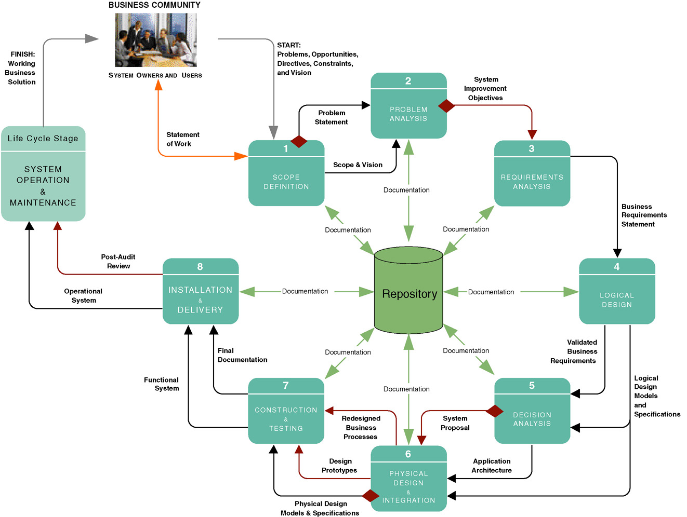
System Development Documentation, Repository, and Presentations
Notes:
Teaching Notes
Some instructors prefer the term “dictionary” or “encyclopedia” depending on what their CASE tool calls its repository.
The key point here is that system development documentation (“knowledge”) is shared via a repository as well as flowing between phases and people.

Slide 32
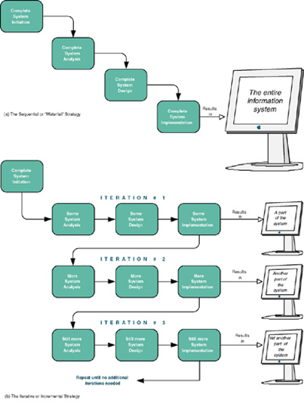
Sequential versus Iterative Development
Waterfall development approach an approach to systems analysis and design that completes each phase one after another and only once .
Iterative development approach an approach to systems analysis and design that completes the entire information system in successive iterations. Each iterations does some analysis, some design, and some construction. Synonyms include incremental and spiral.
Notes:
Conversion Notes
In the sixth edition this slide appeared in chapter 1. These concepts were moved here to better focus this chapter on methodologies.
Teaching Notes
Sequential processes are one alternative. This is often called a “waterfall development” process.
An iterative or incremental development process develops and placed into operation a portion of the new system as quickly as possible and then moves on to other parts of the system.
Consider asking students to come up with pros and cons of each approach. For instance, the iterative approach gives the users some of what they want much sooner than the sequential approach. But the sequential approach is less likely to require fixes and redesigns to what has previously been implemented.

Slide 33
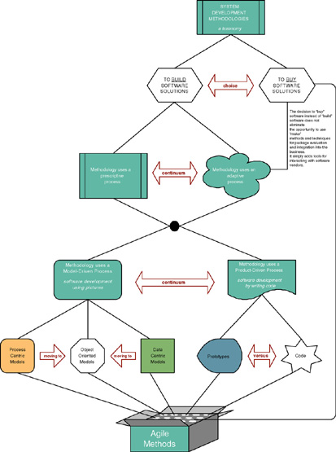
A Taxonomy for System Development Methodologies & Strategies
(p. 93)
Notes:
Teaching Notes
There can be multiple strategies or “routes” through the traditional phases. Thus, “one size does not fit all projects.”
We have included a few of the more common routes, but there are literally dozens of routes and hundreds of variations in many methodologies.
A key precept is that, contrary to popular marketing and consulting hype, the routes are merely different implementations of the same basic phases already covered (usually cleverly disguised in proprietary languages and terminology). Different routes emphasize different phases, tools, and techniques.

Slide 34
Model-Driven Development Strategy
Model-driven development – a system development strategy that emphasizes the drawing of system models to help visualize and analyze problems, define business requirements, and design information systems.
  Process modeling – a process-centered technique popularized by the structured analysis and design methodology that used models of business process requirements to derive effective software designs for a system.
  Data modeling – a data-centered technique used to model business data requirements and design database systems that fulfill those requirements.
  Object modeling – a technique that attempts to merge the data and process concerns into singular constructs called objects. Object models are diagrams that document a system in terms of its objects and their interactions.
Notes:
Teaching Notes
The model-driven “route” is most typically associated with “methodologies based on structured analysis and design, information engineering (data modeling), or object-oriented analysis and design (use-case, UML, etc.).
It was not the intent to teach the techniques in this chapter. That is why we elected not to include sample models that the students would not truly understand until they read the modeling chapters themselves.

Slide 35
Logical vs. Physical Models
Logical model - a pictorial representation that depicts what a system is or does.
Physical model - a technical pictorial representation that depicts what a system is or does and how the system is implemented.
Notes:
Conversion Notes
This slide is new to the seventh edition.
Teaching Notes
We always emphasize to students that logical models are built in the analysis phases while physical models are built in the design phases after the implementation architecture is selected.

Slide 36
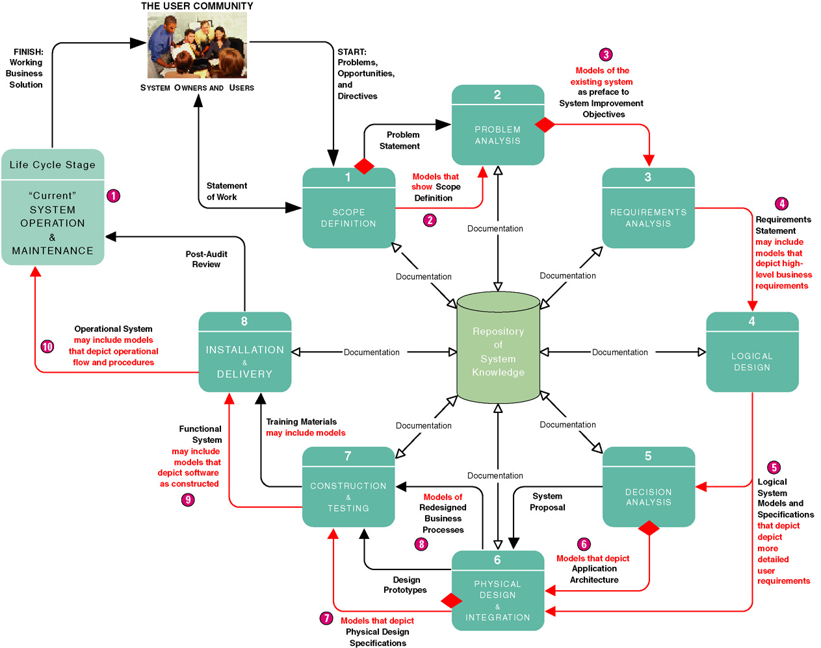
Model-Driven Development Strategy
Notes:
Teaching Notes
The model-driven approach (with the notable exception of OOAD) is most commonly associated with the “waterfall” approach to system development. While often criticized for its time and effort intensity, model-driven strategies still work well with large and unstructured problem domains.

Slide 37
Model-Driven Development Strategy
Advantages
Disadvantages
Requirements often more thorough
Easier to analyze alternatives
Design specifications often more stable and flexible
Systems can be constructed more correctly the first time
Time consuming
Models only as good as users' understanding of requirements
Reduces users' role because pictures are not software
Can be Inflexible
Notes:
Conversion Notes
This slide is new to the seventh edition.

Slide 38
Rapid Application Development Strategy
Rapid application development (RAD) – a system development strategy that emphasizes speed of development through extensive user involvement in the rapid, iterative, and incremental construction of series of functioning prototypes of a system that eventually evolves into the final system.
  Prototype – a small-scale, representative, or working model of the users’ requirements or a proposed design for an information system.
  Time box – the imposition of a non-extendable period of time, usually 60-90 days, by which the first (or next) version of a system must be delivered into operation.
Notes:
Teaching Notes
The rapid application development “route” is most typically associated with prototyping, JAD, and incremental or iterative approaches to system development.

Slide 39
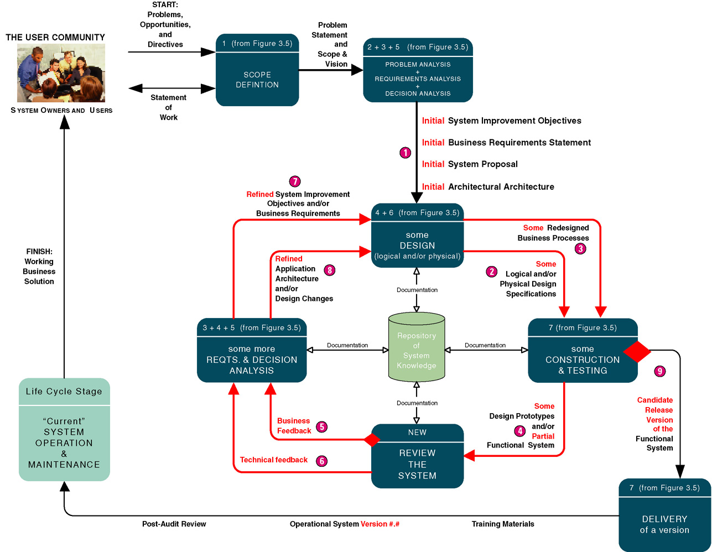
Rapid Application Development Strategy
Notes:
Teaching Notes
The rapid application development approach is most commonly associated with an incremental or iterative approach to system development. It is very popular for smaller and relatively structured projects in which requirements are fairly well understood from the beginning of the project.

Slide 40
Rapid Application Development Strategy
Advantages
Disadvantages
User requirements often uncertain or imprecise
Encourages active user and management participation
Projects get higher visibility and support
Stakeholders see working solutions more rapidly
Errors detected earlier
Testing and training are natural by-products
More natural process because change is expected
May encourage "code, implement, repair" mentality
Can solve wrong problem since problem analysis is abbreviated
May discourage analysts from considering alternatives
Stakeholders reluctant to throw away prototype
Emphasis on speed can adversely impact quality
Notes:
Conversion Notes
This slide is new to the seventh edition.

Slide 41
Commercial Application Package Implementation Strategy
Commercial application package – software application that can be purchased and customized to meet business requirements of a large number of organizations or specific industry. A synonym is commercial off-the-shelf (COTS) system.
  Request for proposal (RFP) – formal document that communicates business, technical, and support requirements for application software package to vendors that may wish to compete for the sale of application package and services.
  Request for quotation (RFQ) – formal document that communicates business, technical, and support requirements for an application software package to a single vendor that has been determined as being able to supply that application package and services.
  Gap analysis – comparison of business and technical requirements for a commercial application package against capabilities and features of a specific commercial application package to define requirements that cannot be met.
Notes:
Teaching Notes
COTS has become extraordinarily important to aspiring systems analysts because an ever-increasing percentage of all information systems are purchased, not built in-house.
Emphasize to students that tomorrow’s systems analysts will be as likely to participate in a software package selection and integration as they will in a traditional design-and-construction style project.

Slide 42
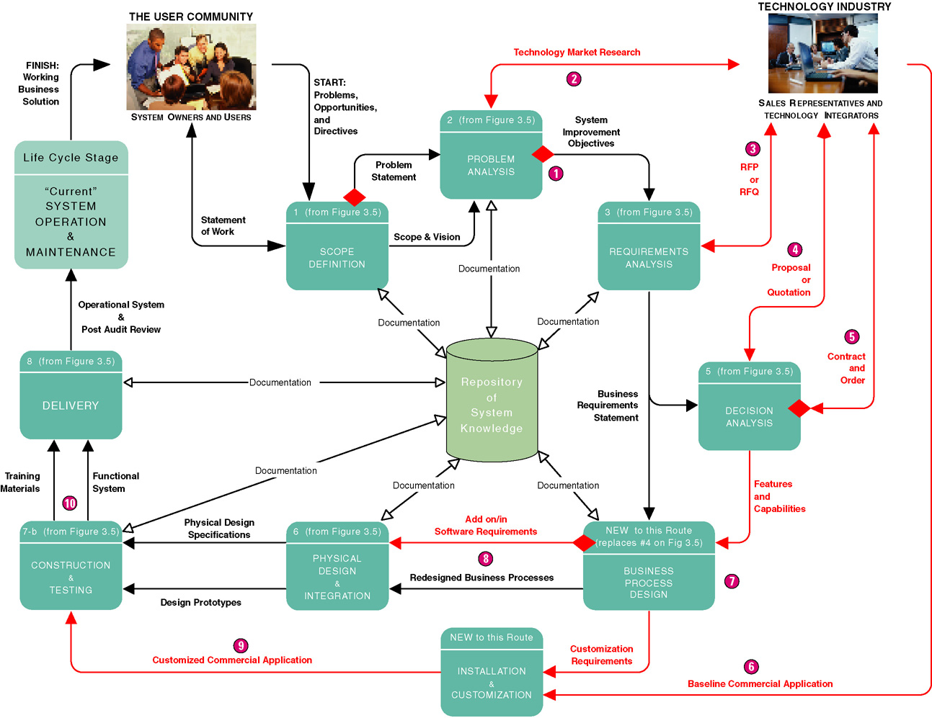
Commercial Application Package Implementation Strategy
Notes:
Teaching Notes
This slide depicts a typical project to select a software package and then integrate that package into a business (and its other existing information systems).
In the chapter, we specifically omitted ERP applications from this COTS route. ERP applications are so large and complex that their vendors typically provide a custom methodology (and consulting) to implement the ERP solution.
The COTS route looks more complex because few software packages fulfill 100 percent of an organizations requirements. Thus, a COTS project does not preclude traditional analysis, design, and construction activities to supplement capabilities not provided by the chosen software package.
Additionally, most software packages require customization that requires additional requirements analysis, design customization, and programming within the application’s embedded language.

Slide 43
Commercial Application Package Implementation Strategy
Advantages
Disadvantages
Systems usually implemented more quickly
Avoids staffing required to develop in-house solutions
Generally less expensive
Vendor assumes responsibility for improvements and corrections
Many business functions more similar than dissimilar for all businesses in a given industry
Dependent on long-term viability of vendor
Rarely reflects ideal solution
Often resistance to changes business processes to adapt to software
Notes:
Conversion Notes
This slide is new to the seventh edition.

Slide 44
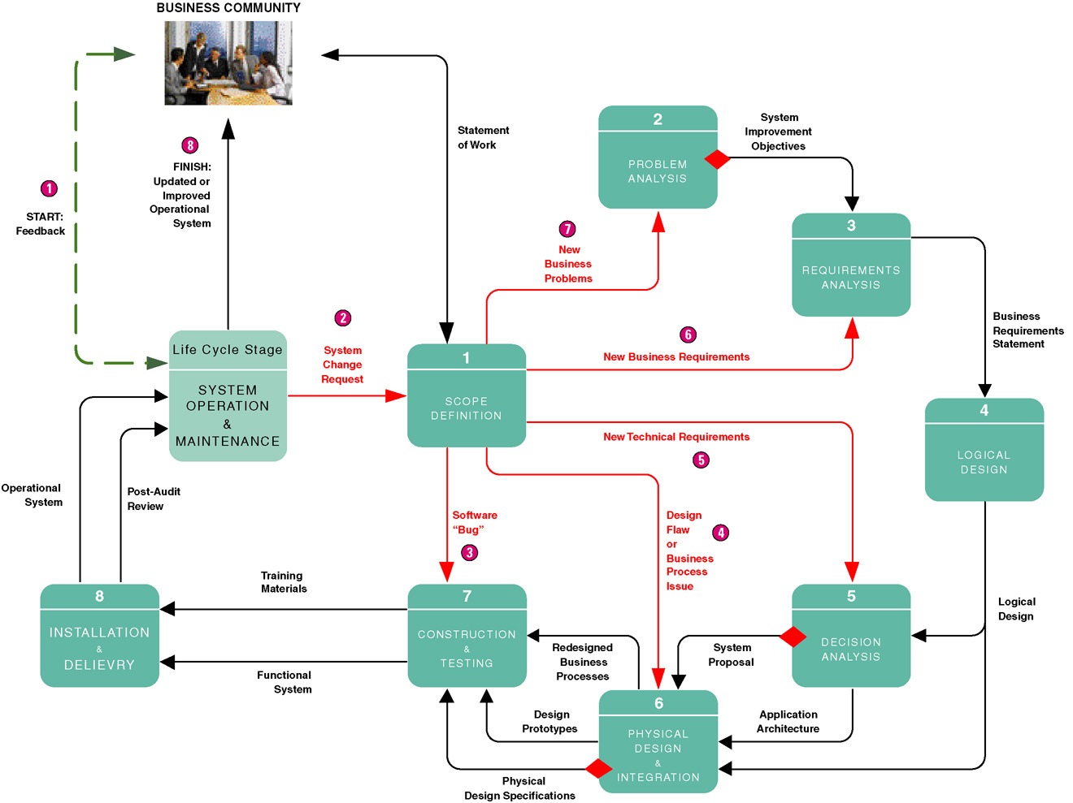
A System Maintenance Perspective
Notes:
Teaching Notes
The key point illustrated in this slide is that system maintenance is merely a smaller-scale version of the development methodology that was used to create a system in the first place.
Notice that maintenance and reengineering projects do not have to start in the same phase.
It is important to recognize that any given phase will not require the same amount of time in a maintenance and reengineering project as it would for a new system development project. Thus, any phase illustrated may require hours or days in maintenance and reengineering versus days, weeks, or months in a new system development project.

Slide 45
Automated Tools and Technology
Computer-aided systems engineering (CASE)
Application development environments (ADEs)
Process and project managers
Notes:
No additional notes.

Slide 46
Computer-Assisted Software Engineering (CASE)
Computer-aided systems engineering (CASE) –automated software tools that support the drawing and analysis of system models and associated specifications. Some CASE tools also provide prototyping and code generation capabilities.
  CASE repository – system developers’ database where developers can store system models, detailed descriptions and specifications, and other products of system development. Synonyms: dictionary and encyclopedia.
  Forward engineering – CASE tool capability that can generate initial software or database code directly from system.
  Reverse engineering – CASE tool capability that can generate initial system models from software or database code.
Notes:
Teaching Notes
Different CASE tools may refer to their repository as a dictionary or encyclopedia.
Some CASE tools maintain a repository at a project-by-project level. Others provide or integrate into a project-independent repository to promote sharing of models and specifications between projects.
Most CASE tools interface with one or more ADEs to provide round-trip engineering that supports the full life cycle.
If the students will be using a CASE tool during the semester, this would be a good time to introduce it.

Slide 47
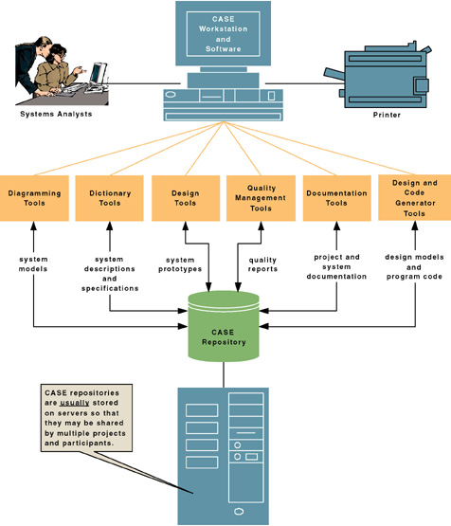
CASE Tool Architecture
Notes:
Teaching Notes
Map your course’s CASE (and ADE) environment into this diagram to help your students better understand the automated tools that will be taught in your course.

Slide 48
Application Development Environments
Application development environments (ADEs) – an integrated software development tool that provides all the facilities necessary to develop new application software with maximum speed and quality. A common synonym is integrated development environment (IDE)
  ADE facilities may include:
    Programming languages or interpreters
    Interface construction tools
    Middleware
    Testing tools
    Version control tools
    Help authoring tools
    Repository links
Notes:
Teaching Notes
ADE is compatible with both model-driven and rapid application development methodologies. In contemporary literature, it is the basis for all RAD methodologies.
Many ADEs provide links to a repository to support sharing of program code.
Most ADEs either interface with one or more CASE tool repositories or they provide rudimentary CASE-like modeling tools within the ADE. This allows developers to integrate RAD and MDD techniques as was demonstrated in the first hybrid route presented earlier in the chapter.

Slide 49
Process and Project Managers
Process manager application – an automated tool that helps document and manage a methodology and routes, its deliverables, and quality management standards. An emerging synonym is methodware.
Project manager application – an automated tool to help plan system development activities (preferably using the approved methodology), estimate and assign resources (including people and costs), schedule activities and resources, monitor progress against schedule and budget, control and modify schedule and resources, and report project progress.
Notes:
Teaching Notes
Examples of process and project management technology will be covered extensively in Chapter 4.

