Slide 1
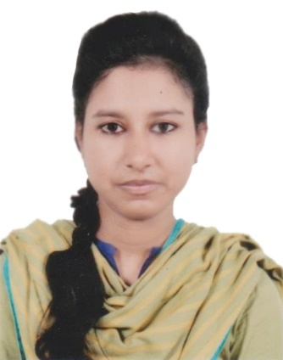



NOWSHIN
+8801789960465
ibnatkdb@gmail.com
Syeda Nowshin Ibnat soha
IBNAT
Education

