Slide 1

NOX UI
Technical Requirements Phase 1
V2.0 07/06/2023

Slide 2
Index
3: Form UI Components
3.1a: NoxTextInput: Overview
3.1b: NoxTextInput: Blazor Usage Example
3.1c: NoxTextInput: Nox.Solution.NoxSimpleTypeDefinition
3.1d: NoxTextInput: Nox.Types.TextTypeOptions
3.1e: NoxTextInput: Nox.Solution.TypeUserInterface
3.1f: NoxTextInput: Nox.Solution.TypeUserInterface.Widget
3.2a: NoxMoneyInput: Overview
3.2b: NoxMoneyInput : Blazor Usage Example
3.2c: NoxMoneyInput: Nox.Solution.NoxSimpleTypeDefinition
3.2d: NoxMoneyInput: Nox.Types.MoneyTypeOptions
3.2e: NoxMoneyInput: Nox.Solution.TypeUserInterface
3.2f: NoxMoneyInput: Nox.Solution.TypeUserInterface.Widget
3.3a: NoxNumberInput: Overview
3.3b: NoxNumberInput : Blazor Usage Example
3.3c: NoxNumberInput: Nox.Solution.NoxSimpleTypeDefinition
3.3d: NoxNumberInput: Nox.Types.NumberTypeOptions
3.3e: NoxNumberInput: Nox.Solution.TypeUserInterface
3.3f: NoxNumberInput: Nox.Solution.TypeUserInterface.Widget
3.4a: NoxCollectionSelectInput: Overview
3.4b: NoxCollectionSelectInput: Blazor Usage Example
3.4c: NoxCollectionSelectInput: Nox.Solution.NoxSimpleTypeDefinition
3.4d: NoxCollectionSelectInput: Nox.Types.CollectionSelectTypeOptions
3.4e: NoxCollectionSelectInput: Nox.Solution.TypeUserInterface
3.5a: NoxCheckboxInput: Overview
3.5b: NoxCheckboxInput: Blazor Usage Example
3.5c: NoxCheckboxInput: Nox.Solution.NoxSimpleTypeDefinition
3.5d: NoxCheckboxInput: Nox.Solution.TypeUserInterface
3.6a: NoxButtonInput: Overview
3.6b: NoxButtonInput : Blazor Usage Example
3.6c: NoxButtonInput: Nox.Solution.NoxSimpleTypeDefinition
3.6d: NoxButtonInput: Nox.Solution.TypeUserInterface
1.1 Summary
1.2 Historic Issues
1.3 Assumptions
2.1 Architecture Overview

Slide 3
1.1 Summary
This document is a technical requirement specification for the Nox.Ui.
Nox.Ui is a Ui helper library project that can be added to Blazor App projects and gives access to templated Ui components. This enables developers to quickly and safely create and release Blazor Apps that have standardised Ui layout, data management, logging and support out of the box. The Nox.Ui philosophy is to use default configuration driven templates attempting to remove as many of standard concerns a Blazor App developer would have as possible. This helps developers to focus on the overall user experience rather than specific data, custom handlers and releasing projects.
Although usually using defaulted templates optionally Nox.Ui also has the ability to display fully customised Ui layouts driven by configuration data.
Nox.Ui components can be grouped together or used singularly as templates.
Nox.Ui components should be data type and culture aware where possible ie: a Date input components will handle and display Date related data in the correct selected culture format.

Slide 4
1.2 Historic Issues
Inconsistent layouts and user experience
Expensive to refactor changes
Long lead time to implement changes
Examples
https://www.myregus.com/home
https://saleshub.iwgplc.com/
https://aca.acc.accesscontrolapp.com/centres

Slide 5
1.3 Assumptions
Using Blazor Server as App platform
Using Nox Library to help rapid and standardised App development
Primarily using 3rd party Blazor plugins where possible rather than creating custom components – ie: https://mudblazor.com/
Project development will use GitHub repository: https://github.com/NoxOrg
Ui is compatible with responsive mobile design – so that it can be displayed on desktop, tablet, mobile browsers.
Project is Unit tested where possible including Blazor HTML output testing where possible.

Slide 6
2: Architecture Overview

Slide 7
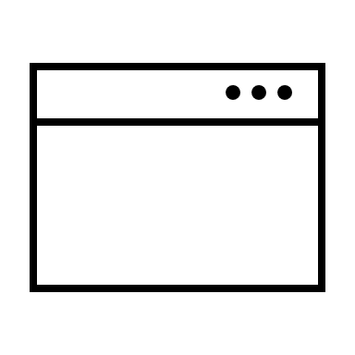



2.1: General Overview
(Optional) Blazor Project Design Folder
Configuration .yaml(s)
(mostly default if possible)
Browser Blazor App
Nox.Ui
Library DLL
(nuget package)
Nox.UI Control
Nox.Ui provides Blazor App with an embeddable Ui templated component
Each Ui component has a contract handling config, events and data
Each Ui component is driven by template yaml – mostly the associated yaml classes are NoxSimpleTypeDefinition, TypeOptions, UserInterface
Ui Control should handle required config, events, data, validation and translations

Slide 8
3: UI Components (based on Nox.Types)

Slide 9




3.1a: NoxTextInput: Overview
MudBlazor
NoxTextInput is a Nox.UI form component used to handle Text input.
NOTE:
It is primarily based on MudBlazor component textfield
For now CSS used is the default MudBlazor CSS
Generally if a component property is null then treat as display hidden – ie Icon = null means hide Icon
Any validations are triggered by OnChange event by default
(Non Focused: no entered value)
(Focused: entered value)
(Disabled: no entered value)

Slide 10
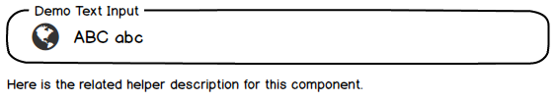
3.1b: NoxTextInput: Blazor Usage Example
MudBlazor
Property | Overridable | Mandatory | Default
Value | YES | NO | Null
Label | YES | NO | Null
Icon | YES | NO | Null
IconPosition | YES | NO | Begin
InputMask | YES | NO | Null
OutputMask | YES | NO | Null
Regex | YES | NO | Null
PageGroup | YES | NO | Null
FieldGroup | YES | NO | Null
InputOrder | YES | NO | Null
HelpHint | YES | NO | String.Empty
ErrorMessage | YES | NO | String.Empty
IsUnicode | YES | NO | True
MinLength | YES | NO | 0
MaxLength | YES | NO | 255
Casing | YES | NO | Normal
IsMultiline | YES | NO | False
IsRequired | YES | NO | False
IsReadonly | YES | NO | False
Event: OnClick | YES | NO | Null
Event: OnIconClick | YES | NO | Null
Event: OnChange | YES | NO | Null
(Example Blazor usage)
<NoxTextInput Value
="TextVar" Label="Demo Text Input" Icon="@Icons.Material.Filled.Globe" InputMask="C" HelpHint="Here is the related helper description for this component."/>
(Resulting example focused component)
(Notes)
Example TextVar input on the Value is of Nox.Types.Text
For now Icon references MudBlazor Icons or CSS Ref

Slide 11
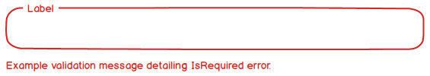
3.1c: NoxTextInput: Nox.Solution.NoxSimpleTypeDefinition
MudBlazor
Class | Property | Behaviour
NoxSimpleTypeDefinition | Description | Used as default TypeUserInterface.HelpHint text for component
NoxSimpleTypeDefinition | IsRequired | Determines whether component value is mandatory – should throw Validation value not set when component IsRequired = True
NoxSimpleTypeDefinition | IsReadOnly | Determines whether component input is allowed and used or if component has a read only display
NoxSimpleTypeDefinition | DefaultProperty | Used as default property if Nox.Types default property not set
(IsRequired validation thrown on component)

Slide 12


3.1d: NoxTextInput: Nox.Types.TextTypeOptions
MudBlazor
Class | Property | Behaviour
TextTypeOptions | MinLength | Minimum length in characters of input allowed – if less throw validation error
TextTypeOptions | MaxLength | Maximum length in characters of input allowed – any keystroke above MaxLength wont be entered into value of component
TextTypeOptions | IsUnicode | Allows component to accept Unicode characters otherwise ASCII only – if IsUnicode = false then Unicode keystrokes wont be entered into value of component
TextTypeOptions | Casing | Text Case – Enum TextTypeCasing (normal, lower, upper)
(MinLength(1), MaxLength(10) example)
(TextTypeCasing.upper example – default is TextTypeCasing.normal)

Slide 13


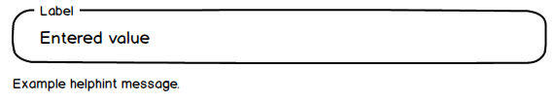
3.1e: NoxTextInput: Nox.Solution.TypeUserInterface
MudBlazor
Class | Property | Behaviour
TypeUserInterface | Label | Default Display Name of NoxTextInput component
TypeUserInterface | Icon | Icon name string Reference URI (usually CSS reference) – example using MudBlazor icons "@Icons.Material.Filled.Globe"
TypeUserInterface | IconPosition | Sets the position of the Icon in relation to the component. Enum IconPosition(Begin, End) default is Begin
TypeUserInterface | InputMask | Expression for controlling input – if input incorrect ignore input: ref: control-data-entry-formats-with-input-masks
TypeUserInterface | OutputMask | Expression for controlling output – if output incorrect throw validation error
TypeUserInterface | Regex | Expression for validating output value ref: regular-expression-language-quick-reference
TypeUserInterface | PageGroup | Used to associate component with a PageGroup ID
TypeUserInterface | FieldGroup | Used to associate component with a FieldGroup ID
TypeUserInterface | InputOrder | Used to define the sequentially focusable Tab Order of a UI component within a FieldGroup
TypeUserInterface | HelpHint | Used as default helper text for component to aid user understand the component function
TypeUserInterface | ErrorMessage | Used as default error message when validation event is thrown
(Label)
(Icon)
(InputMask(example 'C' = Characters & Spaces only), OutputMask('C'))
(HelpHint example)

Slide 14
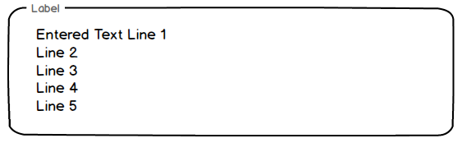
3.1f: NoxTextInput: Nox.Solution.TypeUserInterface.Widget
MudBlazor
Class | Property | Behaviour
Widget | IsMultiline | Enables component to handle multiline text input
(IsMultiline example)

Slide 15




3.2a: NoxMoneyInput: Overview
MudBlazor
NoxMoneyInput is a Nox.UI form component used to handle and display Money input.
NOTE:
It is primarily based on MudBlazor component numeric field
For now CSS used is the default MudBlazor CSS
Generally if a component property is null then treat as display hidden – ie Icon = null means hide Icon
Any validations are triggered by OnChange event by default
(Non Focused: no entered value)
(Focused: entered value)
(Disabled: no entered value)

Slide 16
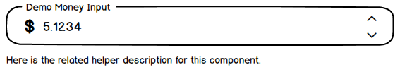
3.2b: NoxMoneyInput : Blazor Usage Example
MudBlazor
Property | Overridable | Mandatory | Default
Value | YES | NO | Null
Label | YES | NO | Null
Icon | YES | NO | CurrencyCode.Symbol CHECK
IconPosition | YES | NO | Begin
InputMask | YES | NO | Null
OutputMask | YES | NO | Null
Regex | YES | NO | Null
PageGroup | YES | NO | Null
FieldGroup | YES | NO | Null
InputOrder | YES | NO | Null
HelpHint | YES | NO | String.Empty
ErrorMessage | YES | NO | String.Empty
IsRequired | YES | NO | False
IsReadonly | YES | NO | False
DecimalDigits | YES | NO | 0
MinValue | YES | NO | -999999999
MaxValue | YES | NO | 999999999
IncrementValue | YES | NO | 0
Event: OnClick | YES | NO | Null
Event: OnIconClick | YES | NO | Null
Event: OnChange | YES | NO | Null
(Example Blazor usage)
<NoxMoneyInput Value
="MoneyVar" Label="Demo Money Input" HelpHint="Here is the related helper description for this component."/>
(Resulting example focused component – default Currency.USD)
(Notes)
Example MoneyVar input on the Value is of Nox.Types.Money

Slide 17
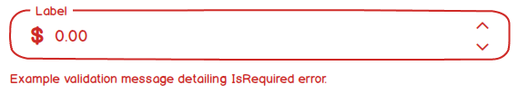
3.2c: NoxMoneyInput: Nox.Solution.NoxSimpleTypeDefinition
MudBlazor
Class | Property | Behaviour
NoxSimpleTypeDefinition | Description | Used as default TypeUserInterface.HelpHint text for component
NoxSimpleTypeDefinition | IsRequired | Determines whether component value is mandatory – should throw Validation value not set when component IsRequired = True
NoxSimpleTypeDefinition | IsReadOnly | Determines whether component input is allowed and used or if component has a read only display
NoxSimpleTypeDefinition | DefaultProperty | Used as default property if Nox.Types default property not set
(IsRequired validation thrown on component)

Slide 18


3.2d: NoxMoneyInput: Nox.Types.MoneyTypeOptions
MudBlazor
Class | Property | Behaviour
MoneyTypeOptions | MinValue | Minimum number value of component – can be below zero – any input below MinValue is ignored
MoneyTypeOptions | MaxValue | Maximum number value of component - can be below zero – any input above MaxValue is ignored
MoneyTypeOptions | DecimalDigits | Amount of digits before the decimal place
(DecimalDigits(4), IntegerDigits(9) example)
(Default Currency USD example)

Slide 19
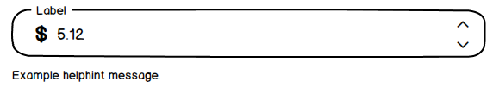
3.2e: NoxMoneyInput: Nox.Solution.TypeUserInterface
MudBlazor
Class | Property | Behaviour
TypeUserInterface | Label | Default Display Name of NoxTextInput component
TypeUserInterface | Icon | Icon name string Reference URI (usually CSS reference) – example using MudBlazor icons "@Icons.Material.Filled.Globe"
TypeUserInterface | IconPosition | Sets the position of the Icon in relation to the component. Enum IconPosition(Begin, End) default is Begin
TypeUserInterface | InputMask | Expression for controlling input – if input incorrect ignore input: ref: control-data-entry-formats-with-input-masks
TypeUserInterface | OutputMask | Expression for controlling output – if output incorrect throw validation error
TypeUserInterface | Regex | Expression for validating output value –ref: regular-expression-language-quick-reference
TypeUserInterface | PageGroup | Used to associate component with a PageGroup ID
TypeUserInterface | FieldGroup | Used to associate component with a FieldGroup ID
TypeUserInterface | InputOrder | Used to define the sequentially focusable Tab Order of a UI component within a FieldGroup
TypeUserInterface | HelpHint | Used as default helper text for component to aid user understand the component function
TypeUserInterface | ErrorMessage | Used as default error message when validation event is thrown
(Label + Default Icon (Currency Symbol))
(HelpHint example)
(ErrorMessage example)

Slide 20
3.2f: NoxMoneyInput: Nox.Solution.TypeUserInterface.Widget
MudBlazor
Class | Property | Behaviour
Widget | IncrementValue | Sets in Nox.Type.Number Increase/Decrease Incremental button action amount – if IncrementValue is zero then no need to display Incremental buttons on component

Slide 21



3.3a: NoxNumberInput: Overview
MudBlazor
NoxNumberInput is a Nox.UI form component used to handle and display numerical input.
NOTE:
It is primarily based on MudBlazor component numeric field
For now CSS used is the default MudBlazor CSS
Generally if a component property is null then treat as display hidden – ie Icon = null means hide Icon
Any validations are triggered by OnChange event by default
(Non Focused: no entered value)
(Focused: entered value)
(Disabled: no entered value)

Slide 22
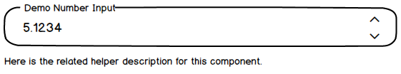
3.3b: NoxNumberInput : Blazor Usage Example
MudBlazor
Property | Overridable | Mandatory | Default
Value | YES | NO | Null
Label | YES | NO | Null
Icon | YES | NO | Null
IconPosition | YES | NO | Begin
InputMask | YES | NO | Null
OutputMask | YES | NO | Null
Regex | YES | NO | Null
PageGroup | YES | NO | Null
FieldGroup | YES | NO | Null
InputOrder | YES | NO | Null
HelpHint | YES | NO | String.Empty
ErrorMessage | YES | NO | String.Empty
IsRequired | YES | NO | False
IsReadonly | YES | NO | False
DecimalDigits | YES | NO | 0
MinValue | YES | NO | -999999999
MaxValue | YES | NO | 999999999
IncrementValue | YES | NO | 0
Event: OnClick | YES | NO | Null
Event: OnIconClick | YES | NO | Null
Event: OnChange | YES | NO | Null
(Example Blazor usage)
<NoxNumberInput Value
="NumberVar" Label="Demo Number Input" HelpHint="Here is the related helper description for this component."/>
(Resulting example focused component)
(Notes)
Example NumberVar input on the Value is of Nox.Types.Number

Slide 23
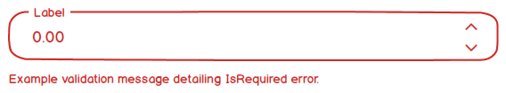
3.3c: NoxNumberInput: Nox.Solution.NoxSimpleTypeDefinition
MudBlazor
Class | Property | Behaviour
NoxSimpleTypeDefinition | Description | Used as default TypeUserInterface.HelpHint text for component
NoxSimpleTypeDefinition | IsRequired | Determines whether component value is mandatory – should throw Validation value not set when component IsRequired = True
NoxSimpleTypeDefinition | IsReadOnly | Determines whether component input is allowed and used or if component has a read only display
NoxSimpleTypeDefinition | DefaultProperty | Used as default property if Nox.Types default property not set
(IsRequired validation thrown on component)

Slide 24

3.3d: NoxNumberInput: Nox.Types.NumberTypeOptions
MudBlazor
Class | Property | Behaviour
NumberTypeOptions | MinValue | Minimum number value of component – can be below zero – any input below MinValue is ignored
NumberTypeOptions | MaxValue | Maximum number value of component - can be below zero – any input above MaxValue is ignored
NumberTypeOptions | DecimalDigits | Amount of digits before the decimal place
(DecimalDigits(4), IntegerDigits(9) example)

Slide 25


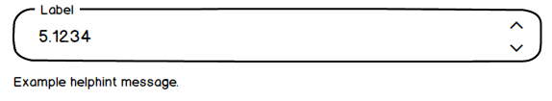
3.3e: NoxNumberInput: Nox.Solution.TypeUserInterface
MudBlazor
Class | Property | Behaviour
TypeUserInterface | Label | Default Display Name of NoxTextInput component
TypeUserInterface | Icon | Icon name string Reference URI (usually CSS reference) – example using MudBlazor icons "@Icons.Material.Filled.Globe"
TypeUserInterface | IconPosition | Sets the position of the Icon in relation to the component. Enum IconPosition(Begin, End) default is Begin
TypeUserInterface | InputMask | Expression for controlling input – if input incorrect ignore input: ref: control-data-entry-formats-with-input-masks
TypeUserInterface | OutputMask | Expression for controlling output – if output incorrect throw validation error
TypeUserInterface | Regex | Expression for validating output value –ref: regular-expression-language-quick-reference
TypeUserInterface | PageGroup | Used to associate component with a PageGroup ID
TypeUserInterface | FieldGroup | Used to associate component with a FieldGroup ID
TypeUserInterface | InputOrder | Used to define the sequentially focusable Tab Order of a UI component within a FieldGroup
TypeUserInterface | HelpHint | Used as default helper text for component to aid user understand the component function
TypeUserInterface | ErrorMessage | Used as default error message when validation event is thrown
(Label)
(Icon)
(HelpHint example)
(ErrorMessage example)

Slide 26
3.3f: NoxNumberInput: Nox.Solution.TypeUserInterface.Widget
MudBlazor
Class | Property | Behaviour
Widget | IncrementValue | Sets in Nox.Type.Number Increase/Decrease Incremental button action amount – if IncrementValue is zero then no need to display Incremental buttons on component

Slide 27

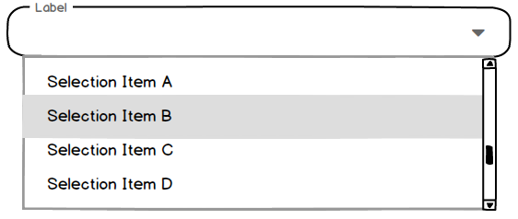


3.4a: NoxCollectionSelectInput: Overview
MudBlazor
NoxCollectionSelectInput is a Nox.UI form component used to handle, select and display list input.
NOTE:
It is primarily based on MudBlazor component select field
For now CSS used is the default MudBlazor CSS
Generally if a component property is null then treat as display hidden – ie Icon = null means hide Icon
This component handles single description and reference selection from a collection.
When item is selected the component displays a cross to clear selection.
Any validations are triggered by OnChange event by default
(Non Focused: no entered value)
(Focused: Selecting value)
(Focused: Post Selection - Selected value)
(Disabled: no entered value)

Slide 28

3.4b: NoxCollectionSelectInput: Blazor Usage Example
MudBlazor
Property | Overridable | Mandatory | Default
Value | YES | NO | Null
Label | YES | NO | Null
Icon | YES | NO | Null
IconPosition | YES | NO | Begin
InputMask | YES | NO | Null
OutputMask | YES | NO | Null
Regex | YES | NO | Null
PageGroup | YES | NO | Null
FieldGroup | YES | NO | Null
InputOrder | YES | NO | Null
HelpHint | YES | NO | String.Empty
ErrorMessage | YES | NO | String.Empty
IsRequired | YES | NO | False
IsReadonly | YES | NO | False
IsUnicode | YES | NO | True
Casing | YES | NO | Normal
Event: OnClick | YES | NO | Null
Event: OnIconClick | YES | NO | Null
Event: OnChange | YES | NO | Null
(Example Blazor usage)
<NoxCollectionSelectInput Value
="Collection<(Ref,Description)>" Label="Demo Collection Select Input" HelpHint="Here is the related helper description for this component."/>
(Resulting example focused component)

Slide 29

3.4c: NoxCollectionSelectInput: Nox.Solution.NoxSimpleTypeDefinition
MudBlazor
Class | Property | Behaviour
NoxSimpleTypeDefinition | Description | Used as default TypeUserInterface.HelpHint text for component
NoxSimpleTypeDefinition | IsRequired | Determines whether component value is mandatory – should throw Validation value not set when component IsRequired = True
NoxSimpleTypeDefinition | IsReadOnly | Determines whether component input is allowed and used or if component has a read only display
NoxSimpleTypeDefinition | DefaultProperty | Used as default property if Nox.Types default property not set
(IsRequired validation thrown on component)

Slide 30
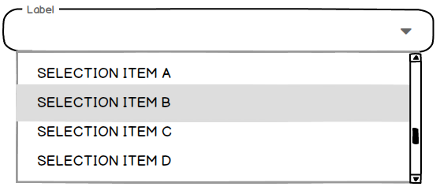

3.4d: NoxCollectionSelectInput: Nox.Types.CollectionSelectTypeOptions
MudBlazor
Class | Property | Behaviour
TextTypeOptions | IsUnicode | Allows component to accept Unicode characters otherwise ASCII only – if IsUnicode = false then Unicode keystrokes wont be entered into value of component
TextTypeOptions | Casing | Text Case – Enum TextTypeCasing (normal, lower, upper)
(TextTypeCasing.upper example – default is TextTypeCasing.normal)

Slide 31


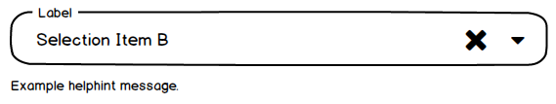
3.4e: NoxCollectionSelectInput: Nox.Solution.TypeUserInterface
MudBlazor
Class | Property | Behaviour
TypeUserInterface | Label | Default Display Name of NoxTextInput component
TypeUserInterface | Icon | Icon name string Reference URI (usually CSS reference) – example using MudBlazor icons "@Icons.Material.Filled.Globe"
TypeUserInterface | IconPosition | Sets the position of the Icon in relation to the component. Enum IconPosition(Begin, End) default is Begin
TypeUserInterface | PageGroup | Used to associate component with a PageGroup ID
TypeUserInterface | FieldGroup | Used to associate component with a FieldGroup ID
TypeUserInterface | InputOrder | Used to define the sequentially focusable Tab Order of a UI component within a FieldGroup
TypeUserInterface | HelpHint | Used as default helper text for component to aid user understand the component function
TypeUserInterface | ErrorMessage | Used as default error message when validation event is thrown
(Label)
(Icon)
(HelpHint example)
(ErrorMessage example)

Slide 32



3.5a: NoxCheckboxInput: Overview
MudBlazor
NoxCheckboxInput is a Nox.UI form component used to handle boolean input.
NOTE:
It is primarily based on MudBlazor component checkbox field
For now CSS used is the default MudBlazor CSS
Generally if a component property is null then treat as display hidden – ie Icon = null means hide Icon
Any validations are triggered by OnChange event by default
(Non Focused: no entered value)
(Focused: entered value)
(Disabled: no entered value)

Slide 33

3.5b: NoxCheckboxInput: Blazor Usage Example
MudBlazor
Property | Overridable | Mandatory | Default
Value | YES | NO | Null
Label | YES | NO | Null
Icon | YES | NO | Null
IconPosition | YES | NO | Begin
PageGroup | YES | NO | Null
FieldGroup | YES | NO | Null
InputOrder | YES | NO | Null
HelpHint | YES | NO | String.Empty
ErrorMessage | YES | NO | String.Empty
IsRequired | YES | NO | False
IsReadonly | YES | NO | False
Event: OnClick | YES | NO | Null
Event: OnIconClick | YES | NO | Null
Event: OnChange | YES | NO | Null
(Example Blazor usage)
<NoxCheckboxInput Value="BooleanVar" Label="Demo Checkbox Input" HelpHint="Here is the related helper description for this component."/>
(Resulting example focused component)
(Notes)
Example BooleanVar input on the Value is of Nox.Types.Boolean -TBC

Slide 34
3.5c: NoxCheckboxInput: Nox.Solution.NoxSimpleTypeDefinition
MudBlazor
Class | Property | Behaviour
NoxSimpleTypeDefinition | Description | Used as default TypeUserInterface.HelpHint text for component
NoxSimpleTypeDefinition | IsReadOnly | Determines whether component input is allowed and used or if component has a read only display
NoxSimpleTypeDefinition | DefaultProperty | Used as default property if Nox.Types default property not set

Slide 35



3.5d: NoxCheckboxInput: Nox.Solution.TypeUserInterface
MudBlazor
Class | Property | Behaviour
TypeUserInterface | Label | Default Display Name of NoxTextInput component
TypeUserInterface | Icon | Icon name string Reference URI (usually CSS reference) – example using MudBlazor icons "@Icons.Material.Filled.Globe"
TypeUserInterface | IconPosition | Sets the position of the Icon in relation to the component. Enum IconPosition(Begin, End) default is Begin
TypeUserInterface | PageGroup | Used to associate component with a PageGroup ID
TypeUserInterface | FieldGroup | Used to associate component with a FieldGroup ID
TypeUserInterface | InputOrder | Used to define the sequentially focusable Tab Order of a UI component within a FieldGroup
TypeUserInterface | HelpHint | Used as default helper text for component to aid user understand the component function
TypeUserInterface | ErrorMessage | Used as default error message when validation event is thrown
(Label)
(Icon)
(HelpHint example)
(ErrorMessage example)

Slide 36



3.6a: NoxButtonInput: Overview
MudBlazor
NoxButtonInput is a Nox.UI form component used to handle button action input.
NOTE:
It is primarily based on MudBlazor component button
For now CSS used is the default MudBlazor CSS
Generally if a component property is null then treat as display hidden – ie Icon = null means hide Icon
(Focused)
(Hover)
(Disabled)

Slide 37

3.6b: NoxButtonInput : Blazor Usage Example
MudBlazor
Property | Overridable | Mandatory | Default
Label | YES | NO | Null
Icon | YES | NO | Null
IconPosition | YES | NO | Begin
PageGroup | YES | NO | Null
FieldGroup | YES | NO | Null
InputOrder | YES | NO | Null
HelpHint | YES | NO | String.Empty
ErrorMessage | YES | NO | String.Empty
Event: OnClick | YES | NO | Null
(Example Blazor usage)
<NoxButtonInput Label="Demo Button Input" HelpHint="Here is the related helper description for this component." OnClick="@EventClickHandler"/>
(Resulting example focused component)

Slide 38
3.6c: NoxButtonInput: Nox.Solution.NoxSimpleTypeDefinition
MudBlazor
Class | Property | Behaviour
NoxSimpleTypeDefinition | Description | Used as default TypeUserInterface.HelpHint text for component

Slide 39



3.6d: NoxButtonInput: Nox.Solution.TypeUserInterface
MudBlazor
Class | Property | Behaviour
TypeUserInterface | Label | Default Display Name of NoxTextInput component
TypeUserInterface | Icon | Icon name string Reference URI (usually CSS reference) – example using MudBlazor icons "@Icons.Material.Filled.Globe"
TypeUserInterface | IconPosition | Sets the position of the Icon in relation to the component. Enum IconPosition(Begin, End) default is Begin
TypeUserInterface | PageGroup | Used to associate component with a PageGroup ID
TypeUserInterface | FieldGroup | Used to associate component with a FieldGroup ID
TypeUserInterface | InputOrder | Used to define the sequentially focusable Tab Order of a UI component within a FieldGroup
TypeUserInterface | HelpHint | Used as default helper text for component to aid user understand the component function
TypeUserInterface | ErrorMessage | Used as default error message when validation event is thrown
(Label)
(Icon)
(HelpHint example)
(ErrorMessage example)

