Slide 1
1: Nox.Type Simple UI Components

Slide 2

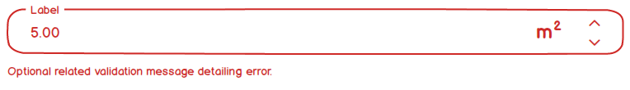
Nox.Types.Area
MudBlazor
(Non Focused: no entered value)
(Focused: entered value)
(Disabled)
(Validation Thrown)

Slide 3
Nox.Types.AutoNumber
(UI Not Required - TBC)

Slide 4



Nox.Types.SingleSwitch:Boolean
MudBlazor
(Normal Switch - OFF)
(Normal Switch - ON)
(Normal Switch Disable)

Slide 5



Nox.Types.Checkbox:Boolean
MudBlazor
(Normal Checked)
(Normal Unchecked)
(Disabled)

Slide 6


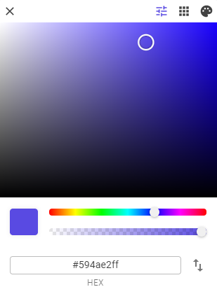
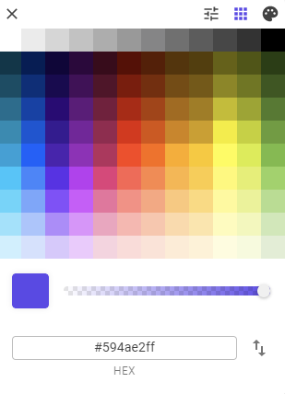
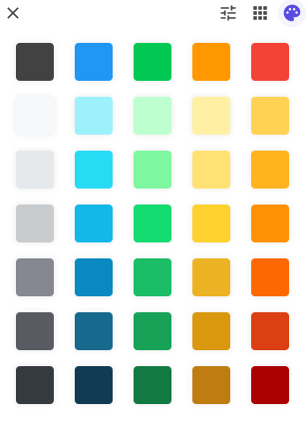

Nox.Types.Color or Nox.Types.Colour
MudBlazor
(Non Focused: no entered value)
(Colour Picker Selected – 3 types)
(Focused: entered value HEX)
(Disabled)
(Colour Selector)
(Web Safe Colour Selector)
(Custom Palette Selector)

Slide 7
Nox.Types.CurrencyCode
(UI Not Required - TBC)

Slide 8
Nox.Types.CurrencyNumber
(UI Not Required - TBC)

Slide 9
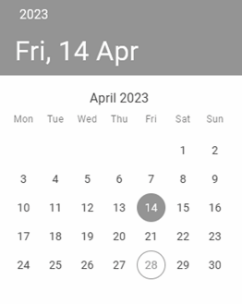
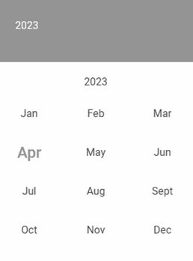
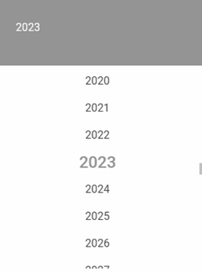
Nox.Types.Date
MudBlazor
(Non Focused: no entered value)
(Focused Selected Date)
(Day (+Today) Selection Overlay)
(Month Selection Overlay)
(Year Selection Overlay)

Slide 10



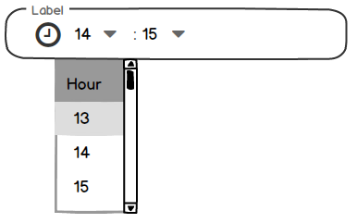
Nox.Types.Time
MudBlazor
(Non Focused: no entered value)
(Focused Selecting Time AM/PM
(Focused Selecting Time 24HR
(Time Selection Dropdown Example)

Slide 11

Nox.Types.Distance or Nox.Types.Length
MudBlazor
(Non Focused: no entered value)
(Focused: entered value)
(Disabled)
(Validation Thrown)

Slide 12
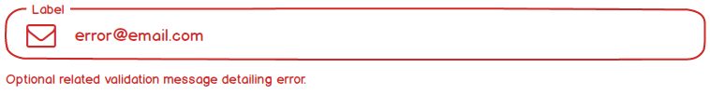
Nox.Types.Email
MudBlazor
(Non Focused: no entered value)
(Focused: entered value)
(Disabled)
(Validation Thrown)

Slide 13
Nox.Types.EncryptedText
(UI Not Required - TBC)

Slide 14
Nox.Types.Formula
(UI Not Required - TBC)

Slide 15
Nox.Types.Guid (Nuid)
(UI Not Required - TBC)

Slide 16
Nox.Types.HashedText or Nox.Types.Password
MudBlazor
(Password Hidden)
(Password Shown)

Slide 17
Nox.Types.Html
(UI Not Required - TBC)

Slide 18

Nox.Types.InternetDomain or Nox.Types.Uri or Nox.Types.Url
MudBlazor
(Non Focused: no entered value)
(Focused: entered value)
(Disabled)
(Validation Thrown)

Slide 19


Nox.Types.IpAddress
MudBlazor
(Non Focused: no entered value)
(Focused: entered value)
(Disabled)
(Validation Thrown)

Slide 20
Nox.Types.Json
(UI Not Required - TBC)

Slide 21
Nox.Types.JwtToken
(UI Not Required - TBC)

Slide 22

Nox.Types.MacAddress
MudBlazor
(Non Focused: no entered value)
(Focused: entered value)
(Disabled)
(Validation Thrown)

Slide 23
Nox.Types.Markdown
(UI Not Required - TBC)

Slide 24
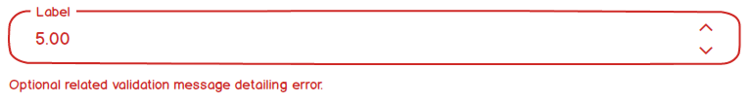
Nox.Types.Number
MudBlazor
(Non Focused: no entered value)
(Focused: entered value)
(Disabled)
(Validation Thrown)

Slide 25

Nox.Types.Percentage
MudBlazor
(Non Focused: no entered value)
(Focused: entered value)
(Disabled)
(Validation Thrown)

Slide 26
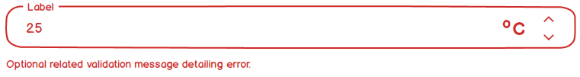
Nox.Types.Temperature
MudBlazor
(Non Focused: no entered value)
(Focused: entered value)
(Disabled)
(Validation Thrown)

Slide 27
Nox.Types.Text
MudBlazor
(Non Focused: no entered value)
(Focused: entered value)
(Disabled: no entered value)
(Disabled: entered value)

Slide 28
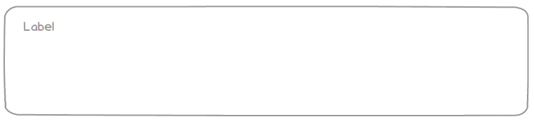
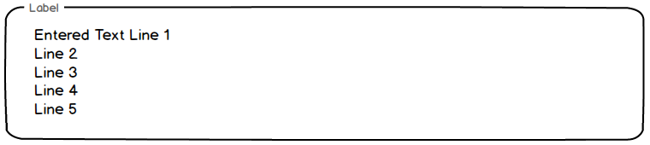
Nox.Types.MultilineText:Text
MudBlazor
(Non Focused: no entered text)
(Focused: entered text)

Slide 29

Nox.Types.User
MudBlazor
(Non Focused Display)

Slide 30

Nox.Types.Weight
MudBlazor
(Non Focused: no entered value)
(Focused: entered value)
(Disabled)
(Validation Thrown)

Slide 31
Nox.Types.Yaml
(UI Not Required - TBC)

Slide 32
2: Nox.Type Complex UI Components

Slide 33



Nox.Type.ValueSwitch: Nox.Types.Array<Ref,Description>
MudBlazor
(Value Selection Type Switch – ValueA selected)
(Value Selection Type Switch – ValueB selected)
(Value Selection Type Switch Disabled)

Slide 34



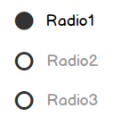
Nox.Type.RadioGroup: Nox.Types.Array<Ref,Description>
MudBlazor
(Normal)
(Disabled)
(Hover Example)
(Vertical Orientation)

Slide 35
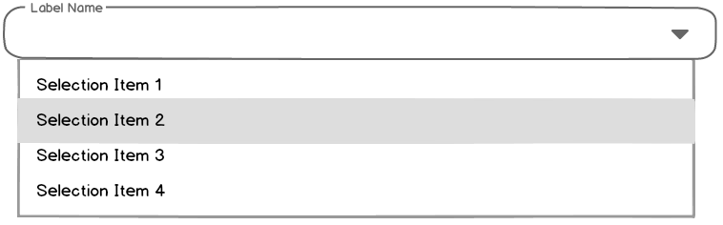
Nox.Type.CollectionSelect: Nox.Types.Array<Ref,Description>
MudBlazor
(Non Focused)
(Focused Selecting Item)
(Focused Item Selected)

Slide 36
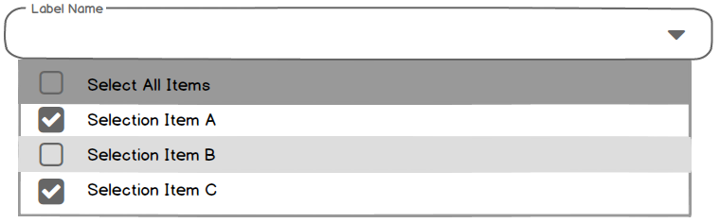
Nox.Type.CollectionMultiSelect: Nox.Types.Array<Ref,Description>
MudBlazor
(Non Focused)
(Focused Selecting Item)
(Focused Item Selected)

Slide 37
3: Nox.Type Compound UI Components

Slide 38


Nox.Types.Area2D:Area
MudBlazor
(Non Focused: no entered value)
(Focused: entered value)
(Disabled)
(Validation Thrown)

Slide 39
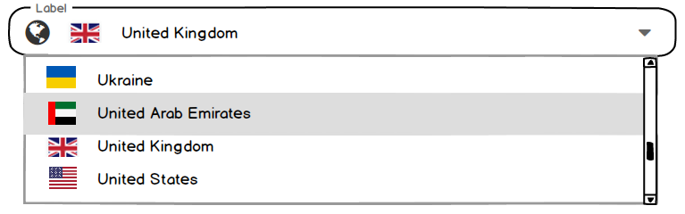
Nox.Types.CountryCode2 or Nox.Types.CountryCode3 or Nox.Types.CountryNumber
MudBlazor
(Non Focused: no entered value)
(Disabled)
(Selection)
(Focused: Selected value)

Slide 40
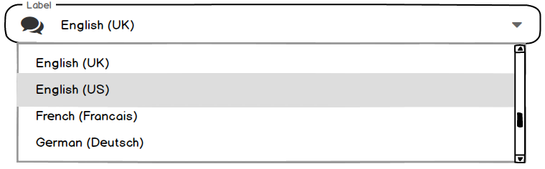
Nox.Types.Culture or Nox.Types.Language
MudBlazor
(Non Focused: no entered value)
(Disabled)
(Selection)
(Focused: Selected value)

Slide 41
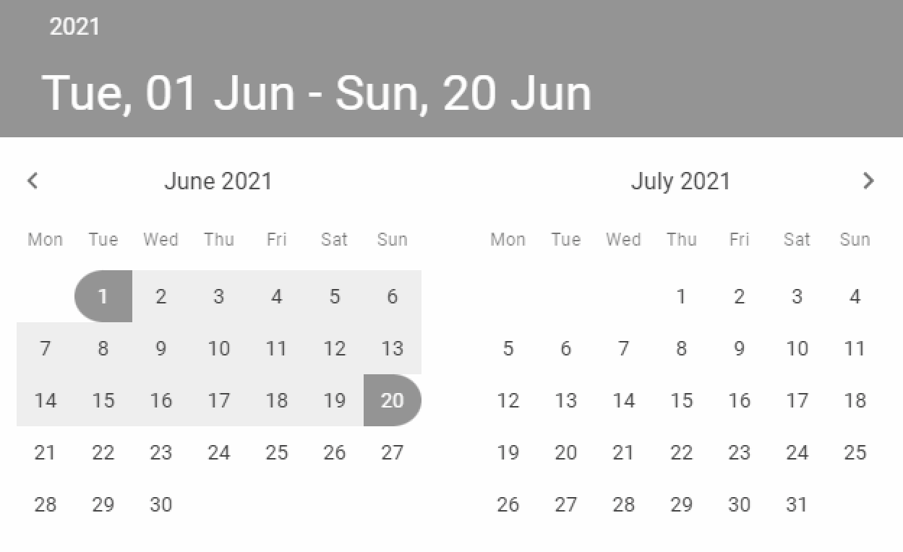
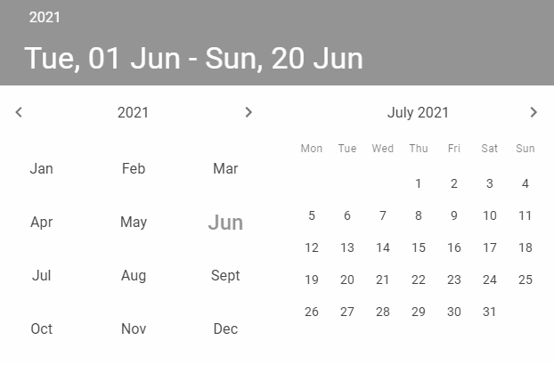
Nox.Types.DateTimeDuration or Nox.Types.DateTimeRange
MudBlazor
(Non Focused: no entered value)
(Focused Selected Date)
(Day Selection Overlay)
(Month Selection Overlay)

Slide 42
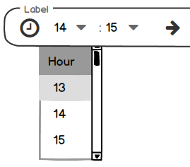
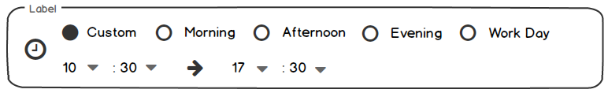
Nox.Types.DateTimeDuration
MudBlazor
(Non Focused: no entered value)
(Focused Selecting Time AM/PM
(Focused Selecting Time 24HR
(Time Selection Example)
(Common Time Ranges Selection + Custom)

Slide 43
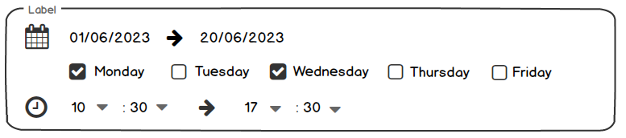
Nox.Types.DateTimeSchedule
MudBlazor
(Focused Selecting Weekly Schedule)

Slide 44
Nox.Types.Entity
(UI Not Required - TBC)

Slide 45
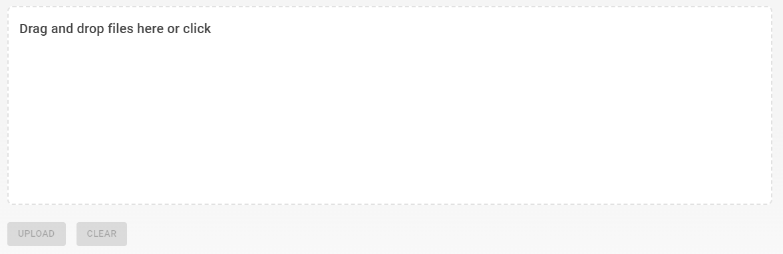
Nox.Types.File or Nox.Types.Image or Nox.Types.ImageJpg or Nox.Types.ImagePng or Nox.Types.ImageSvg
MudBlazor

Slide 46

Nox.Types.LatLong
MudBlazor
(Non Focused: no entered value)
(Focused: entered value)
(Disabled)
(Validation Thrown)

Slide 47




Nox.Types.Money
MudBlazor
(Non Focused: no entered value)
(Focused: entered value)
(Disabled)
(Validation Thrown)

Slide 48

Nox.Types.PhoneNumber
MudBlazor
(Non Focused: no entered value)
(Focused: entered value)
(Disabled)
(Validation Thrown)

Slide 49
Nox.Types.StreetAddress
(UI Not Required - TBC)

Slide 50
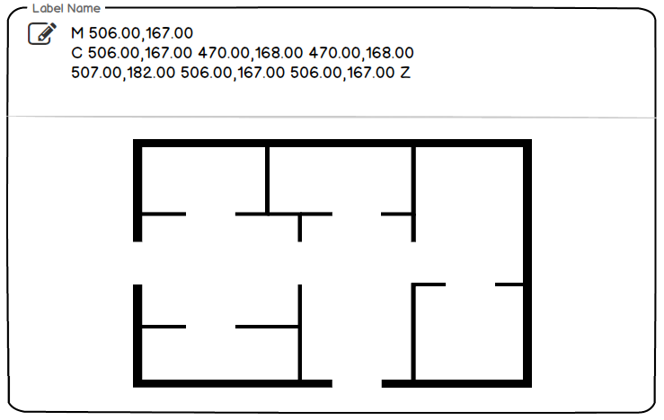
Nox.Types.SVGClosedPath
MudBlazor
(examples of Floorplan – all closed paths ends with an M and ending Z force closes path)

Slide 51
Nox.Types.TranslatedText
(UI Not Required - TBC)

Slide 52

Nox.Types.Volume
MudBlazor
(Non Focused: no entered value)
(Focused: entered value)
(Disabled)
(Validation Thrown)

Slide 53
4: Command UI Components

Slide 54




Nox.Types.Button
MudBlazor
(Normal)
(Hover: Normal)
(Normal + Icon)
(Disabled)

Slide 55




Nox.Types.TextButton:Button
MudBlazor
(Normal)
(Hover)
(Normal + Icon)
(Disabled)

