Slide 1

NOX

Slide 2
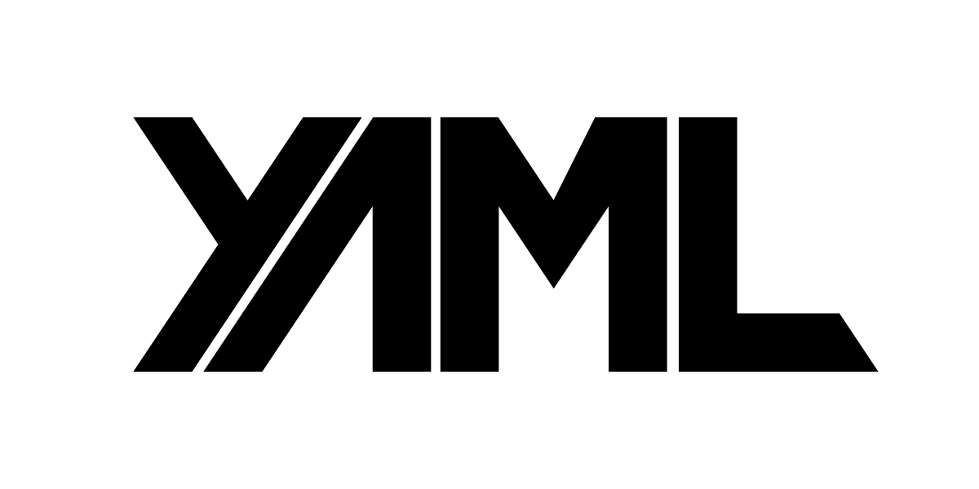
Consumers (other microservices, front-ends, gateways & listeners)
REST
ODATA/REST
gRPC
GraphQL
Amazon SQS
Azure Service Bus
RabbitMQ
Dynamic API’s
Persistence
Migrations
Messaging
ETL
Scheduling
Logging
Health checks
DevOps
…and more
Your Project
Project & Domain Definition
*.nox.yaml
Your .NET code
Your configuration, startup, types, classes, endpoints and services
Nox generates strong types for you in your IDE
Nox.Lib
Core
Configuration
Components
Interfaces
Constants
Exceptions
Dynamic Models
Generator
Generator/Analyzer
Strong-typed Entities
CQRS Handler interfaces
Visual Studio
Rider
Data
Persistence
Entity Framework
Auto migrations
Support for:
Sql Server
Postgress
MySQL
ETL
Supports
Sql Server
Postgress
MySQL/Oracle
CSV/Excel/Json
Parquet/Redis
…and more
Messaging
In-process events Domain events
Integration events
Supports:
RabbitMQ
Azure Service Bus
Amazon SQS
Jobs
Recurring tasks
Cron scheduler
Job monitoring
Scale horizontally
API
CRUD Api
Developer control
Security
Dynamic endpoints
OData/REST
gRPC
GraphQl
YamlDotNet
AutoMapper
FluentValidation
EF Core
ETLBox
SqlKata
MassTransit
Hangfire
Serilog
Asp.NET
Data Sources (API’s, files, databases, legacy systems)

