Slide 1
Predicting reservoir Sweet Spots with Machine Learning
Team members
Alan Wilson: geologist (10 years)
Geoff Chambers: data scientist (6 months) + geophysicist (9 years)
Marco van der Linden: AI Engineer (6 months) + Sr. Software Engineer (20 years)
Maxim Kotenev: development geologist (8 years)
Rowan Haddad: Reservoir Engineer (8 years)
Project Outline:
Dataset= Gullfaks Petrel reservoir model
Input features= suite of reservoir property maps (thickness, NTG, etc.)
Machine learning algorithm= Gaussian Naive Bayes (Classification)
Training & validation data= sweet spot maps manually created in Petrel
Use ML model to predict sweet spots for many realisations of input maps
Communicate most-likely and uncertainty estimates for sweet spots

Slide 2
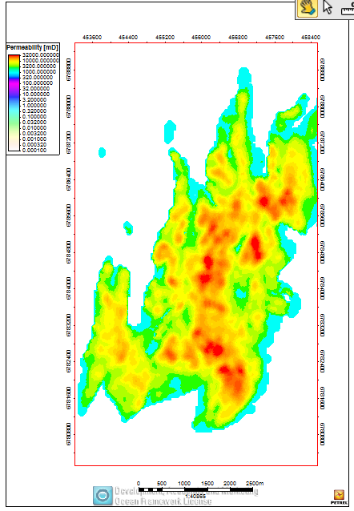
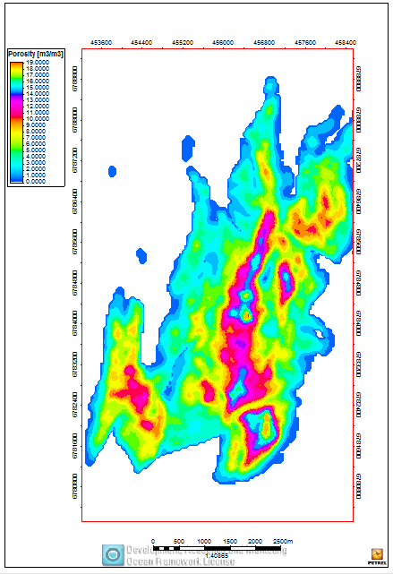
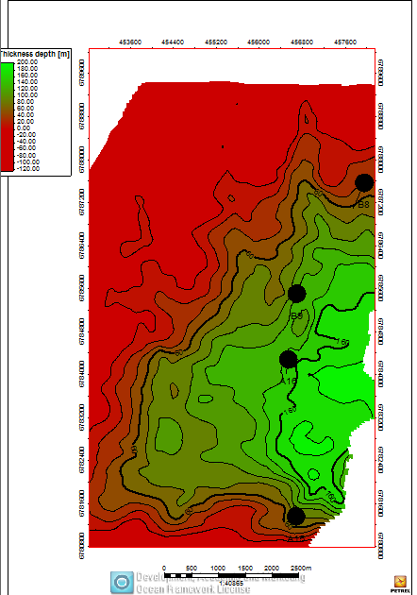
Predicting reservoir Sweet Spots with Machine Learning
Suite of reservoir property maps …
Predict sweet spots for well Locations
Net & average maps for reservoir properties (porosity, permeability, net/gross)
Thickness map
Combine to find sweet spots: Manually vs. Machine learning- prediction and validation

Slide 3
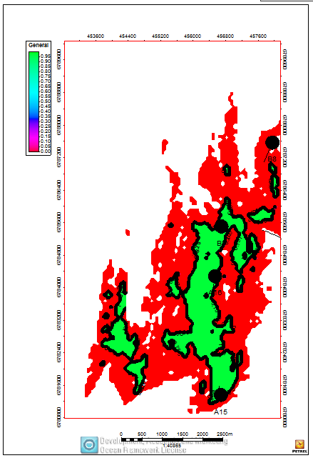
Petrel Workflow
Filtering based on some criteria:
NTG (facies)
Porosity& Perm (For quality)
Net reservoir (above contact)
Thickness (hydrocarbon Column)
Find sweet spots ➔ classified 0,1
Sweet spot map generated manually for base case properties, forming the training data for ML
ML predicts a sweet spot map for multiple realisations of new property maps

Slide 4
Machine learning- demo
Jupyter notebooks
Product output: Interactive display of results across realisations
Validation test: compare prediction to new manually interpreted sweet spot map

Slide 5
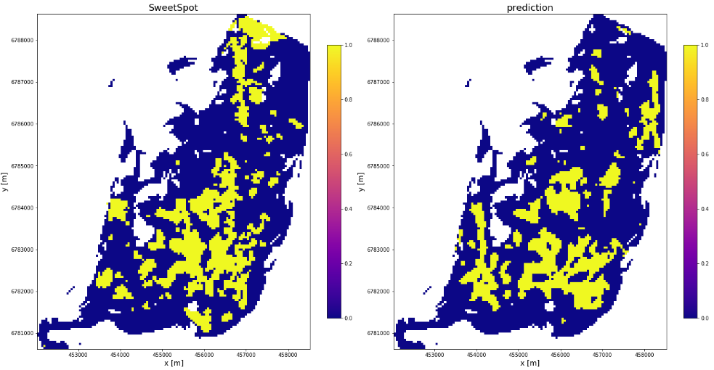
Results & Next steps
Current model performance: ROC/AUC Score 0.75 and F1 Score 0.52
Improving the performance of the ML model
Acquire data from different fields as additional training data
Switch to Deep Learning: Convolutional Neural Networks to improve performance
Feature Engineering

