Slide 1
Predicting reservoir Sweet Spots with Machine Learning
Team members
Alan Wilson
Geoff Chambers
Marco van der Linden
Maxim Kotenev
Rowan Haddad
Project Outline:
Training data= “Features” incorporated are net reservoir maps and thickness maps
Machine learning algorithm= Gaussian Naive Bayes (Classification)
Validation on base case derived from Petrel
Further predictions with uncertainty indication on multiple realisations

Slide 2
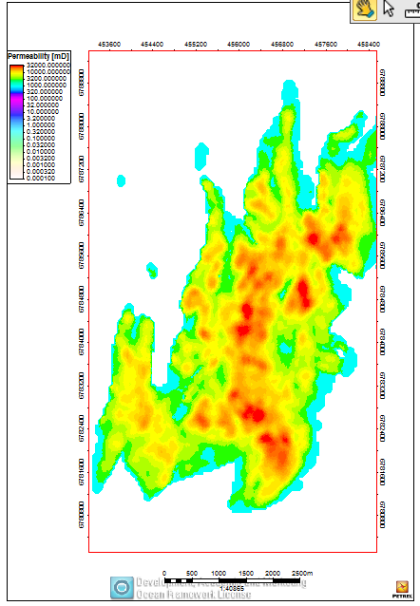
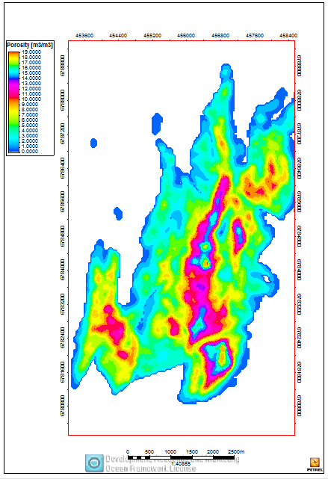
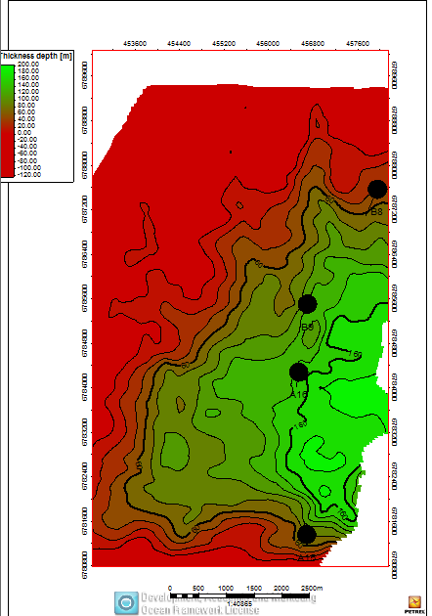
Predicting reservoir Sweet Spots with Machine Learning
Predict sweet spots for well Locations
Net & average maps for reservoir properties
Thickness map
Combine to find sweet spots: Manually vs. Machine learning- prediction and validation

Slide 3
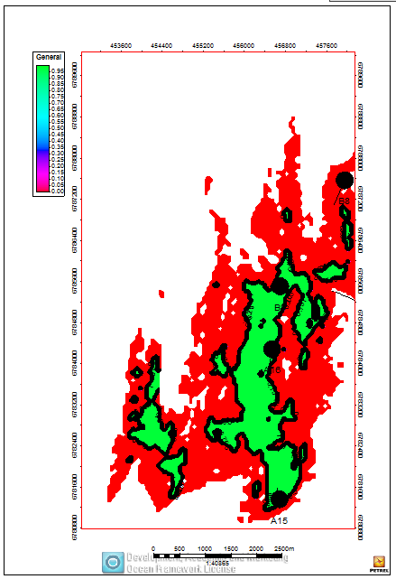
Petrel Workflow
Filtering based on some criteria:
NTG (facies)
Porosity& Perm (For quality)
Net reservoir (above contact)
Thickness (hydrocarbon Column)
Find sweet spots ➔ classified 0,1
This is what we will also try to predict with ML

Slide 4
Machine learning- results
Base case and multi realisations
Add stuff here!!

