Slide 1
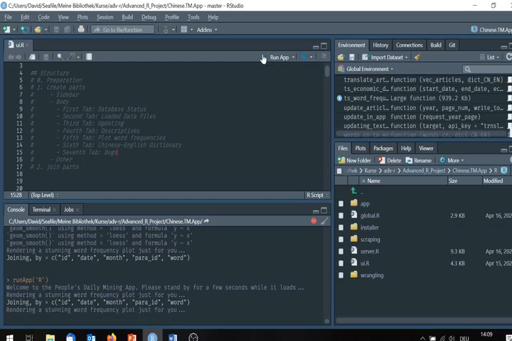
5. Conclusion
Thank you for your attention!
Notes:
To wrap up, we hope this app is a useful proof of concept, on how Shiny can make web-scraping, text-mining, and API-integration for translation and data requests automated. Our app now can generate up-to-date databases and plots for use in research or just tracking events in real time. Moreover, the resulting datasets can be used for text-mining in other projects. Many planned features and functions of the app have had to be left out of this version due to time constraints, so it can be most certainly be called pre-alpha. But we hope that this shows how Shiny apps have the potential to make data and data-based research methods accessible to people without programming skills, and inspire exchange and collaboration between data scientists, economists and researchers from other disciplines. Thank you for your attention!

