Slide 1
H1-B Data Analysis (Checkpoint 2)
TEAM MEMBER:
PRATIK KHEDEKAR
STUTI GARG
PRIYA RAO
NAMRATA PATEL
IST 707 Applied Machine Learning

Slide 2
Agenda:
Final Goal
Current Progress
H1-B is lottery system, right?
Initial Proposal
Yes, But we found some pattern!!!
Idea

Slide 3
Recap: Initial Proposal (1)
Dataset: H1-B Data from 2017 to 2022 (3.4 million datapoints)
Motivation: Determining the factors that affecting the H1-B grant and creating a prediction model.
Business Questions:
1) EDA (Exploratory Data Analysis):
What are the most top 10 desirable Job Titles and their average salary?
Which Employers/Companies file the most H-1B petitions annually?
Analysis of Top 10 Favourite Worksite .
What is the rate of income inequality among the employees?
Analysis the number of applications year wise. And applicants' growth rate per year.
Apart from STEM which domain has increasing demand for H-1B positions ?
How did COVID-19 affect the H-1B Visas? What changes were observed pre and post pandemic in terms of H-1B visa petitions?

Slide 4
Recap: Initial Proposal (2)
2) Classification Model
Logistic Regression
Decision Tree
Random Forest Classifier
Multi-layer Perceptron classifier.
3) Predictive model.
Creating a prediction model based on domain, income , and demographics to predict the probability of an individual get H-1B.

Slide 5
Current Status
Data Wrangling
Phase 1
Exploratory Data Analysis
Phase 2
Feature Engineering
Phase 3
Data Mining
Phase 4
Accuracy results.
Phase 5

Slide 6
Data Wrangling: (Phase 1)
Initial row count : 3469873 (Approx. 3.4 Million)
1) Converting the Unit of Pay column to one scale. (Yearly Income)
2) Handling missing value:
Dropped rows with NULL values.
Some columns were imputed.
Maintaining data type consistency.
3) Down - sampled the data to balance proportions to avoid bias.
3.4 Million
2.7 Million
1.9 Million
1.1 Million

Slide 7
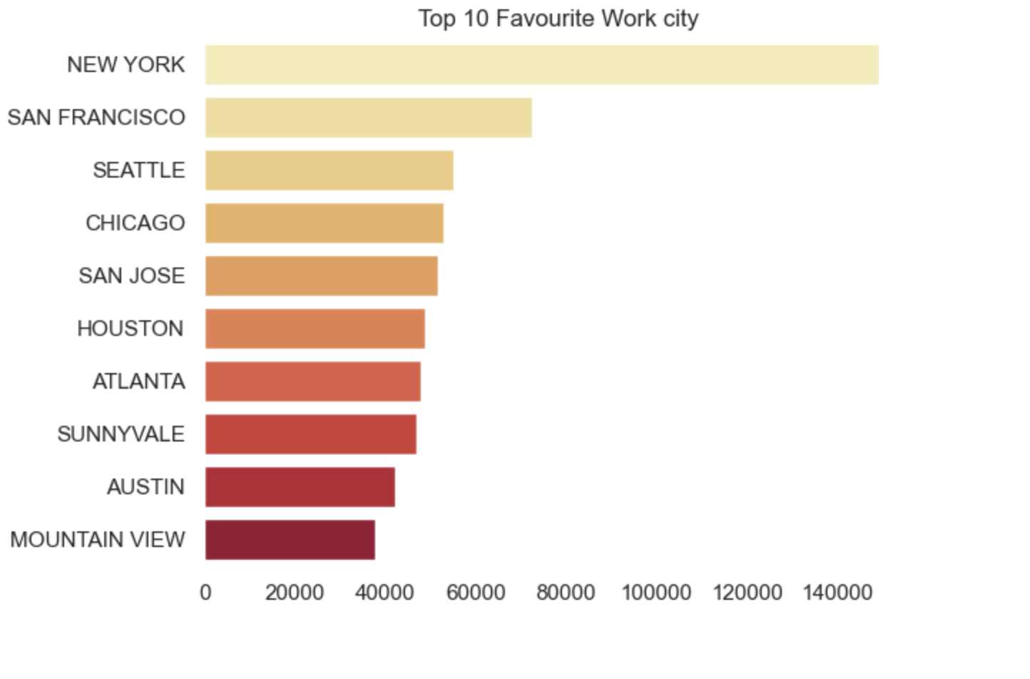
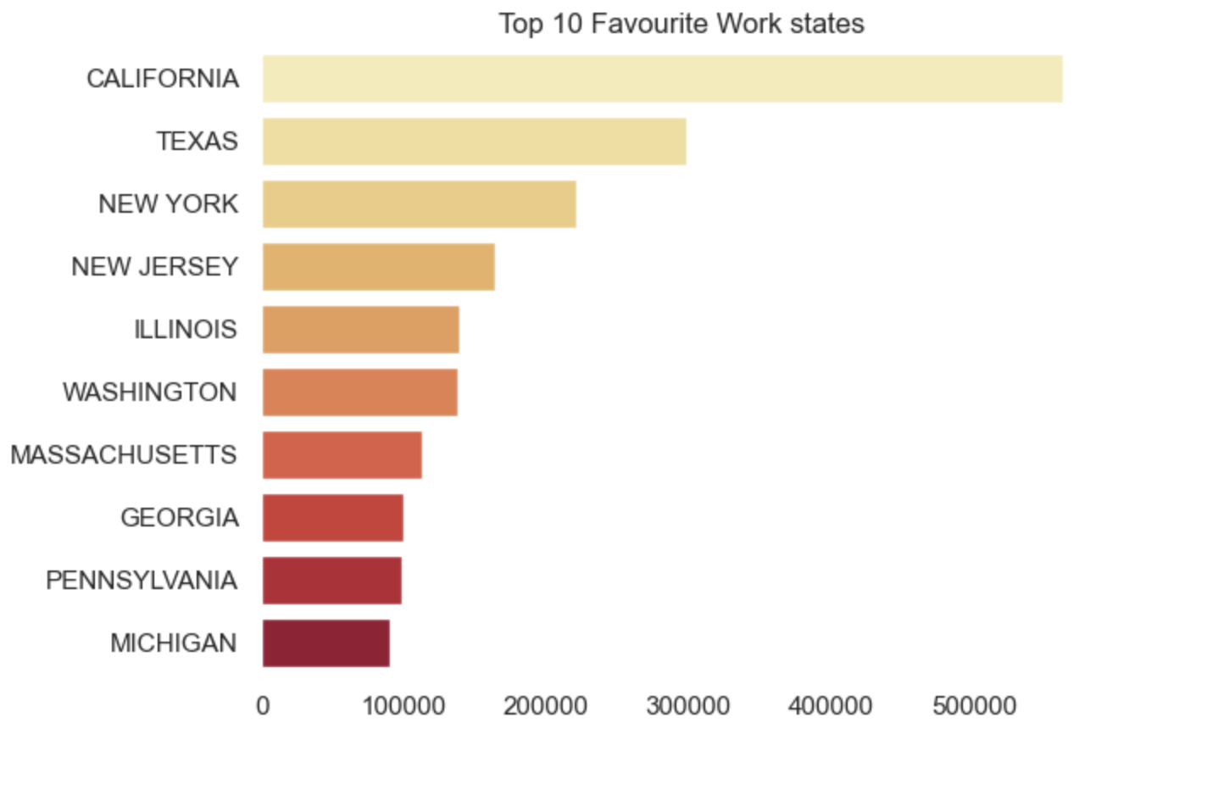
Exploratory Data Analysis: (Phase 2)

Slide 8
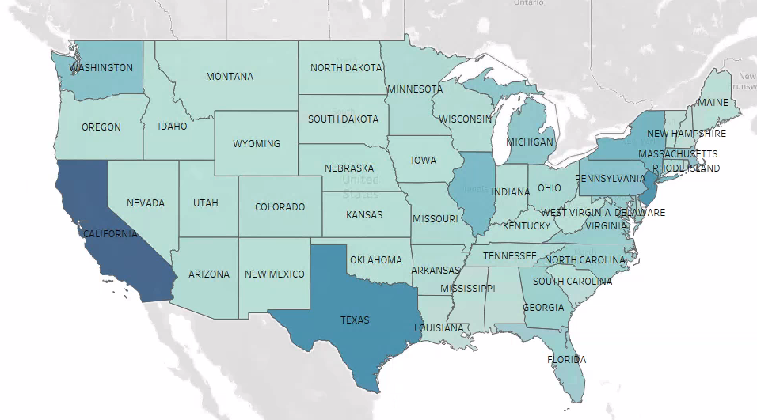
Overview of H1-B filing from 2017 to 2022
More visualization in Tableau public

Slide 9
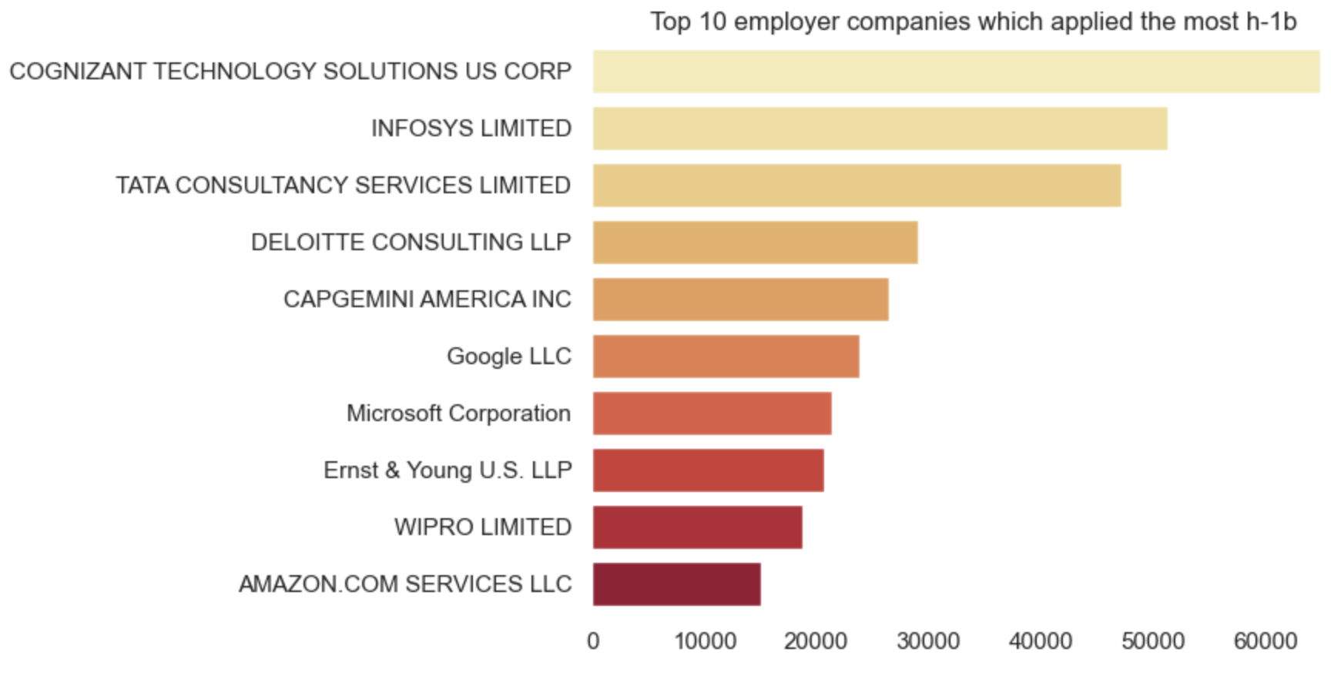

Slide 10
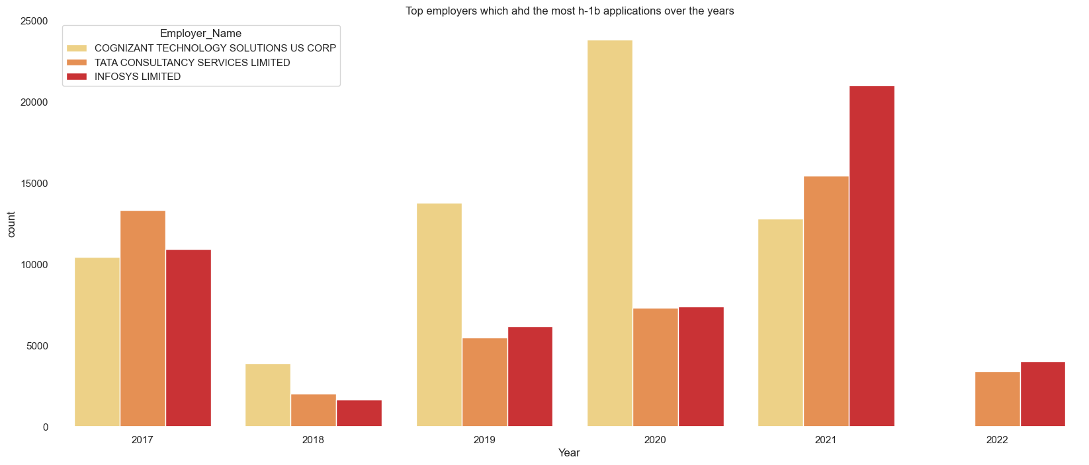
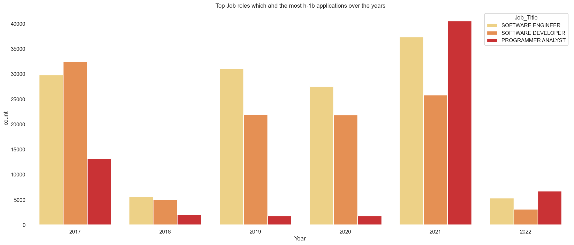

Slide 11
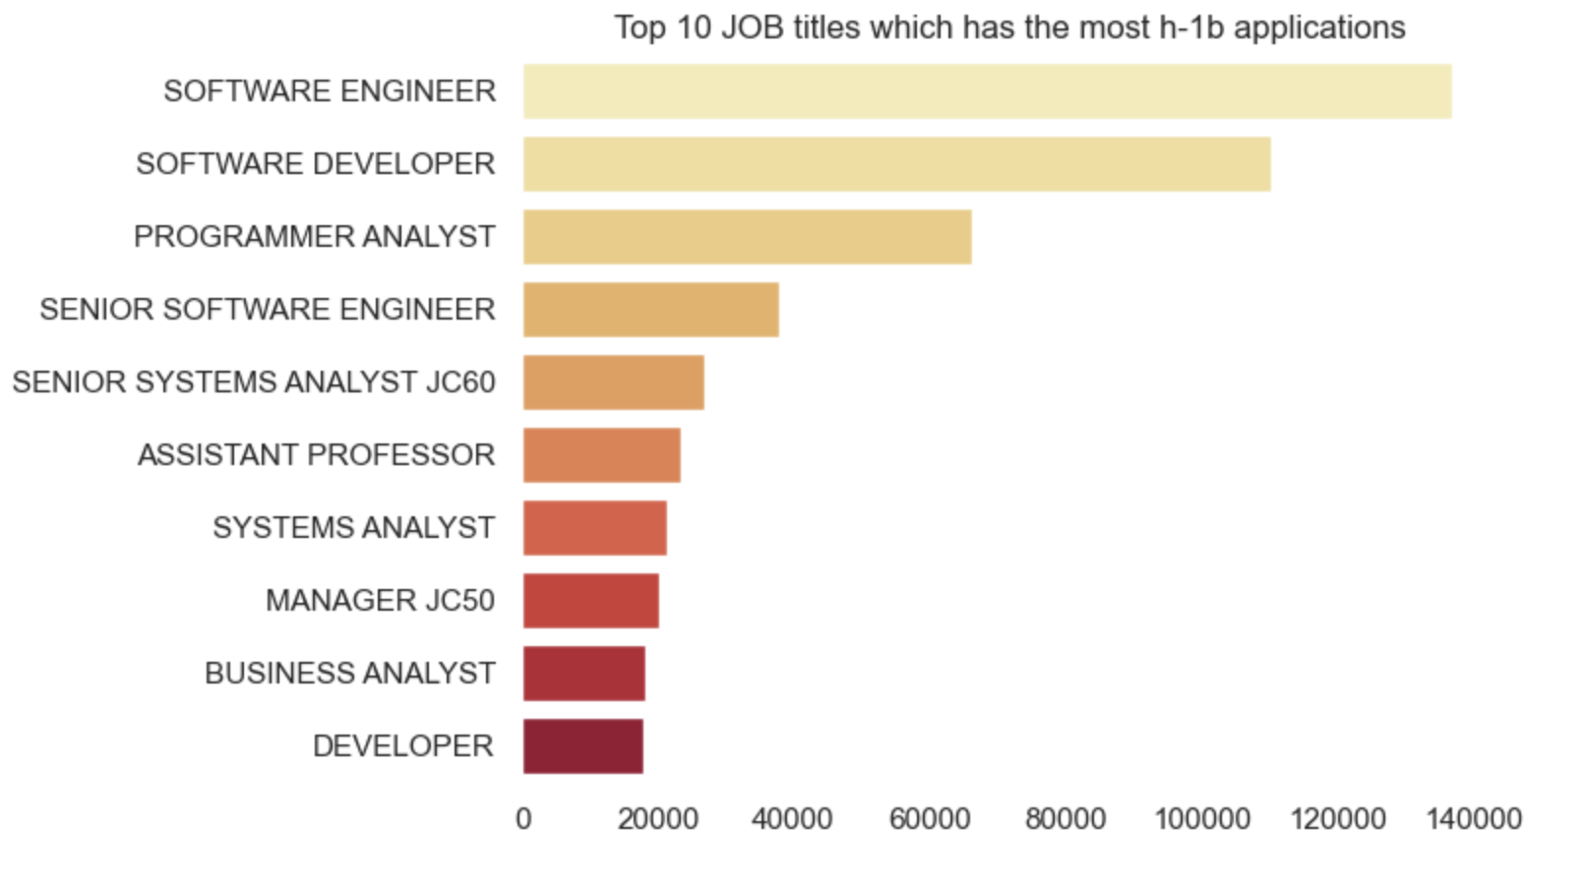
Where are Data Science roles????
Insights: Software Engineer & Software developer always had an upper trend and will continue so…But Data
Science related roles started to be registered after 2018.

Slide 12
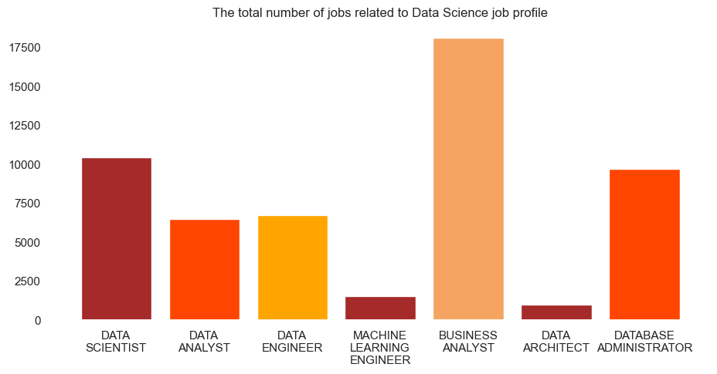
Data Related Jobs
Data Science still a new domain!!!!

Slide 13
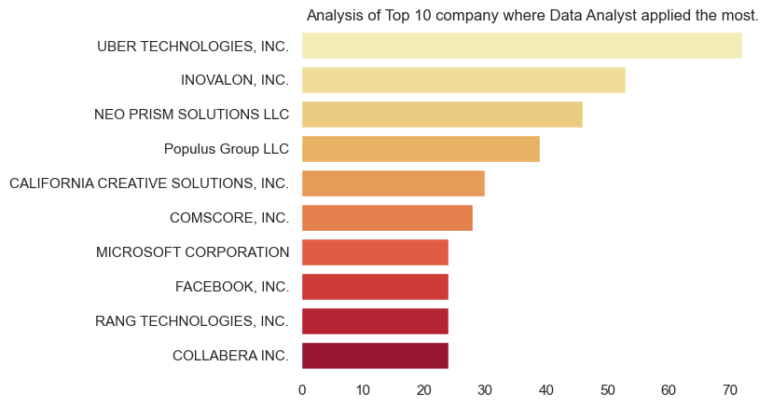
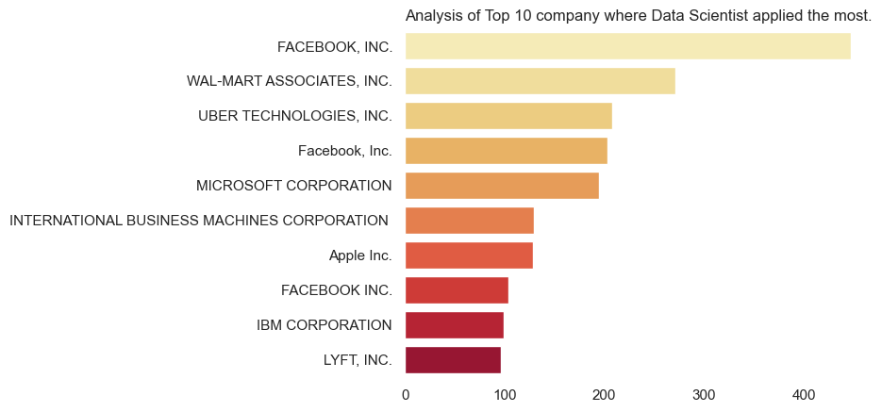
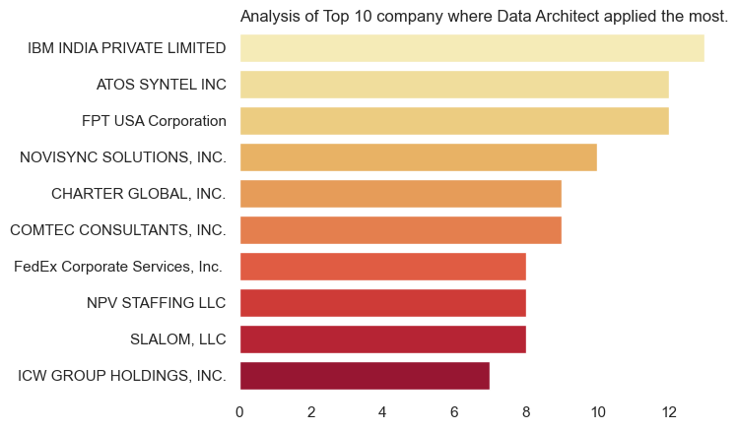
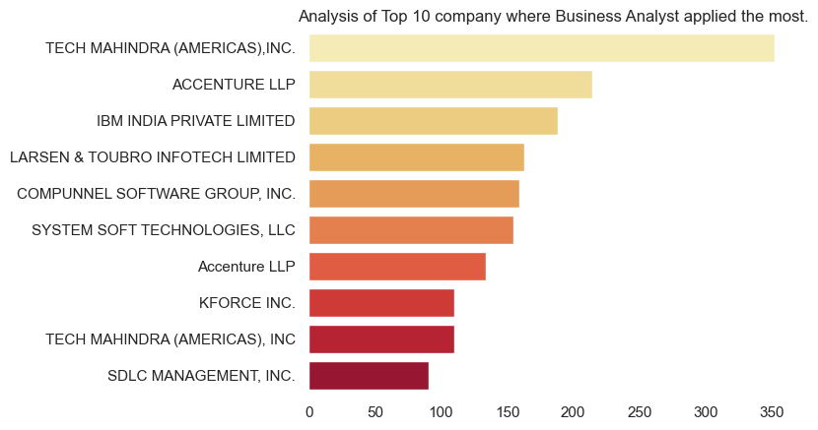

Slide 14
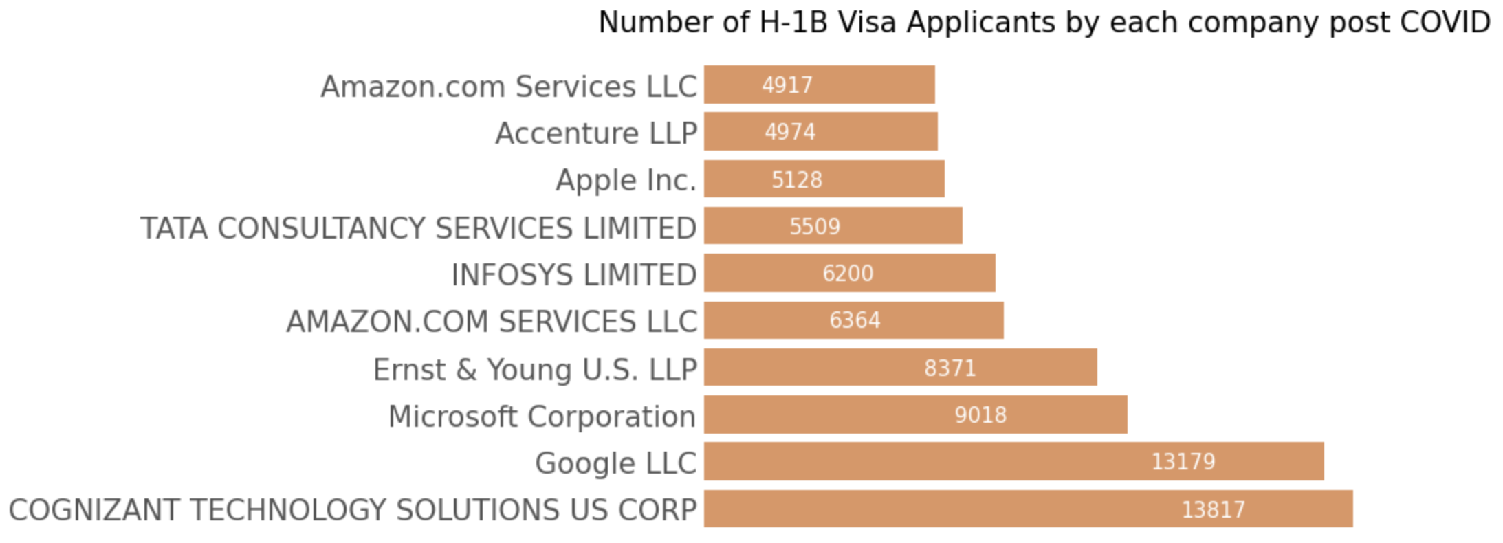
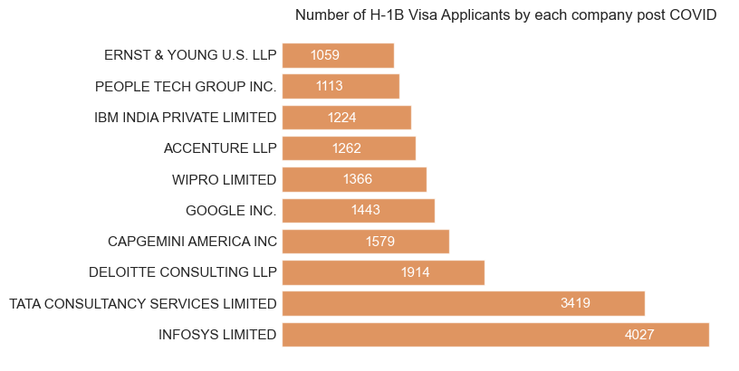
Conditions Pre-Covid
Conditions Post-Covid
Insight: Cognizant and Goggle were the companies which filed most H1-B before Covid
but the scenario changed after the pandemic.

Slide 15
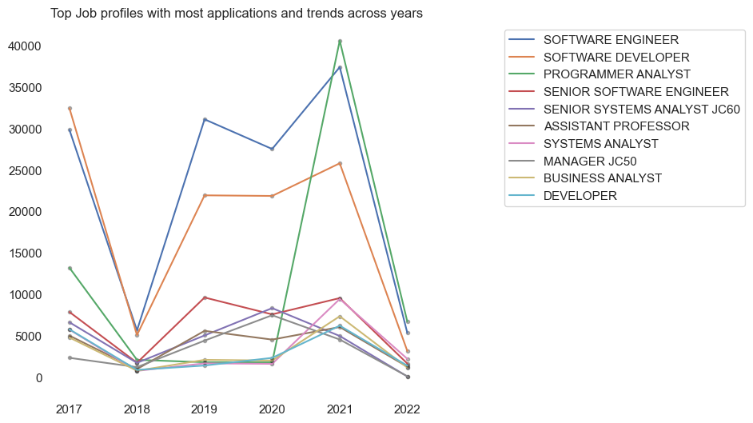
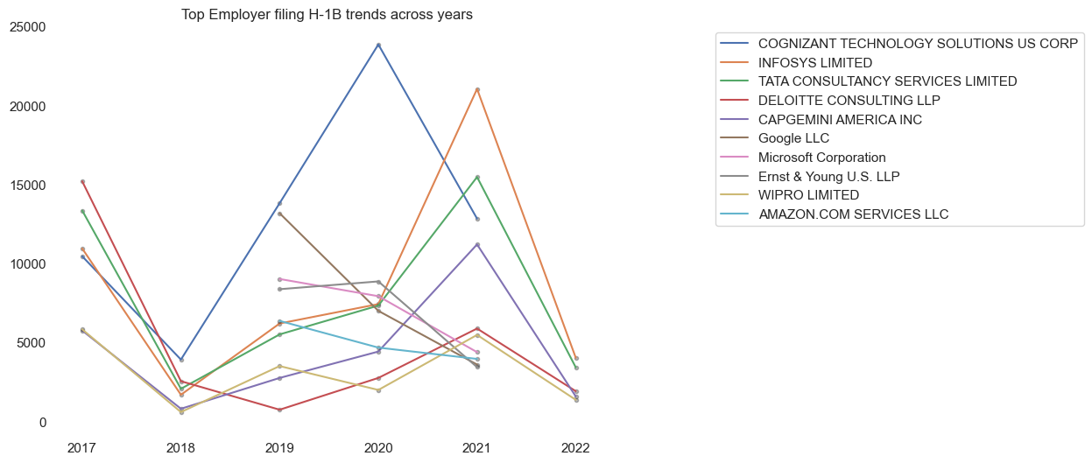
After 2021 Cognizant, EY, Microsoft freeze the H1-B filing process.
Don’t know why??

Slide 16
Feature Engineering: (Phase 3)
1) Bucketing/Discretization - converting or partitioning continuous attributes, features or variables to discretized or nominal attributes/features/variables/intervals.
2) One-Hot Encoding – Converted the categorical data into numerical data.
3) Feature Creation – Constructed new features based on the existing data.
4) Recursive Feature Extraction – Correlated the target column along with the features and extracted the top 40 features. (Out of 75 features)

Slide 17
Data Mining Techniques: (Phase 4)
Classification :
Logistic Regression
Random Forest Classifier
Decision Tree Classifier
Multi-layer Perceptron classifier
Target variable is categorial i.e.,
CERTIFIED or DENIED

Slide 18
Accuracy Results: (Phase 5)
Sr. no. | Model | Precision | Recall | Accuracy
1 | Logistic Regression | 87.2% | 95% | 86.2%
2 | Decision Tree Classifier | 88% | 94% | 87%
3 | Random Forest Classifier | 88% | 95% | 86%
4 | Multi-layer Perceptron classifier | 84% | 93% | 88%
5 | Support Vector Machines | 87% | 95% | 86%

Slide 19
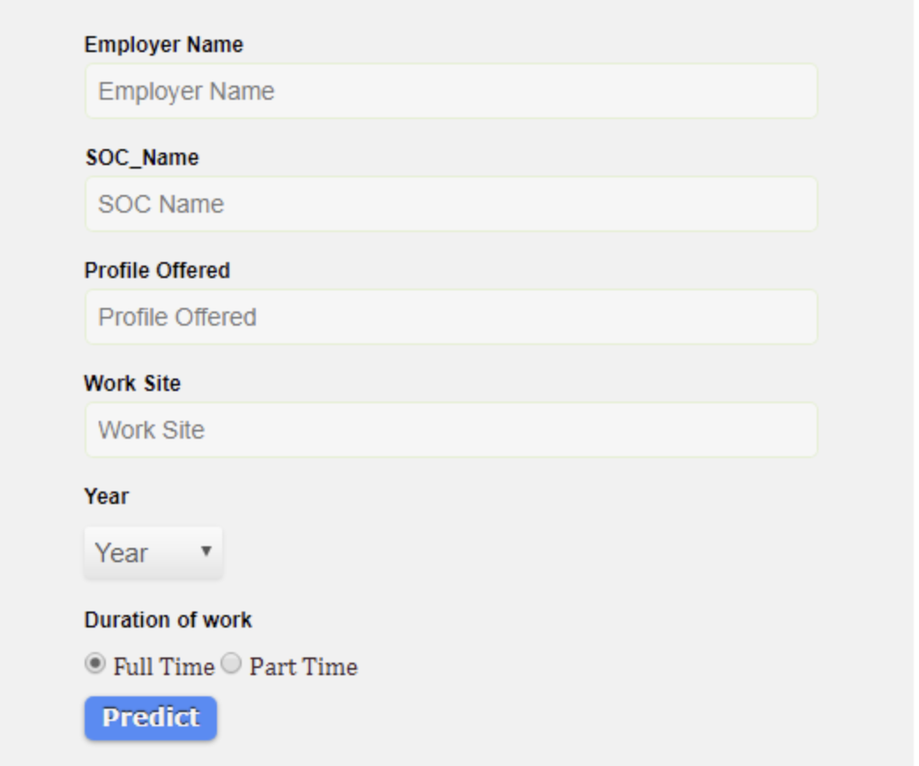
Final Checkpoints
1) Hyper parameter tuning getting the best features
2) Try increasing the number of features to test the accuracy.
3) SMOTE (Synthetic Minority Oversampling Technique) for sampling.
4) Applying other clustering techniques.
5) Creating an interactive UI to predict the probability of getting an H1-B certified.

Slide 20
THANK YOU! Open for Question

