Slide 1
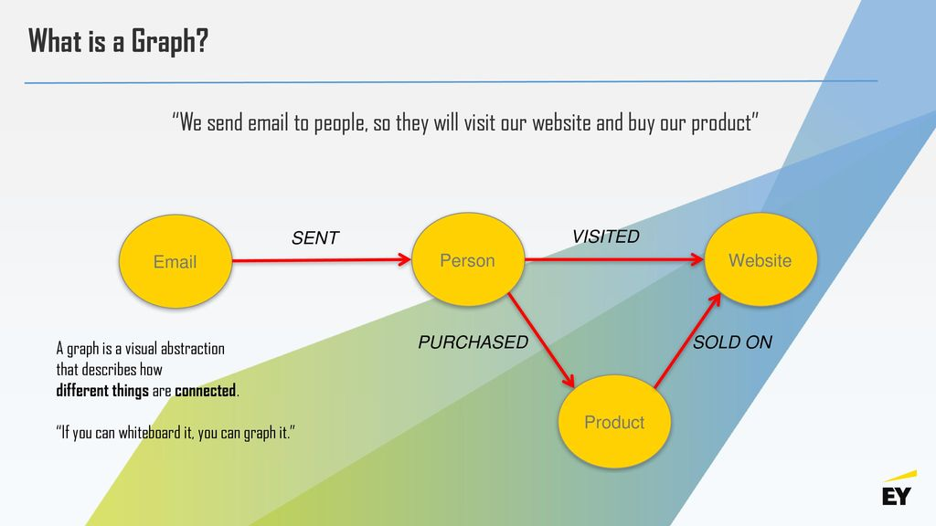
KNOLWEDGE GRAPH

Slide 2
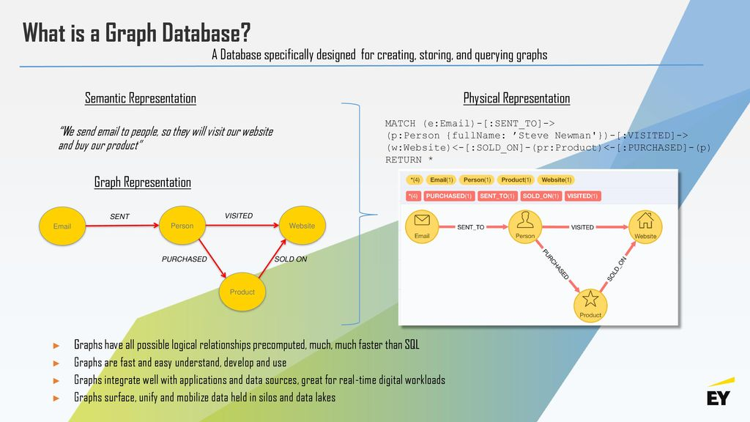

Slide 3
Bringing knowledge graphs and machine learning (ML) together can systematically improve the accuracy of systems and extend the range of machine learning capabilities.
KG lets us build relationship between entities that are not directly connected but might have a connection which is not inferable from the data available.
ML is used to build complex datasets to train their models. But, this alone is a huge task & comes with numerous challenges. Incorporating KG into ML would mean that we have more unbiased and truthful data which when visualized would help us understand more meaningful insights.
This would further lead to better decision making & thus fulfilling business needs.

Slide 4
Knowledge graphs can interconnect several tables with individual attributes as relations with entities.
Complex networks can be easily understood by traversing through relations (edges) and nodes (entities)
In a knowledge graph, entities will be nodes with their detailed profiles and connected through edges (relationships) to other entities.
Each relationship can be expanded to get all the entities with that particular relationship

Slide 5
THANK YOU

