Slide 1

FARM RESOURCE ALLOCATION PROBLEM: A CASE STUDY OF A FARM IN QUEENSTOWN, EASTERN CAPE SOUTH AFRICA
Nqabakazi Dyantyi, Dr G. Buzuzi

Slide 2

INTRODUCTION
Resource allocation is a challenge for various farmers worldwide.
Experts have studied this all over the world showing the challenge of resource allocation in agriculture.
Scholars such as Bhatia & Bhat (2019:155) express issues experienced by farmers in the northern region of India
Scholars such as Miao et al (2023:7) express similar problems in China
In South Africa, scholars such as Muzhinji & Ndou (2022:21056) highlight the resource allocation challenges within the agricultural sector,

Slide 3

PROBLEM STATEMENT
Farm managers encounter resource allocation challenges
They strive to maximize profit margins
While managing income, space, and labor limitations.
To tackle this, we introduced a linear programming model, executed via the simplex method in MATLAB,
specifically adapted for agricultural applications.
This method has a proven track record of resolving similar allocation issues in other sectors, leading to cost reductions.
Adopting this model leads:
to agricultural resource management
potentially saving thousands of rands
Boosting efficiency within the farm

Slide 4
OBJECTIVES
Investigate the application of linear programming to enhance resource allocation in agriculture.
1
Identify key variables and constraints for a farmer-focused linear programming model.
2
Determine essential parameters and data sources for effective MATLAB implementation.
3
Develop methods to communicate linear programming results to farm managers for informed decision-making.
4

Slide 5
METHODOLOGY Table 1: Farmer’s resource allocation plan before Linear Programming
 | Crops
Resources | Cabbage | Spinach | Butternut | Tomatoes | Potatoes | Maize
Land(ha) | 5 | 5 | 1 | 0.23 | 2 | 2
Labor (people) | 10 | 10 | 10 | 5 | 10 | 10
Fertilizer cost (R) | 2 120 | 2 120 | 1 770 | 2 655 | 1 770 | 3 540
Chemical cost (R) | 2 985 | 2 985 | 2 985 | 1 990 | 2 985 | 2 985
Seed cost (R) | 40 000 | 40 000 | 10 000 | 6 300 | 10 000 | 80 000
Expenses (R) | 45 105 | 45 105 | 14 755 | 11 945 | 14 755 | 86 525
Income(R) | 800 000 | 280 000 | 800 000 | 37 800 | 800 000 | 2 400 000

Slide 6
Table 2: Farmer’s resource allocation plan per hectare before Linear Programming
 | Crops
Resources | Cabbage | Spinach | Butternut | Tomatoes | Potatoes | Maize | Available
Land(ha) | 1 | 1 | 1 | 1 | 1 | 1 | 39
Labor(people) | 2 | 2 | 10 | 22 | 5 | 5 | 100
Fertilizer cost (R) | 424 | 424 | 1 770 | 11 728.07 | 885 | 1 770 | 60 000
Chemical cost (R) | 597 | 597 | 2 985 | 8 790.53 | 1 492.50 | 1 492.50 | 50 000
Seed cost (R) | 8 000 | 8 000 | 10 000 | 27 829.31 | 5 000 | 40 000 | 200 000
Expenses (R) | 9 021 | 9 021 | 14 755 | 52 765.26 | 7 377.50 | 43 262.50
Income(R) | 160 000 | 160 000 | 800 000 | 166 975.88 | 400 000 | 1 200 000

Slide 7
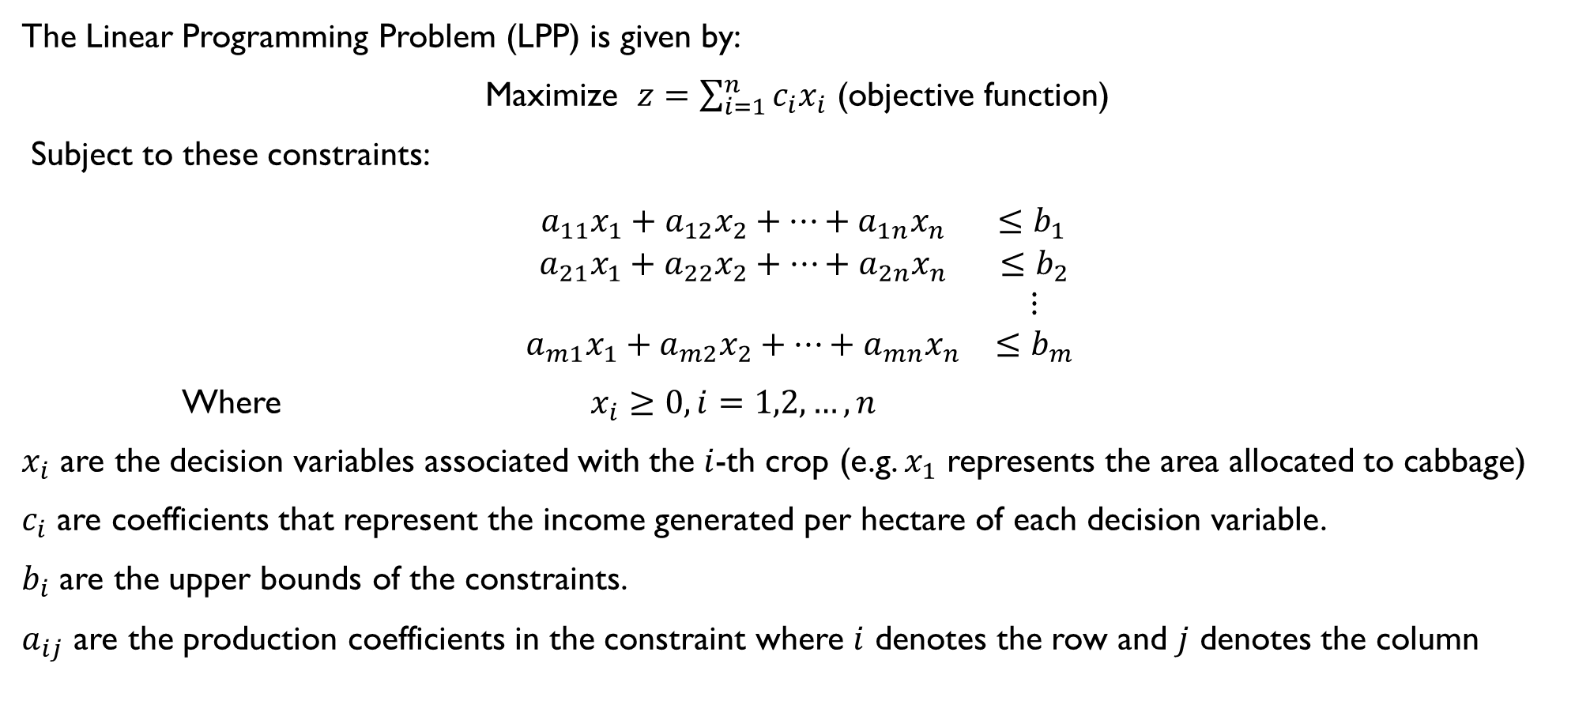
Formulation of the problem
The Linear Programming Problem (LPP) is given by:
Maximize $z=\sum_{i=1}^{n}{c_{i}x_{i}}$ (objective function)
Subject to these constraints:
$$\begin{matrix}a_{11}x_{1}+a_{12}x_{2}+⋯+a_{1n}x_{n} & ≤b_{1 } \\ a_{21}x_{1}+a_{22}x_{2}+⋯+a_{2n}x_{n} & ≤b_{2} \\ & ⋮ \\ a_{m1}x_{1}+a_{m2}x_{2}+⋯+a_{mn}x_{n} & ≤b_{m}\end{matrix}$$
Where $x_{i}≥0, i=1,2,…,n$
$x_{i}$ are the decision variables associated with the $i$-th crop (e.g. $x_{1}$ represents the area allocated to cabbage)
$c_{i}$ are coefficients that represent the income generated per hectare of each decision variable.
$b_{i}$ are the upper bounds of the constraints.
$a_{ij}$ are the production coefficients in the constraint where $i$ denotes the row and $j$ denotes the column

Slide 8

Formulation of the problem continued
Let $x_{1}$ be the area allocated for cabbage per ha.
Let $x_{2}$ be the area allocated for spinach per ha.
Let $x_{3}$ be the area allocated for butternut per ha.
Let $x_{4}$ be the area allocated for tomatoes per ha.
Let $x_{5}$ be the area allocated for potatoes per ha.
Let $x_{6}$ be the area allocated for maize per ha.

Slide 9
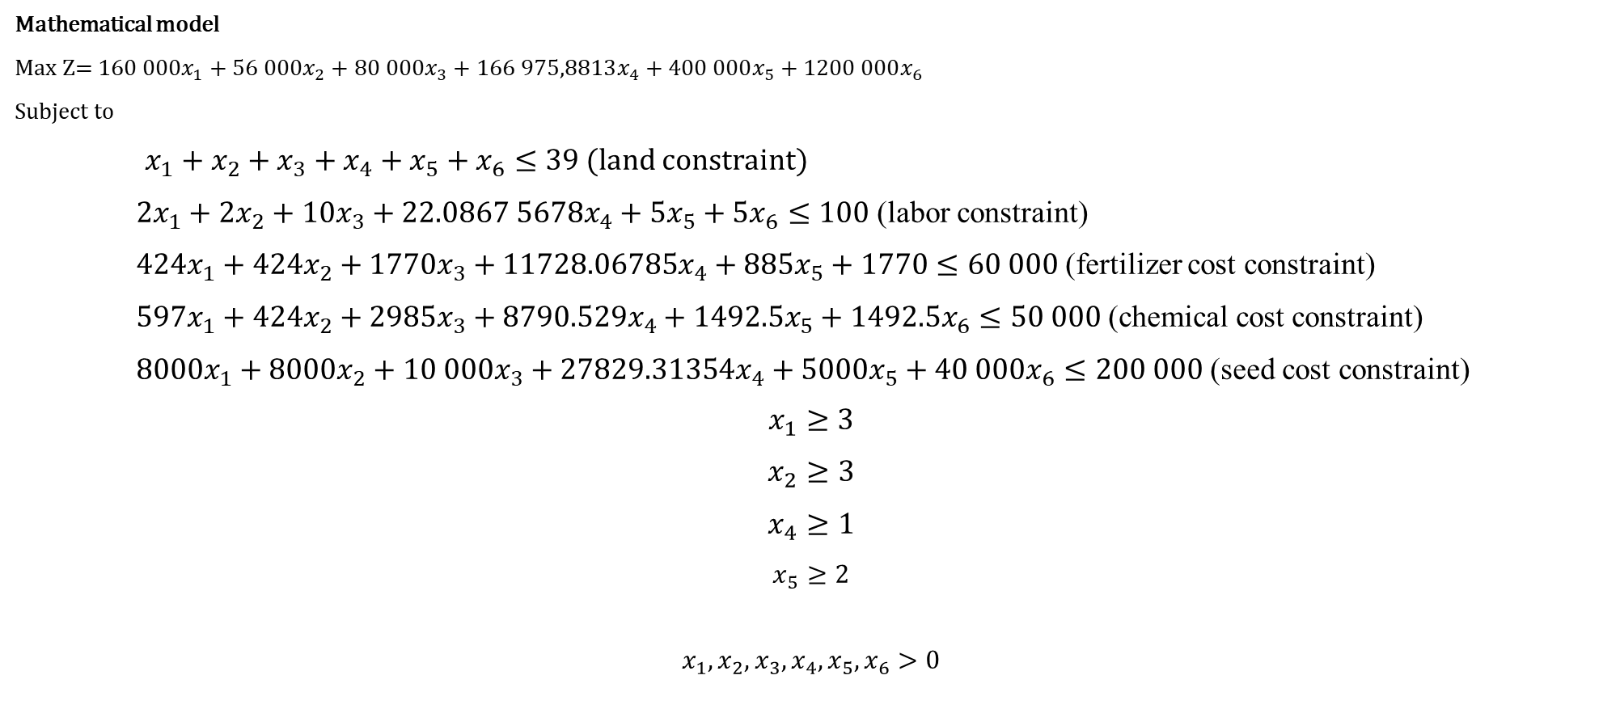
Formulation of the problem continued
Mathematical model
Max Z= $160 000x_{1}+56 000x_{2}+80 000x_{3}+166 975,8813x_{4}+400 000x_{5}+1200 000x_{6}$
Subject to
$x_{1}+x_{2}+x_{3}+x_{4}+x_{5}+x_{6}≤39$ (land constraint)
2$x_{1}+2x_{2}+{10x}_{3}+{22.0867 5678x}_{4}+{5x}_{5}+{5x}_{6}≤100$ (labor constraint)
${424x}_{1}+424x_{2}+1770x_{3}+11728.06785x_{4}+885x_{5}+1770≤60 000$ (fertilizer cost constraint)
${597x}_{1}+424x_{2}+{2985x}_{3}+8790.529x_{4}+1492.5x_{5}+1492.5x_{6}≤50 000$ (chemical cost constraint)
${8000x}_{1}+8000x_{2}+{10 000x}_{3}+27829.31354x_{4}+5000x_{5}+{40 000x}_{6}≤200 000$ (seed cost constraint)
$$x_{1}≥3$$
$$x_{2}≥3$$
$$x_{4}≥1$$
$$x_{5}≥2$$
$$x_{1},x_{2},x_{3},x_{4},x_{5},x_{6}>0$$

Slide 10
Results & Discussion
In Table 3 the method of crop planning suggested by the Linear Programming model is shown. The Linear Programming approach suggests that the farmer should grow 3 ha of cabbage, 3 ha of spinach, 4.76 of butternut, 1 ha of tomatoes, 2ha of potatoes, and 1.67 of maize.
Table 3: Farmer’s resource allocation plan using Linear programming.
 | Crops
Resources | Cabbage | Spinach | Butternut | Tomatoes | Potatoes | Maize | Available
Land(ha) | 3 | 3 | 4.76 | 1 | 2 | 1.67 | 39
Labor | 6 | 6 | 48 | 22 | 10 | 8 | 100
Fertilizer cost (R) | 1 272 | 1 272 | 8 423.56 | 11 728.07 | 1 710 | 2 946.16 | 60 000
Chemical cost (R) | 1 791 | 1 791 | 14 205.84 | 8 790.53 | 2 985 | 2 484.26 | 50 000
Seed cost (R) | 24 000 | 24 000 | 47 590.75 | 27 829.31 | 10 000 | 66 579.94 | 200 000
Expenses (R) | 27 063 | 27 063 | 70 220.15 | 52 765.26 | 14 755 | 72 010.36
Income(R) | 480 000 | 480 000 | 38 07260.11 | 166 975.88 | 800 000 | 1 997 398.05

Slide 11
Table 4: Comparison of the income, expenses, and profit levels
 | Farmer’s plan (R) | Linear Programming solution (R)
Income | 5 117 800 | 7 419 634.04
Expenses | 218 190 | 2 63 876.78
Profit | 4 899 610 | 7 155 757.27

Slide 13
Conclusion & Recommendations
A Linear Programming model was developed.
The crops considered were cabbage, spinach, butternut, tomato, potato, and maize.
The model produced the best crop combination.
By using Linear Programming, the farmer’s profit increased by 46% increase in profit.

Slide 14

REFERENCES
Bhatia, M. & Bhat, G.M.J. 2019. Linear Programming Approach- Application in Agriculture. JETIR,6(6):155-157.
Bojang, P.O., Yu, P.S., Yang, T.C.& Kuo, C.M.2016. Optimal Cropping Patterns for Profit Maximization Using a Linear Programming Model: A Case Study in Njawara Village, The Gambia. Hydro-Science & Engineering for Environmental Resilience, 10–13.
Bhatia, M.& Rana, A. 2020. A Mathematical Approach to Optimize Crop Allocation – A Linear Programming Model. International Journal of Design & Nature and Ecodynamics. 15(2):245-252. https://doi.org/10.18280/ijdne.150215
Buzuzi, G. & Buzuzi, A.N. 2018. A Mathematical Programming Technique to Crop Mix Problem on a Farm in Mutasa, Manicaland Province, Zimbabwe. SSRG International Journal of Economics and Management Studies (IJEMS). 5(11): 6-10.
Hemanatha, Jayasuriya, P.W., & Das, R. 2016. Agricultural resources management through a linear programming approach: A case study on productivity optimization of crop-livestock farming integration. Journal of Agricultural and Marine Sciences.22(1): 27-35.
Landau, P. 2023. What Is Resource Allocation? How to Allocate Resources for Projects.https://www.projectmanager.com/blog/resource-allocation[24 February 2024].

Slide 15
Mellaku, M.T., Reynolds, T.W. & Woldeamanuel, T. 2018. Linear Programming-Based Cropland Allocation to Enhance Performance of Smallholder Crop Production: A Pilot Study in Abaro Kebele, Ethiopia. Resources. 7(4):1-15.
Miao, B.-L., Liu, Y., Fan, Y.-B., Niu, X.-J., Jiang, X.-Y. & Tang, Z.2023. Optimization of Agricultural Resource Allocation among Crops: A Portfolio Model Analysis.Land.12(1901):1-18. https://doi.org/10.3390/land1210190
Mohamad, N.H. & Said, F. 2011. A mathematical programming approach to crop mix problem. African Journal of Agricultural Research. 6(1): 191-197.
Muzhinji, K. & Ndou, N. 2022. A cash crop combination for maximum net income: A case study of a small-scale cash crop farmer in Vhembe, Limpopo province, South Africa. African Journal of Food, Agriculture, Nutrition and Development. 22(7): 21056-21071. https://doi.org/10.18697/ajfand.112.21640
Sofi, N.A., Ahmed, A., Ahmad, M. & Bhat, B.A. 2015. Decision Making in Agriculture: A Linear Programming Approach. International Journal of Modern Mathematical Sciences. 13(2):160-169.

