Slide 1
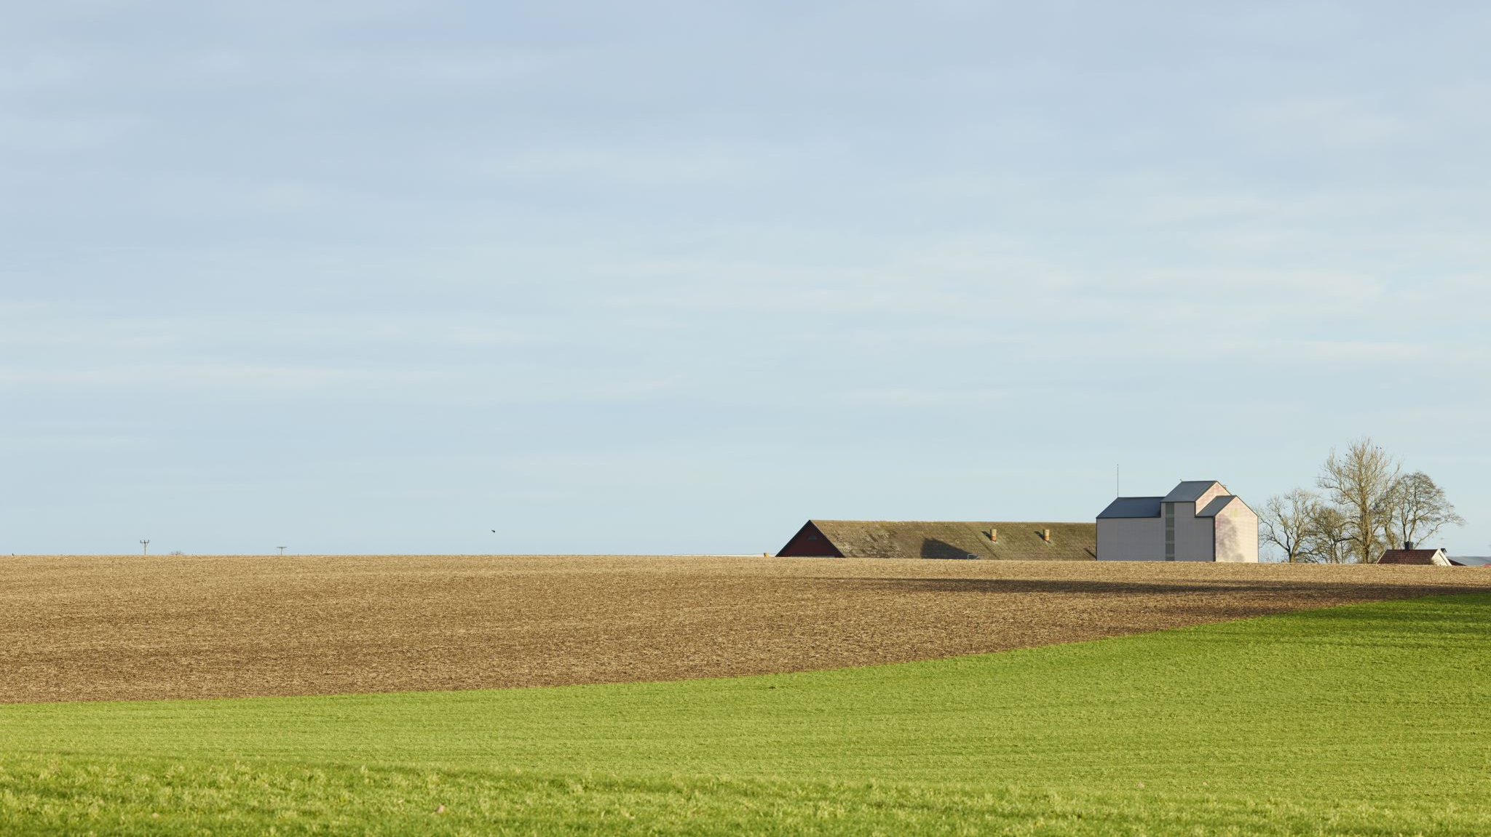
INVESTIGATING WINESCAN AS A TOOL FOR IDENTIFYING PINKING IN WINE: A STUDY OF TREATMENTS AND THEIR EFFECTS
Nqabakazi Dyantyi,
Dr A.P Nel & Dr A. Eldud

Slide 2
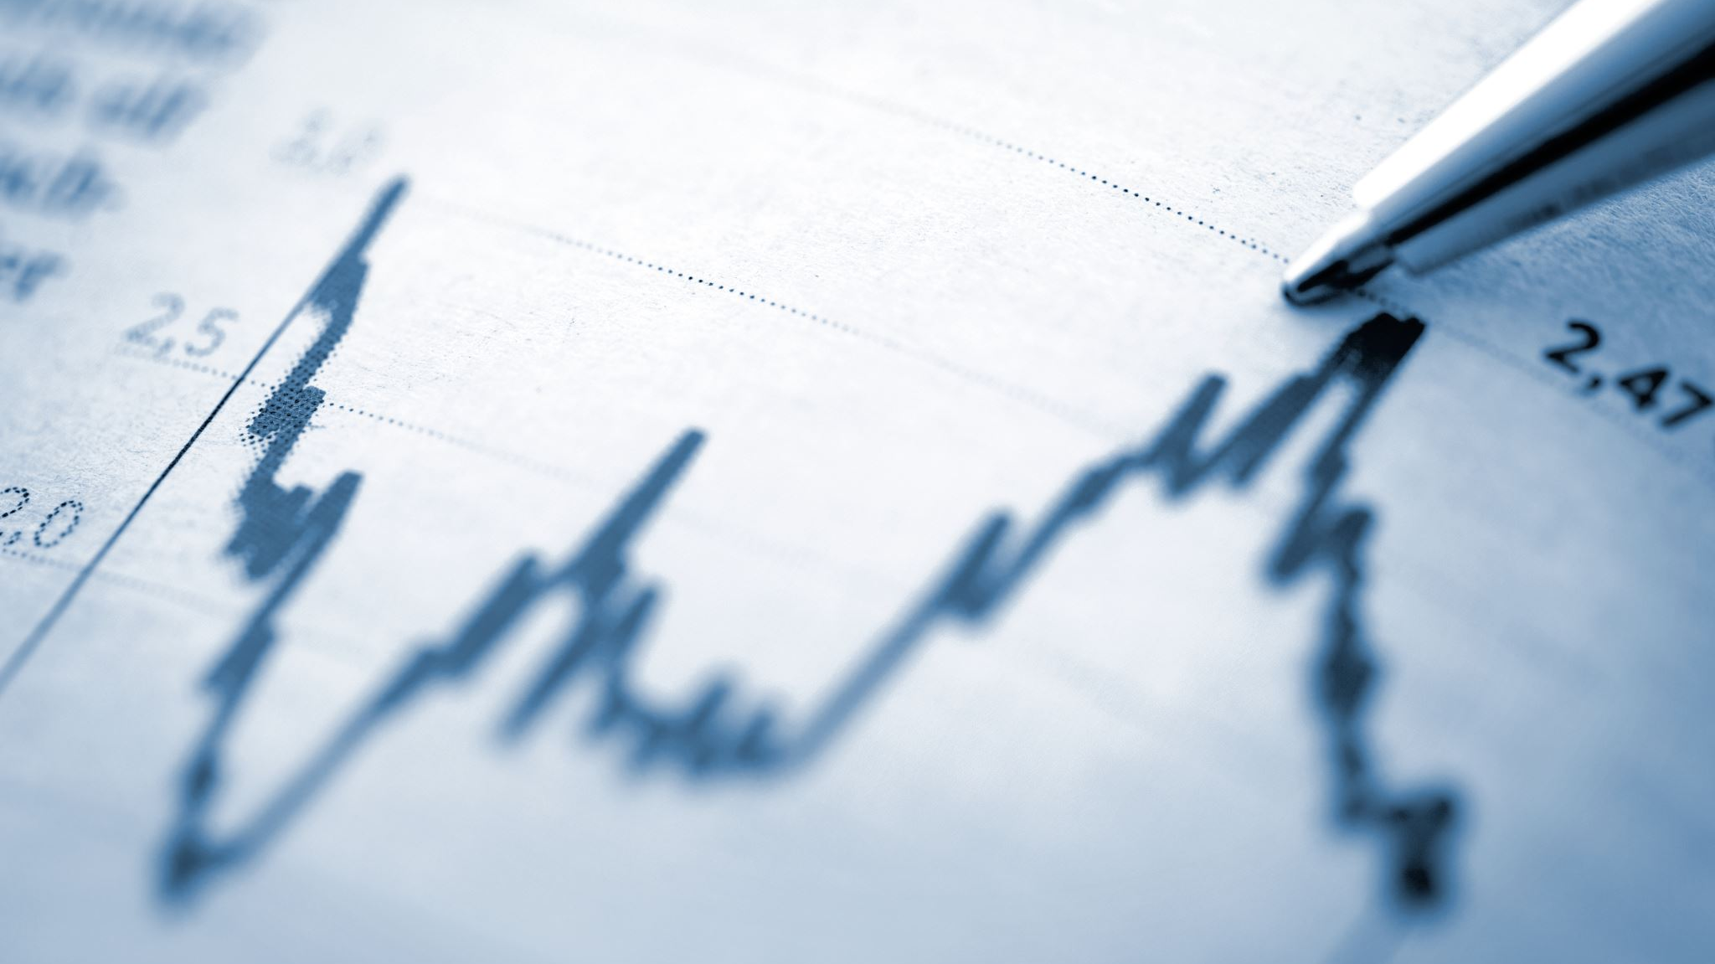
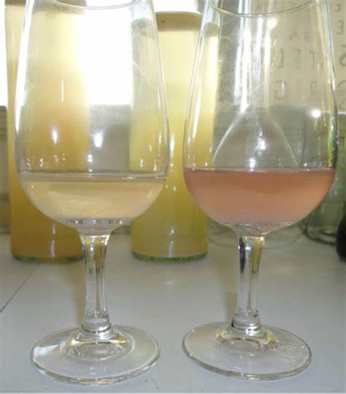
INTRODUCTION
Before bottling
Less marketability + financial loss
Traditional Methods of Detection:
Visual + subjective methods + Inaccurate +unreliable
WineScan with FTIR Spectroscopy:
Non-destructive + More accurate and reliable

Slide 3
OBJECTIVES
To evaluate the effect of different temperatures 4°C and 20 °C on pinking susceptibility
1
To assess the effect of different ripening stages on the pinking susceptibility.
3
To identify wavenumbers associated with prominent peaks that indicate potential pinking susceptibility in wine samples.
4
To assess the influence of different bag press methods : (BW vs BC) on pinking susceptibility
2

Slide 4
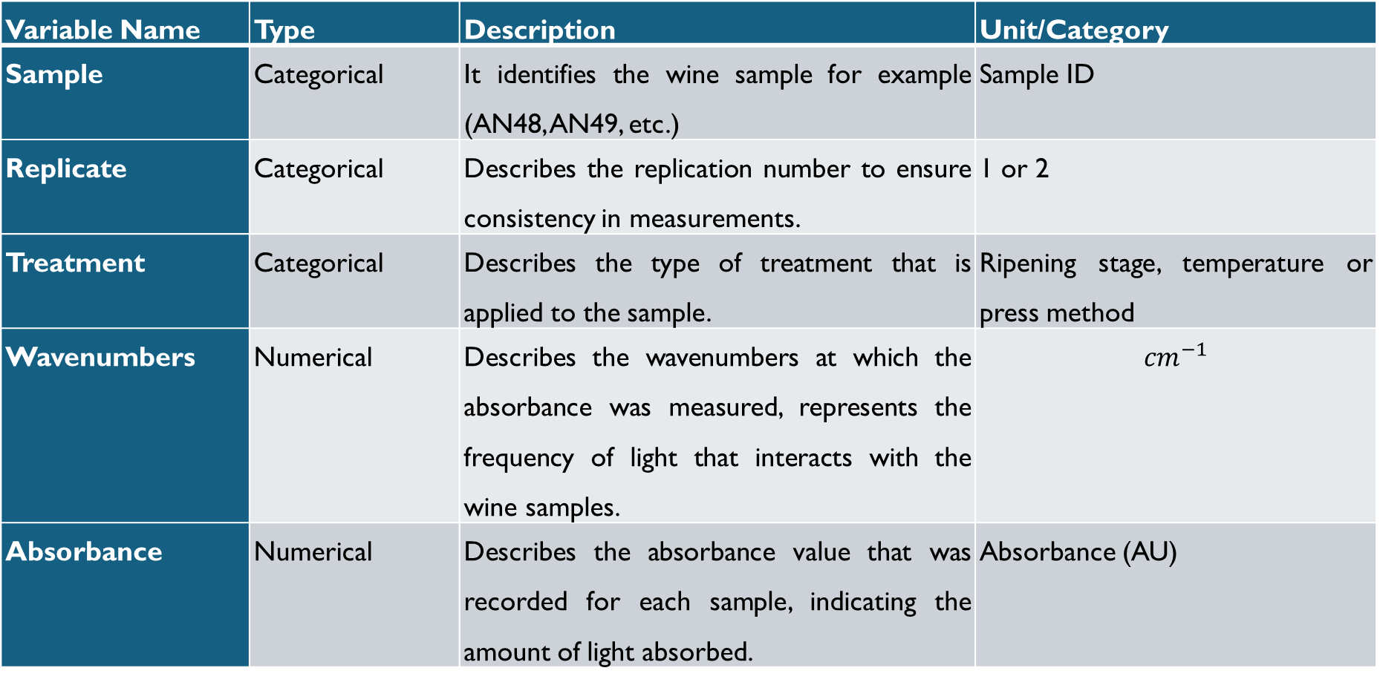
METHODOLOGY Table 1: Outline of dataset
Variable Name | Type | Description | Unit/Category
Sample | Categorical | It identifies the wine sample for example (AN48, AN49, etc.) | Sample ID
Replicate | Categorical | Describes the replication number to ensure consistency in measurements. | 1 or 2
Treatment | Categorical | Describes the type of treatment that is applied to the sample. | Ripening stage, temperature or press method
Wavenumbers | Numerical | Describes the wavenumbers at which the absorbance was measured, represents the frequency of light that interacts with the wine samples. | $${cm}^{−1}$$
Absorbance | Numerical | Describes the absorbance value that was recorded for each sample, indicating the amount of light absorbed. | Absorbance (AU)

Slide 5
Results & Discussion
Analysis of variance (ANOVA)
Is there a significant difference in absorbance between the treatments?
ANOVA Results: F-value: 49.42 and p-value: < 2 × 10⁻¹⁶.
Conclusion: The results indicate that there is a statistically significant difference between treatments
At least one treatment has an effect on absorbance.
TUKEY HONESTLY SIGNIFICANTLY DIFFERENT (HSD)
Where is this significant difference between treatments?
Ripening stage 2 5ºB shows higher absorbance compared to 18ºB and 22ºB
Ripening stage 22ºB has a higher absorbance than 18ºB
Temperature (both 4ºC and Ambient) leads to higher absorbance than Ripening stage 18ºB.
No significant differences between Bag press: Crushed and Bag press: Whole (p-adj > 0.93).

Slide 6
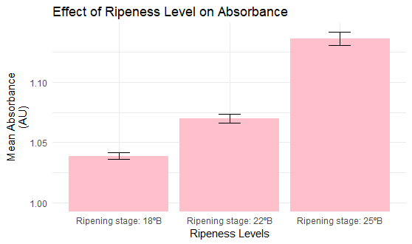

Slide 7
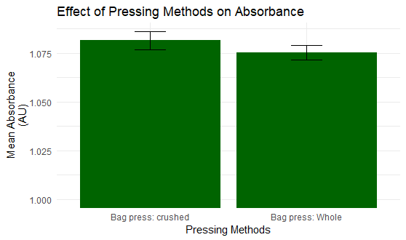

Slide 8
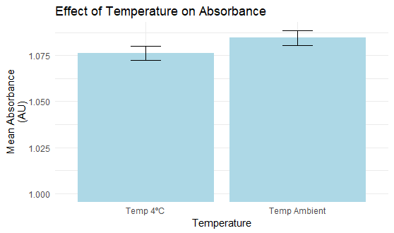

Slide 9
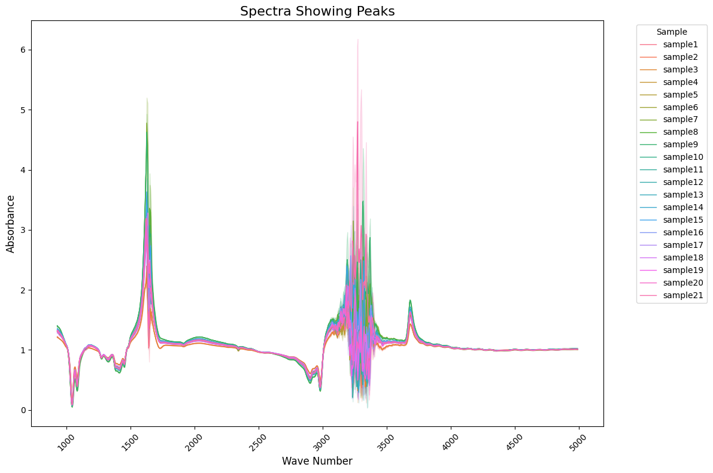

Slide 10

Discussion
Graph highlights the absorbance at different wavenumbers
The prominent peaks are found at:
1500 ${cm}^{−1}$
3000 ${cm}^{−1}$ to 3500 ${cm}^{−1}$
Peaks may indicate higher pinking susceptibility.

Slide 11
Conclusion & Recommendations
This study examined the effect of different treatments on pinking susceptibility in wine and assessed the effectiveness of WineScan for detecting it.
Treatments included: temperature conditions (4°C vs. ambient), ripening stages (18°B, 22°B, and 25°B), and press methods.
Temperature and Press Method: Minimal effect on pinking.
Ripening Stage: Grapes at 25°B have higher pinking susceptibility than 18°B and 22°B stages.
Recommendation: To minimize pinking, winemakers should use less mature grapes (18°B and 22°B) and whole bunch grapes at ambient temperatures.
Final conclusion: Ripening stage was the main factor influencing pinking in this study.

Slide 12

REFERENCES
Andrea-Silva, J., Cosme, F., Ribeiro, L.F., Moreira, A.S.P., Malheiro, A.C., Coimbra, M.A., Domingues, M.R.M. & Nunes, F.M., 2014. Origin of the pinking phenomenon of white wines. J. Agric. Food Chem. 62, 5651-5659.
Arapitsas, P., Oliveira, J., Mattivi, F., 2015. Do white grapes really exist? Food Research International, 69, 21–25.
Bauer, R., Nieuwoudt, H., Bauer, F.F., Kossmann, J., Koch, K.R. and Esbensen, K.H., 2008. FTIR spectroscopy for grape and wine analysis. American Chemical Society. 1371-1379
Bilko, M., Babych, I., Naumenko, O., Ischenko, M., Bilko, M., Gunko, S., Babich, I., Naumenko, O., Mukoid, R., Ischenko, M., Doboniy, I., Danylenko, S., Bovkun, A., & Stotska, O., 2022. Investigation of the appearance and elimination of pinking coloration in white wines. Eastern-European Journal of Enterprise Technologies.1 (11 (115)): 56–62.
Budziak-Wieczorek, I., Mašán, V., Rzad, K., Gładyszewska, B., Karcz, D., Burg, P., Cížková, A., ˇGago´s, M. & Matwijczuk, A., 2022. Evaluation of the Quality of Selected White and Red Wines Produced from Moravia Region of Czech Republic Using Physicochemical Analysis, FTIR Infrared Spectroscopy and Chemometric Techniques. Molecules. 28(6326): 1-15.

Slide 13
Cojocaru, G. A., Antoce, A. O. , 2019. Effect of certain treatments to prevent or partially reverse the pinking phenomenon in susceptible white wines. BIO Web of Conferences, 15, 02003.
Cosme, F., Andrea-Silva, J., Filipe-Ribeiro, L., Moreira, A. S. P., Malheiro, A. C., Coimbra, M. A. & Nunes, F. M., 2019. The origin of pinking phenomenon in white wines: An update. BIO Web Conference.12: 2013.
Dalgaard, P., 2008. Introductory Statistics with R. 2nd ed. New York: Springer.
Jones, T., 1989. Pinking of white table wines: Further studies. Unpublished Master of Science thesis, University of California, Davis, CA, USA.
Jones, T., 1989. Pinking of white table wines: Further studies. Unpublished Master of Science thesis, University of California, Davis, CA, USA.

Slide 14
Lamuela-Raventós, R.M., Huix-Blanquera, M. & Waterhouse, A.L., 2001. Treatments for pinking alteration in white wines. Am. J. Enol. Vitic. 52(2), 156-158.
Luthfi, M.A. & Susanto, A., 2024. Classification of Red Wine Beverage Quality Using a Support Vector Machine Algorithm Based on Forward Selection as Feature Selection. International Journal of Engineering Computing Advanced Research. 1(1): 22-23.10.3390/molecules28176326
Minute, F., Giotto, F., Filipe-Ribeiro, L., Cosme, F., & Nunes, F. M., 2022. Is pinking susceptibility index a good predictor of white wines pinking phenomena? Foods. 10(3), 5531
Minute, F., Giotto, F., Filipe-Ribeiro, L., Cosme, F., & Nunes, F.M., 2021. Alternative Methods for Measuring the Susceptibility of White Wines to Pinking Alteration: Derivative Spectroscopy and CIEL*a*b* Color Analysis. Foods. 10(553): 1-15.

Slide 15
Nanda, A., Mohapatra, D. B. B., Mahapatra, A. P. K., Mahapatra, A. P. K., & Mahapatra, A. P. K., 2021. Multiple comparison test by Tukey's honestly significant difference (HSD): Do the confident level control type I error. International Journal of Statistics and Applied Mathematics, 6, 59– 65.
Nel, A.P., 2021. Pinking of wine – influence of different winemaking processes, causative agents and pinking treatments. Unpublished PhD thesis. Stellenbosch University.
Nel, A.P, du Toit, W. & van Jaarsveld, F.P., 2020. Pinking in White Wines -A Review. South African Journal of Enology and Viticulture. 41(2):151-156.
Ranaweera, R.K.R., Capone, D.L., Bastian, S.E.P., Cozzolino, D. & Jeffery, D.W., 2021. A Review of Wine Authentication Using Spectroscopic Approaches in Combination with Chemometrics. Molecules. 26(4334): 1-15.
Rouxinol, M.I., Martins, M.R., Murta, G.C., Mota Barroso J., & Rato, A.E., 2022. Quality Assessment of Red Wine Grapes through NIR Spectroscopy. Agronomy. 12(637): 1-16.
Simpson, R.F., 1977a. Oxidative pinking in white wines. Vitis 16, 286-294.

Slide 16
Simpson, R.F., Miller, G.C. & Orr, G.L., 1982. Oxidative pinking of white wines: Recent observations. Food Tech. Austr. 34(1), 44-47.
Tobe, S.J., 1983. Pinking in table wines from white grapes. Unpublished MSc thesis, University of California, Davis, USA.
Tukey, J. W., 1991. The Philosophy of Multiple Comparisons. Statistical Science, 6(1), 100-116.
Viejo, C.G. & Fuentes, S., 2023. Digital Assessment and Classification of Wine Faults Using a Low-Cost Electronic Nose, Near-Infrared Spectroscopy and Machine Learning Modelling. Sensors. 22(2303): 1-16.

