Slide 1
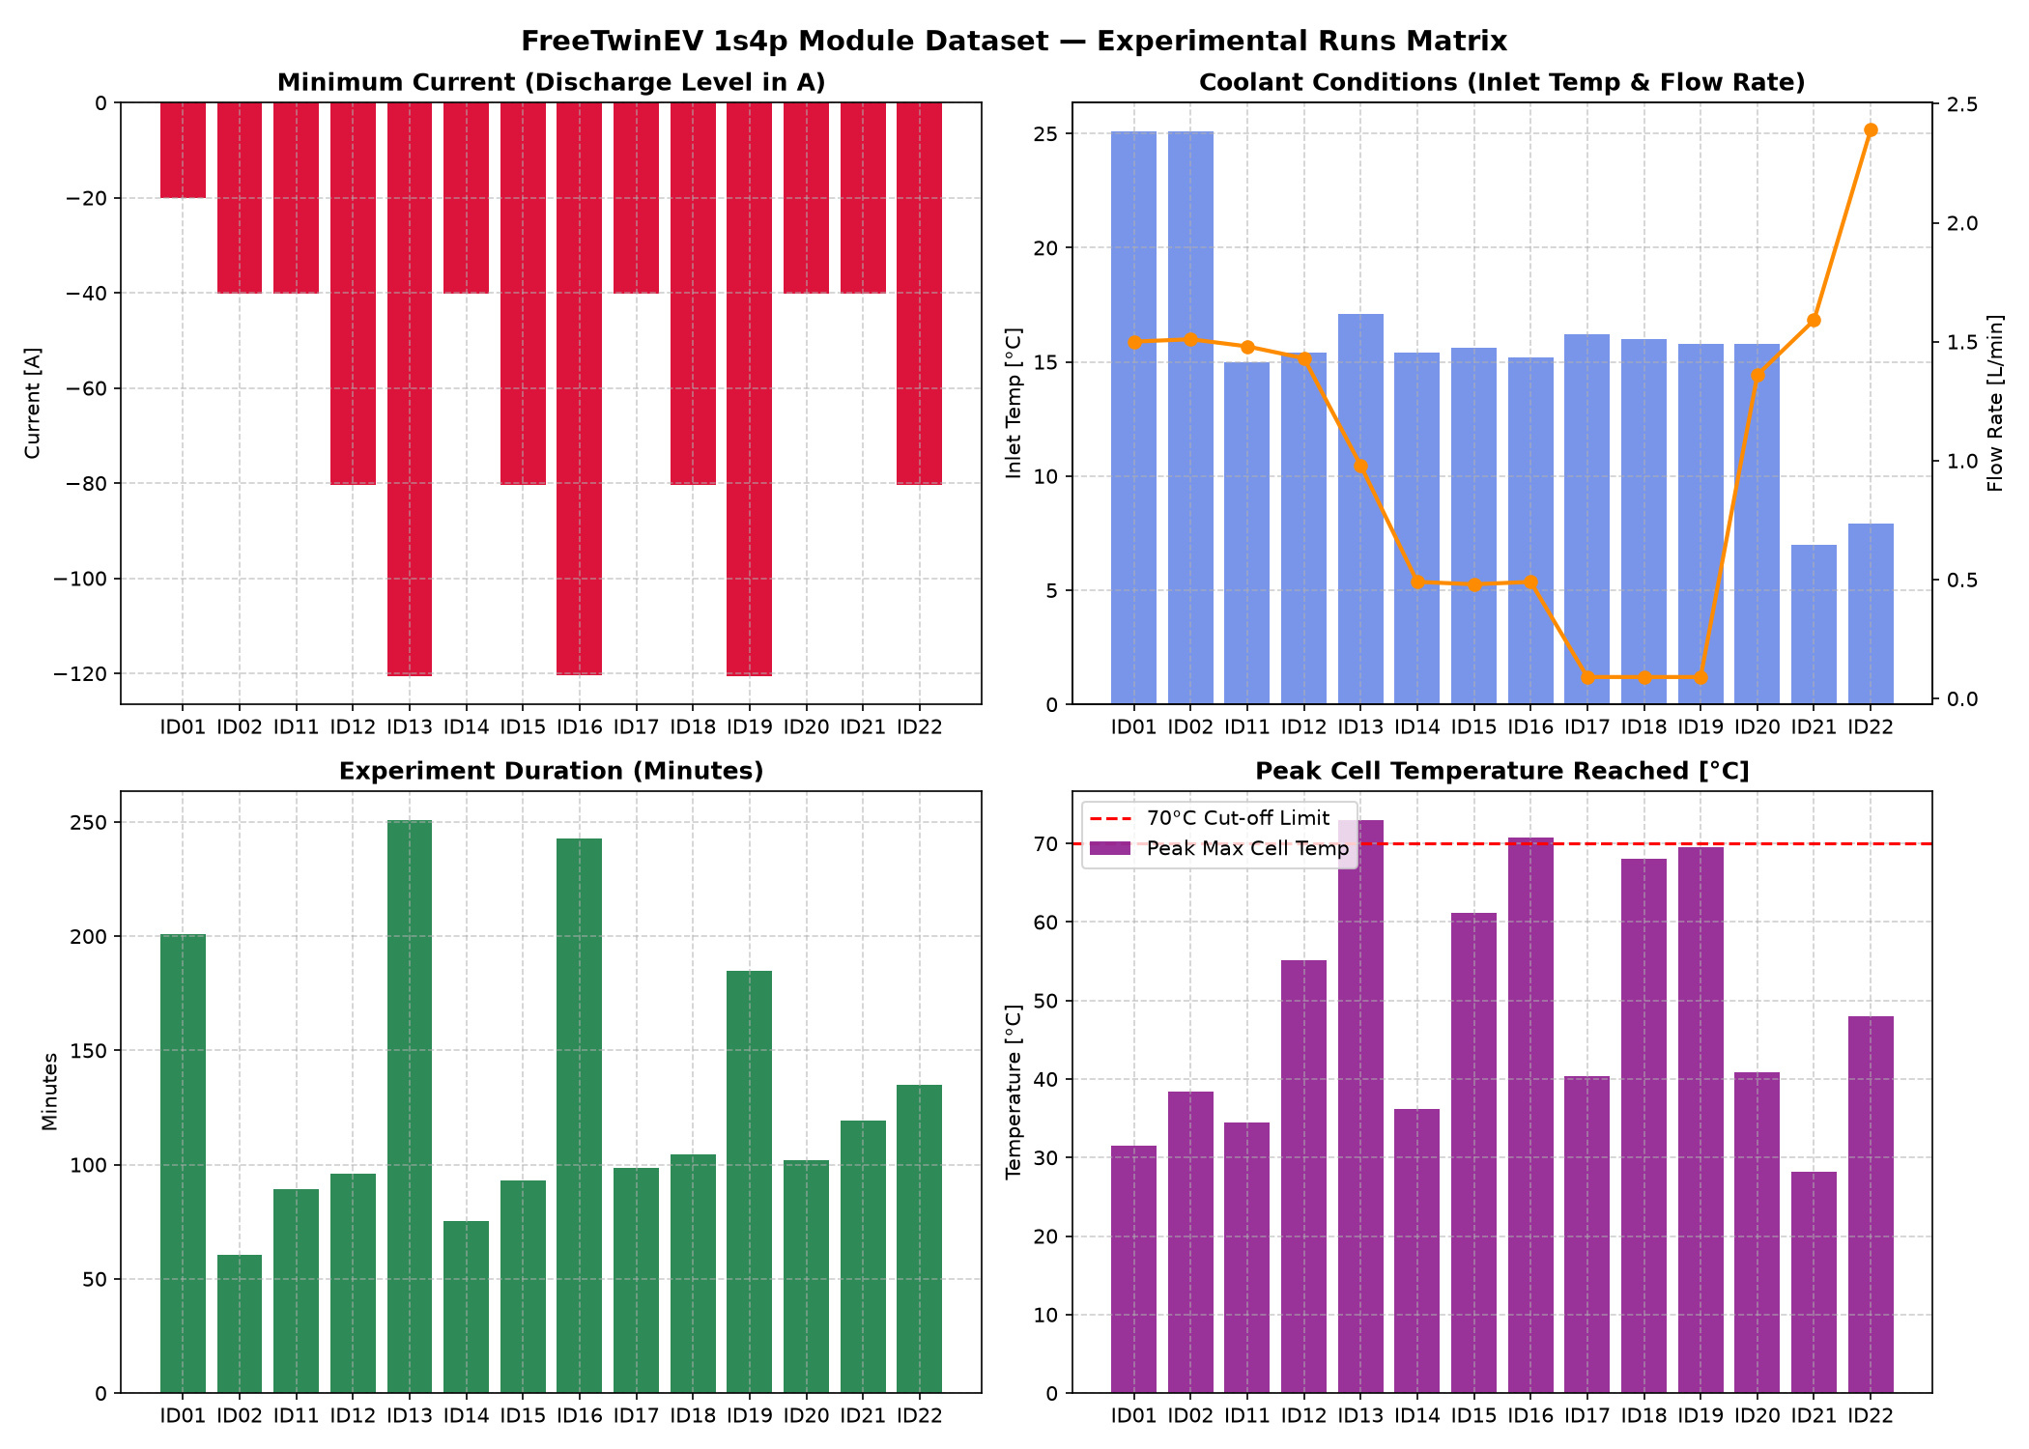
AI-enabled battery thermal forecasting
FreeTwinEV P45B 1s4p battery module
Forecasting, risk interpretation, cooling guidance, and dashboard
AAI Mini Project, KJS-CES-02
Notes:
Source: Phase 0 dataset assessment and persisted FreeTwinEV figures.

Slide 2
Problem framing
Project objective
Predict future maximum cell-surface temperature using measurements available at time t.
Use 60-second and 300-second forecast horizons.
Keep validation for development and ID18 and ID19 as held-out test runs.
Translate frozen forecasts into risk and cooling decision-support outputs.
Phase 11 final presentation | 2
Notes:
The project prioritizes leakage prevention, validation discipline, and traceable outputs.

Slide 3
Physical evidence
Dataset and provenance
14
22,247
5 s
12
physical runs
observations
sampling interval
cell temperature sensors
The previous EV battery CSV was rejected after leakage and continuity checks.
FreeTwinEV provides documented physical battery-module experiments.
Current, voltage, SOC, coolant flow, inlet temperature, ambient temperature, and cell sensors support causal timing at t.
Phase 11 final presentation | 3
Notes:
Source: reports/freetwinev_dataset_assessment.md and reports/freetwinev_eda.md.

Slide 4
Target definition
Forecasting formulation
Training target
DeltaT_h(t) = T_cell_max(t + h) - T_cell_max(t)
Absolute reconstruction
T_future_pred = T_cell_max(t) + predicted_DeltaT_h(t)
Horizon | Steps | Purpose
60s | 12 | Operational response
300s | 60 | Strategic thermal envelope
Phase 11 final presentation | 4
Notes:
Source: Phase 2 target and feature definition.

Slide 5
Validation design
Frozen split and leakage controls
Split | Runs
Train | ID01, ID02, ID11, ID12, ID13, ID14, ID15, ID17, ID20, ID21
Validation | ID16, ID22
Held-out test | ID18, ID19
Run-level split. No row shuffle.
StandardScaler fitted on training data only.
Rolling and lag features use time t or earlier only.
ID18 and ID19 never inform model selection, threshold derivation, or recommendation rules.
Phase 11 final presentation | 5
Notes:
Source: preprocessing_config.json and split_manifest.csv.

Slide 6
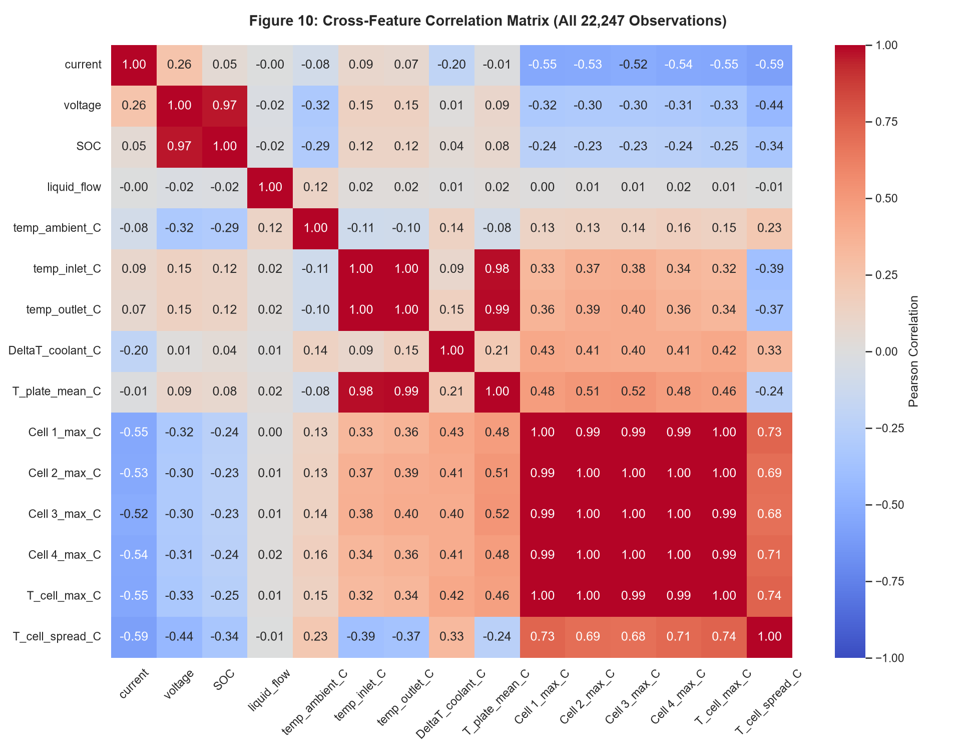
Feature engineering
Extended 21-feature representation
Electrical state: current, voltage, and SOC.
Cooling state: liquid flow, inlet temperature, and ambient temperature.
Thermal state: current hotspot, cell spread, and plate mean.
Derived physics terms: current squared, power, rolling load history, thermal velocity, and gradients.
Ablation outlet-temperature features were not promoted into the selected model.
Phase 11 final presentation | 6
Notes:
Source: feature_manifest.json and reports/freetwinev_target_feature_definition.md.

Slide 7
Validation only
Model selection evidence
Horizon | Selected model | Validation MAE | Validation RMSE | Validation R2
60s | Extended Ridge, alpha = 1.0 | 0.1598 | 0.7228 | 0.7890
300s | Extended OLS | 2.2582 | 4.5396 | 0.5027
Tree ensembles were evaluated with grouped cross-validation.
They did not beat the selected Extended linear models on validation.
Selection occurred before held-out test access.
Phase 11 final presentation | 7
Notes:
Source: Phase 4, Phase 5, and Phase 6 reports.

Slide 8
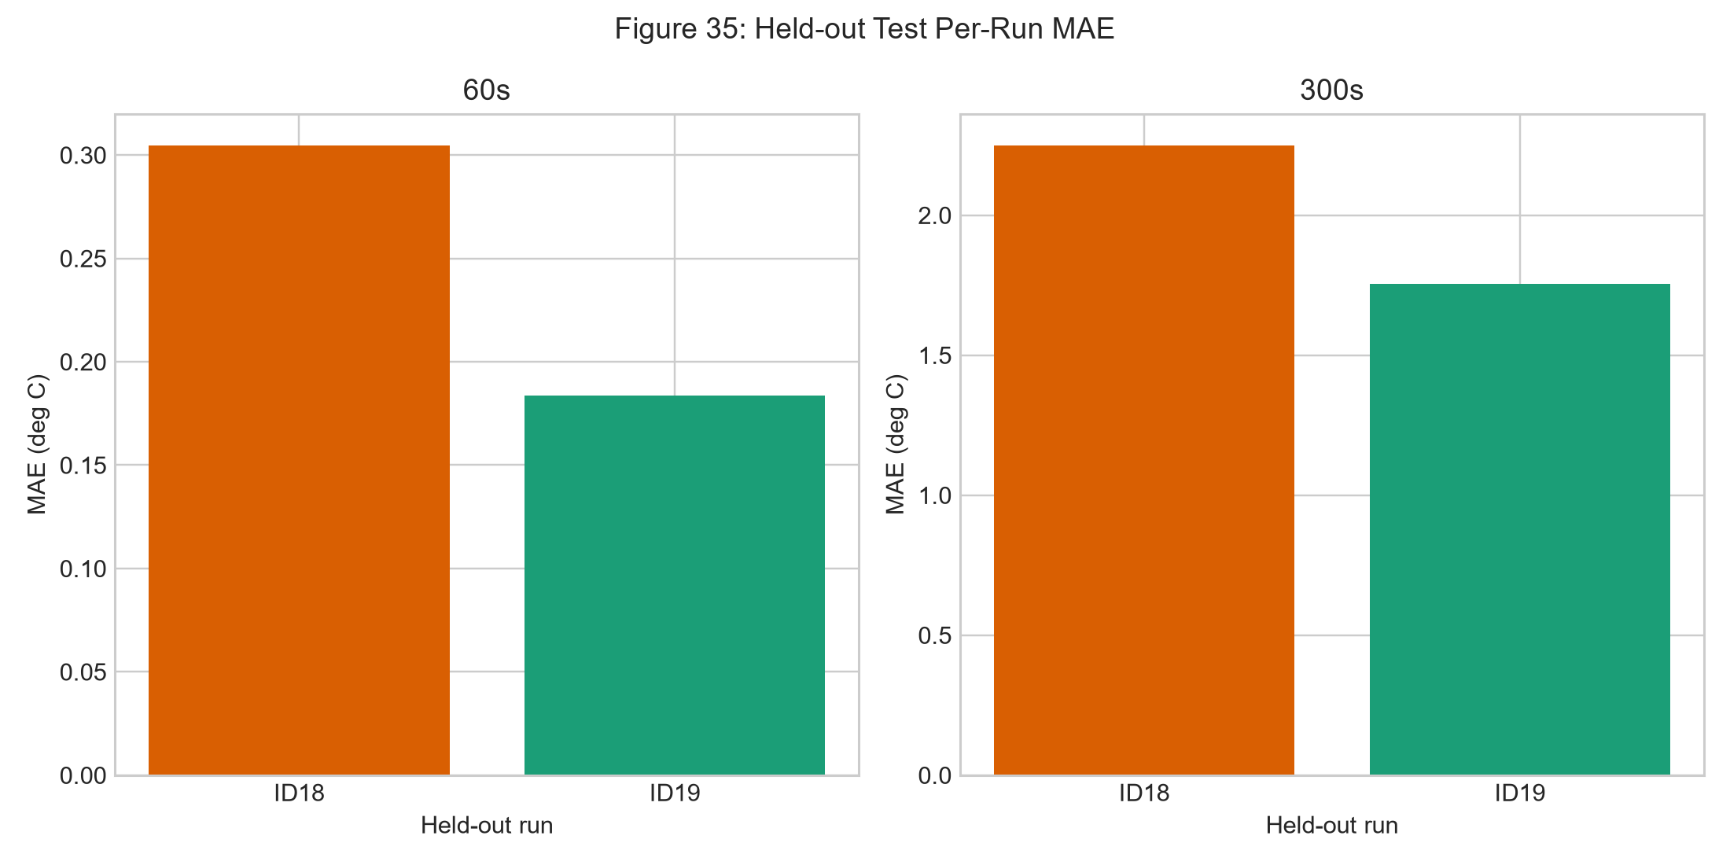
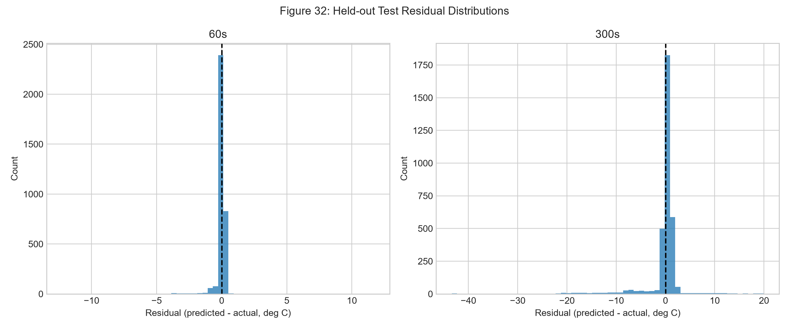
Final evaluation
Held-out test performance
Horizon | Model | Test MAE | Test RMSE | Test R2 | Max AE
60s | Extended Ridge | 0.2271 | 0.8256 | 0.8060 | 12.2504
300s | Extended OLS | 1.9302 | 4.9649 | 0.5836 | 43.3812
Phase 11 final presentation | 8
Notes:
Source: results/freetwinev/phase6_results.csv and phase6_results_per_run.csv.

Slide 9
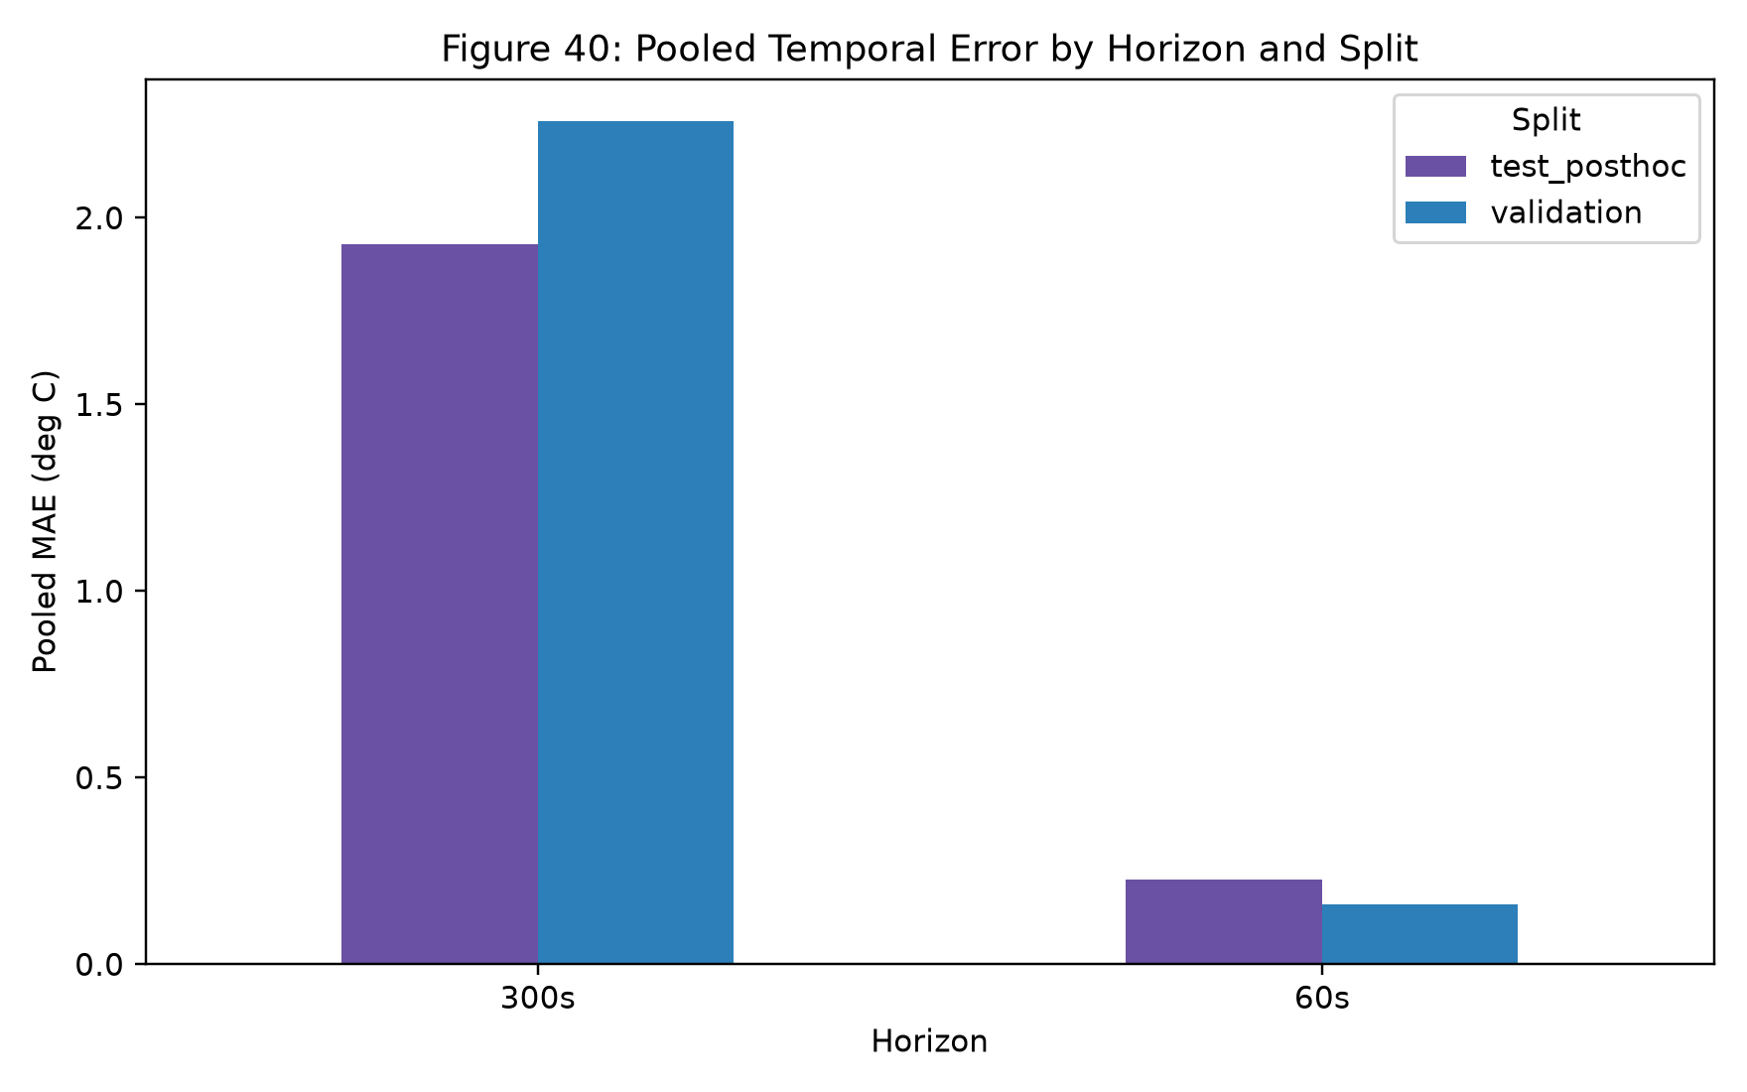
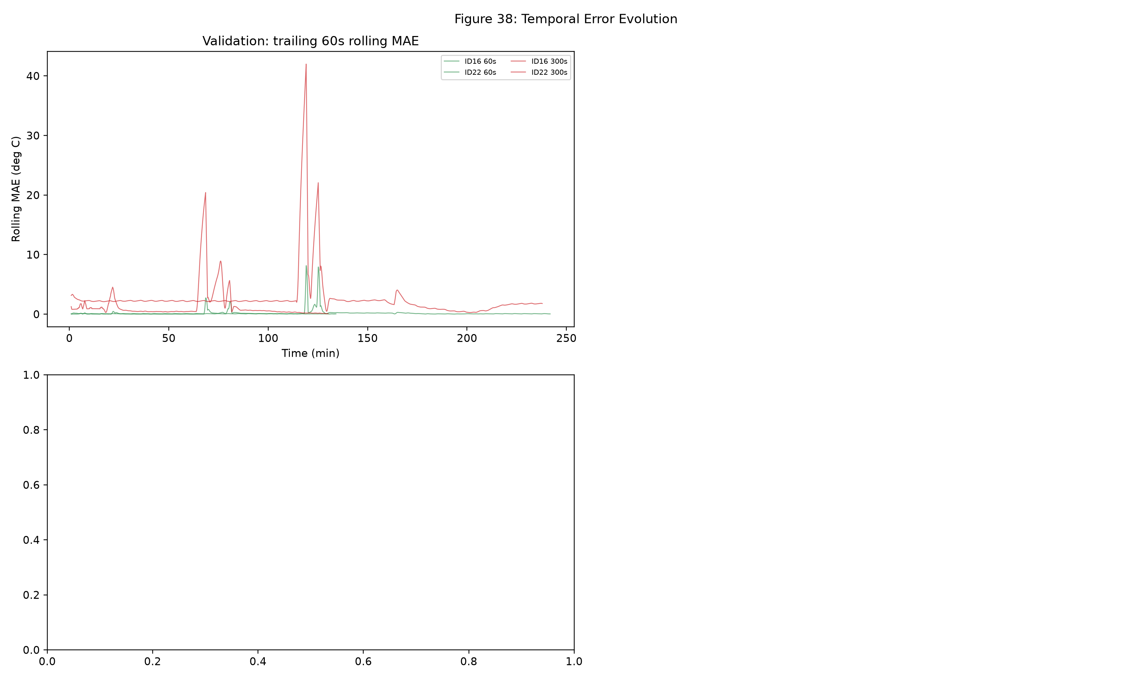
Forecast stability
Temporal behavior
60s is tighter. 300s has useful signal but larger local error spikes.
Phase 11 final presentation | 9
Notes:
Source: Phase 7 temporal forecasting report and figures 38 and 40.

Slide 10
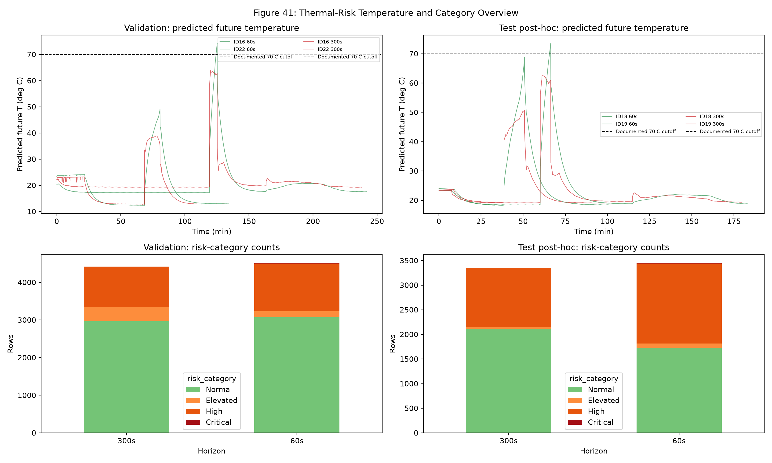
Interpretability
Thermal-risk layer
Critical uses the documented 70 deg C cell-surface cutoff.
P75, P90, and P99 bands come from validation forecasts only.
Secondary signals include predicted DeltaT, recent trend, cell spread, and sustained elevated state.
Held-out ID19 produced 9 critical rows at 60s after rules were frozen.
Risk categories are decision-support indicators, not certified safety labels.
Phase 11 final presentation | 10
Notes:
Source: phase8_thresholds.json and reports/freetwinev_phase8_thermal_risk.md.

Slide 11
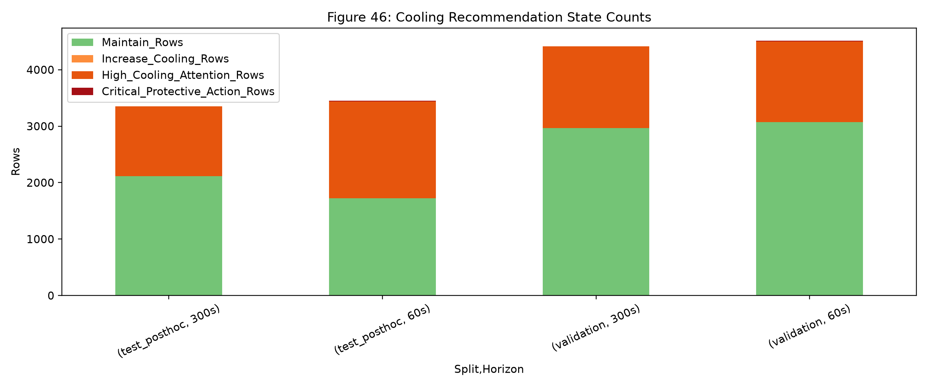
Decision support
Cooling recommendation layer
Recommendation | Meaning
MAINTAIN | Normal risk
INCREASE_COOLING | Elevated, active load, low flow
HIGH_COOLING_ATTENTION | High risk or unsupported Elevated state
CRITICAL_PROTECTIVE_ACTION | Critical risk
Horizon | Flow Spearman | Inlet-temp Spearman
60s | -0.4325 | 0.4195
300s | -0.4865 | 0.5451
Associations are observational and confounded by operating regime.
Phase 11 final presentation | 11
Notes:
Source: Phase 9 cooling recommendation report and validation associations.

Slide 12
Interface layer
Dashboard
Streamlit and Plotly dashboard over persisted Phase 6-9 artifacts.
Filters by run, horizon, time, risk category, and recommendation state.
Shows forecast trajectories, risk timelines, recommendation transitions, and final metrics.
Does not train models, tune thresholds, or generate new predictions.
Phase 11 final presentation | 12
Notes:
Source: reports/freetwinev_phase10_dashboard.md and phase10_dashboard_audit.json.

Slide 13
Scope
Limitations
Fourteen physical runs from one laboratory module setup.
Only ID18 and ID19 serve as held-out stress-test runs.
The 300s model has materially larger RMSE and tail errors than the 60s model.
P75/P90/P99 risk bands are descriptive validation percentiles.
Cooling guidance is not causal proof and not a certified controller.
Phase 11 final presentation | 13
Notes:
Source: Phase 6-10 limitations sections.

Slide 14
Final conclusion
The project delivers a reproducible thermal forecasting and decision-support prototype with protected held-out evaluation.
0.2271 deg C
0.8060
1.9302 deg C
held-out 60s MAE
held-out 60s R2
held-out 300s MAE
Best framing: validated academic decision support, not a certified EV battery safety controller.
Notes:
Source: Phase 6 final evaluation and final report limitations.

