Slide 1
CLEAN CITY
SAN JOSE STATE UNIVERSITY
NRUPESH PATEL
Nrupesh.patel@sjsu.edu

Slide 2
ARCHITECTURE
OVERVIEW

Slide 3
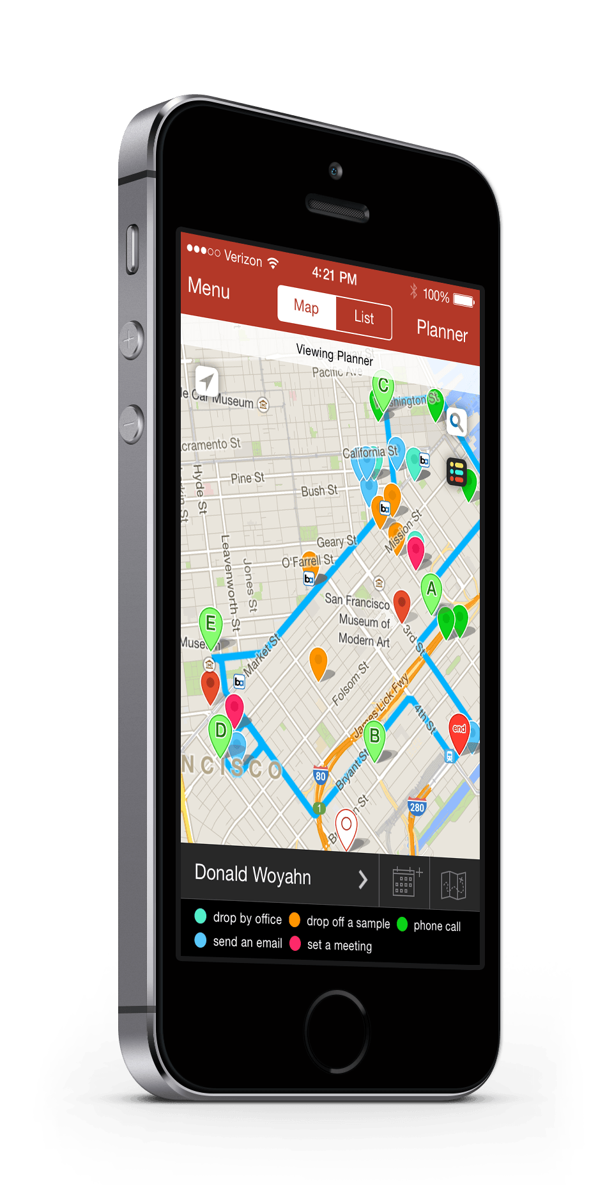
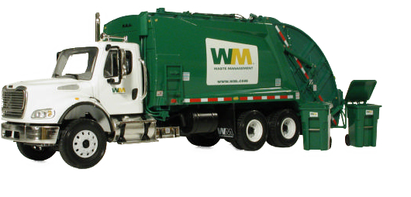
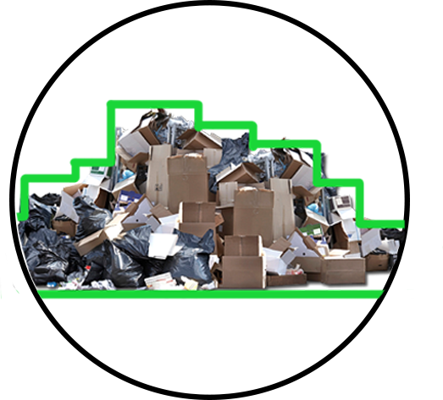
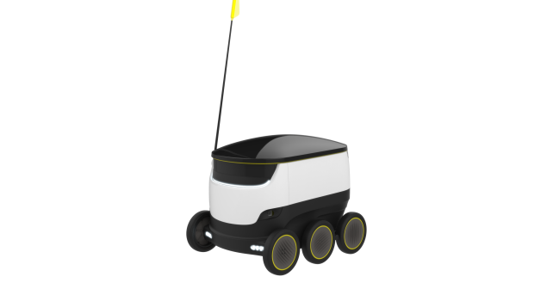
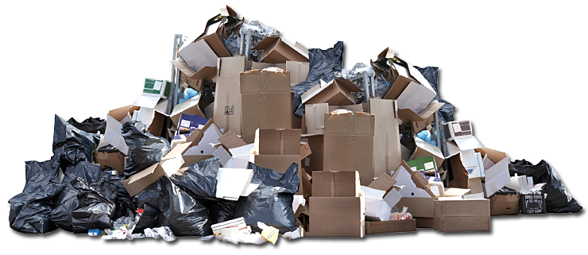

ARCHITECTURE OVERVIEW

Slide 4
WORKFLOW
OVERVIEW

Slide 5
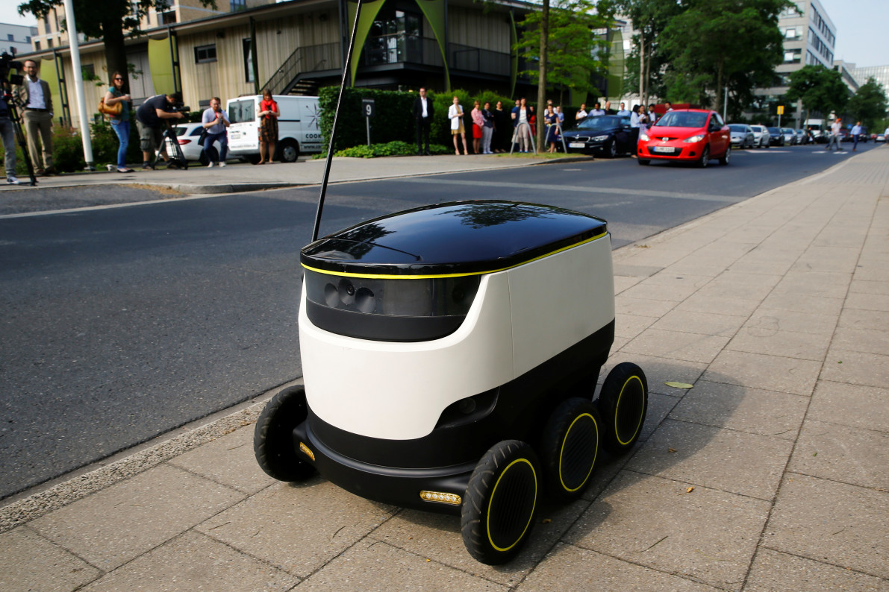
WORKFLOW OVERVIEW
Self-driving robot will be left on the streets of the city and real-time updates regarding garbage detection will be collected using AI and deep learning.

Slide 6
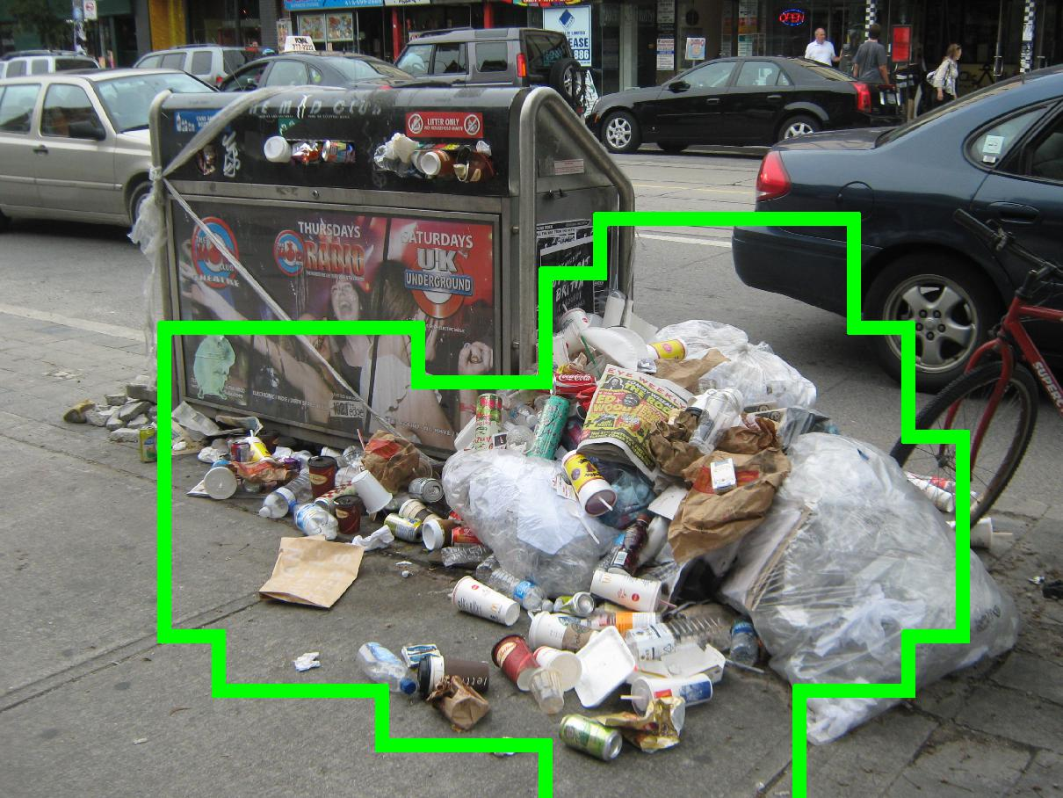
WORKFLOW OVERVIEW (Cont..)
Deep Learning will be used to segment the garbage from collected images by the robot. Trained model will be used to compare images to GINI (Garbage IN Images) dataset for garbage detection.

Slide 7
WORKFLOW OVERVIEW (Cont..)
Optimized route will be prepared by the Robot and sent to the cleaning trucks in the city so that maximum garbage can be collected in one go.

Slide 8
PHASE
DISCTRIBUTION

Slide 9
PHASE DISTRIBUTION
The entire solution is divided into four phases:
Enhance current Garbage detection system.
Prepare the robot for detecting garbage.
Train the robot for generating optimized path.
Create an application for Cleaning trucks to get the real-time updates.

Slide 10
TECHNOLOGY
STACK

Slide 11





TECHNOLOGY STACK

Slide 12
REFERENCE

Slide 13
REFERENCE
http://caffe.berkeleyvision.org/
https://en.wikipedia.org/wiki/Artificial_intelligence
Mittal, Gaurav, et al. "SpotGarbage: smartphone app to detect garbage using deep learning." Proceedings of the 2016 ACM International Joint Conference on Pervasive and Ubiquitous Computing. ACM, 2016.

Slide 14
THANK YOU
SAN JOSE STATE UNIVERSITY
NRUPESH PATEL
Nrupesh.patel@sjsu.edu

