Slide 1
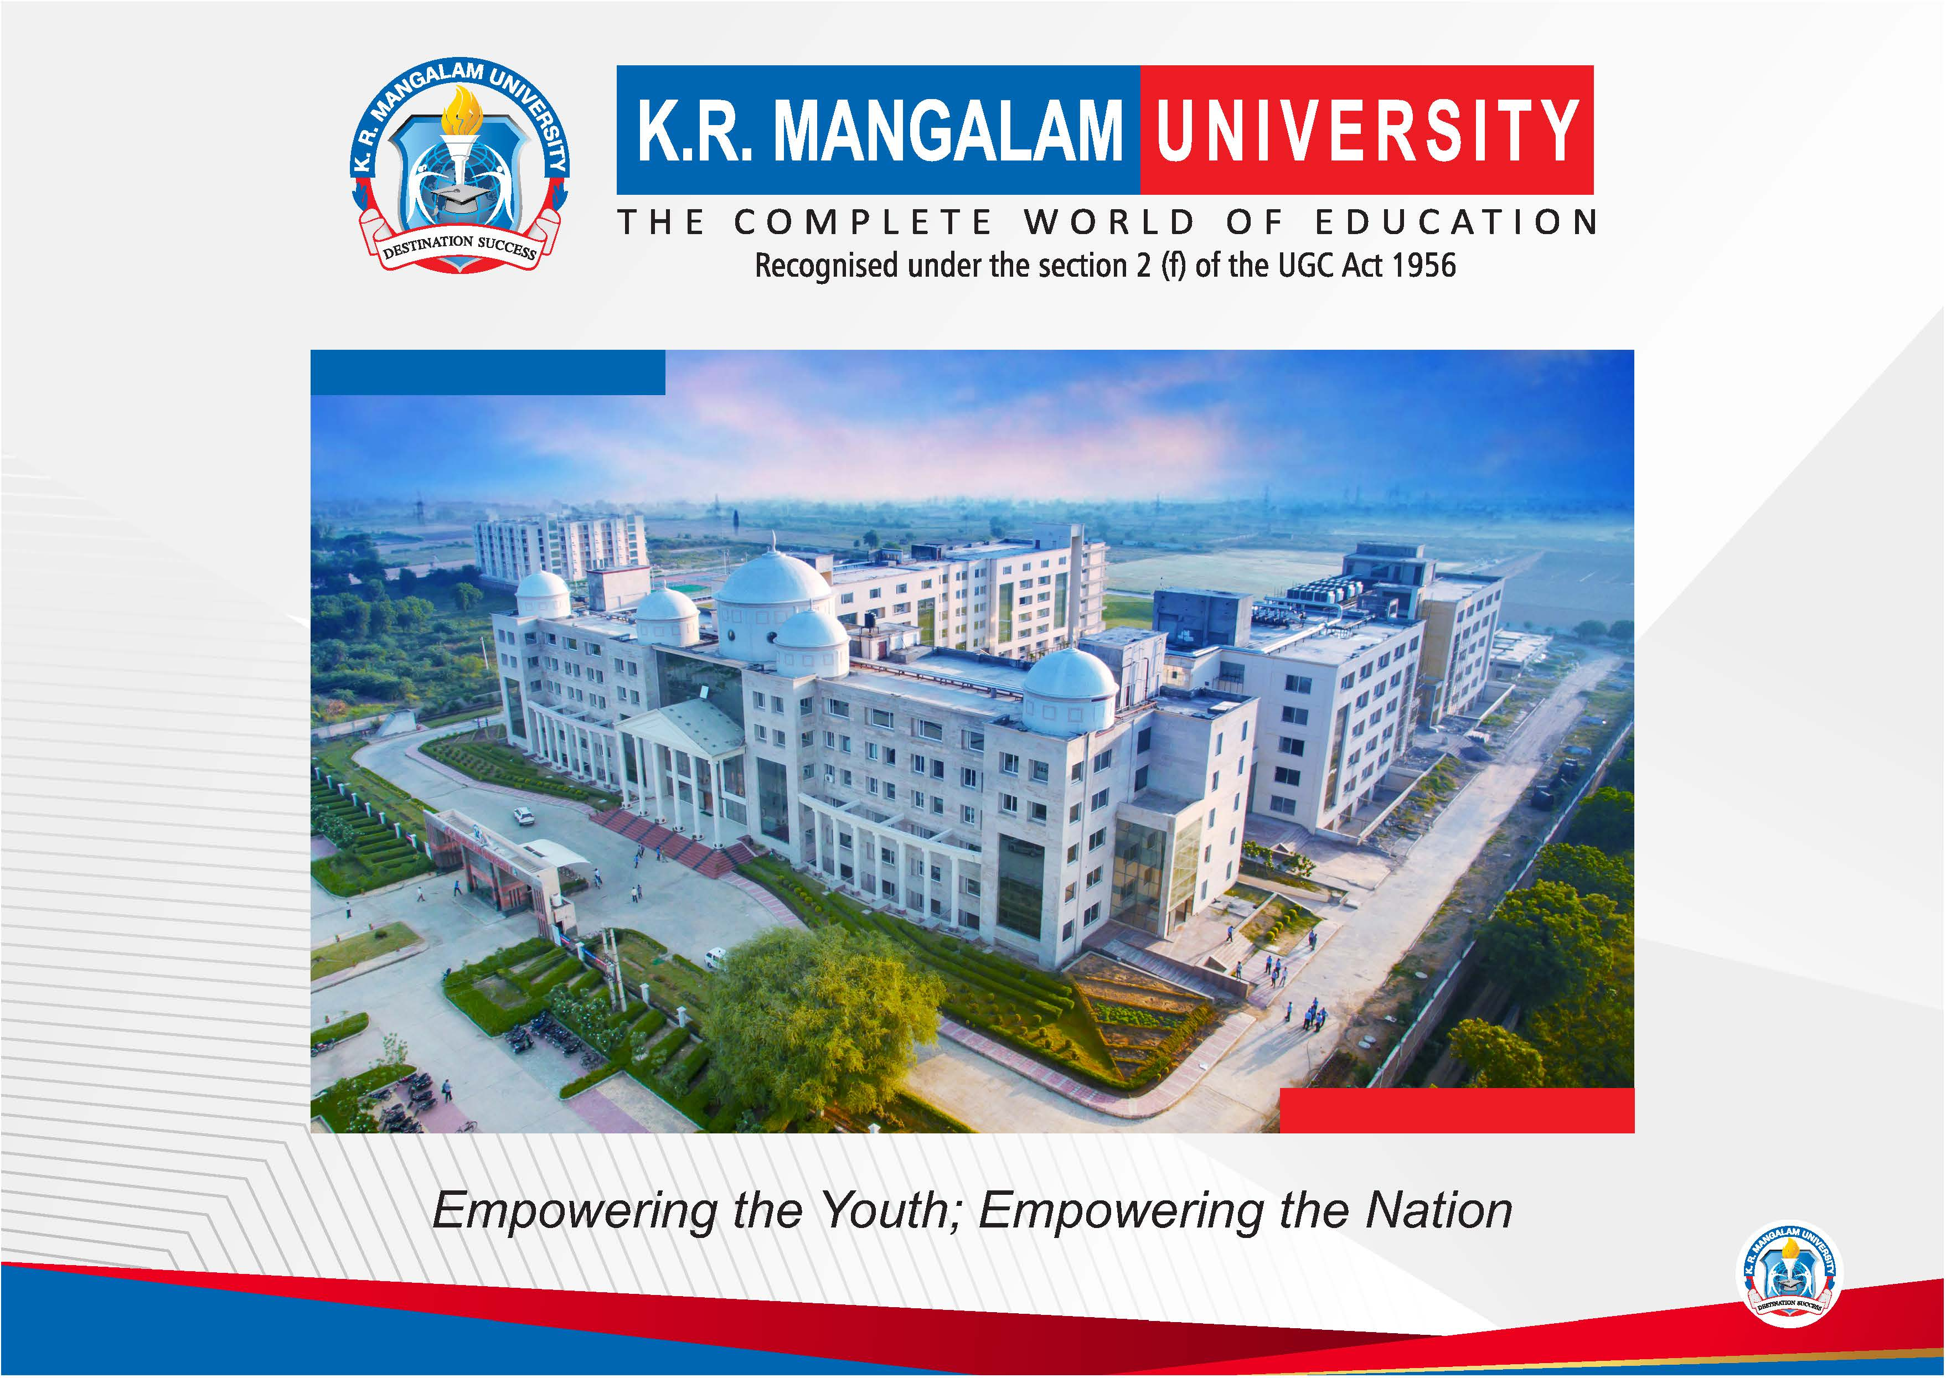

Slide 2


Cold Start Energy Prediction
Final Year Project Synopsis
Submitted by
ROLL | NAME
2201730013 | Neeraj Singh Bisht
2201730036 | Amber Paul
Faculty Mentor: Ms. Neetu Chauhan
Notes:
New Courses replaced with New Programmes

Slide 3

Project Overview
This project focuses on predicting short-term electricity consumption in smart buildings using machine learning and deep learning techniques. Accurate energy forecasting is essential for efficient energy management, especially in cold-start scenarios where little or no historical data is available for a building or device.
The study uses high-frequency smart meter data collected at three-minute intervals to analyze energy usage patterns and develop predictive models.
Several models were implemented and evaluated, including Linear Regression, XGBoost, and Long Short-Term Memory (LSTM) networks. These models were trained to capture both linear relationships and complex temporal patterns present in energy consumption data. The project also involves data preprocessing, feature engineering, and performance evaluation using metrics such as MAE, RMSE, and R².
The results provide insights into how different modeling approaches perform in cold-start energy prediction and demonstrate how machine learning can support smarter and more efficient building energy management systems.
Notes:
New Courses replaced with New Programmes

Slide 4
Specific Objectives
To analyze smart meter energy consumption data and understand usage patterns in buildings.
To address the cold-start energy prediction problem, where limited historical data is available for accurate forecasting.
To preprocess and clean the dataset to make it suitable for machine learning and deep learning models.
To implement and compare different predictive models, including Linear Regression, XGBoost, and LSTM, for energy consumption forecasting.
To evaluate model performance using metrics such as MAE, RMSE, and R² to determine prediction accuracy.
To identify the most effective model for short-term energy prediction in cold-start scenarios.
To demonstrate how machine learning techniques can contribute to efficient energy management in smart buildings.
Notes:
New Courses replaced with New Programmes

Slide 5
Key Features
High-Resolution Energy Data – Utilizes smart meter data recorded at 3-minute intervals, enabling detailed analysis of energy consumption patterns.
Cold-Start Prediction Focus – Addresses the challenge of predicting energy usage when limited historical data is available.
Multiple Machine Learning Models – Implements and compares Linear Regression, XGBoost, and LSTM models to evaluate different prediction approaches.
Data Preprocessing Pipeline – Includes data cleaning, feature engineering, and normalization to improve model performance.
Time-Series Forecasting – Uses sequential modeling techniques to capture temporal dependencies in energy consumption data.
Performance Evaluation – Assesses models using standard metrics such as MAE, RMSE, and R² for reliable comparison.
Scalable Approach – Designed so the methodology can be extended to other smart building energy datasets and forecasting applications.
Notes:
New Courses replaced with New Programmes

Slide 6
Project Usecases & Scope
Smart Building Management: Predicts short-term electricity consumption to help optimize energy usage in buildings.
Cold-Start Energy Prediction: Provides forecasts even when only limited historical energy data is available.
Energy Demand Forecasting: Helps utility providers estimate power demand for better load balancing and grid stability.
Energy Efficiency Improvement: Identifies patterns in energy usage to support strategies for reducing power wastage.
Model Comparison: Evaluates different approaches such as Linear Regression, XGBoost, and LSTM for accurate prediction.
Scalable Framework: The methodology can be extended to smart grids, IoT-based energy monitoring systems, and larger datasets.
Future Expansion: Can be enhanced with real-time prediction systems and additional deep learning models for improved performance.
Notes:
New Courses replaced with New Programmes

Slide 7
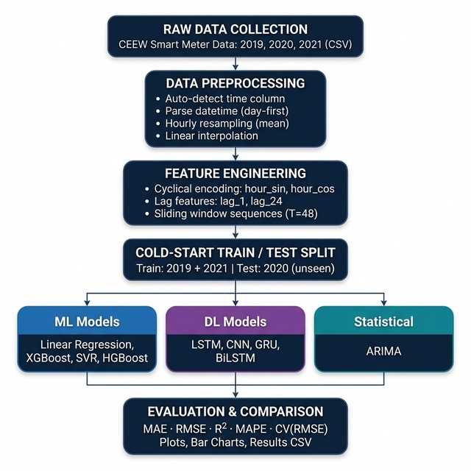
Prototype/Project Flow diagram/Architecture
Notes:
New Courses replaced with New Programmes

Slide 8
Data & Resources
Dataset: Smart meter electricity consumption data from CEEW (Council on Energy, Environment and Water).
Location & Period: Data collected from households in Mathura, India (2020).
Data Frequency: Energy readings recorded at 3-minute intervals, enabling detailed time-series analysis.
Data Attributes: Includes timestamp, electricity consumption values, and related time-based features.
Tools & Technologies: Python, Jupyter Notebook, and machine learning libraries such as Pandas, NumPy, Scikit-learn, TensorFlow/Keras, and XGBoost.
Development Platform: Code and project files managed using GitHub for collaboration and version control.
Hardware Requirements: Standard computer system capable of running Python-based ML models and data processing tasks.
Notes:
New Courses replaced with New Programmes

Slide 9
Progress Summary
Project Planning: Defined the problem of cold-start energy consumption prediction and selected suitable machine learning approaches.
Dataset Acquisition: Collected and organized the smart meter dataset from the CEEW source for analysis.
Data Preprocessing: Cleaned the dataset, handled missing values, and prepared the data for time-series modeling.
Model Implementation: Developed and trained models including Linear Regression, XGBoost, and LSTM for energy prediction.
Model Evaluation: Compared model performance using metrics such as MAE, RMSE, and R².
Result Analysis: Analyzed prediction results to understand the effectiveness of different models.
Project Documentation: Compiled code, results, and explanations in the project repository for presentation and reporting.
Notes:
New Courses replaced with New Programmes

Slide 10
Methodology
Data Collection: Smart meter energy consumption data was obtained from the CEEW dataset, containing high-frequency electricity readings.
Data Preprocessing: The dataset was cleaned by handling missing values, formatting timestamps, and normalizing energy consumption values.
Feature Engineering: Time-based features such as hour, day, and sequential patterns were extracted to improve model learning.
Model Development: Multiple models including Linear Regression, XGBoost, and LSTM were implemented for energy consumption prediction.
Training and Testing: The dataset was divided into training and testing sets to evaluate model performance objectively.
Performance Evaluation: Models were compared using metrics such as MAE, RMSE, and R² to measure prediction accuracy.
Result Analysis: The outputs of each model were analyzed to identify the most effective approach for cold-start energy forecasting.
Notes:
New Courses replaced with New Programmes

Slide 11
Expected Results & Impact
The implemented models successfully predicted short-term energy consumption patterns from smart meter data.
Linear Regression served as a baseline model for understanding basic relationships in the data.
XGBoost captured non-linear patterns and generally produced more accurate predictions than the baseline model.
LSTM was able to learn temporal dependencies in the time-series data, improving forecasting capability for sequential energy usage.
Model performance was evaluated using MAE, RMSE, and R², allowing comparison of prediction accuracy.
The results showed that advanced models like XGBoost and LSTM performed better than traditional regression approaches for energy forecasting.
These findings demonstrate the effectiveness of machine learning and deep learning techniques for cold-start energy prediction in smart building environments.
Notes:
New Courses replaced with New Programmes

Slide 12
Project Timeline
Week 1 – Problem Definition: Identified the cold-start energy prediction problem and finalized project objectives.
Week 2 – Data Collection: Acquired the smart meter dataset and organized it for analysis.
Week 3 – Data Preprocessing: Cleaned the dataset, handled missing values, and prepared time-series features.
Week 4 – Model Development: Implemented prediction models such as Linear Regression, XGBoost, and LSTM.
Week 5 – Training & Evaluation: Trained models and evaluated performance using MAE, RMSE, and R² metrics.
Week 6 – Result Analysis: Compared model outputs and identified the best-performing approach.
Week 7 – Documentation & Presentation: Compiled results, code, and findings for the final report and presentation.
Notes:
New Courses replaced with New Programmes

Slide 13
THANK YOU

