Slide 1
Cold-Start Energy Consumption
Prediction for Smart Buildings
Using Machine Learning, Deep Learning & Transfer Learning Approaches
Presented by: Neeraj Singh Bisht
Dataset: CEEW Smart Meter Data — Mathura, India | 2019 · 2020 · 2021
April 2026

Slide 2
Presentation Agenda
01
Problem Statement & Motivation
02
Dataset Description
03
Methodology & Architecture
04
Feature Engineering
05
Models Implemented (ML, DL, Statistical)
06
Transfer Learning Approach
07
Results & Performance Comparison
08
Key Findings & Conclusions
09
Future Work & References
2

Slide 3
Problem Statement & Motivation
Why cold-start prediction matters for smart buildings
❄ THE COLD-START PROBLEM
⚡ OUR APPROACH
Traditional forecasting needs historical data
from the same building & time period
But this data doesn't exist for:
• Newly installed smart meters
• New buildings with no usage history
• Post-renovation energy changes
Train on 2019 + 2021 smart meter data
Test on 2020 (completely unseen year)
This simulates a real cold-start scenario
where next-year data is unavailable
Compare 12 models across 3 paradigms
🔬 Research Question: Can models trained on non-contiguous years (2019 + 2021) accurately predict energy consumption of an unseen year (2020)?
🌍 REAL-WORLD IMPACT
Enables energy planning for new buildings • Supports smart grid optimization • Reduces energy waste • Enables proactive demand response in smart cities
3

Slide 4
Dataset Description
CEEW Smart Meter Data — Mathura, India
2019 Data
2020 Data
2021 Data
CEEW Smart Meter Mathura 2019
CEEW Smart Meter Mathura 2020
SM Cleaned Data MH 2021
Role: Training Set
Role: Test Set (Unseen)
Role: Training Set
~47 MB CSV
~182 MB CSV
Supplementary
📊 KEY FEATURES
🔄 COLD-START SPLIT STRATEGY
Target Variable: t_kWh (total energy in kWh)
Temporal resolution: Hourly readings
Preprocessing: Resampled to hourly mean
Missing values: Linear interpolation
Geographic: Mathura, Uttar Pradesh, India
Training: 2019 + 2021 combined data
Testing: 2020 — completely unseen year
No data leakage from the test year
Simulates real-world deployment scenario
Models must generalize across year gaps
4

Slide 5
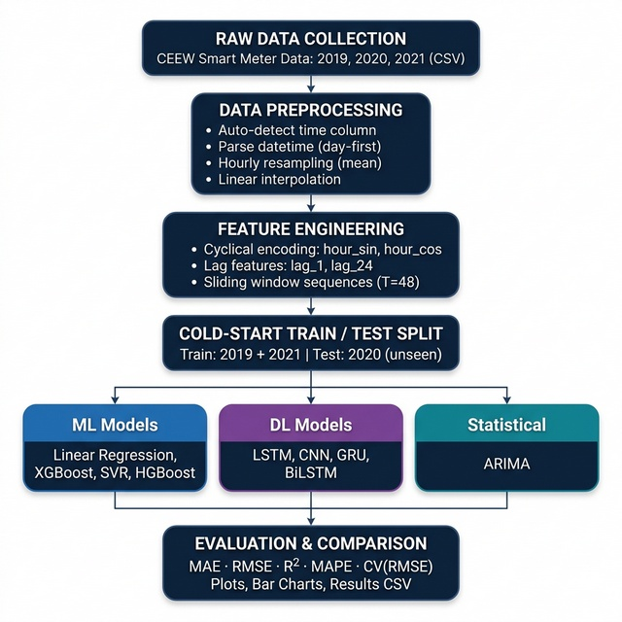
Methodology & Pipeline Architecture
End-to-end prediction framework
1. Raw Data Collection
Load CEEW CSV files (2019, 2020, 2021)
2. Data Preprocessing
Auto-detect time column, parse datetime, hourly resampling, linear interpolation
3. Feature Engineering
Cyclical encoding (hour_sin, hour_cos), lag features (1h, 24h), sliding windows (T=48)
4. Cold-Start Split
Train on 2019+2021 → Test on 2020
5. Model Training
12 models: ML + DL + Statistical
6. Evaluation
MAE, RMSE, R², MAPE, CV(RMSE)
5

Slide 6
Feature Engineering
Transforming raw data into predictive features
Cyclical Time Encoding
Lag Features
Sliding Window Sequences
hour_sin = sin(2π × hour / 24)
hour_cos = cos(2π × hour / 24)
Why? Captures the circular nature of time
(Hour 23 is close to Hour 0)
Avoids misleading linear time features
lag_1: Energy value 1 hour ago
lag_24: Energy value 24 hours ago
Why? Captures short-term patterns
and daily periodicity in energy usage
Most recent history is the best predictor
Window size T = 48 hours (2 days)
Used for LSTM, CNN, GRU, BiLSTM
Input: 48 consecutive timesteps
Output: Next timestep's energy value
Captures multi-day consumption patterns
💡 Key Insight: Combining cyclical encoding with lag features allows models to learn both time-of-day patterns and recent consumption trends — critical for cold-start generalization.
6

Slide 7
Models Implemented — Overview
12 models across 3 paradigms
MACHINE LEARNING
DEEP LEARNING
STATISTICAL
▸ Linear Regression
▸ LSTM (Long Short-Term Memory)
▸ ARIMA (AutoRegressive Integrated Moving Average)
▸ Ridge Regression
▸ CNN (1D Convolutional)
▸ Lasso Regression
▸ GRU (Gated Recurrent Unit)
▸ XGBoost (Gradient Boosting)
▸ BiLSTM (Bidirectional)
▸ SVR (Support Vector)
▸ Transfer LSTM (Pre-train + Fine-tune)
▸ HGBoost (AutoML)
Total: 6 ML models + 5 DL models + 1 Statistical model = 12 models compared
7

Slide 8
Machine Learning Models — Details
Traditional and ensemble approaches
Linear Regression
Ridge Regression
Lasso Regression
Baseline model using ordinary least squares
L2 regularization (α=1.0) prevents overfitting
L1 regularization (α=0.01) feature selection
R² = 0.9902
R² = 0.9900
R² = 0.3105
XGBoost
SVR
HGBoost
600 trees, lr=0.03, depth=4 gradient boosting ensemble
RBF kernel, C=10, ε=0.1 scaled feature space
Bayesian hyperparameter optimization, 250 evals
R² = 0.9912
R² = 0.9912
R² = 0.9922
8

Slide 9
Deep Learning Models — Details
Sequence-based neural network architectures
LSTM
CNN (1D)
GRU
64 units, 32 dense 80 epochs, batch 64 Captures long-term dependencies
64 filters, kernel=3 pool=2, 80 epochs 1D convolutions for patterns
64 units, 32 dense 80 epochs, lighter LSTM Faster training, similar perf
R² = 0.9146
R² = 0.8673
R² = 0.8815
BiLSTM
Transfer LSTM
64 units bidirectional Forward + backward pass Context from both directions
Pre-train on 2019 → Fine-tune on 2021 3-phase progressive unfreezing
R² = 0.8703
R² = 0.8866
Common config: Sequence length = 48 hours | Optimizer = Adam | Loss = MSE | Batch size = 64
9

Slide 10
Transfer Learning — LSTM Approach
Progressive unfreezing for cold-start adaptation
PHASE 1
→
PHASE 2
→
PHASE 3
Pre-training on Source
Fine-tune Dense Head
Full Fine-tuning
Train LSTM on 2019 data (source domain)
64 units, 32 dense layer
50 epochs with Adam optimizer
Learns general energy patterns
Freeze LSTM layers
Fine-tune only dense output layers
Train on 2021 data (target domain)
20 epochs, LR = 5×10⁻⁴
Unfreeze all layers
Very low learning rate: 1×10⁻⁵
20 epochs gentle fine-tuning
Adapts without catastrophic forgetting
📊 Transfer LSTM Results
R² = 0.8866 | MAE = 0.0015 | RMSE = 0.0028 | MAPE = 15.80% While not outperforming traditional ML, Transfer LSTM demonstrates viability of cross-domain knowledge transfer for cold-start scenarios.
10

Slide 11
Results — Performance Comparison
Complete metrics across all 12 models
Model | MAE | RMSE | R² | MAPE (%) | CV(RMSE) (%)
HGBoost ★ | 0.0004 | 0.0007 | 0.9922 | 4.53 | 8.44
XGBoost | 0.0004 | 0.0008 | 0.9912 | 4.67 | 9.00
SVR | 0.0005 | 0.0008 | 0.9912 | 7.49 | 8.98
Linear Regression | 0.0006 | 0.0008 | 0.9902 | 8.09 | 9.46
Ridge Regression | 0.0006 | 0.0008 | 0.9900 | 8.50 | 9.60
LSTM | 0.0012 | 0.0025 | 0.9146 | 13.10 | 28.04
Transfer LSTM | 0.0015 | 0.0028 | 0.8866 | 15.80 | 32.31
GRU | 0.0013 | 0.0029 | 0.8815 | 13.09 | 33.03
BiLSTM | 0.0015 | 0.0030 | 0.8703 | 15.09 | 34.55
CNN (1D) | 0.0016 | 0.0031 | 0.8673 | 17.59 | 34.96
Lasso Regression | 0.0063 | 0.0069 | 0.3105 | 115.16 | 79.51
ARIMA | 0.0050 | 0.0089 | -0.1415 | 44.26 | 102.30
★ Best Overall | Green = Top performers | Red = Poor performers | Ranked by R² (descending)
11

Slide 12
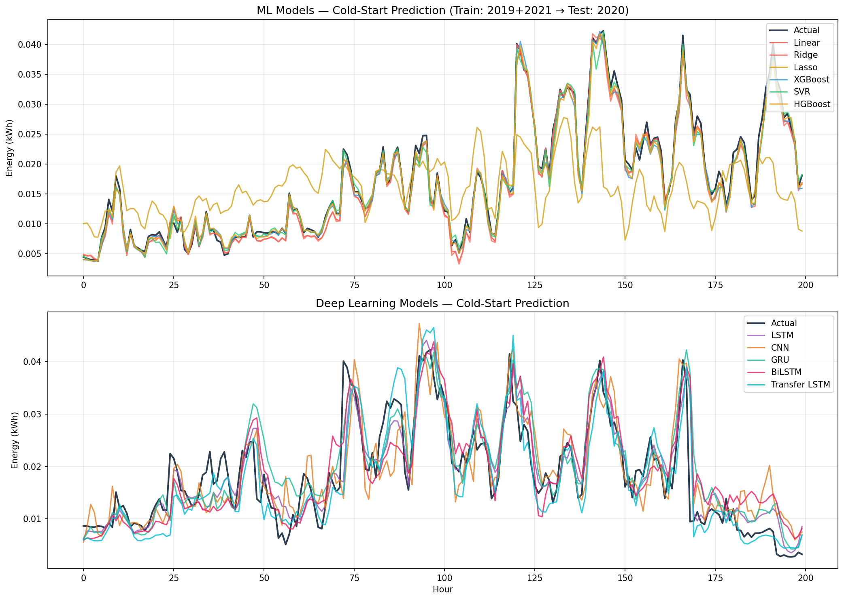
Visual Results — Prediction Comparison
ML models (top) vs Deep Learning models (bottom)
12

Slide 13
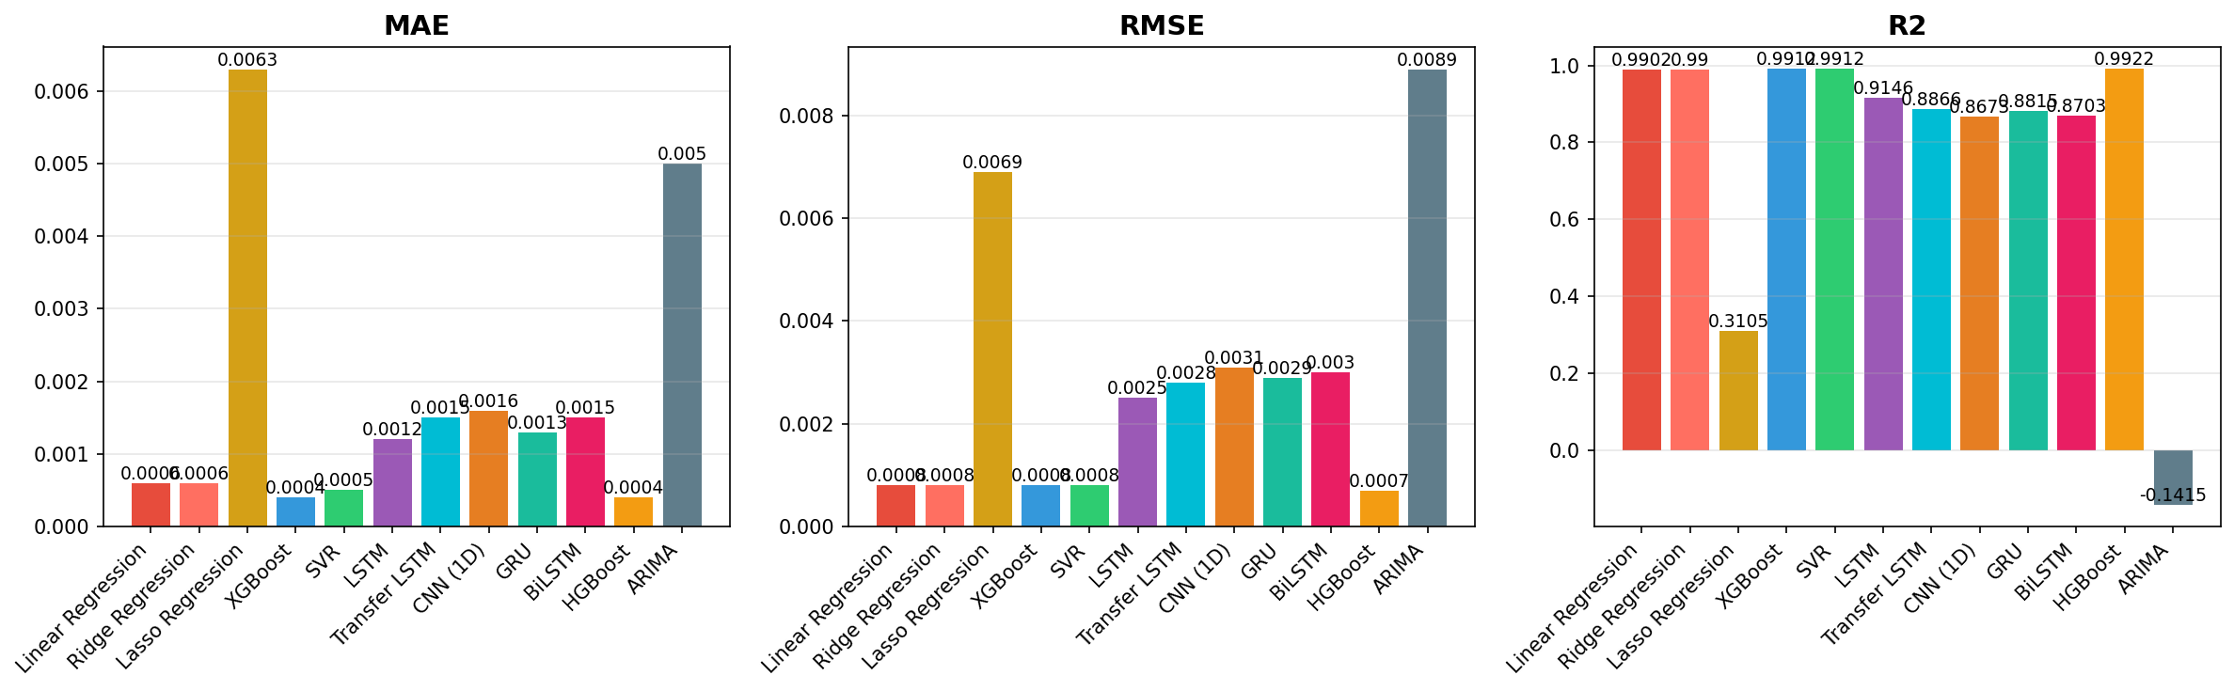
Visual Results — Metrics Comparison
MAE, RMSE, and R² across all models
💡 ML models (especially HGBoost, XGBoost, SVR) significantly outperform DL models in the cold-start scenario. ARIMA and Lasso show poor generalization to unseen years.
13

Slide 14
Key Findings & Conclusions
🏆
HGBoost is the Best Overall Model
R² = 0.9922, lowest CV(RMSE) of 8.44%. Bayesian hyperparameter optimization pays off.
📊
ML Models Dominate Cold-Start Prediction
Top 5 models (R² > 0.99) are all ML-based. Feature-engineered tabular models outperform sequence-based DL models in this scenario.
🧠
Deep Learning Achieves ≈0.87–0.91 R²
LSTM leads DL models (R²=0.9146). DL models need more data to reach ML-level performance in cold-start conditions.
🔄
Transfer Learning Shows Promise
Transfer LSTM (R²=0.8866) demonstrates viability of cross-domain knowledge transfer, though still behind traditional ML approaches.
⚠️
ARIMA & Lasso Fail in Cold-Start
ARIMA (R²=-0.14) and Lasso (R²=0.31) cannot generalize across years. Statistical models and aggressive regularization are not suitable.
14

Slide 15
Future Work & Improvements
→ Ensemble Methods
→ Weather Data Integration
Combine top ML and DL models for even better predictions. Stacking HGBoost + LSTM could leverage both paradigms.
Incorporate temperature, humidity, and solar radiation data to improve cold-start generalization.
→ Attention Mechanisms
→ Multi-Building Transfer
Add Transformer-based attention to DL models for better long-range dependency capture.
Extend transfer learning across multiple buildings and geographic regions.
→ Real-Time Deployment
→ Explainability (XAI)
Build a production pipeline with online learning and streaming predictions for smart grid integration.
Apply SHAP/LIME for model interpretability in energy management decisions.
15

Slide 16
References & Tools
📚 REFERENCES
CEEW (Council on Energy, Environment and Water) — Smart Meter Data, Mathura, India
Hochreiter & Schmidhuber (1997) — Long Short-Term Memory (LSTM)
Chen & Guestrin (2016) — XGBoost: A Scalable Tree Boosting System
Cho et al. (2014) — Learning Phrase Representations using RNN Encoder–Decoder (GRU)
Yosinski et al. (2014) — How Transferable are Features in Deep Neural Networks?
Box, Jenkins, Reinsel (2015) — Time Series Analysis: ARIMA Models
🛠 TOOLS & TECHNOLOGIES
Python 3.8+ • TensorFlow / Keras • scikit-learn • XGBoost
pandas • NumPy • Matplotlib • pmdarima • HGBoost
GitHub Repository: github.com/Nsb05/Cold-Heart
16

Slide 17
Thank You!
Cold-Start Energy Consumption Prediction for Smart Buildings
Neeraj Singh Bisht
github.com/Nsb05/Cold-Heart
Questions & Discussion

