Slide 1
Cold-Start Energy Consumption
Prediction for Smart Buildings
Using Machine Learning, Deep Learning & Transfer Learning Approaches
Presented by:
Neeraj Singh Bisht
Amber Paul
Dataset: CEEW Smart Meter Data — Mathura, India | 2019 · 2020 · 2021
April 2026

Slide 2
Presentation Agenda
01
Problem Statement & Motivation
02
Dataset Description
03
Methodology & Pipeline Architecture
04
Feature Engineering
05
Models Implemented (ML · DL · Statistical)
06
Transfer Learning — LSTM Approach
07
Results & Performance Comparison
08
Best Model Deep-Dive (HGBoost)
09
Key Findings & Conclusions
10
Future Work & References
2

Slide 3
Problem Statement & Motivation
Why cold-start prediction matters for smart buildings
THE COLD-START PROBLEM
OUR APPROACH
Traditional forecasting requires historical data
from the same building and time period.
But this data doesn't exist for:
• Newly installed smart meters
• New buildings with no usage history
• Post-renovation energy pattern changes
Train on 2019 + 2021 smart meter data
Test on 2020 (completely unseen year)
Simulates a real cold-start scenario
where next-year data is unavailable
Compare 12 models across 3 paradigms
Research Question: Can models trained on non-contiguous years (2019 + 2021) accurately predict energy consumption of an unseen year (2020)?
REAL-WORLD IMPACT
Enables energy planning for new buildings · Supports smart-grid optimization · Reduces energy waste · Enables proactive demand response in smart cities
3

Slide 4
Dataset Description
CEEW Smart Meter Data — Mathura, India
2019 DATA
2020 DATA
2021 DATA
CEEW Smart Meter Mathura 2019
CEEW Smart Meter Mathura 2020
SM Cleaned Data MH 2021
Role: Training Set
Role: Test Set (Unseen)
Role: Training Set
~47 MB CSV
~182 MB CSV
Supplementary
KEY FEATURES
COLD-START SPLIT STRATEGY
Target: t_kWh (total energy in kWh)
Resolution: Hourly readings
Preprocessing: Resampled to hourly mean
Missing values: Linear interpolation
Location: Mathura, Uttar Pradesh, India
Training: 2019 + 2021 combined data
Testing: 2020 — completely unseen year
No data leakage from the target year
Simulates real-world deployment scenario
Models must generalize across year gaps
4

Slide 5
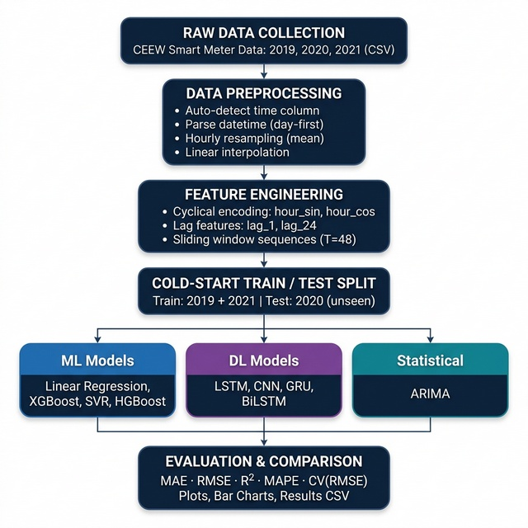
Methodology & Pipeline Architecture
End-to-end prediction framework
1. Raw Data Collection
Load CEEW CSV files (2019, 2020, 2021)
2. Data Preprocessing
Auto-detect time column · parse datetime · hourly resampling · interpolation
3. Feature Engineering
Cyclical encoding (hour_sin/cos) · lag (1h, 24h) · sliding windows T=48
4. Cold-Start Split
Train: 2019 + 2021 → Test: 2020 (unseen)
5. Model Training
12 models: 6 ML + 5 DL + 1 Statistical
6. Evaluation & Output
MAE · RMSE · R² · MAPE · CV(RMSE) + plots & CSV
5

Slide 6
Feature Engineering
Transforming raw data into predictive features
Cyclical Time Encoding
Lag Features
Sliding Window Sequences
hour_sin = sin(2π × hour / 24)
hour_cos = cos(2π × hour / 24)
Captures circular nature of time
(Hour 23 is close to Hour 0)
Prevents misleading linear features
lag_1 : Energy value 1 hour ago
lag_24: Energy value 24 hours ago
Captures short-term patterns
and daily periodicity in usage
Recent history = best predictor
Window size T = 48 hours (2 days)
Used for LSTM, CNN, GRU, BiLSTM
Input: 48 consecutive timesteps
Output: Next timestep prediction
Captures multi-day patterns
Key Insight: Combining cyclical encoding with lag features lets models learn time-of-day patterns and recent consumption trends — critical for cold-start generalization.
6

Slide 7
Models Implemented — Overview
12 models across 3 paradigms
MACHINE LEARNING (6)
DEEP LEARNING (5)
STATISTICAL (1)
▸ Linear Regression
▸ LSTM (Long Short-Term Memory)
▸ ARIMA (AutoRegressive
▸ Ridge Regression
▸ CNN (1D Convolutional)
▸ Integrated Moving Avg)
▸ Lasso Regression
▸ GRU (Gated Recurrent Unit)
▸ XGBoost (Gradient Boosting)
▸ BiLSTM (Bidirectional)
▸ SVR (Support Vector)
▸ Transfer LSTM (Fine-tune)
▸ HGBoost (AutoML)
Total: 6 ML + 5 DL + 1 Statistical = 12 models compared under cold-start conditions
7

Slide 8
Machine Learning Models — Details
Traditional and ensemble approaches
Linear Regression
Ridge Regression
Lasso Regression
Baseline OLS model
L2 regularization, α = 1.0
L1 regularization, α = 0.01
R² = 0.9902
R² = 0.9900
R² = 0.3105
XGBoost
SVR
HGBoost
600 trees, lr=0.03, depth=4
RBF kernel, C=10, ε=0.1
Bayesian optimized, 250 evals
R² = 0.9912
R² = 0.9912
R² = 0.9922
8

Slide 9
Deep Learning Models — Details
Sequence-based neural network architectures
LSTM
CNN (1D)
GRU
64 units, 32 dense, 80 epochs Captures long-term dependencies
64 filters, kernel=3, pool=2 1D convolutions for local patterns
64 units, 80 epochs Lighter LSTM alternative
R² = 0.9146
R² = 0.8673
R² = 0.8815
BiLSTM
Transfer LSTM
64 units bidirectional Forward + backward context
Pre-train 2019 → Fine-tune 2021 3-phase progressive unfreezing
R² = 0.8703
R² = 0.8866
Common config: Sequence length = 48 h | Optimizer = Adam | Loss = MSE | Batch = 64
9

Slide 10
Transfer Learning — LSTM Approach
Progressive unfreezing for cold-start adaptation
PHASE 1
→
PHASE 2
→
PHASE 3
Pre-training on Source
Fine-tune Dense Head
Full Fine-tuning
Train LSTM on 2019 data
64 units, 32 dense
50 epochs, Adam optimizer
Learns general energy patterns
Freeze LSTM layers
Fine-tune output dense only
Train on 2021 (target domain)
20 epochs, LR = 5×10⁻⁴
Unfreeze all layers
Very low LR: 1×10⁻⁵
20 epochs gentle tuning
Prevents catastrophic forgetting
Transfer LSTM Results
R² = 0.8866 | MAE = 0.0015 | RMSE = 0.0028 | MAPE = 15.80%
While not outperforming traditional ML models, Transfer LSTM demonstrates the viability of cross-domain knowledge transfer for cold-start scenarios. With more diverse source data and advanced domain-adaptation techniques, this gap can be further narrowed.
10

Slide 11
Results — Full Performance Comparison
All 12 models ranked by R² (descending)
Model | MAE | RMSE | R² | MAPE (%) | CV(RMSE) (%)
HGBoost ★ | 0.0004 | 0.0007 | 0.9922 | 4.53 | 8.44
XGBoost | 0.0004 | 0.0008 | 0.9912 | 4.67 | 9.00
SVR | 0.0005 | 0.0008 | 0.9912 | 7.49 | 8.98
Linear Regression | 0.0006 | 0.0008 | 0.9902 | 8.09 | 9.46
Ridge Regression | 0.0006 | 0.0008 | 0.9900 | 8.50 | 9.60
LSTM | 0.0012 | 0.0025 | 0.9146 | 13.10 | 28.04
Transfer LSTM | 0.0015 | 0.0028 | 0.8866 | 15.80 | 32.31
GRU | 0.0013 | 0.0029 | 0.8815 | 13.09 | 33.03
BiLSTM | 0.0015 | 0.0030 | 0.8703 | 15.09 | 34.55
CNN (1D) | 0.0016 | 0.0031 | 0.8673 | 17.59 | 34.96
Lasso Regression | 0.0063 | 0.0069 | 0.3105 | 115.16 | 79.51
ARIMA | 0.0050 | 0.0089 | −0.14 | 44.26 | 102.30
★ Best overall | Green = Top performers | Red = Poor performers
11

Slide 12
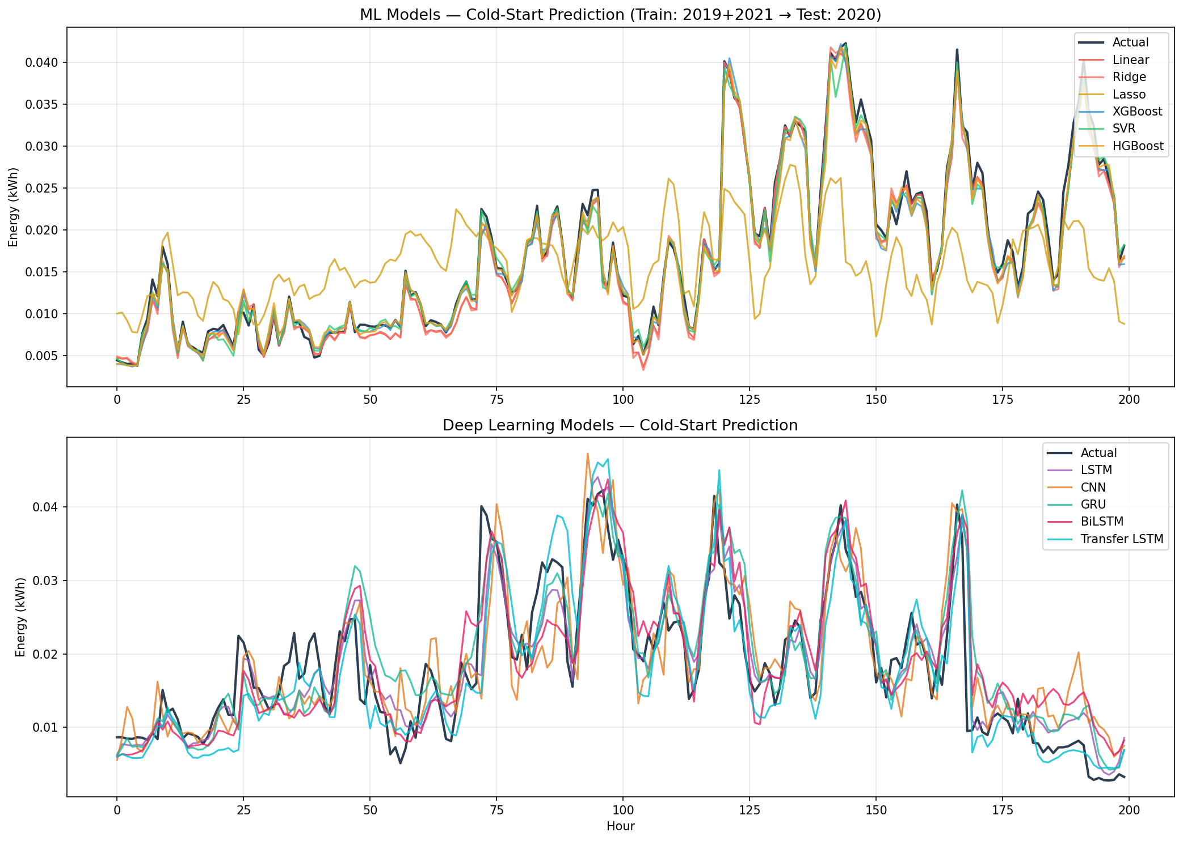
Visual Results — Prediction Comparison
ML models (top) vs Deep Learning models (bottom)
12

Slide 13
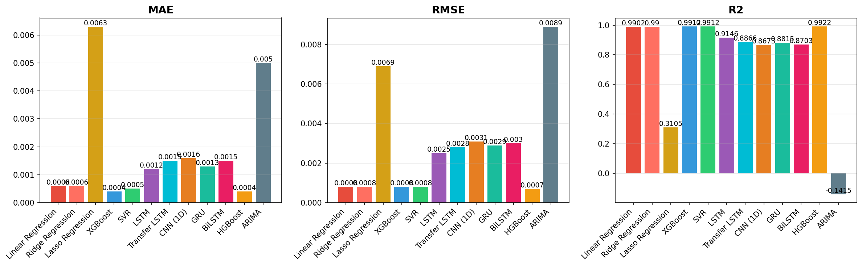
Visual Results — Metrics Comparison
MAE · RMSE · R² across all 12 models
ML models (HGBoost, XGBoost, SVR) significantly outperform DL models in the cold-start scenario. ARIMA and Lasso show poor generalization to unseen years.
13

Slide 14
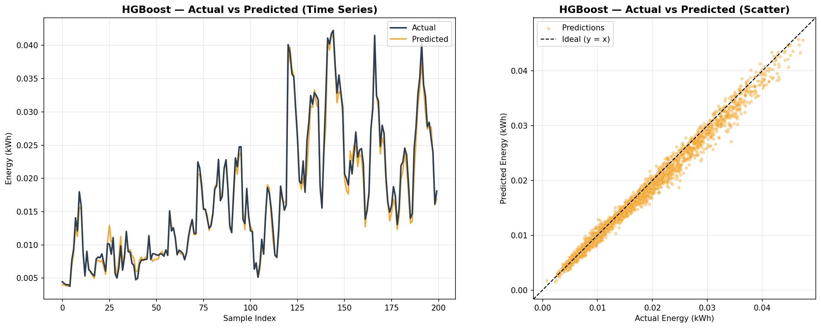
Best Model — HGBoost (Actual vs Predicted)
R² = 0.9922 | MAE = 0.0004 | RMSE = 0.0007 | MAPE = 4.53%
HGBoost achieves the best R² and lowest error across all metrics under cold-start conditions.
14

Slide 15
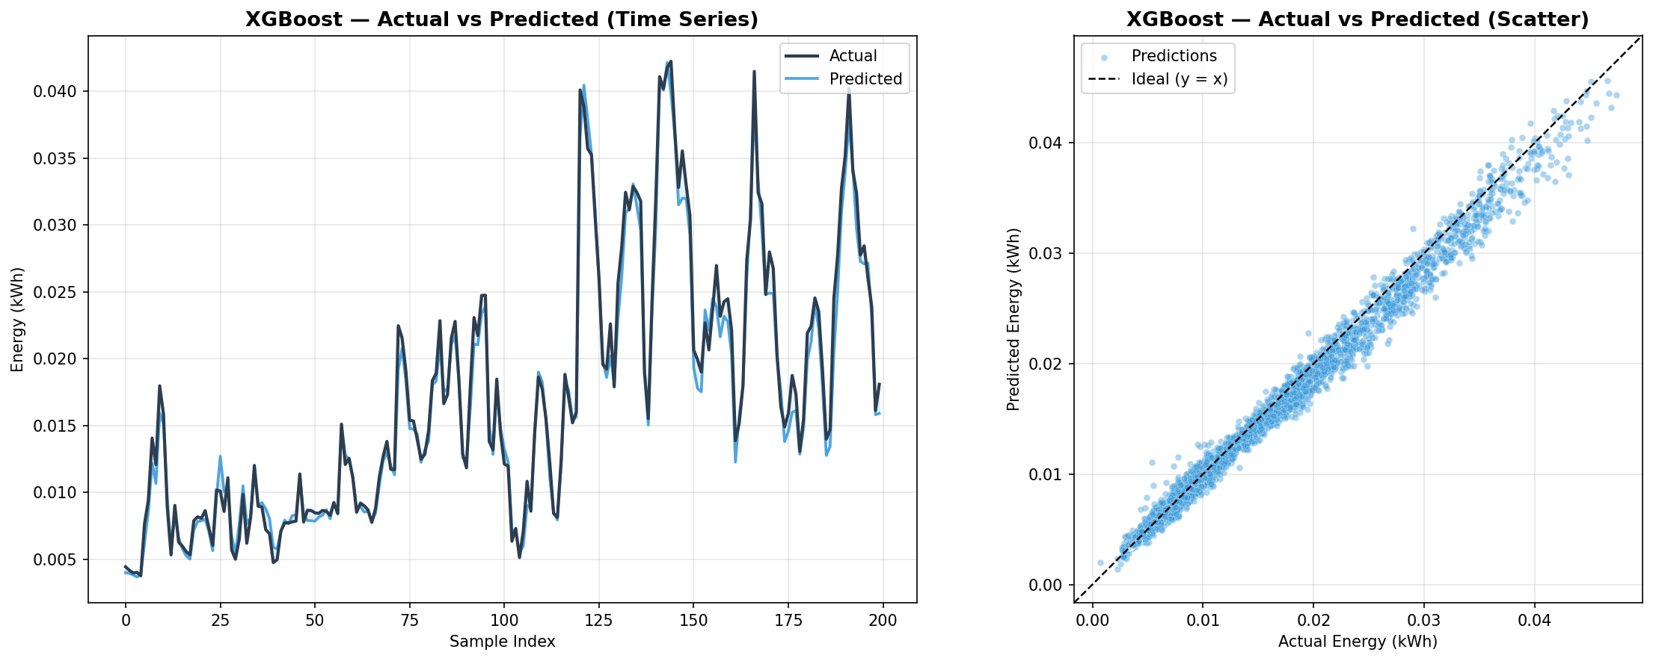
Runner-up — XGBoost (Actual vs Predicted)
R² = 0.9912 | MAE = 0.0004 | RMSE = 0.0008 | MAPE = 4.67%
XGBoost matches HGBoost closely with gradient boosting and is the fastest high-accuracy model.
15

Slide 16
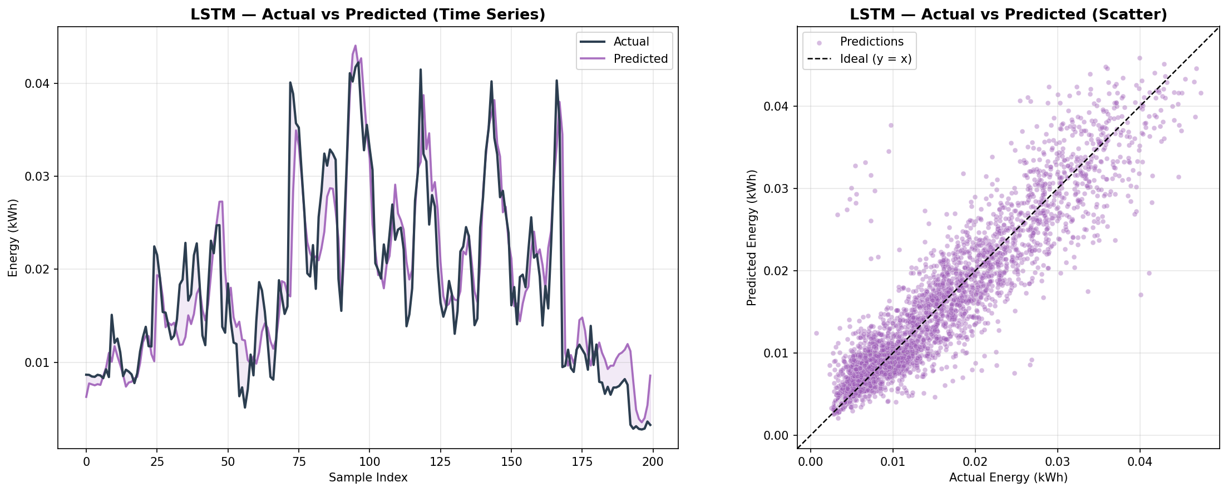
Best DL Model — LSTM (Actual vs Predicted)
R² = 0.9146 | MAE = 0.0012 | RMSE = 0.0025 | MAPE = 13.10%
LSTM is the best deep learning model, though it trails ML models — DL needs more cold-start data.
16

Slide 17
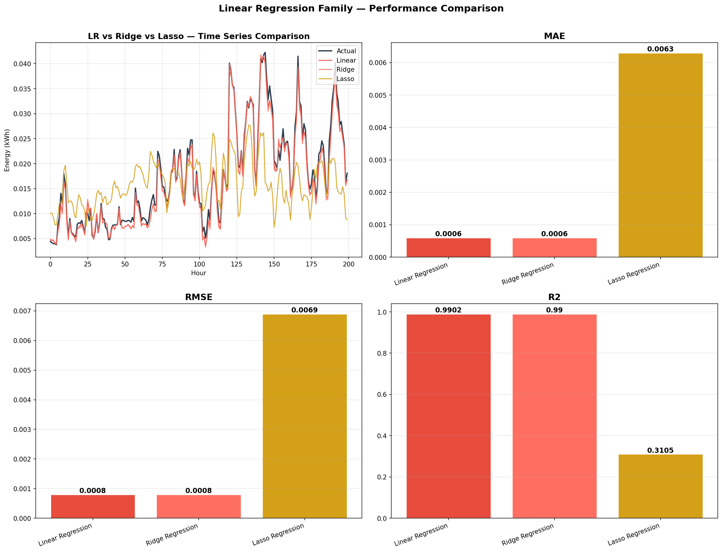
Linear Regression Family — Comparison
Linear vs Ridge vs Lasso under cold-start conditions
Linear & Ridge perform comparably (R² ≈ 0.99). Lasso's aggressive L1 regularization destroys features needed for cold-start.
17

Slide 18
Key Findings & Conclusions
HGBoost is the Best Overall Model
R² = 0.9922, lowest CV(RMSE) of 8.44%. Bayesian hyperparameter optimization delivers the best cold-start performance.
ML Models Dominate Cold-Start Prediction
Top 5 models are all ML-based (R² > 0.99). Tabular feature-engineered models outperform sequence-based DL in this scenario.
Deep Learning Achieves R² ≈ 0.87–0.91
LSTM leads DL (0.9146). DL requires more diverse training data to match ML in cold-start conditions.
Transfer Learning Shows Promise
Transfer LSTM (R²=0.8866) validates cross-domain knowledge transfer despite limited source diversity.
ARIMA & Lasso Fail in Cold-Start
ARIMA (R²=−0.14) and Lasso (R²=0.31) cannot generalize across years. Not suitable for cold-start deployment.
18

Slide 19
Future Work & Improvements
→ Ensemble Stacking
→ Weather Data Integration
Combine HGBoost + LSTM to leverage both ML and DL strengths.
Add temperature, humidity, solar radiation for richer features.
→ Transformer Attention
→ Multi-Building Transfer
Replace RNN layers with self-attention for long-range patterns.
Extend transfer learning across buildings & geographic regions.
→ Real-Time Deployment
→ Explainability (XAI)
Online learning pipeline with streaming predictions for smart grids.
Apply SHAP / LIME for model interpretability in energy decisions.
19

Slide 20
References & Tools
REFERENCES
CEEW (Council on Energy, Environment and Water) — Smart Meter Data, Mathura, India
Hochreiter & Schmidhuber (1997) — Long Short-Term Memory (LSTM)
Chen & Guestrin (2016) — XGBoost: A Scalable Tree Boosting System
Cho et al. (2014) — Learning Phrase Representations using RNN Encoder–Decoder (GRU)
Yosinski et al. (2014) — How Transferable are Features in Deep Neural Networks?
Box, Jenkins, Reinsel (2015) — Time Series Analysis: ARIMA Models
TOOLS & TECHNOLOGIES
Python 3.8+ · TensorFlow / Keras · scikit-learn · XGBoost
pandas · NumPy · Matplotlib · pmdarima · HGBoost
GitHub Repository: github.com/Nsb05/Cold-Heart
All code is open-source under MIT License
20

Slide 21
Thank You!
Cold-Start Energy Consumption Prediction for Smart Buildings
Neeraj Singh Bisht
github.com/Nsb05/Cold-Heart
Questions & Discussion

