Slide 1
Instacart Data Science Challenge
10/12/2018
Naveed Sharif

Slide 2
Overview
Using the dataset provided, investigate observations about orders, order location, customer ratings and any issues reported by the customer for a set of orders.
The observations will be based on the following analysis:
Customer Orders by Hour
Customer Orders by Minute within an Hour
Customer Orders by Day
Customer Orders by Day of Month
Repeated Customer Orders (duplicates of order_id)
Customer Order Ratings
Reported Customer Order Issues
How would you staff the Customer Support Team?
I will be assuming that one staff member can manage 15 orders an hour*.
Based on the increasing/decreasing hourly marginal rate of orders, I will estimate staff requirements for the customer service team.
I will be using a series of Piecewise (Spline) Regression Models to estimate the hourly marginal rate of customer orders.
2 | * This is an estimated guess.

Slide 3
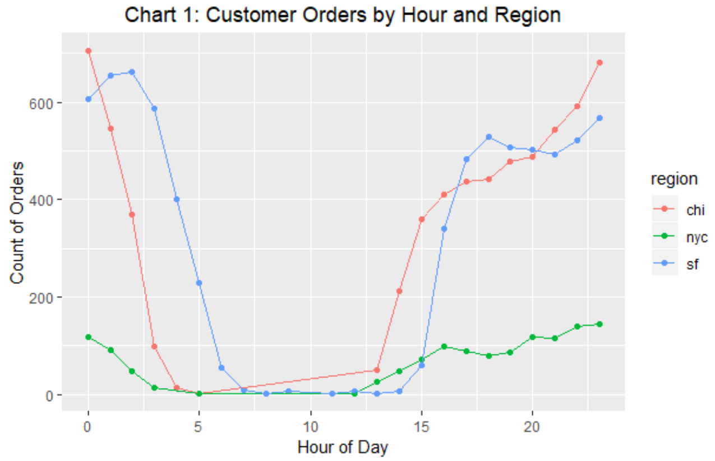
Customer Orders by Hour
Regardless of region, and assuming hours are in military time, the bulk of orders occur during early morning hours (0 through 2), and evening through midnight hours (17 through 24).
Mornings through afternoon are hours where generally no orders are occurring.
Customers are likely making purchases during non-working hours.

Slide 4
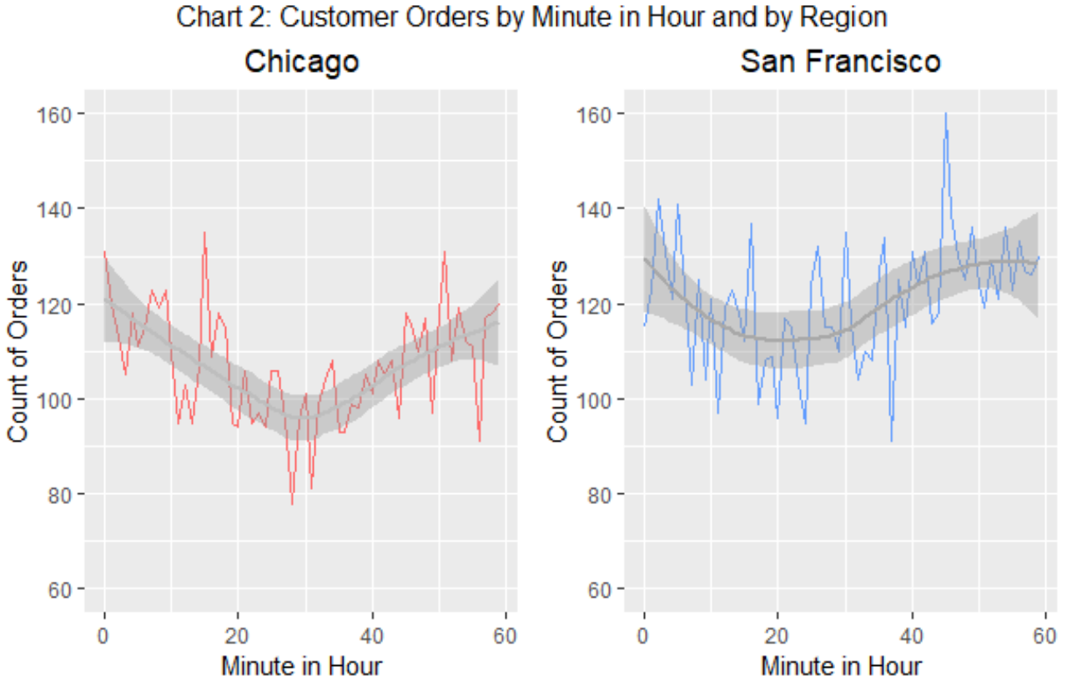
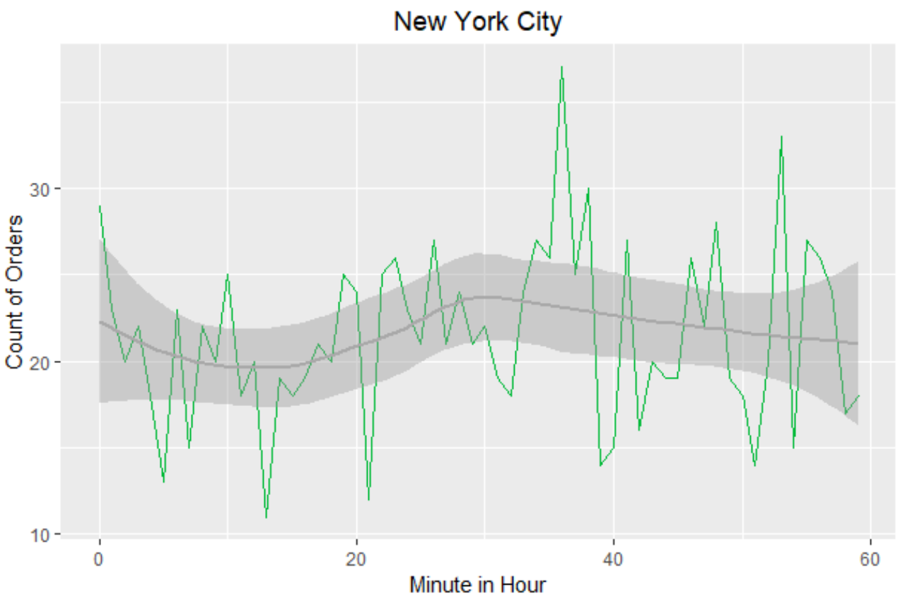
Customer Orders by Minute within an Hour
In Chicago and San Francisco, the majority of orders occur during top of the hour. However, the opposite is true in New York City – the bulk of the orders occurs bottom of the hour, albeit it also appears flat.

Slide 5
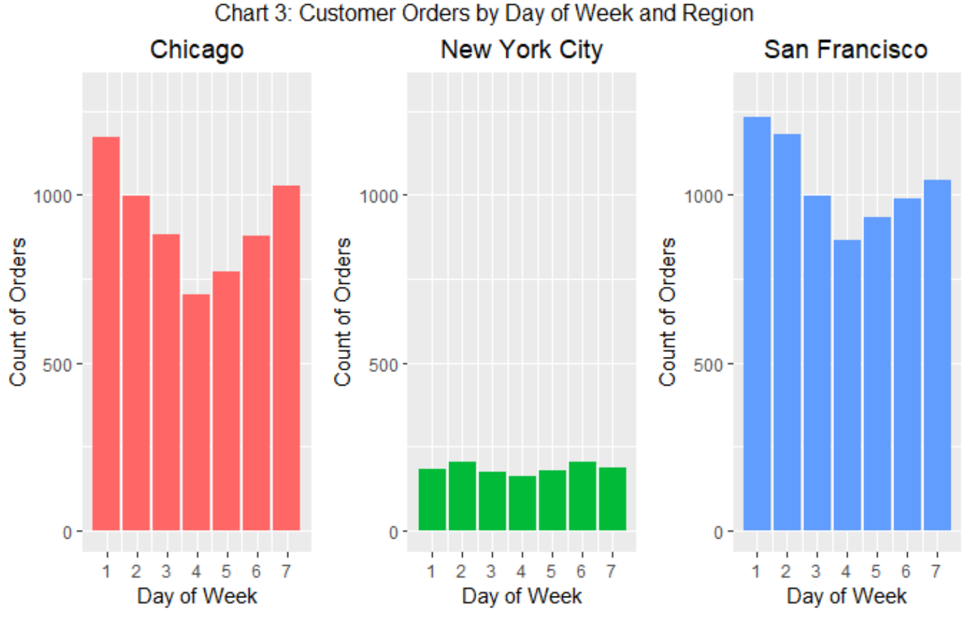
Customer Orders by Day
Generally, customer orders occur most frequently early in the week (Day 1 & 2). Orders steadily decline while hitting a turning point by mid-week.
Rather then making orders during a customers busy week, customers are likely making these purchases during the weekend (when they have more time on their hands).
Noticeably, New York City is hauling at least three times less orders then both San Francisco and Chicago.

Slide 6
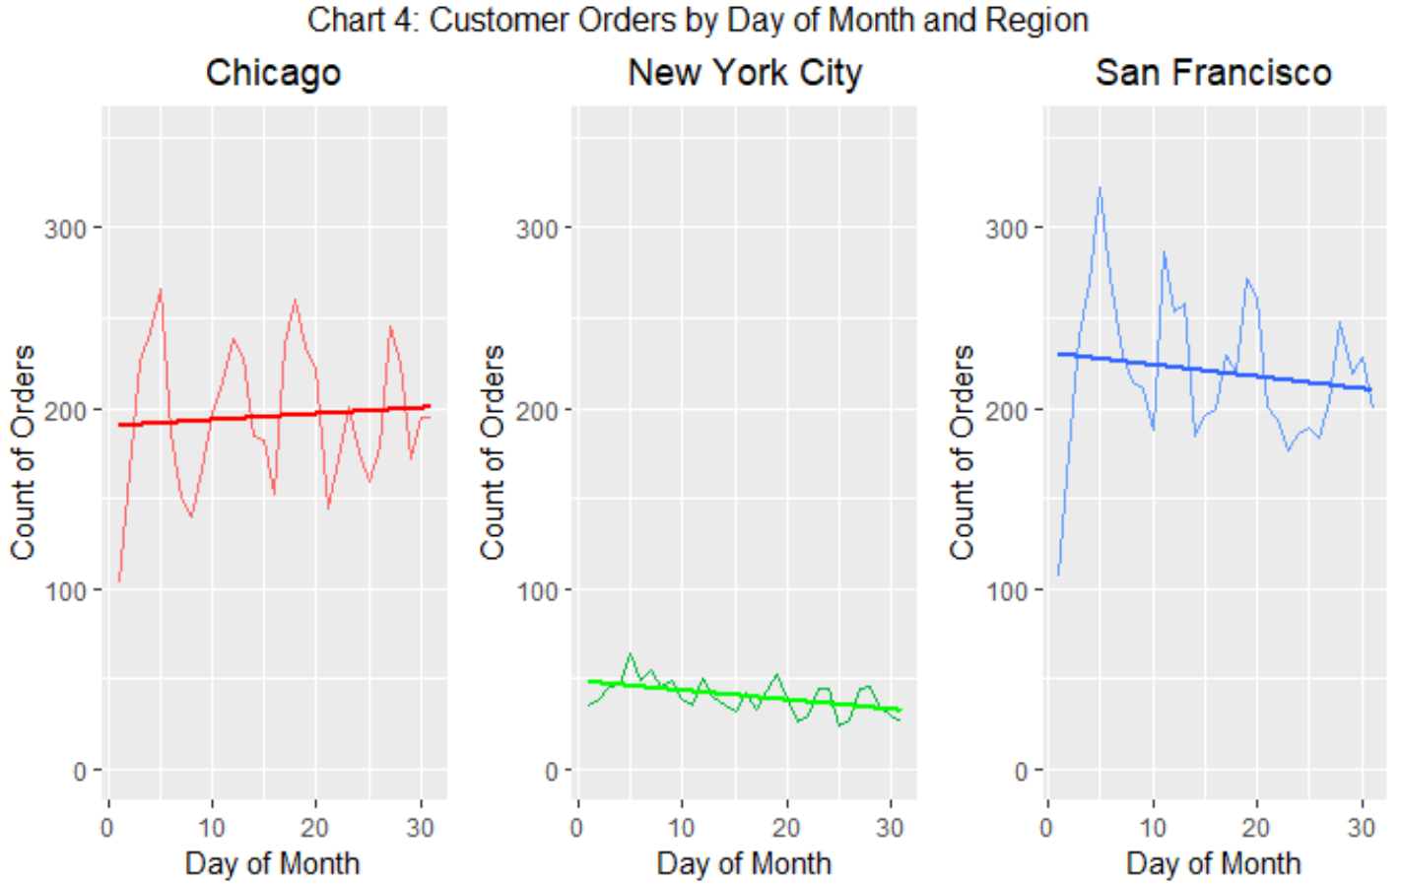
Customer Orders by Day of Month
Regions vary in trend of customer orders by day of month.
Orders in New York City and San Francisco occur most frequently beginning of the month.
In New York City and San Francisco, the ordering rate declines throughout the remainder of the month.
Chicago behaves differently. The ordering rate steadily increases throughout the remainder of the month.

Slide 7
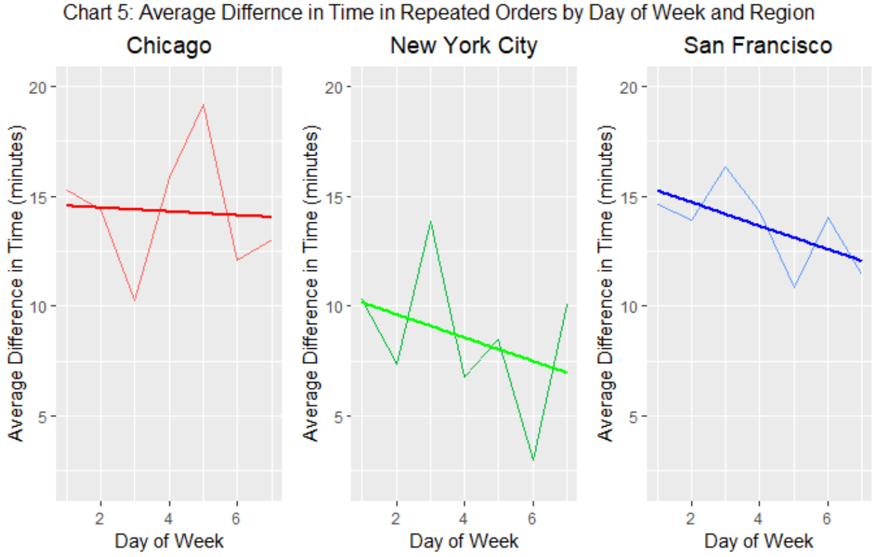
Repeated Customer Orders
Repeated orders are separated by an average of 10 to 15 minute difference in delivery time.
New York City’s repeated orders are on average delivered 5 minutes less than both Chicago and San Francisco.
In San Francisco and New York City, the average repeated orders drops by ~3 minutes by week-end.

Slide 8
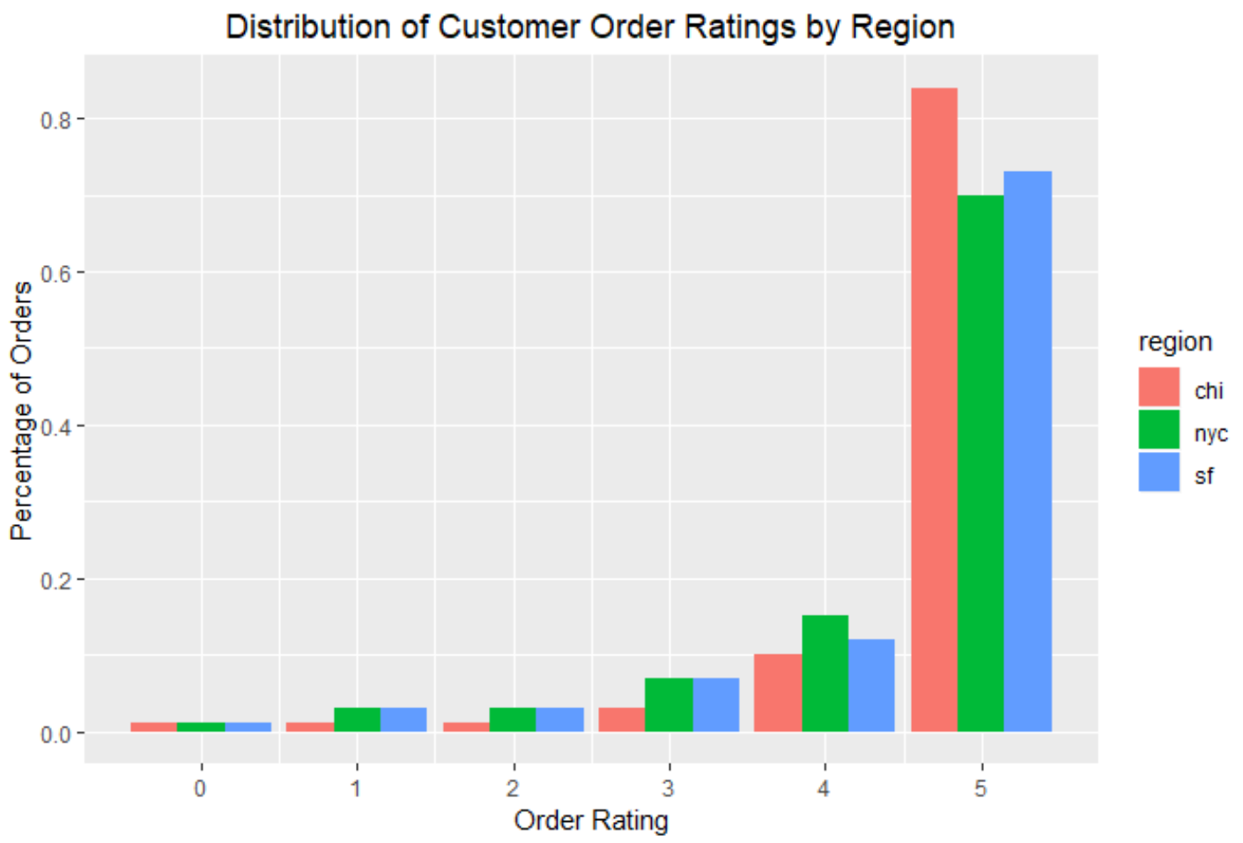
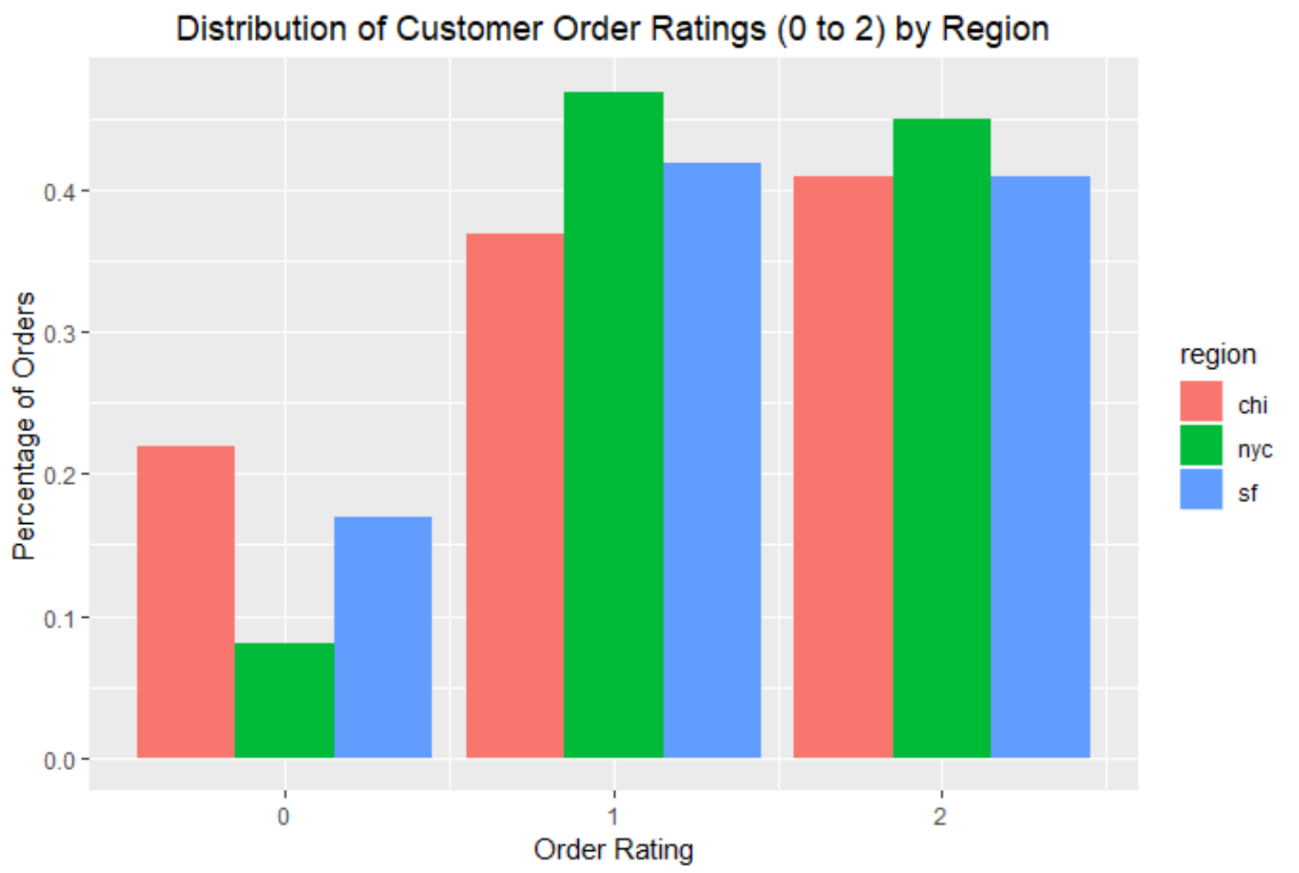
Customer Order Ratings
Chicago has the highest percentage of orders with a customer order rating of 5 (left chart) – it is roughly 10% pts higher than the other regions. However, Chicago also has the highest percentage of orders with a customer rating of 0 (right chart) – at least 5% pts higher than San Francisco and over 10% pts higher than New York City.

Slide 9
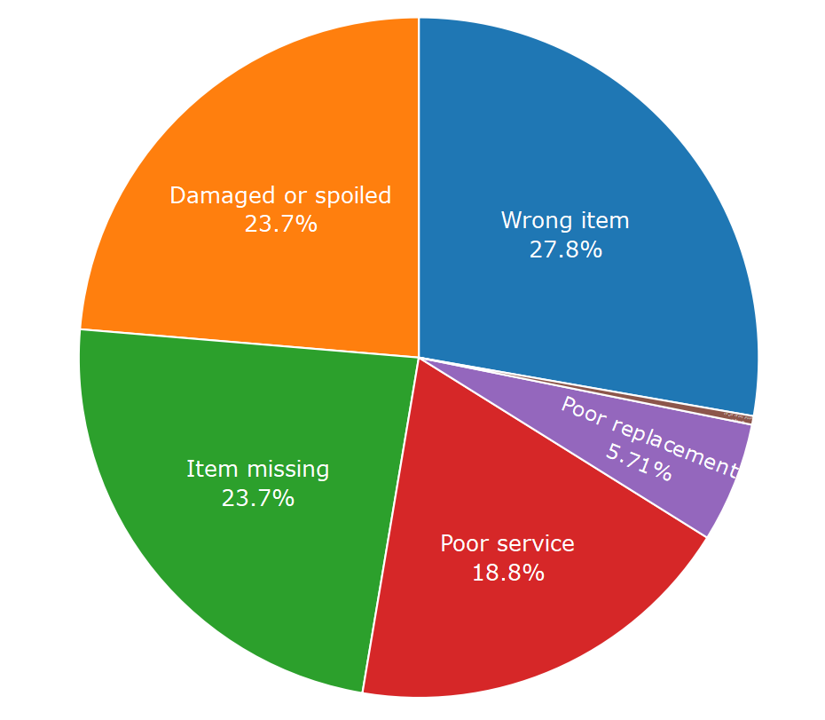
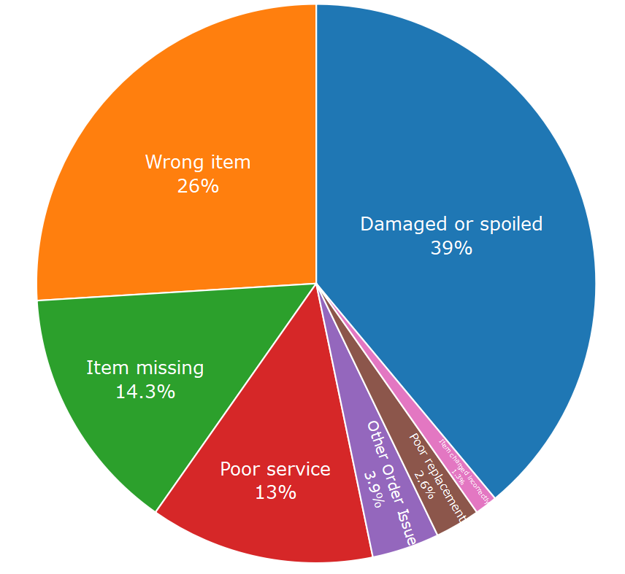
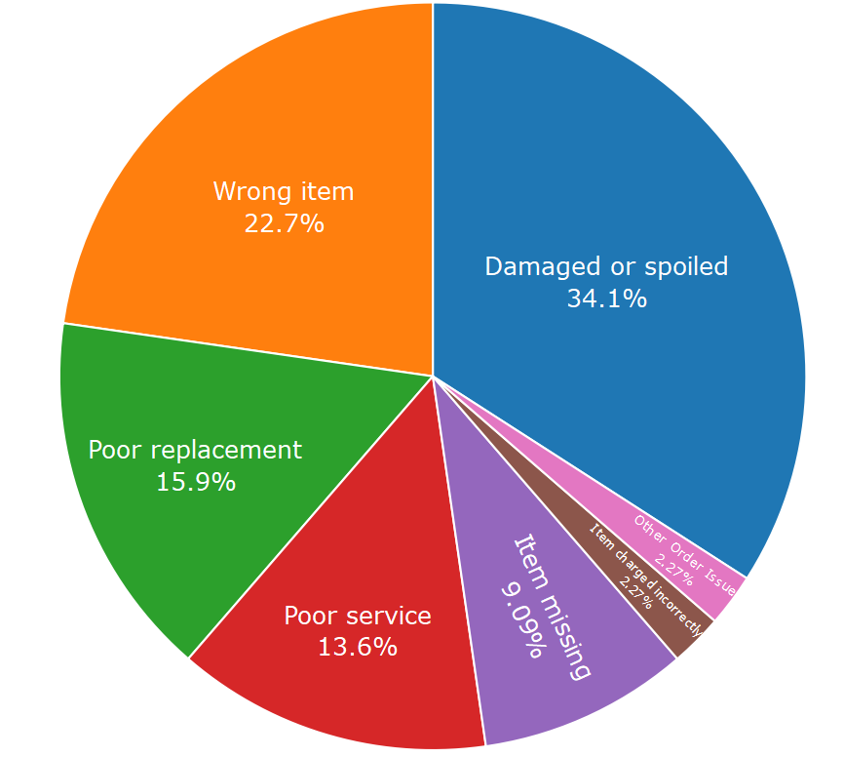
Reported Customer Order Issues
The distribution of reported customer order issues are somewhat consistent across the regions. The bulk of the reported issues are related to a Damaged Item, Spoiled Item, or Wrong Item Delivered. Item’s Missing stands out in San Francisco more so than Chicago or New York City.
San Francisco
Chicago
New York City

Slide 10
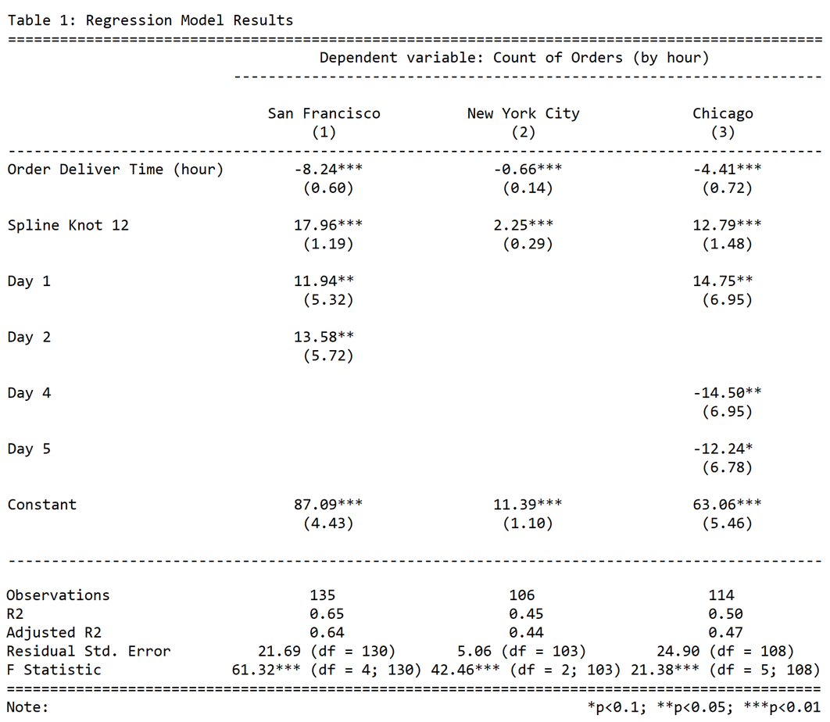
Staffing the Customer Support Team: San Francisco
I will be estimating staffing requirements based on results of a series of Piecewise Regressions.
I am assuming that each staff member can manage 15 orders an hour. Since each region is different, in terms of count of orders an hour, some regions will require more staff members than others.
San Francisco
Day 1 & 2: Generates 12 and 14 additional orders, respectively (rounded up).
Hour 0 (the constant): 87 orders are estimated to be delivered. Therefore, six staff members should be on deck.
8 orders (coefficient of order delivery time) are reduced by each hour until hour 12. Therefore, reduce one staff member every two hours or until there are no orders placed.
Hour 13: Orders pick back up. 69 orders are estimated to be delivered. Therefore, five staff members should be on deck.
10 orders are increased by each hour until hour 24. Therefore, increase two staff members every three hours until hour 24.
10 | Note, estimated staff members are rounded up. Estimated staff member calculations are in the appendix

Slide 11
Staffing the Customer Support Team: New York City
I will be estimating staffing requirements based on results of a series of Piecewise Regressions.
I am assuming that each staff member can manage 15 orders an hour. Since each region is different, in terms of count of orders an hour, some regions will require more staff members than others.
New York City
Hour 0 (the constant): 11 orders are estimated to be delivered. Therefore, one staff member should be on deck.
1 order (coefficient of order delivery time rounded up) is reduced by each hour until hour 12. Therefore, only one staff member is required during the shift.
Hour 13: Orders pick back up. 9 orders are estimated to be delivered. Therefore, one staff member should be on deck.
2 (rounded up) orders are increased by each hour until hour 24. Therefore, by the end of the shit (hour 24), there should be two staff members on deck.
11 | Note, estimated staff members are rounded up. Estimated staff member calculations are in the appendix

Slide 12
Staffing the Customer Support Team: Chicago
I will be estimating staffing requirements based on results of a series of Piecewise Regressions.
I am assuming that each staff member can manage 15 orders an hour. Since each region is different, in terms of count of orders an hour, some regions will require more staff members than others.
Chicago
Day 1, 4 & 5: Generates 15, -15, and -12 additional orders, respectively.
Hour 0 (the constant): 63 orders are estimated to be delivered. Therefore, four staff members should be on deck.
4 orders (coefficient of order delivery time rounded down) are reduced by each hour until hour 12. Therefore, every three hours reduce one staff member until hour 12.
Hour 13: Orders pick back up. 50 orders are estimated to be delivered. Therefore, three staff members should be on deck.
8 (rounded down) orders are increased by each hour until hour 24. Therefore, one additional staff member should be added every two hours.
12 | Note, estimated staff members are rounded up. Estimated staff member calculations are in the appendix

Slide 13
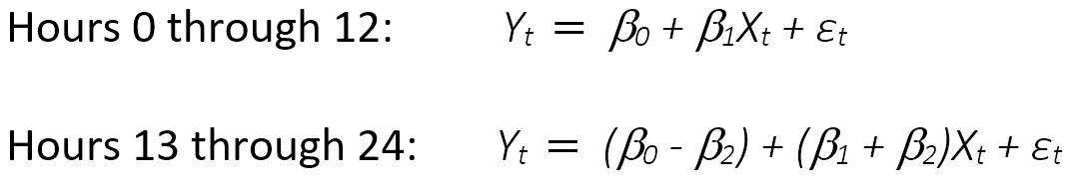
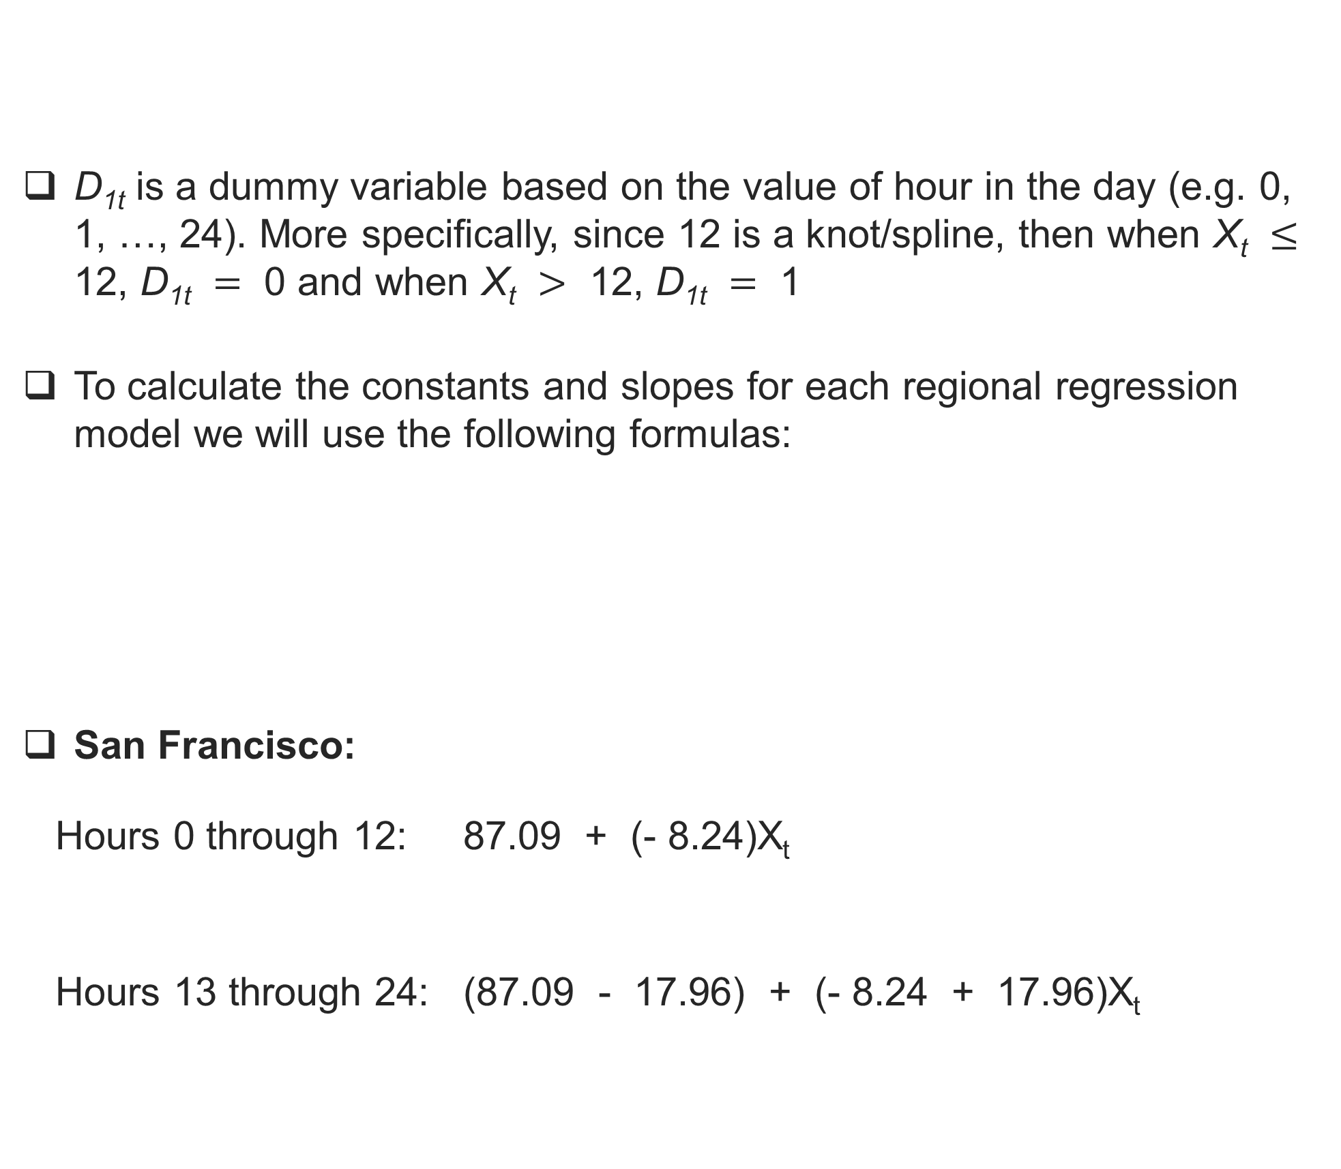
Appendix: Calculations for Staffing the Customer Support Team
D_{1t} is a dummy variable based on the value of hour in the day (e.g. 0, 1, …, 24). More specifically, since 12 is a knot/spline, then when X_{t} $≤$ 12, D_{1t} $=$ 0 and when X_{t} $>$ 12, D_{1t} $=$ 1
To calculate the constants and slopes for each regional regression model we will use the following formulas:
San Francisco:
Hours 0 through 12: 87.09 + (- 8.24)X_{t}
Hours 13 through 24: (87.09 - 17.96) + (- 8.24 + 17.96)X_{t}
New York City:
Hours 0 through 12: 11.39 + (- 0.66)X_{t}
Hours 13 through 24: (11.39 - 2.25) + (- 0.66 + 2.25)X_{t}
Chicago:
Hours 0 through 12: 63.06 + (- 4.41)X_{t}
Hours 13 through 24: (63.06 - 12.79) + (- 4.41 + 12.79)X_{t}
Constant
Slope
Constant
Slope
Constant
Slope
Constant
Slope
Constant
Slope
Constant
Slope
13

