Slide 1
BLP Model of Demand Estimation
Predictive Modeling & Analytics | MMSA

Slide 2
Learning Objectives
Gain a fundamental understanding of the BLP model from a theoretical perspective (BLP stands for Berry, Levinsohn, & Pakes; they thought it up in 1995)
Be able to use that understanding to know the strengths and limitations of the BLP model in different contexts
Develop a practical understanding of how to implement the BLP model

Slide 3
Outline
Basic Markets – Naïve OLS Approach
Review of Utility
The Logit Model
BLP in Theory – Relaxing Assumptions
BLP in Practice – The Algorithm

Slide 4

Basic Markets Example – OLS Elasticity
P
Demand
$Q=c_{1}−P$
Supply
$Q=c_{2}+P$
Advantage?
Easy to estimate – Just fit OLS!
Q

Slide 5

Problem with OLS
P
D
Demand
$$Q=c_{1}−P$$
Supply
$$Q=c_{2}+P$$
Any given point
$$Q_{D}=Q_{S}$$
$$c_{2}+P=c_{1}−αP$$
$$Q_{D}=β_{o}+β_{1}P_{D}+ε_{D}$$
Q
Notes:
Simultaneity
OVB
Most people use the logit model of demand

Slide 6
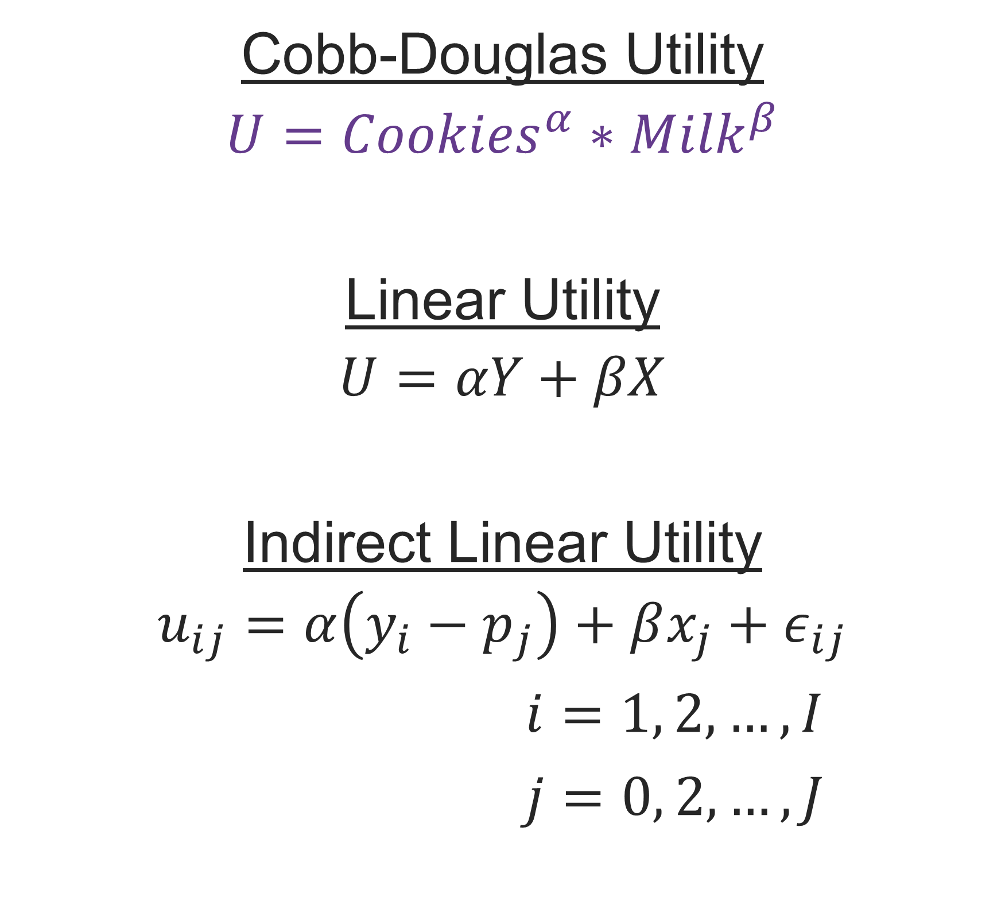




Utility as a Foundation for Logit
$$Cookies$$
Cobb-Douglas Utility
$$U={Cookies}^{α}∗{Milk}^{β}$$
Linear Utility
$$U=αY+βX$$
Indirect Linear Utility
$$u_{ij}=α\left(y_{i}−p_{j}\right)+βx_{j}+ε_{ij}$$
$i=1, 2,…,I$
$j=0, 2,…,J$
$$U=15$$
$$U=10$$
$$Milk$$
Notes:
This is the foundation to build to the logit model

Slide 7
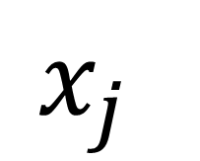


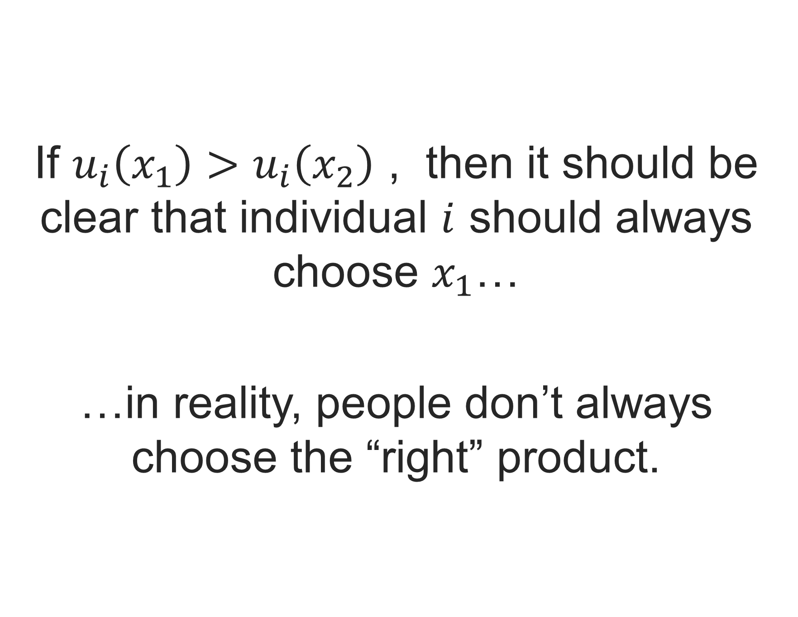


Utility as a Foundation for Logit
$$\left(y_{i}−p_{j}\right)$$
If $u_{i}\left(x_{1}\right)>u_{i}\left(x_{2}\right)$ , then it should be clear that individual $i$ should always choose $x_{1}$…
…in reality, people don’t always choose the “right” product.
$$x_{1}$$
$$x_{2}$$
$$ε_{ij}$$
$$x_{j}$$

Slide 8
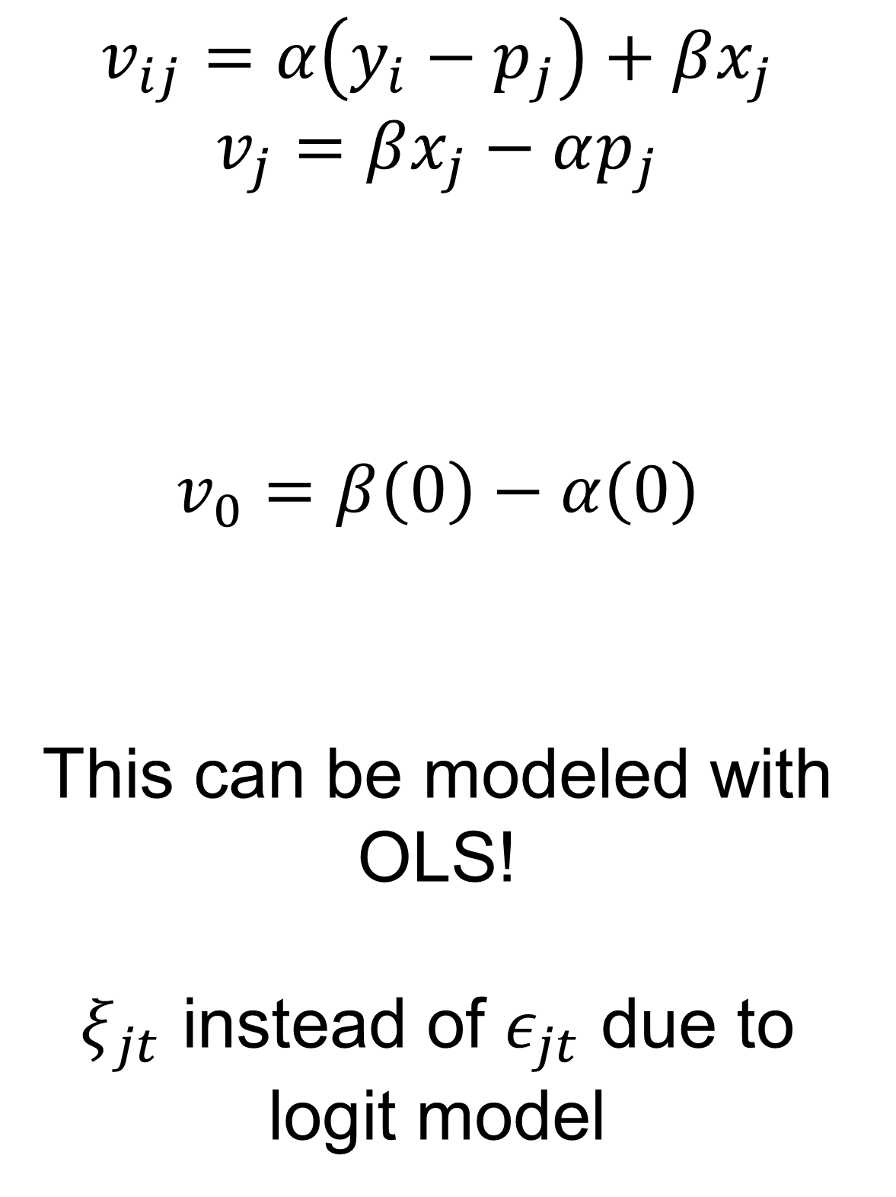
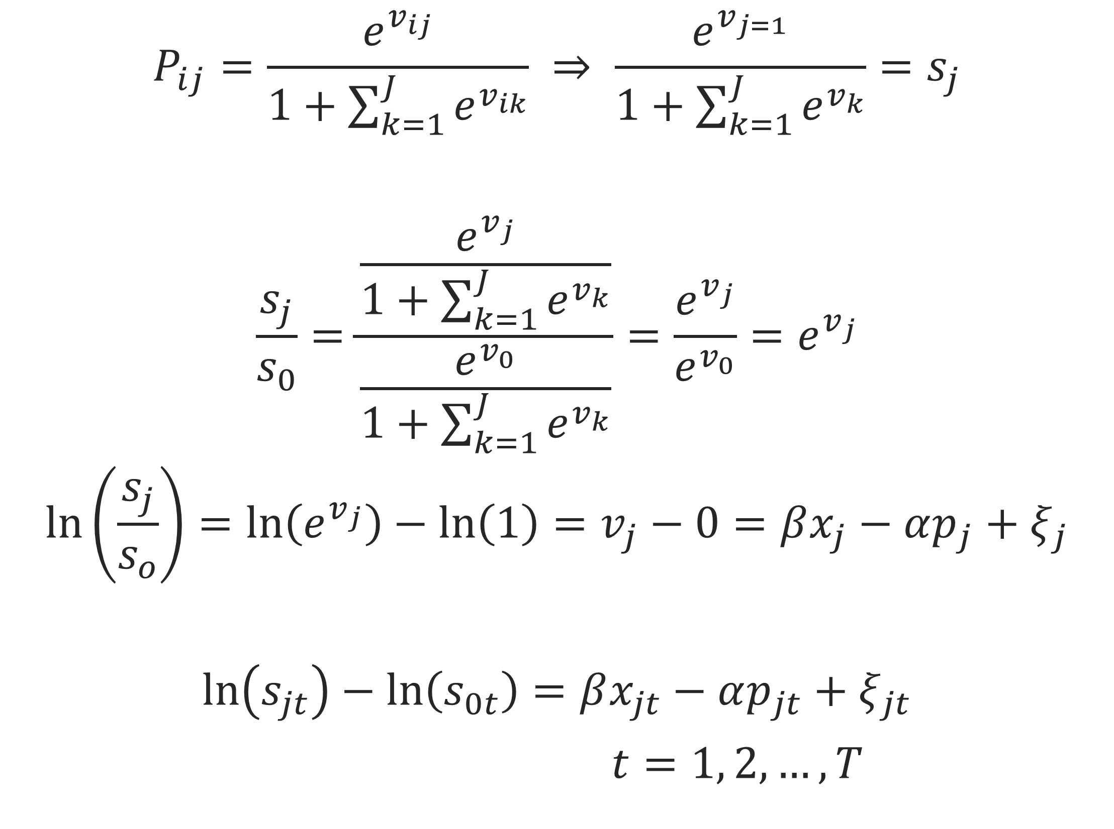
The Logit Model
$$P_{ij}=\frac{e^{v_{ij}}}{1+\sum_{k=1}^{J}{e^{v_{ik}}}} ⇒ \frac{e^{v_{j=1}}}{1+\sum_{k=1}^{J}{e^{v_{k}}}}=s_{j}$$
$$\frac{s_{j}}{s_{0}}=\frac{\frac{e^{v_{j}}}{1+\sum_{k=1}^{J}{e^{v_{k}}}}}{\frac{e^{v_{0}}}{1+\sum_{k=1}^{J}{e^{v_{k}}}}}=\frac{e^{v_{j}}}{e^{v_{0}}}=e^{v_{j}}$$
$$\ln\left(\frac{s_{j}}{s_{o}}\right)=\ln\left(e^{v_{j}}\right)−\ln\left(1\right)=v_{j}−0=βx_{j}−αp_{j}+ξ_{j}$$
$$\ln\left(s_{jt}\right)−\ln\left(s_{0t}\right)=βx_{jt}−αp_{jt}+ξ_{jt}$$
$t=1, 2,…, T$
$$v_{ij}=α\left(y_{i}−p_{j}\right)+βx_{j}$$
$$v_{j}=βx_{j}−αp_{j}$$
$$v_{0}=β\left(0\right)−α\left(0\right)$$
This can be modeled with OLS!
$ξ_{jt}$ instead of $ε_{jt}$ due to logit model

Slide 9
Logit Problems – Independence of Irrelevant Alternatives (IIA)
Original Situation
What We Expect
What Logit Says
CAR
50%
CAR
50%
CAR
33%
RED BUS
50%
RED BUS
25%
RED BUS
33%
BLUE BUS
25%
BLUE BUS
33%

Slide 10

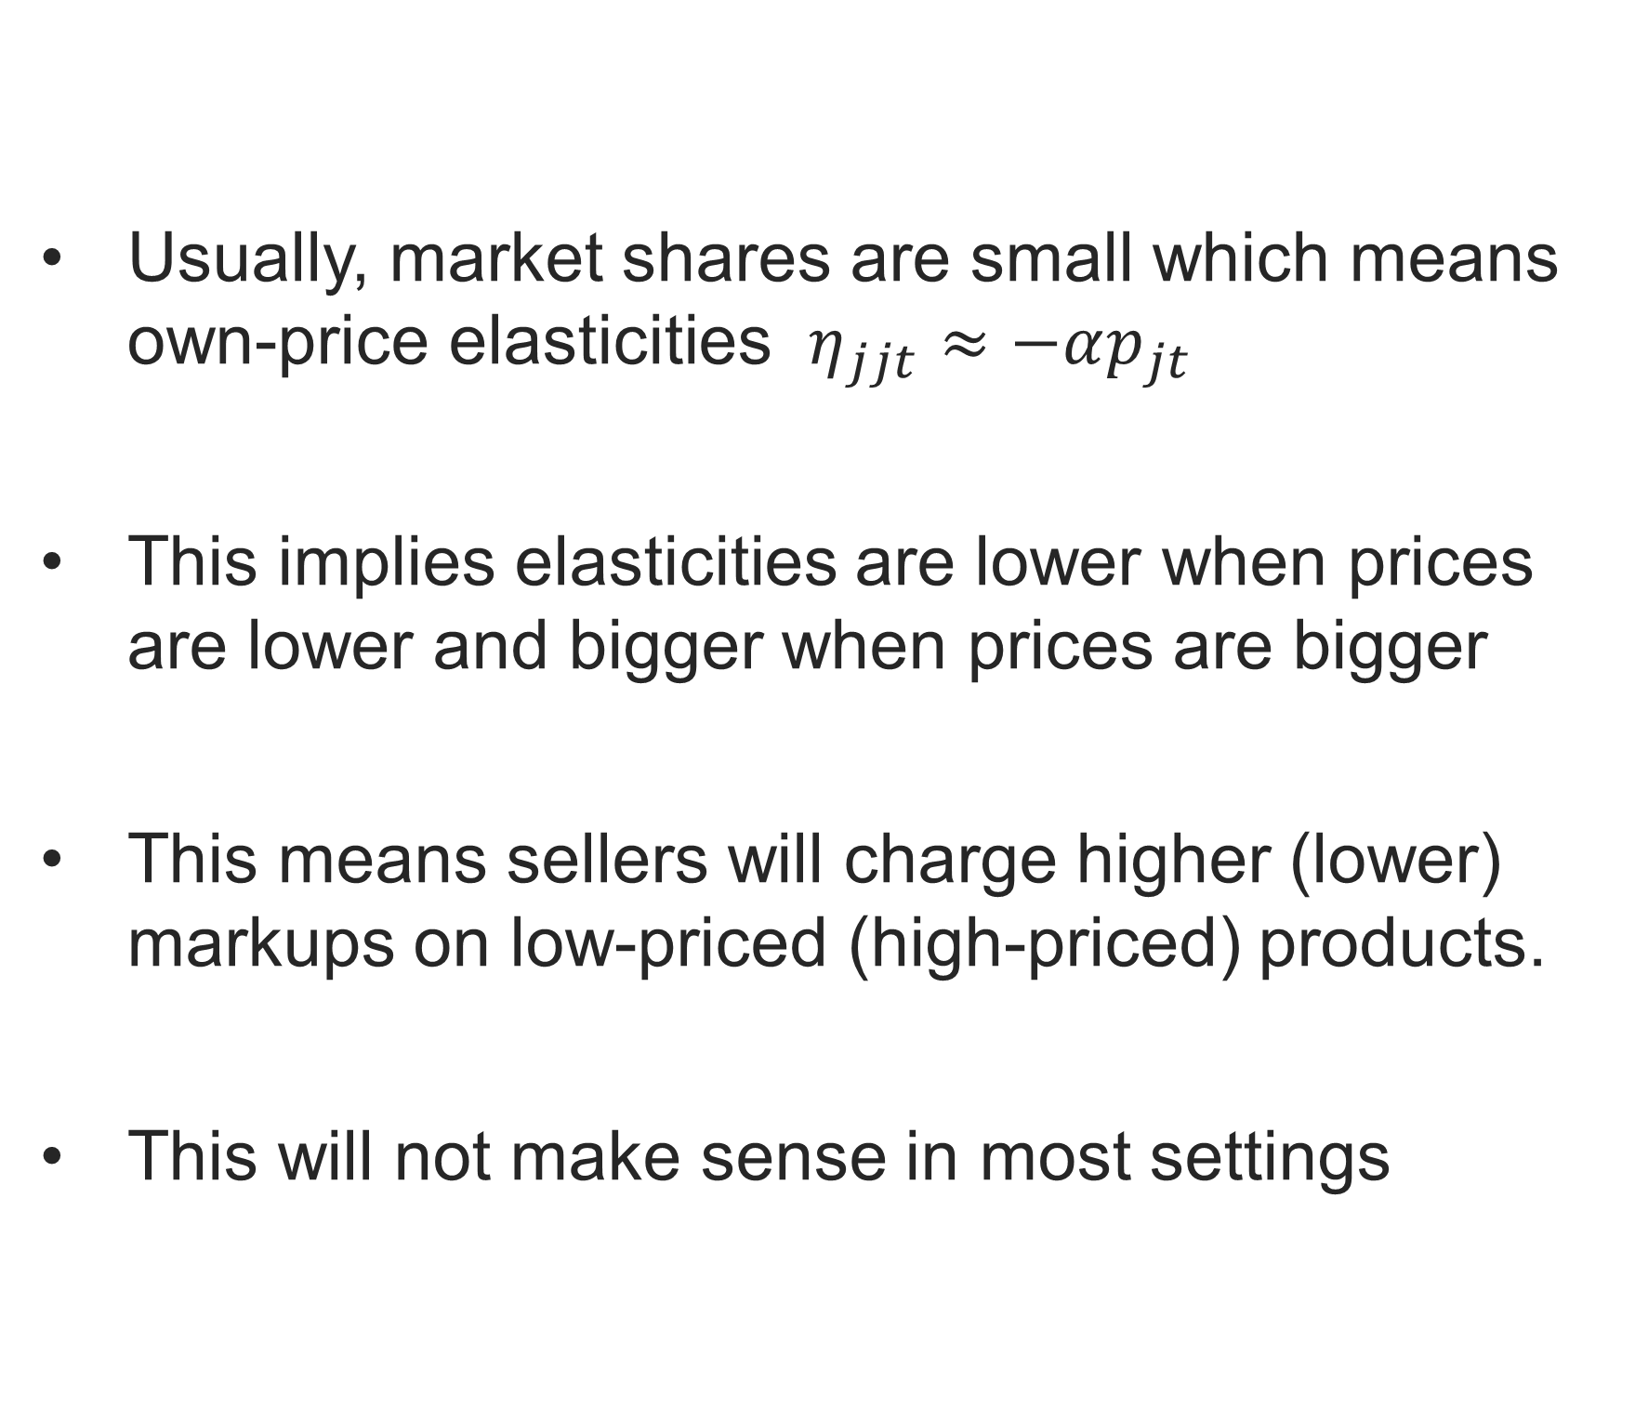
Logit Problems – Own Price Elasticities
$$η_{jkt}=\left\{ \begin{aligned}−αp_{jt}\left(1−s_{jt}\right), if j=k \\ & αp_{kt}s_{kt}, if j≠k\end{aligned}\right.$$
Usually, market shares are small which means own-price elasticities $η_{jjt}≈−αp_{jt}$
This implies elasticities are lower when prices are lower and bigger when prices are bigger
This means sellers will charge higher (lower) markups on low-priced (high-priced) products.
This will not make sense in most settings

Slide 11
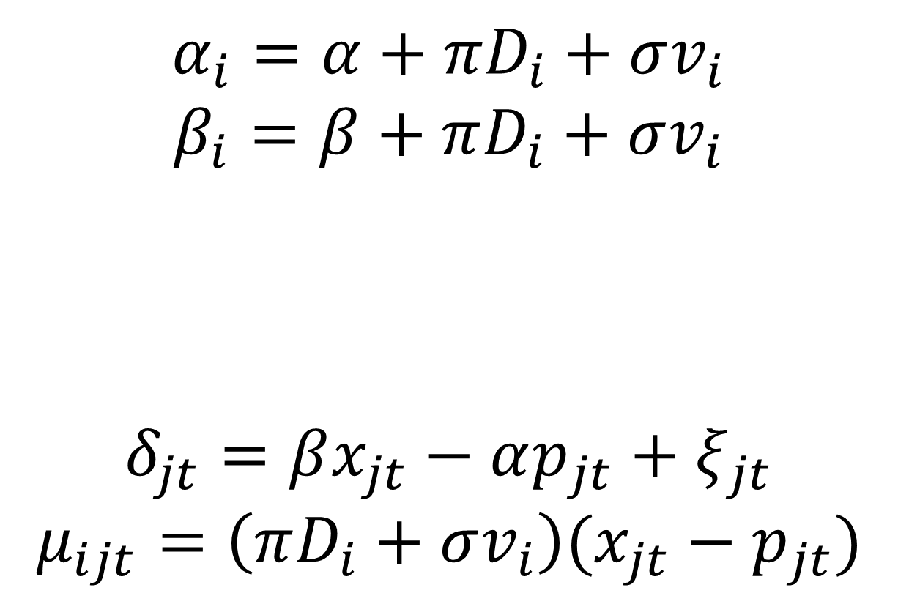
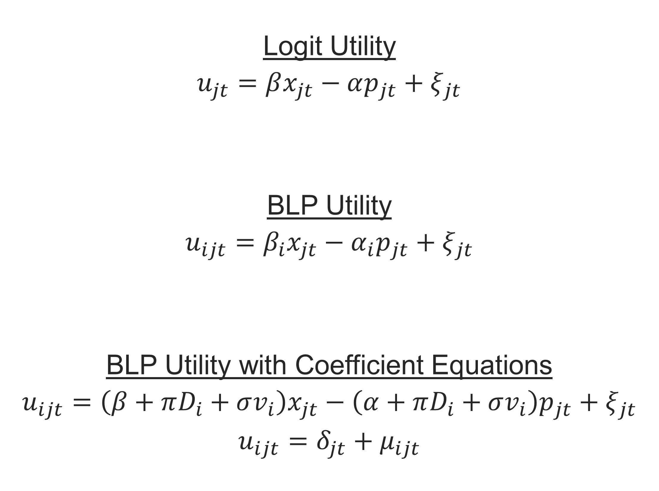
The BLP Model
Logit Utility
$$u_{jt}=βx_{jt}−αp_{jt}+ξ_{jt}$$
BLP Utility
$$u_{ijt}=β_{i}x_{jt}−α_{i}p_{jt}+ξ_{jt}$$
BLP Utility with Coefficient Equations
$$u_{ijt}=\left(β+πD_{i}+σv_{i}\right)x_{jt}−\left(α+πD_{i}+σv_{i}\right)p_{jt}+ξ_{jt}$$
$$u_{ijt}=δ_{jt}+μ_{ijt}$$
$$α_{i}=α+πD_{i}+σv_{i}$$
$$β_{i}=β+πD_{i}+σv_{i}$$
$$δ_{jt}=βx_{jt}−αp_{jt}+ξ_{jt}$$
$$μ_{ijt}=\left(πD_{i}+σv_{i}\right)(x_{jt}−p_{jt})$$

Slide 12
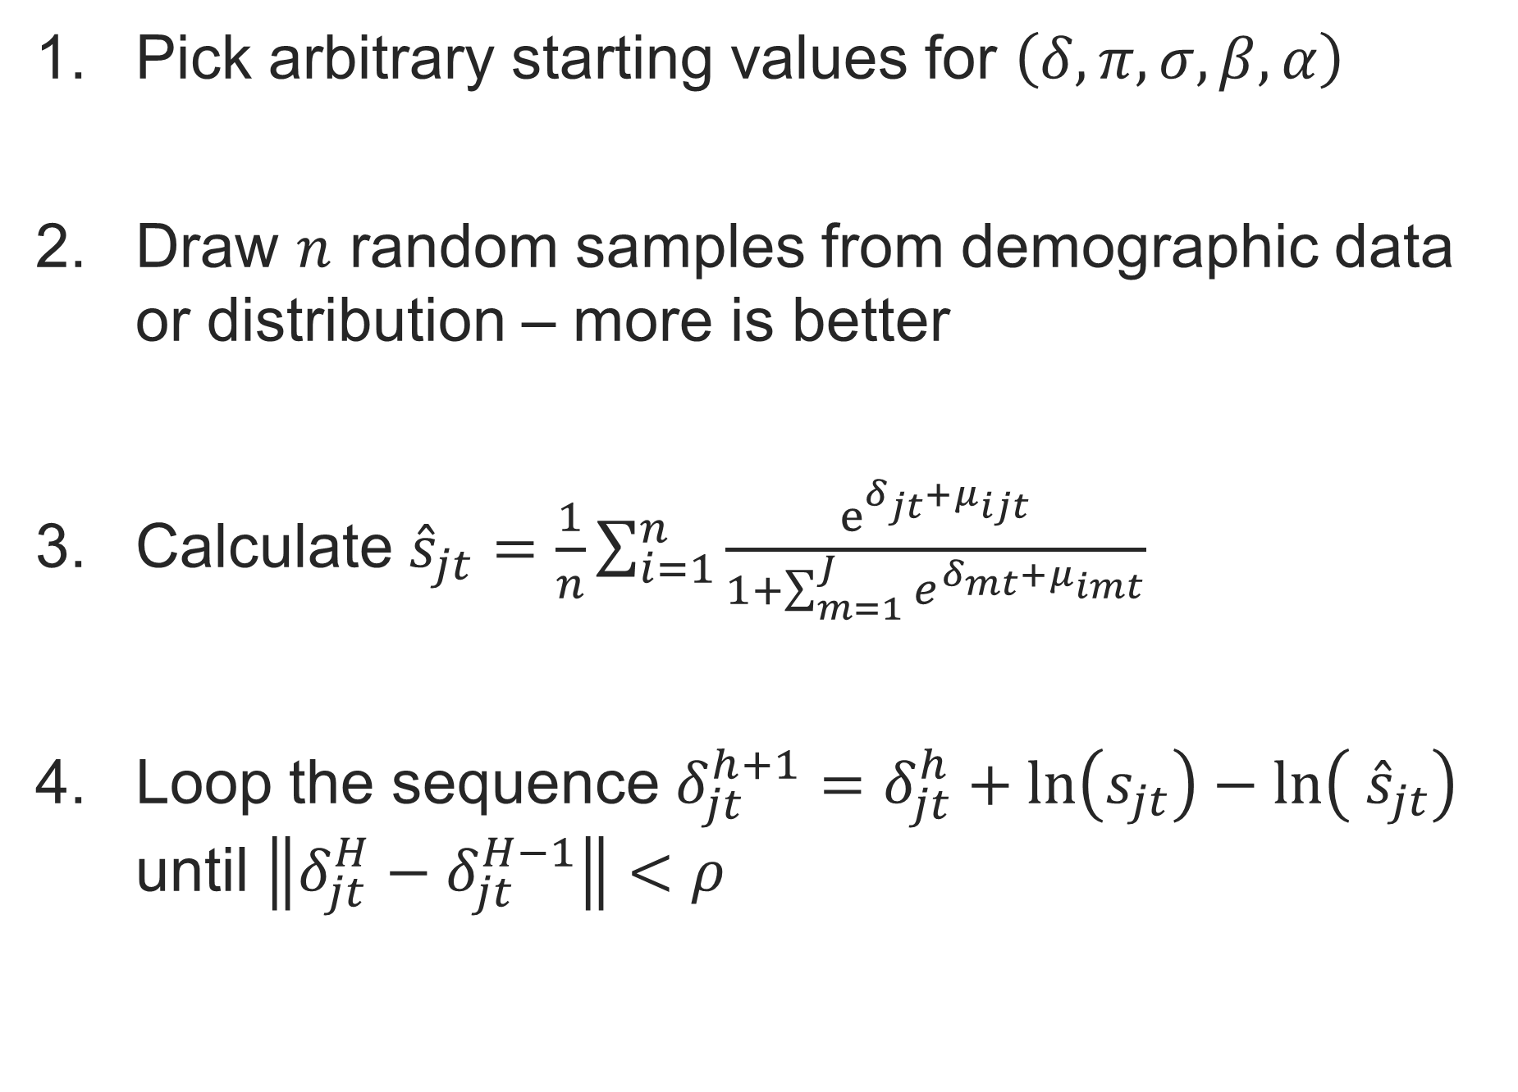
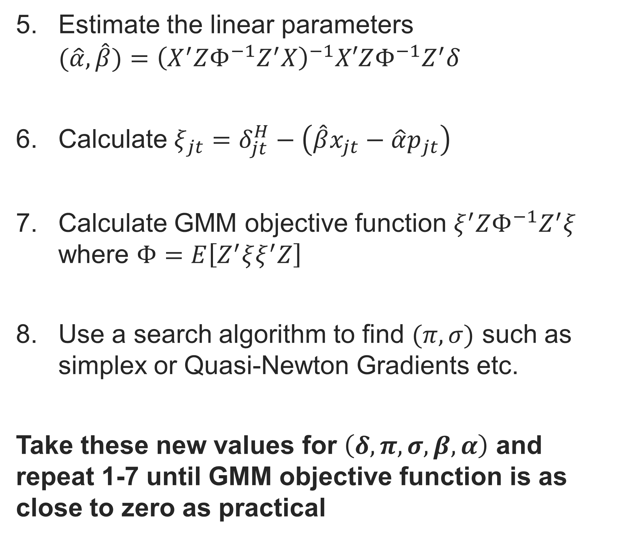
BLP Algorithm – Steps
Pick arbitrary starting values for $\left(δ, π, σ, β, α\right)$
Draw $n$ random samples from demographic data or distribution – more is better
Calculate ${\hat{s}}_{jt}=\frac{1}{n}\sum_{i=1}^{n}{\frac{e^{δ_{jt}+μ_{ijt}}}{1+\sum_{m=1}^{J}{e^{δ_{mt}+μ_{imt}}}}}$
Loop the sequence $δ_{jt}^{h+1}=δ_{jt}^{h}+\ln\left(s_{jt}\right)−\ln\left( {\hat{s}}_{jt}\right)$ until $\left\|δ_{jt}^{H}−δ_{jt}^{H−1}\right\|<ρ$
Estimate the linear parameters $(\hat{α}, \hat{β})={\left(X^{′}ZΦ^{−1}Z^{′}X\right)}^{−1}X′ZΦ^{−1}Z^{′}δ$
Calculate $ξ_{jt}=δ_{jt}^{H}−\left(\hat{β}x_{jt}−\hat{α}p_{jt}\right)$
Calculate GMM objective function $ξ^{′}ZΦ^{−1}Z^{′}ξ$ where $Φ=E\left[Z^{′}ξξ^{′}Z\right]$
Use a search algorithm to find $(π, σ)$ such as simplex or Quasi-Newton Gradients etc.
Take these new values for $\left(δ, π, σ, β, α\right)$ and repeat 1-7 until GMM objective function is as close to zero as practical

Slide 13
Overwhelmed??? Don’t worry, there is an R package for all of this!

Slide 14
Demonstration of BLPestimatoR

Slide 15
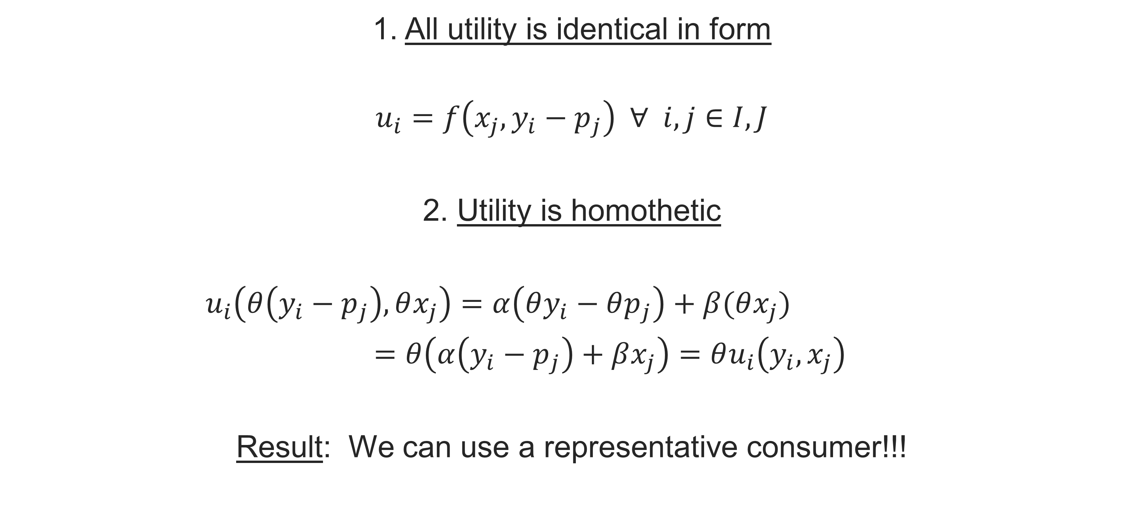
Appendix – Utility Assumptions
1. All utility is identical in form
$$u_{i}=f\left(x_{j},y_{i}−p_{j}\right) ∀ i,j∈I,J$$
2. Utility is homothetic
$u_{i}\left(θ\left(y_{i}−p_{j}\right),θx_{j}\right)=α\left(θy_{i}−θp_{j}\right)+β(θx_{j})$
$=θ\left(α\left(y_{i}−p_{j}\right)+βx_{j}\right)=θu_{i}\left(y_{i},x_{j}\right)$
Result: We can use a representative consumer!!!

Slide 16


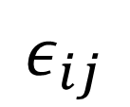
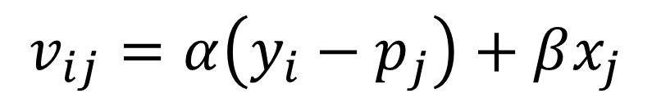
Appendix - The Logit Model
$$v_{ij}=α\left(y_{i}−p_{j}\right)+βx_{j}$$
$$ε_{ij} \sim iid EV I$$
$P_{ij=1}$ $=\operatorname{Pr}\left(u_{i,j=1}>u_{i,j≠1}\right)$
$=\operatorname{Pr}\left(v_{i,j=1}+ε_{i,j=1}>v_{ij}+ε_{ij}\right)$
$=\operatorname{Pr}\left(ε_{ij}<ε_{i,j=1}+v_{i,j=1}−v_{ij}\right)$
$=\frac{e^{v_{i,j=1}}}{\sum_{k=0}^{J}{e^{v_{ik}}}}$
$=\frac{e^{v_{i,j=1}}}{1+\sum_{k=1}^{J}{e^{v_{ik}}}}$
$$ε_{i,j=1}+v_{i,j=1}−v_{ij}$$
$$ε_{ij}$$

Slide 17

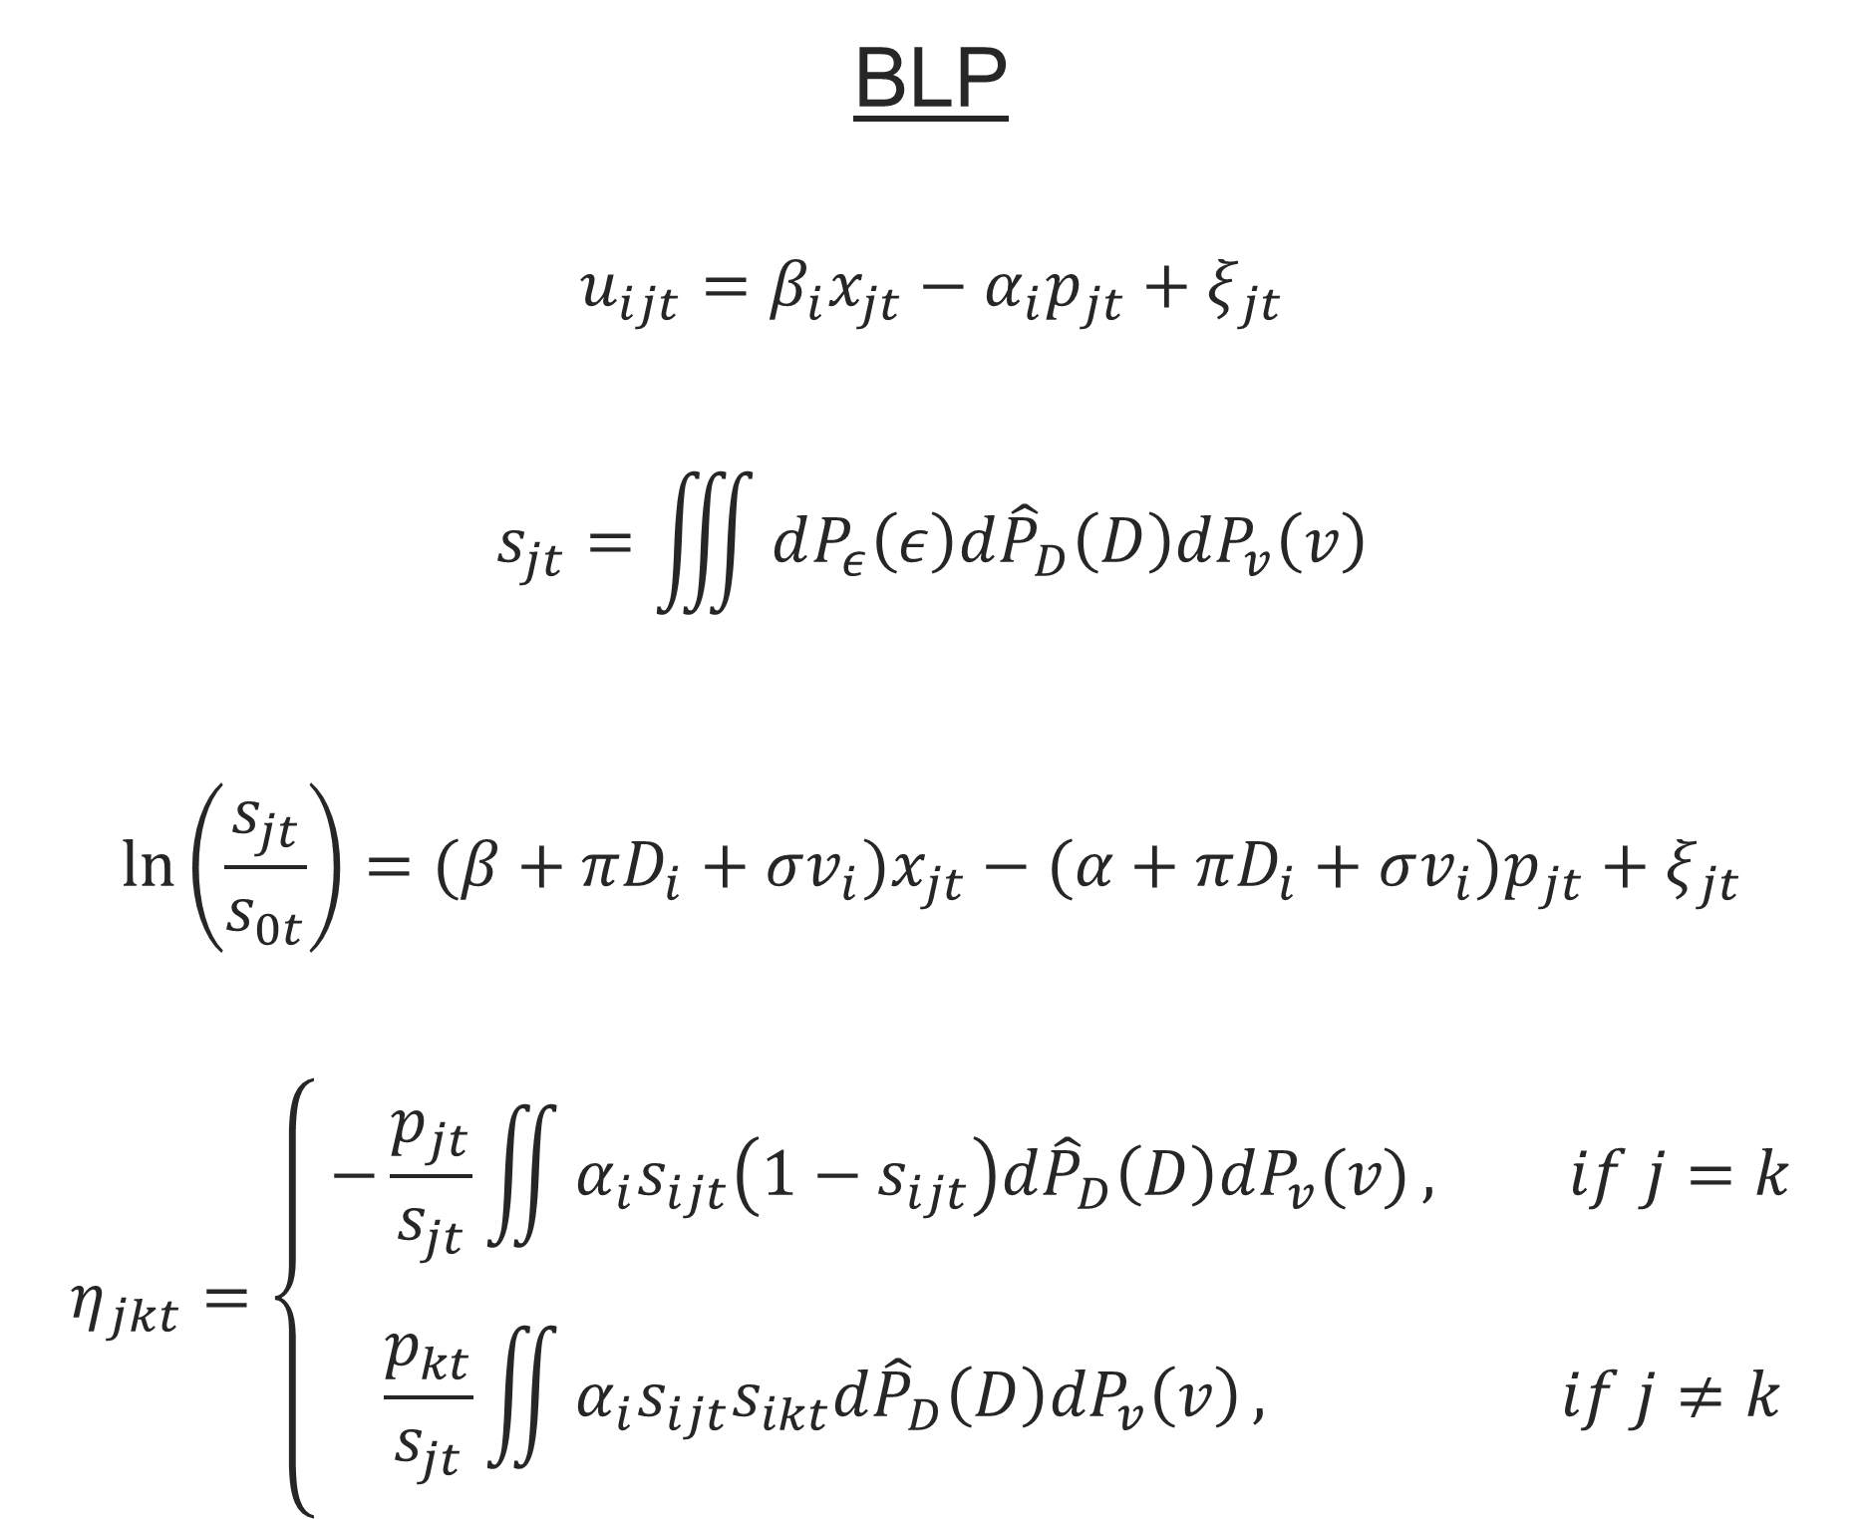
Appendix – Contrasting Logit and BLP
Logit
$$u_{jt}=βx_{jt}−αp_{jt}+ξ_{jt}$$
$$s_{jt}=\frac{e^{βx_{jt}−αp_{jt}+ξ_{jt}}}{1+\sum_{k}{e^{βx_{jt}−αp_{jt}+ξ_{jt}}}}$$
$$\ln\left(\frac{s_{jt}}{s_{0t}}\right)=βx_{jt}−αp_{jt}+ξ_{jt}$$
$$η_{jkt}=\left\{ \begin{aligned}−αp_{jt}\left(1−s_{jt}\right), if j=k \\ & αp_{kt}s_{kt}, if j≠k\end{aligned}\right.$$
BLP
$$u_{ijt}=β_{i}x_{jt}−α_{i}p_{jt}+ξ_{jt}$$
$$s_{jt}=\iiint{dP_{ε}\left(ε\right)d{\hat{P}}_{D}\left(D\right)dP_{v}\left(v\right)}$$
$$\ln\left(\frac{s_{jt}}{s_{0t}}\right)=(β+πD_{i}+σv_{i})x_{jt}−(α+πD_{i}+σv_{i})p_{jt}+ξ_{jt}$$
$$η_{jkt}=\left\{ \begin{aligned}−\frac{p_{jt}}{s_{jt}}\iint{α_{i}s_{ijt}\left(1−s_{ijt}\right)d{\hat{P}}_{D}\left(D\right)dP_{v}(v)}, if j=k \\ &\frac{p_{kt}}{s_{jt}}\iint{α_{i}s_{ijt}s_{ikt}d{\hat{P}}_{D}\left(D\right)dP_{v}\left(v\right)}, if j≠k\end{aligned}\right.$$

Slide 18
Appendix – Selection of Instruments
Hausman Instruments
Prices of the same good in nearby markets
Not too hard to get
Criticized for being a weak instrument
Cost Shifters
Prices of product inputs
Strong correlation with price
Can be difficult to get for all the firms being examined
BLP Instruments
Measures of isolation in characteristic space
Market sum of characteristics of other firm’s products or other products from same firm
Strong correlation with price & based on oligopolistic competition
Easy to get; we can calculate it directly from the data at hand

