Slide 1
Visa Applicant analysis
By: Nirvan Silswal
Ns318
Nirvan.silswal@duke.edu

Slide 2
Guiding Questions
What variables influence an application’s likelihood of being approved?
How do Job wages compare across locations?

Slide 3
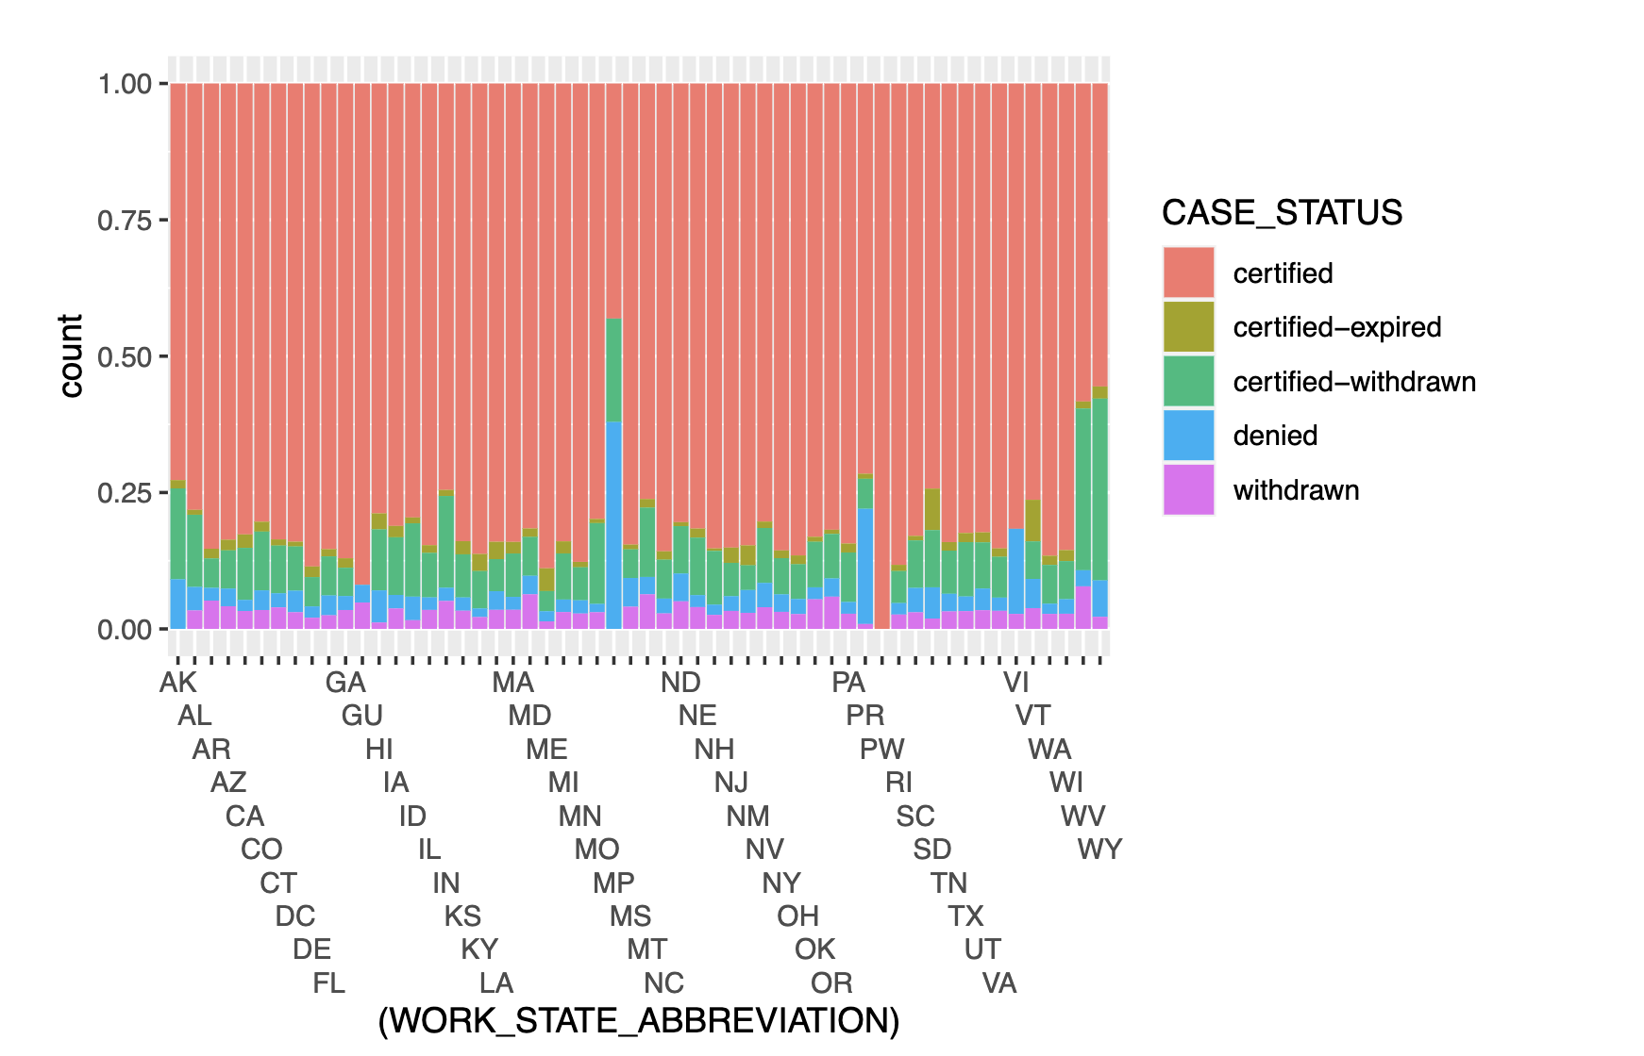
Case Status Based off Location
Certification Rate
Northern Marina Islands, Wyoming, West Virginia
Not much difference between US States

Slide 4
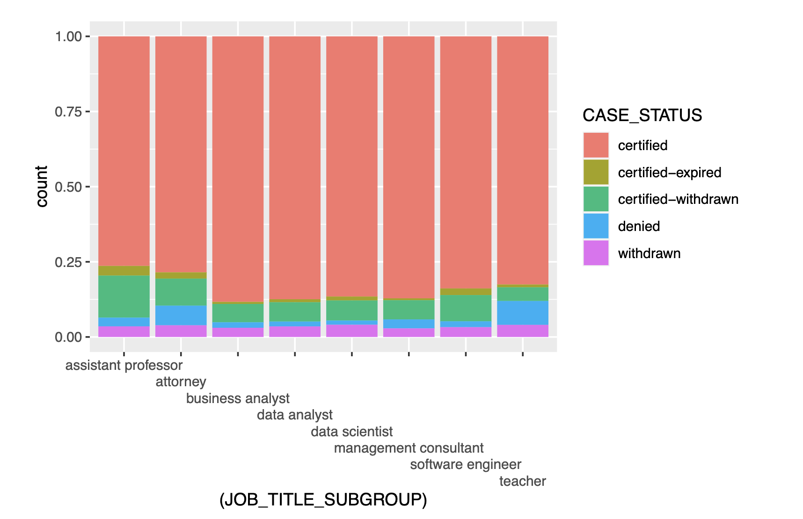
Case Status Based off Occupation
Assistant Professor, Attorney, and Teachers – around 75% Certified
Fluctuation Between 75% - 92%

Slide 5
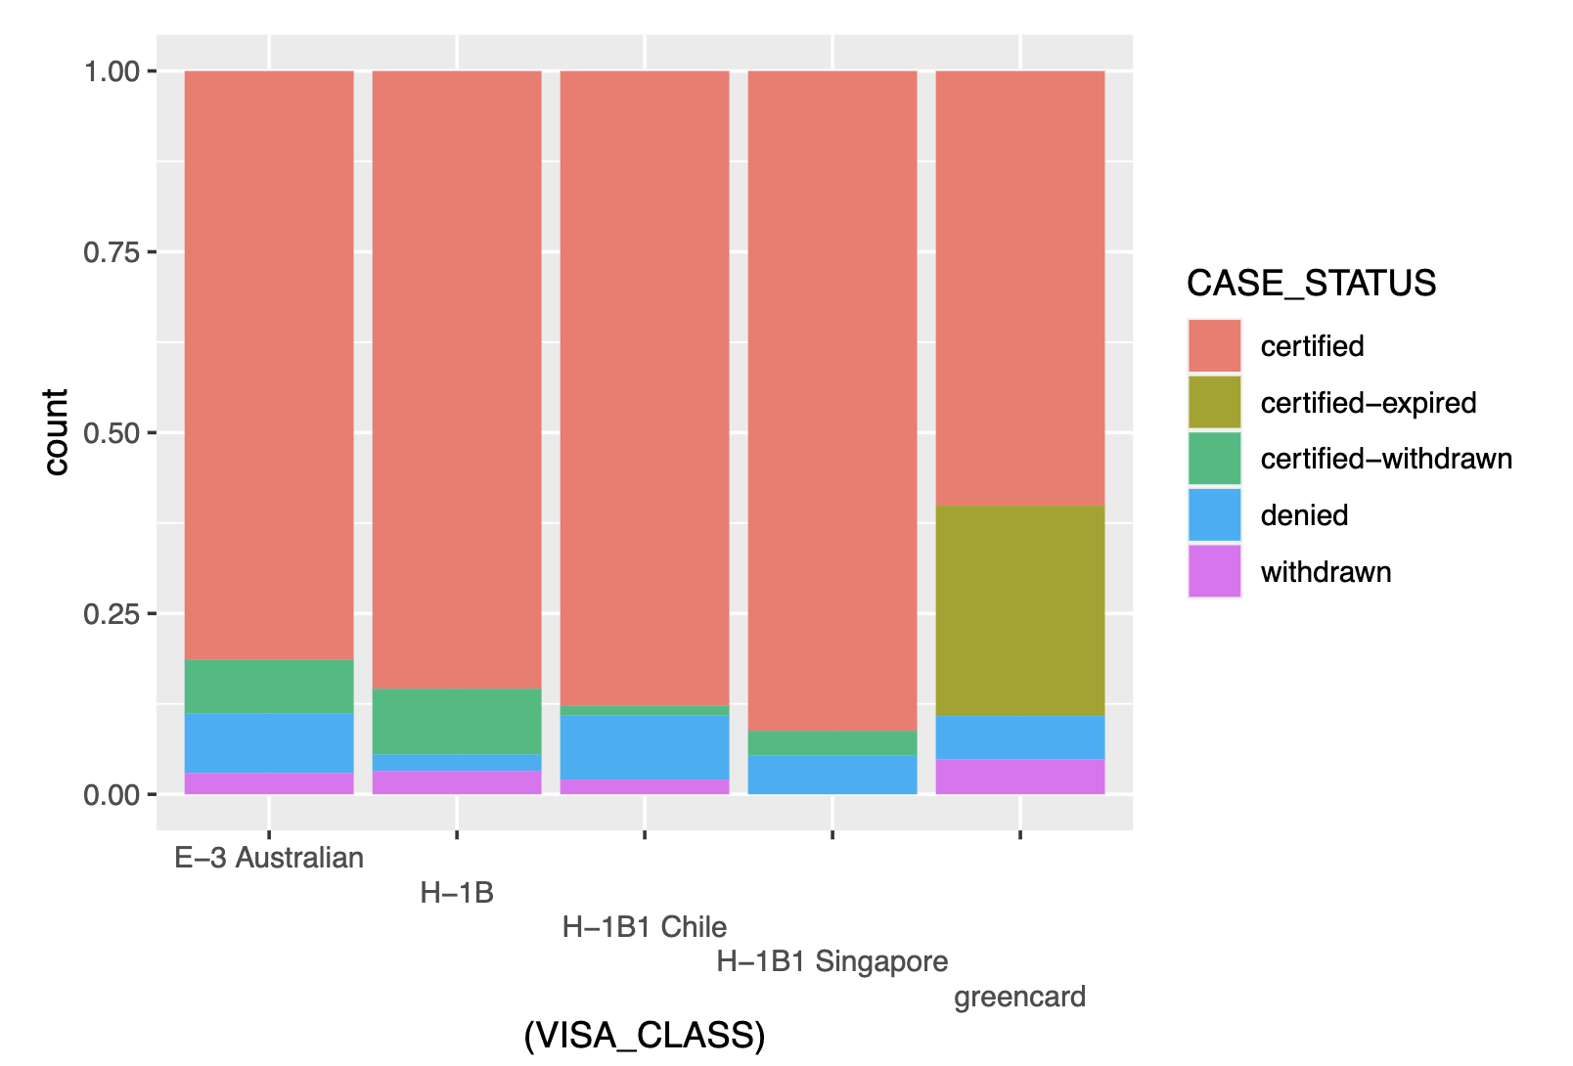
Case Status Based off Visa Class Applied For
Success of H-1B1 from Singapore
Green cards – Least Successful

Slide 6
Takeaways?
Applicant Location
Applicant Occupation
Visa Class Applied For

Slide 7
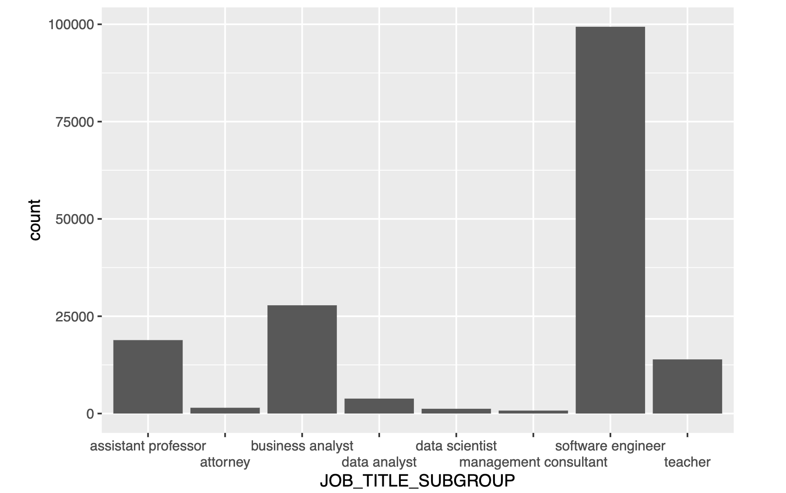
How do Job wages compare across locations?

Slide 8
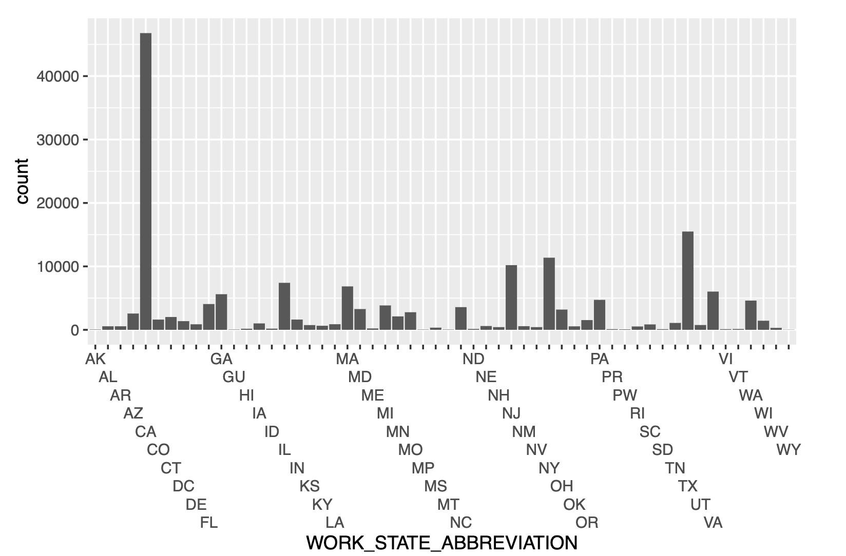

Slide 9
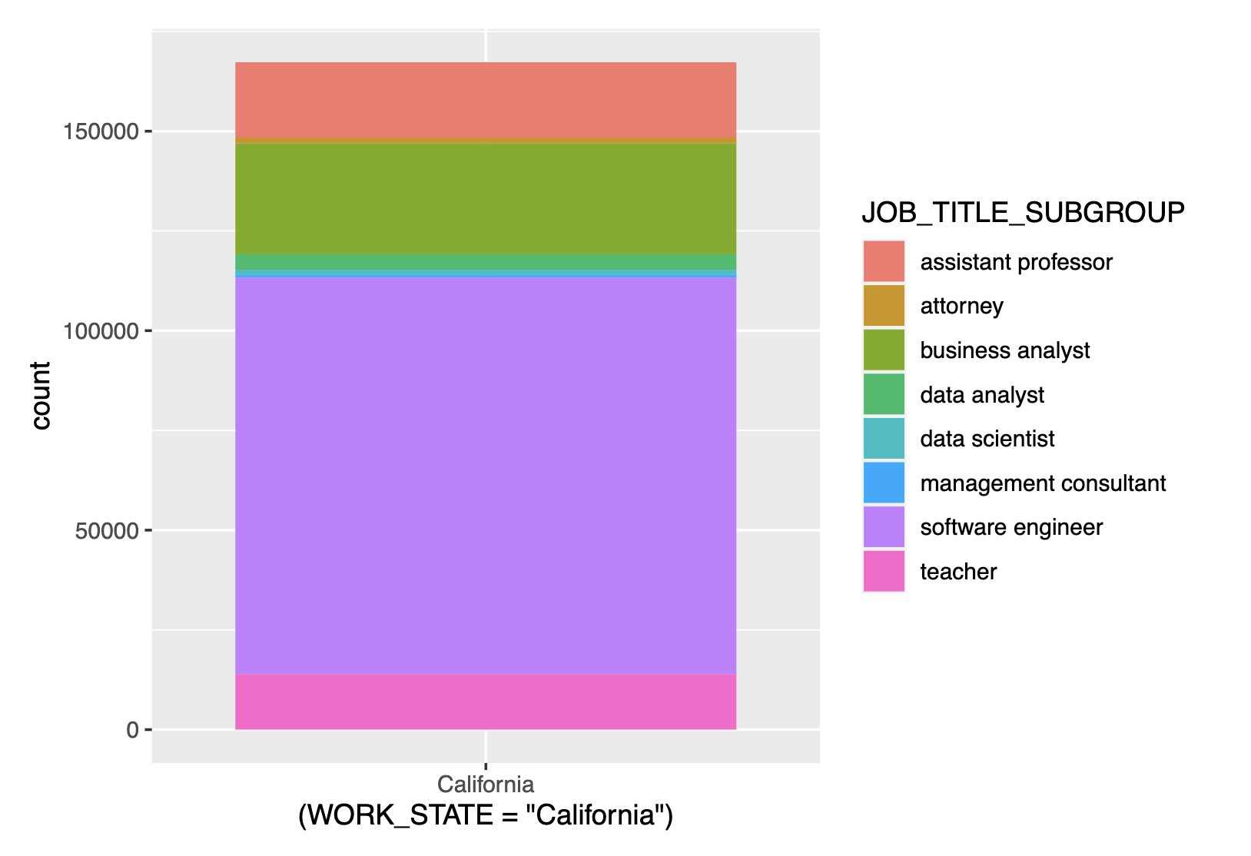
California Job Distributions
Software Jobs Dominate in California

Slide 10
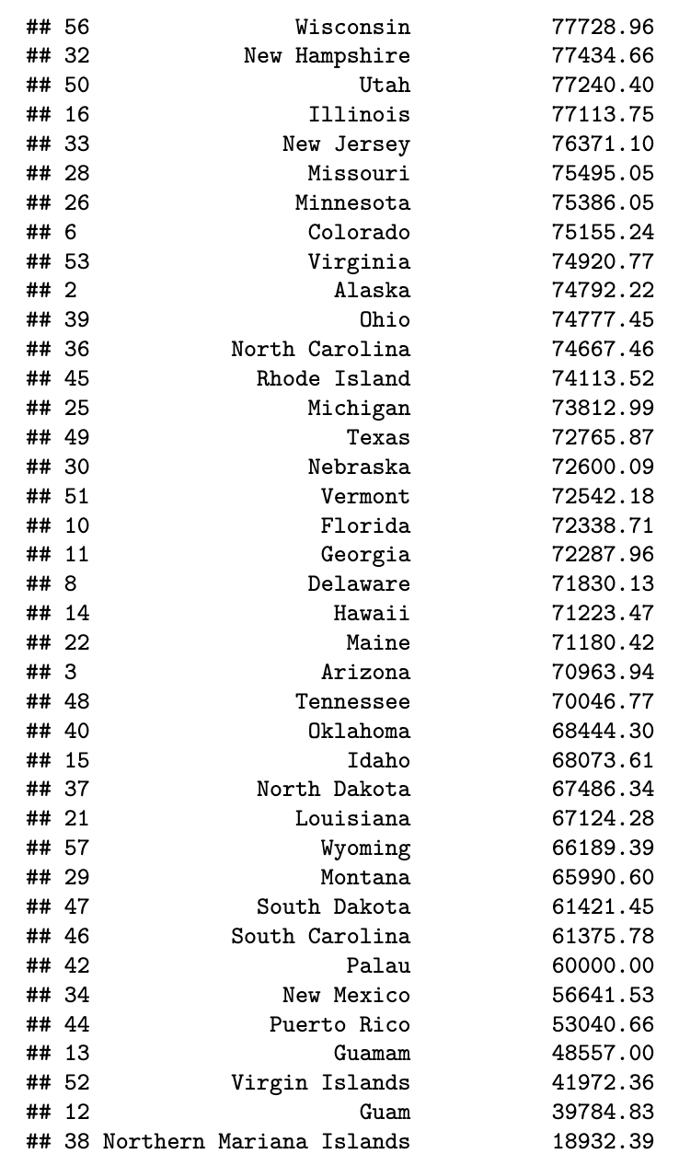
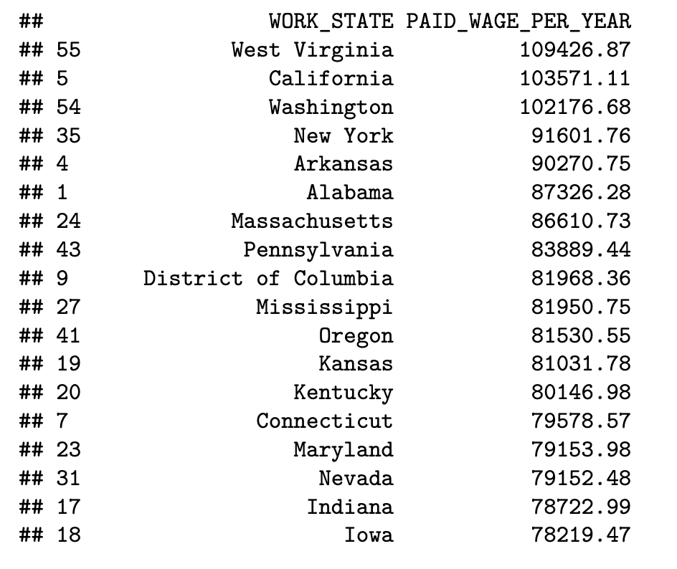
Average Wages per state

Slide 11
Conclusion
Software Jobs Make Up a Large Portion of the Dataset – Hence increasing the average salaries
State’s well known in software development tend to have higher average wages for Visa Applicants
Dataset has a slight skew towards California based Visa Applicants

Slide 12
Questions?
Thank you for your time!

