Slide 1
Clustering Algorithms
BAGANJA EMMANUEL - 2024-B291-11845
NOEL NSIMBI - 2024-B291-13341
KAKUMBA JEREMIAH - 2024-B291-12212

Slide 2
Part A: Data Loading & Preprocessing
200
0
0
customers, 5 columns loaded from Mall_Customers.csv
duplicate rows found, so none removed
missing values; median/mode imputation rule set up as a safeguard
Scaled with StandardScaler
Gender kept out of the distance
Clustering uses Euclidean distance. Income (15 to 137) has a far wider spread than Age or Spending Score, so it would dominate. Each feature is rescaled to mean 0 and standard deviation 1.
A 0/1 binary adds an artificial gap in continuous space and pushes K-Means to split by gender. We cluster on Income and Spending Score, then test Gender against clusters later (Chi-Square).
Group 1 · Jeremiah Kakumba · random_state = 42 for reproducibility
Notes:
Part A. We loaded the Mall Customers dataset of 200 customers. We checked for duplicates and missing values and found none, but we still wrote the cleaning rules (drop rows with over 50% missing, median for numbers, mode for Gender) so the pipeline is reproducible. We scaled Income and Spending Score with StandardScaler because K-Means and hierarchical clustering use Euclidean distance, and unscaled Income has a variance of about 690 and would dominate. We left Gender out of the clustering features because a 0/1 encoding creates an artificial distance and tends to split customers by gender rather than behaviour. Later, in Part E, we test whether gender is related to cluster membership using Chi-Square.

Slide 3
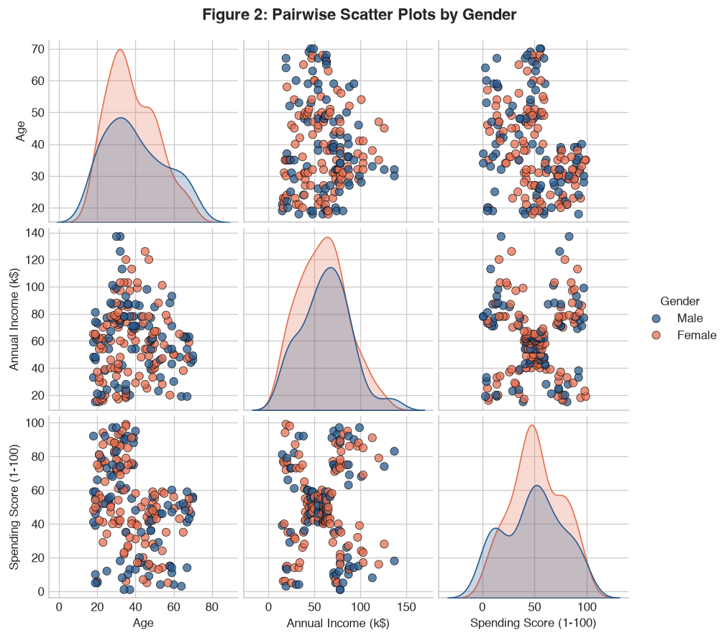
Part B: Exploratory Data Analysis
Feature | Mean | Median | Skew | Outliers
Age | 38.85 | 36.0 | 0.49 | 0
Annual Income (k$) | 60.56 | 61.5 | 0.32 | 2 (137k)
Spending Score | 50.20 | 50.0 | -0.05 | 0
5 visible groups in Income vs Spending Score, with men and women mixed evenly in each.
Income and Spending are uncorrelated (r = 0.01), so a linear test misses what clustering can find.
Age vs Spending is moderately negative (r = -0.33): over-40s rarely score above 60.
The two $137k outliers are kept as realistic wealthy shoppers.
Figure: pairwise scatter plots by Gender, from the notebook
Notes:
Part B. The descriptive statistics show Age, Income and Spending Score are all fairly symmetric. Only Income has outliers, two customers at 137k, which we keep because wealthy shoppers matter for segmentation. In the pairplot, Income vs Spending Score shows five clear groups: low/low, low income with high spending, average/average, high income with low spending, and high/high. Men and women are mixed across all of them. The correlation matrix shows almost no linear relationship between Income and Spending (0.0099), while Age and Spending are moderately negative (-0.327). That motivates using clustering rather than simple correlation.

Slide 4
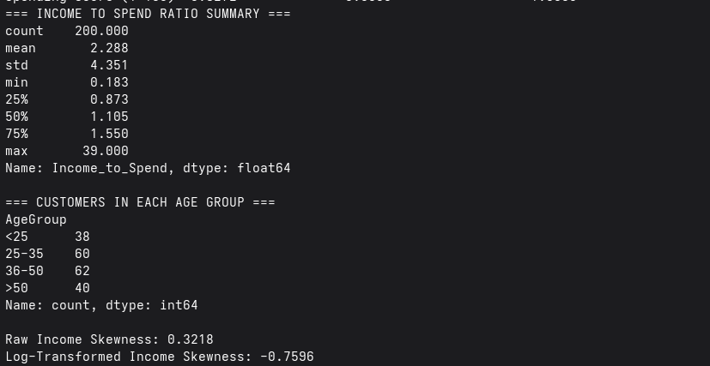
Part C&D: Clustering Modelling,Selection and Feature Engineering

Slide 5
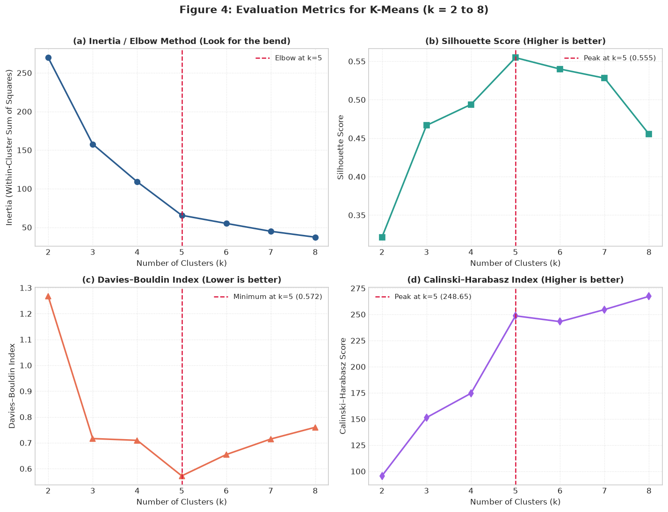
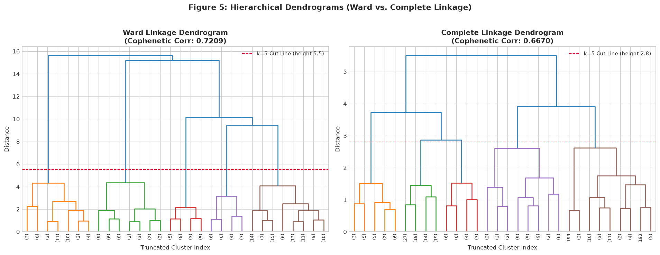

Slide 6
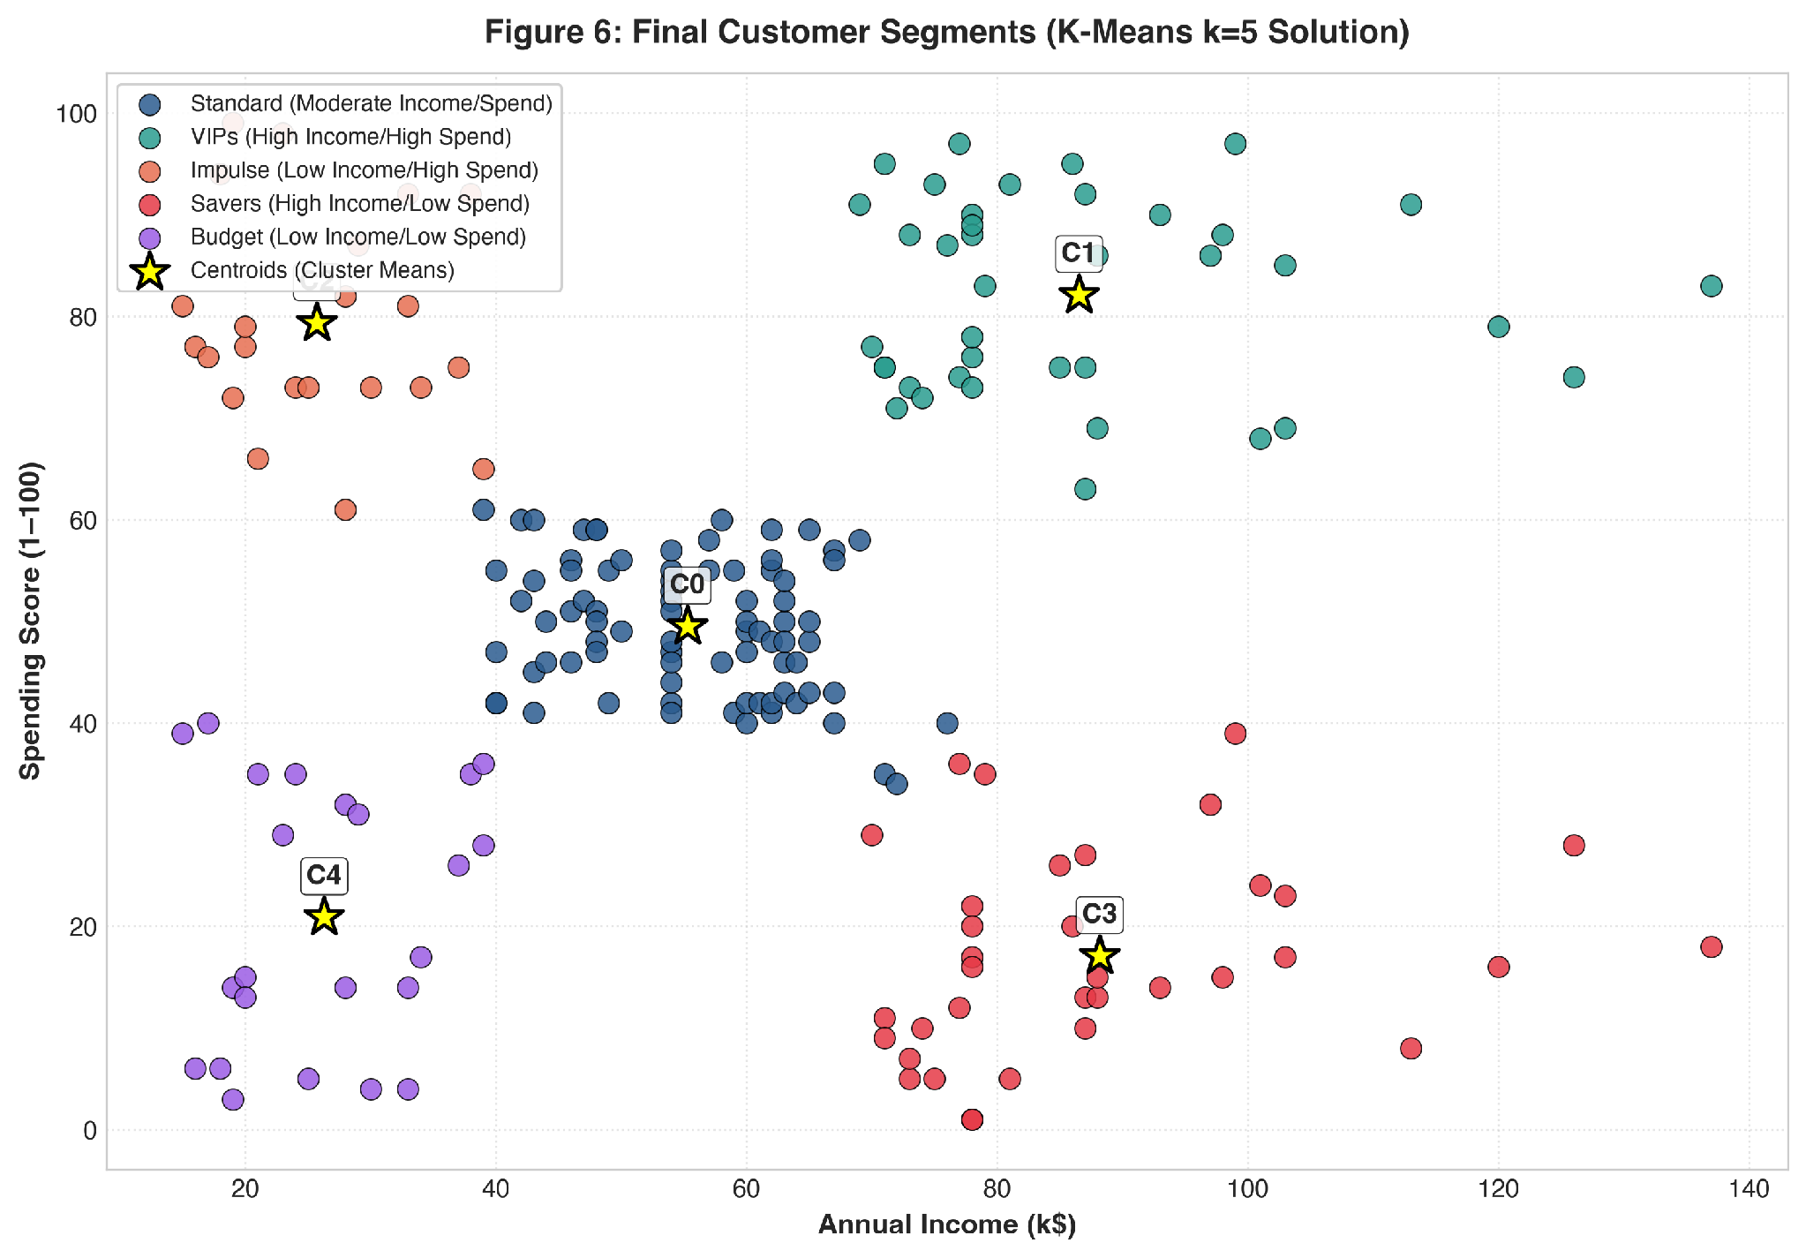
Who Is in Each of the Five Clusters?
PART E | FIGURE 6 AND CLUSTER CENTROIDS
 | Persona | n | Income | Spend | Age
C0 | Middle-Class Essentials | 81 | 55.3 | 49.5 | 42.7
C1 | VIP Spenders | 39 | 86.5 | 82.1 | 32.7
C2 | Young Impulsive Shoppers | 22 | 25.7 | 79.4 | 25.3
C3 | Careful Savers | 35 | 88.2 | 17.1 | 41.1
C4 | Budget Shoppers | 23 | 26.3 | 20.9 | 45.2
What the numbers tell us
C1 (VIP) ages are tightly packed: std only 3.7 years.
C0 is the biggest group (40.5%) with ages spread widely: std 16.5.
Cluster averages come from groupby on the unscaled data.
Each dot is a customer. Yellow stars are the centroids, converted back to real units with inverse_transform. Four clusters sit in the corners; C0 is the dense middle.
Notes:
Fit: KMeans k=5, n_init=20, random_state=42. Centroids table is df.groupby('Cluster').agg(mean, std, count) on the unscaled dataframe, so values are in k$, score points and years. Stars in Figure 6 use scaler.inverse_transform on cluster_centers_.

Slide 7
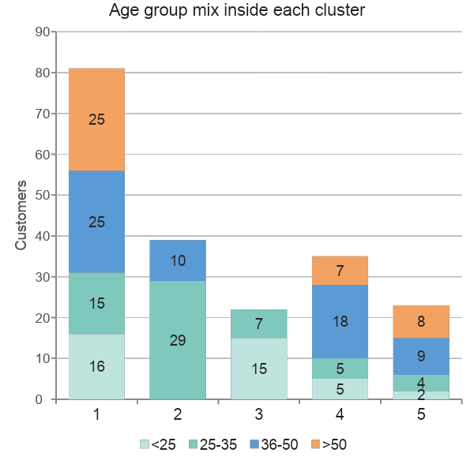
Are the Clusters Statistically Different?
PART E | HYPOTHESIS TESTS
Numeric features: ANOVA (means) and Kruskal-Wallis (ranks)
Feature | ANOVA F | ANOVA p | Kruskal H | Kruskal p
Annual Income | 187.80 | 1.0e-65 | 172.10 | 3.7e-36
Spending Score | 351.65 | 5.9e-88 | 174.78 | 9.9e-37
Age | 12.37 | 5.5e-09 | 41.51 | 2.1e-08
Income_to_Spend | 26.22 | 2.1e-17 | 123.90 | 7.9e-26
All p < 0.05. Even Age differs, although it was never used to build the clusters.
Categorical features: chi-square tests
Gender
Age group
p = 0.693
p = 2e-16
No link to cluster
Strong link to cluster
Notes:
f_oneway and kruskal take one array per cluster. Chi-square uses pd.crosstab counts. Gender: chi2 2.23, df 4, p 0.693, so gender is independent of cluster. AgeGroup: chi2 102.28, df 12, p about 2e-16. The chart is the AgeGroup crosstab: C1 has nobody under 25 or over 50, C2 nobody over 35.

Slide 8
Five Customer Personas, Five Strategies
PART F | PERSONAS AND MARKETING PLAN
C0
Middle-Class Essentials
$55.3k income | spend 49.5
Average age 43
Grocery rewards, anchor-store sales and family weekend events
40.5% | n = 81
C1
VIP Spenders
$86.5k income | spend 82.1
Average age 33
Private previews, personal shoppers, VIP lounge and concierge
19.5% | n = 39
C2
Young Impulsive Shoppers
$25.7k income | spend 79.4
Average age 25
Social media ads, pop-up stores and buy-now-pay-later
11.0% | n = 22
C3
Careful Savers
$88.2k income | spend 17.1
Average age 41
Quality guarantees, warranties and financial planning seminars
17.5% | n = 35
C4
Budget Shoppers
$26.3k income | spend 20.9
Average age 45
Clearance sales, discount coupons and value essentials
11.5% | n = 23
Notes:
Left: who they are. Middle: average profile from the centroid table. Right: recommended action. Biggest growth levers: VIP Spenders (already spending) and Careful Savers (high income, low spend).

Slide 9
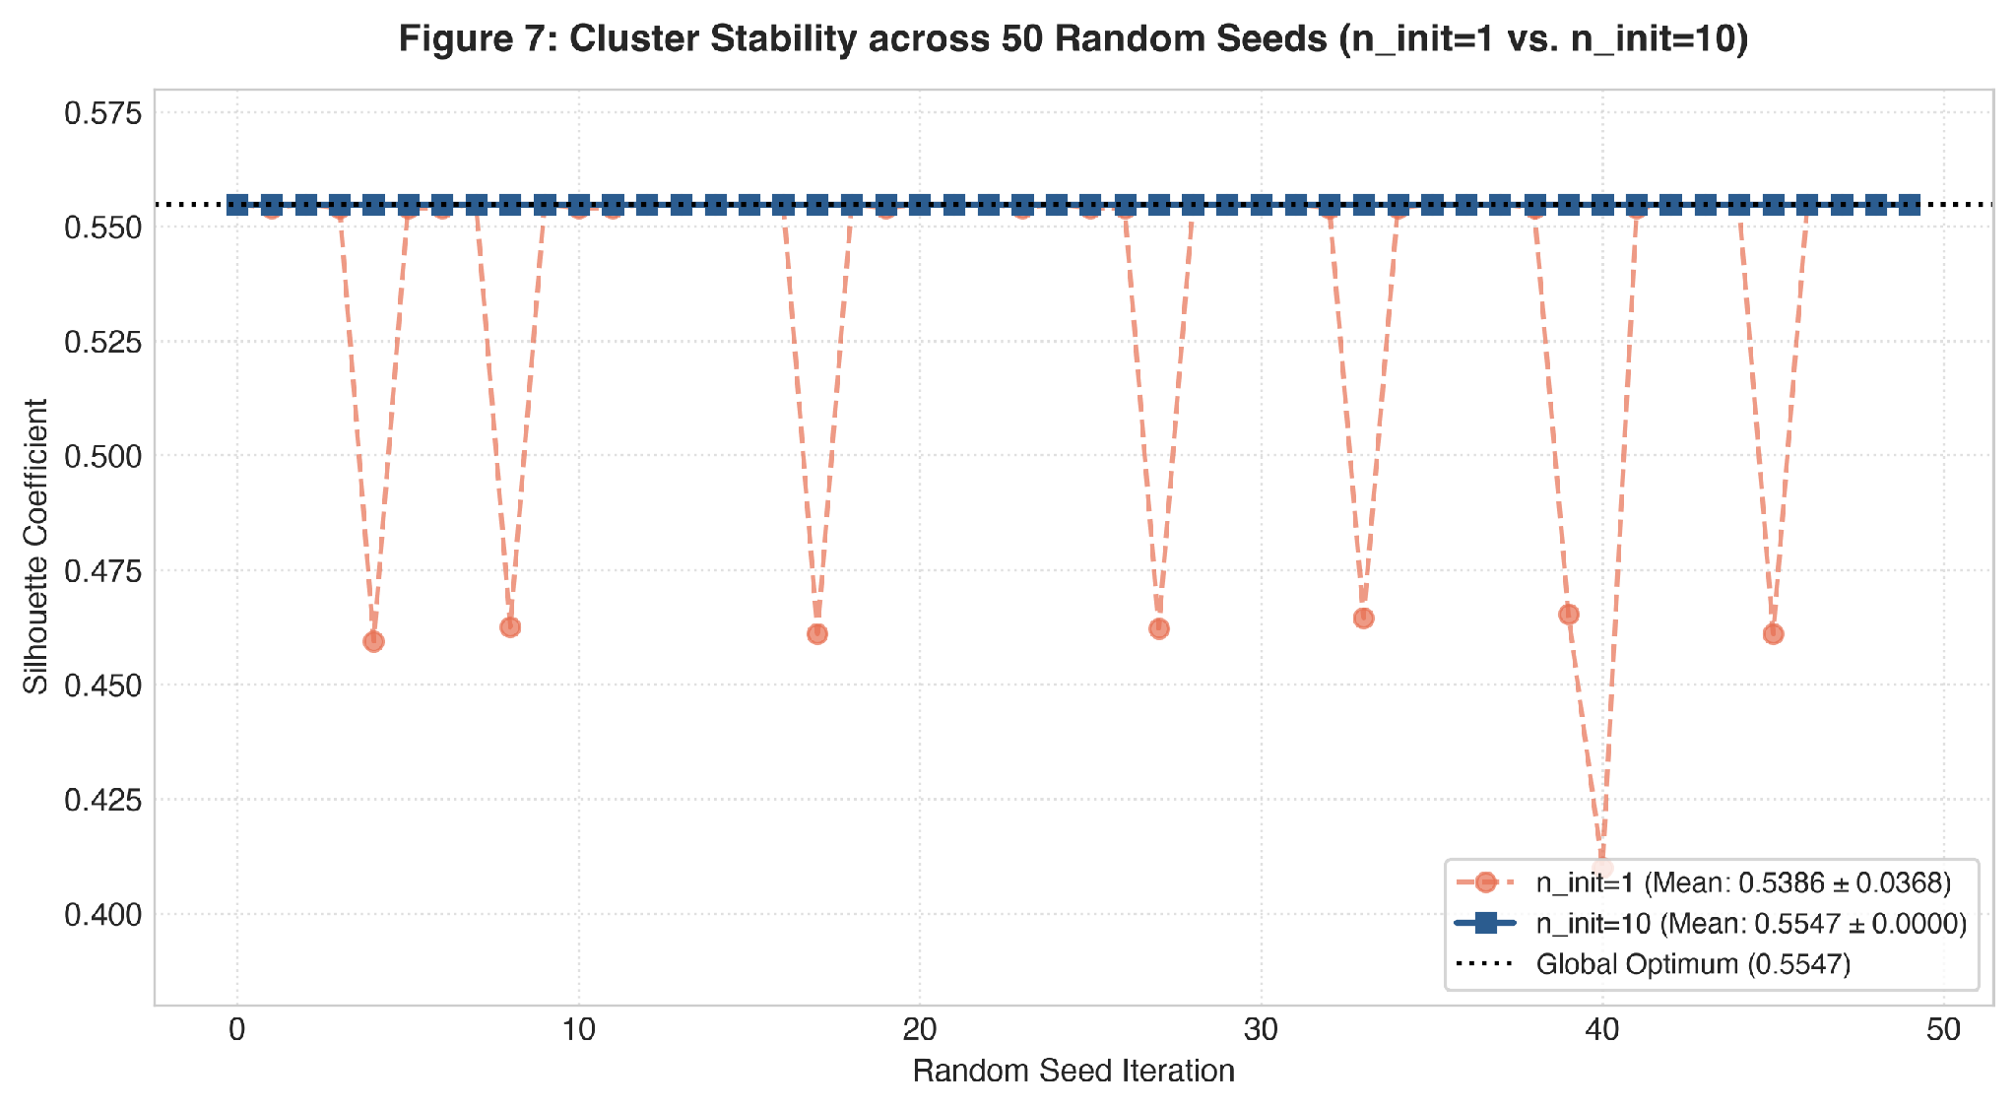
How Reliable Is It, and What Comes Next?
PART F | FIGURE 7, LIMITATIONS AND IMPROVEMENT
Limitations
Round clusters: K-Means struggles with elongated shapes.
Scaling: distance depends on how features are scaled.
Final merges: hierarchical clustering cannot undo a join.
Small sample: only 200 customers.
Improvement: K-Prototypes for mixed data
Lets Gender into the clustering without distorting distance: numbers use Euclidean distance, categories use simple matching.
n_init = 10
n_init = 1
0.5547
0.5386
E = Σ d²(numeric) + γ · Σ mismatch(category)
std 0.0000, identical on all 50 seeds
std 0.0368, 8 of 50 runs got stuck (worst 0.4101)
Notes:
Figure 7: 50 seeds, k=5. Blue squares (n_init=10) sit exactly on 0.5547. Orange circles (n_init=1) dip to about 0.46, once to 0.41, when a single start lands in a poor local minimum. The count of 8 dips was read from the plot. K-Prototypes is Huang (1998); gamma weights categorical mismatches.

Slide 10
What the Whole Project Shows
CONCLUSION | WHOLE PROJECT, PARTS A TO F
1
Clean, scaled data
2
Five natural groups
3
Two methods agree
200 customers, no duplicates or missing values. Income and Spending scaled; log transform rejected.
All four metrics agree on k = 5. Silhouette 0.5547, Davies-Bouldin 0.5722, Calinski-Harabasz 248.65.
Ward (0.5538) and Complete (0.5531) linkage match K-Means (0.5547) at k = 5.
4
Clusters are real
5
Age, not gender
6
Useful and stable
Every numeric test has p < 0.05, and Age differs even though it was not used.
Gender p = 0.693. Age group p = 2e-16. Target campaigns by income and life stage.
Five personas with clear plans. n_init of 10 or more gives the same result every time.
Notes:
Closing summary of Parts A to F. Next steps: K-Prototypes to include Gender, and a larger mall dataset.

