Slide 1
Smart Security Camera with Motion Detection
A Python-based Surveillance and Alert System.

Slide 2

Introduction :
Real-Time Surveillance with AI Alerts & Cloud Storage
This presentation unveils our cutting-edge smart security camera system, engineered for real-time monitoring and automatic alerts using advanced AI technologies. It is designed to meet modern safety needs through seamless integration of motion detection, face recognition, intelligent notifications, and secure cloud storage, wrapped in a sleek, tech-inspired visual aesthetic.
This project aims to solve that by developing a Smart Security Camera that can:
Detect motion in real-time,
Recognize known individuals,
Alert users instantly via email,
Trigger alarms for suspicious activity, and
Store surveillance footage securely in the cloud.

Slide 3
Core Features
Motion Detection
Face Recognition
Email Alerts
Cloud Backup
Real-time tracking using OpenCV technology for accurate and quick movement identification.
Detects known/unknown persons with intelligent alerts, enhancing security precision.
Sends timely notifications with video attachments via smtplib, ensuring fast response.
Secure storage using Google Drive and AWS for reliable, scalable video archiving.

Slide 4





How It Works
Camera
Captures live video streams strategically placed for optimal coverage.
Motion Detection
Analyzes movement dynamically to trigger further facial recognition processing.
Face Recognition
Identifies individuals in the frame, differentiating between known and unknown persons.
Alerts
Instant notifications sent to users via email with relevant video evidence.
Cloud Storage
Videos are securely backed up to cloud platforms for easy retrieval and monitoring.

Slide 5

Why This Project?
Automated security for homes/offices.
This system elevates protection by automating surveillance to reduce manual monitoring and improve responsiveness.
Motivation Behind the Project:
Increasing incidents of theft and unauthorized access demand smarter security.
Traditional CCTV systems only record — they don’t respond.
With automation, alerts, and facial recognition, the camera becomes proactive, not just reactive.
Combines motion detection, face recognition, and instant alerts.
Using AI and computer vision, the camera identifies potential threats efficiently, keeping you informed instantly.

Slide 6
Libraries & Tools
OpenCV
face_recognition
Flask
Powerful computer vision library enabling motion tracking and video processing.
Robust facial recognition API for detecting and identifying faces efficiently.
Lightweight web framework to handle backend server and API endpoints.
smtplib
Google Drive API
Python library for sending automated email alerts with attachments.
Enables cloud backup and management of video files with secure and scalable storage.
Python-based, lightweight, and scalable framework designed for efficient deployment.

Slide 7
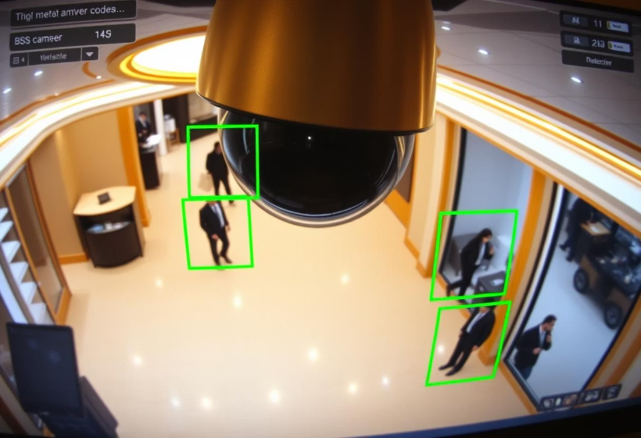
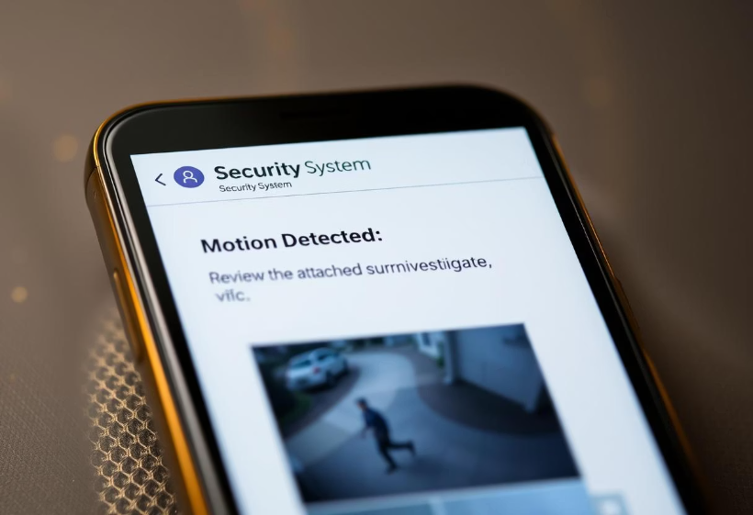
See It in Action
Live video interface highlighting detected motion with clear visual cues for real-time monitoring.
Example of an email alert sent instantly with attached surveillance video for immediate review.

Slide 8
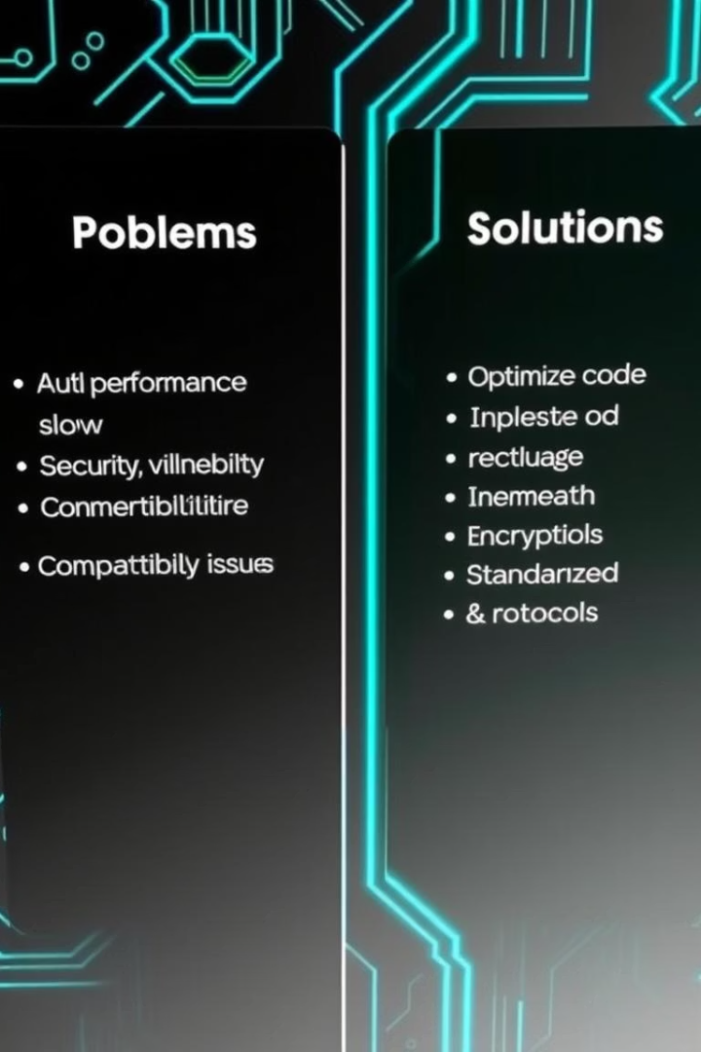
Challenges & Solutions
Challenge
Solution
False motion positives
Adjusted sensor sensitivity and filtering algorithms
Large video attachments
Compression techniques with Google Drive upload integration
Maintaining speed while doing face checks
Optimized frame processing with delay intervals
Authenticating and managing API tokens
Secured cloud API credentials and used PyDrive for auto-upload
Addressing technical hurdles with adaptive algorithms ensures reliable performance and efficient data handling critical for user satisfaction.

Slide 9




What's Next?
Mobile App Alerts
Low-Light Vision
AI Threat Classification
Push notifications for instant updates on any device, anywhere.
Enhanced camera sensors and algorithms for night-time surveillance.
Advanced AI to differentiate threat levels for prioritized response.

Slide 10

Conclusion
This Smart Security Camera system successfully demonstrates how modern technologies like computer vision and automation can transform traditional surveillance.
Key Takeaways:
Real-time detection and response
Easy to use and cost-effective
Secure and cloud-based
Fully customizable and extendable
It’s a step forward in making our homes and workplaces smarter and safer.

Slide 11
THANK YOU

