Slide 1



Project 1
From CO₂ to Insight
A Data-Driven Exploration of CO₂ Electroreduction
Bright Jaato
October 2, 2026
Data Science & Machine Learning

Slide 2
Presentation Overview
Introduction
Dataset & Research Questions
From Raw Data to SQL Analysis
Key Findings
Conclusions
Limitations and Next Steps

Slide 3
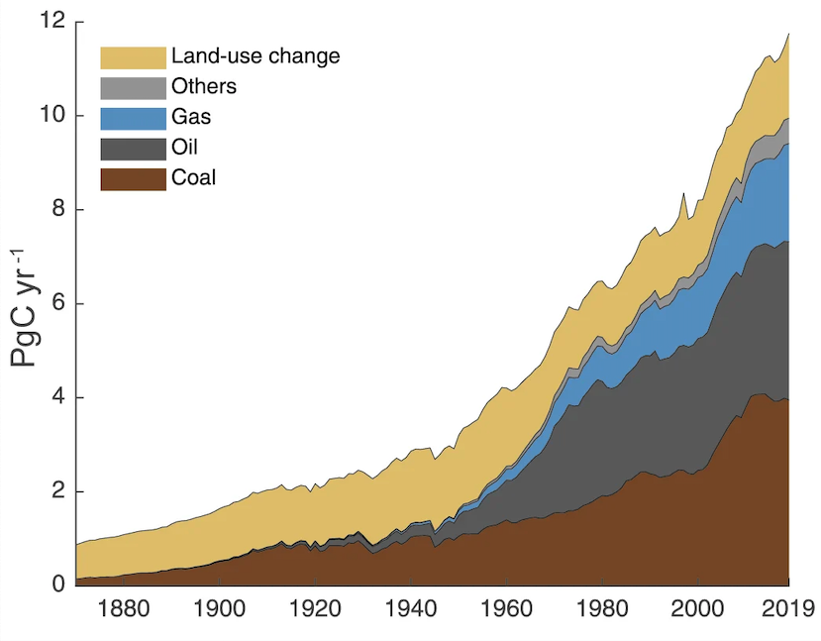
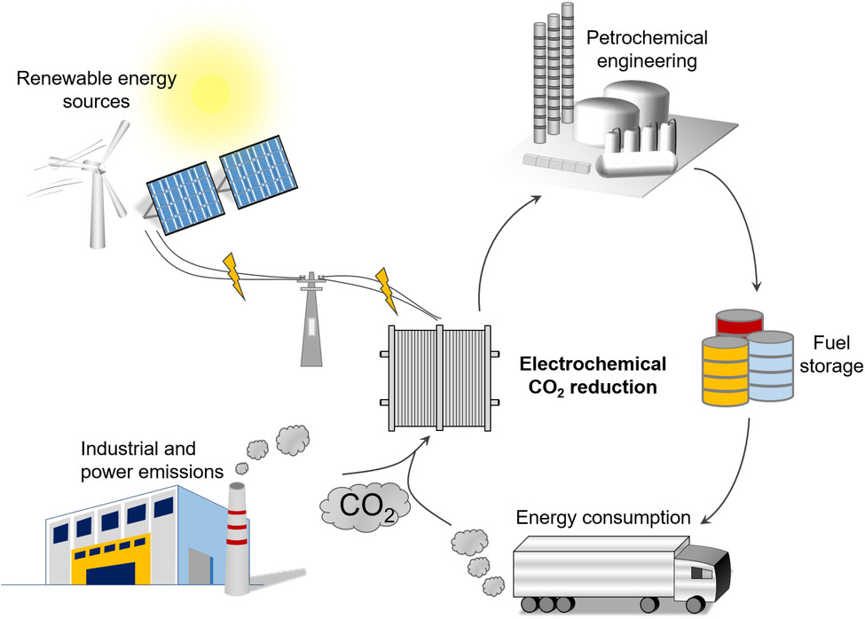
From CO₂ Challenge to Data Challenge
CO₂ Challenge
CO₂RR Opportunity
Data Challenge
Many catalysts and catalyst combinations
Different products and selectivities
Different electrolytes and reactors
Operating conditions vary across studies
Metrics are reported inconsistently
Global anthropogenic CO₂ emissions
CO₂ + renewable electricity → chemicals and fuels
→ Direct comparison is difficult
Can we structure this literature data to identify promising CO₂RR systems?
IPCC. (2021). Climate Change 2021: The Physical Science Basis. Contribution of Working Group I to the Sixth Assessment Report of the Intergovernmental Panel on Climate Change. Cambridge University Press. Quan, Y., Zhu, J., & Zheng, G. (2021). Electrocatalytic Reactions for Converting CO₂ to Value-Added Products. Small Science, 1(10), 2100043.
CO₂: carbon dioxide
CO₂RR: electrochemical CO₂ reduction reaction

Slide 4
Data & Research Questions
Dataset
Questions
RQ1: How does performance vary across catalyst–product combinations?
RQ2: Which combinations have high FE, high current density, and lower reported cost?
RQ3: How does current density vary across catalyst–electrolyte systems?
RQ4 How do systems and current density differ across temperature groups?
Low-temperature dataset
101 records
Catalyst • Product • FE • Current density • Cost
Second experimental dataset
181 records
Catalyst • Electrolyte • Temperature • Total current density
Malek, A., Wang, Q., Baumann, S., Guillon, O., Eikerling, M., & Malek, K. (2021). A Data-Driven Framework for the Accelerated Discovery of CO₂ Reduction Electrocatalysts. Frontiers in Energy Research, 9, 609070.
FE : Faradaic efficiency

Slide 5
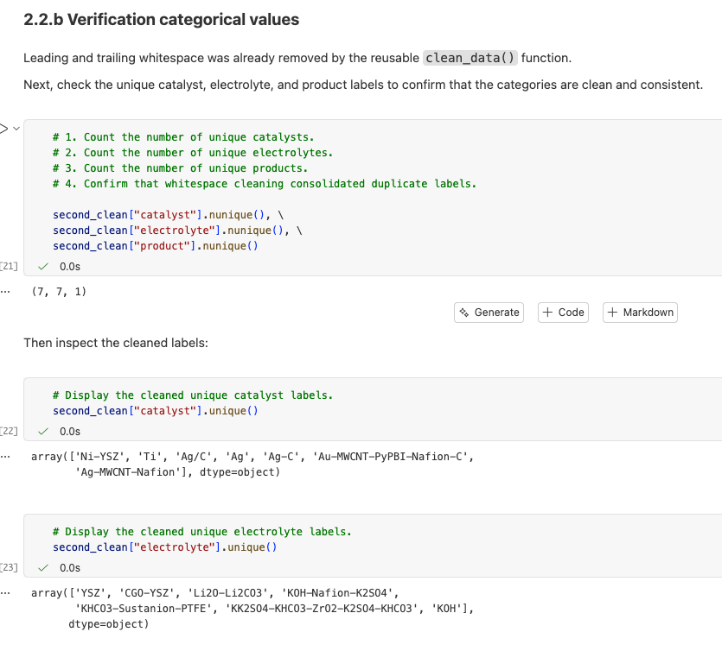
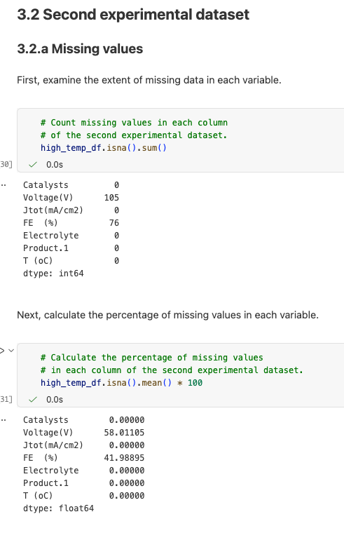
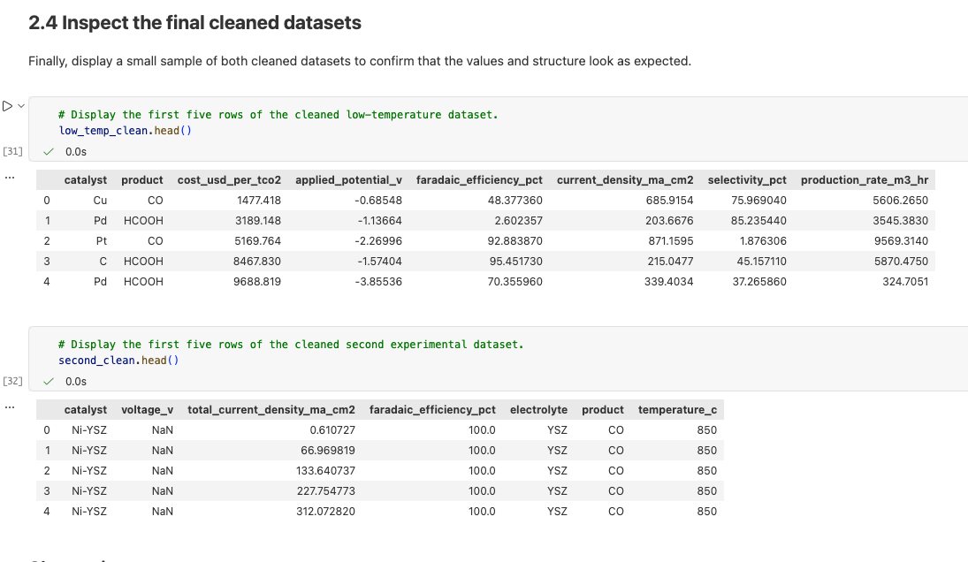
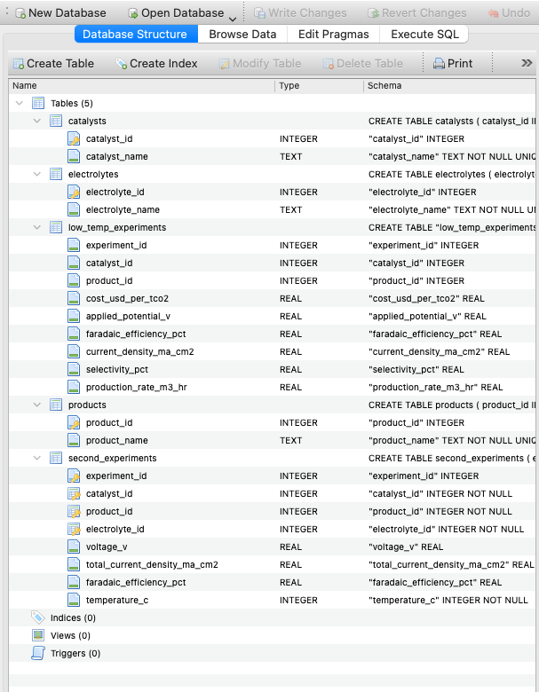
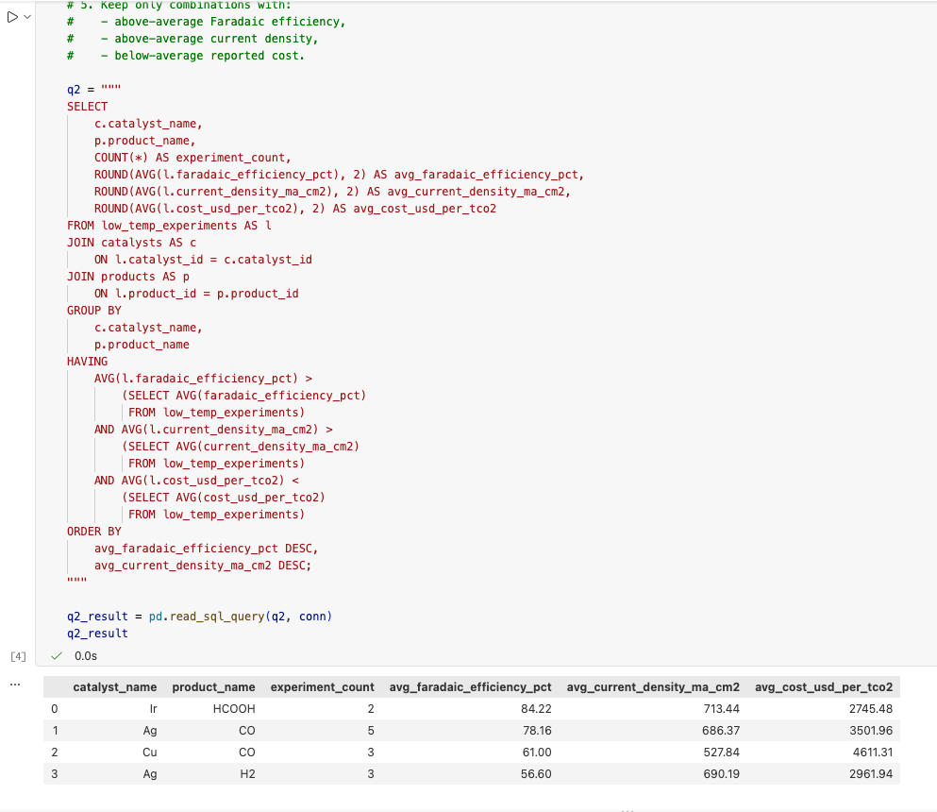
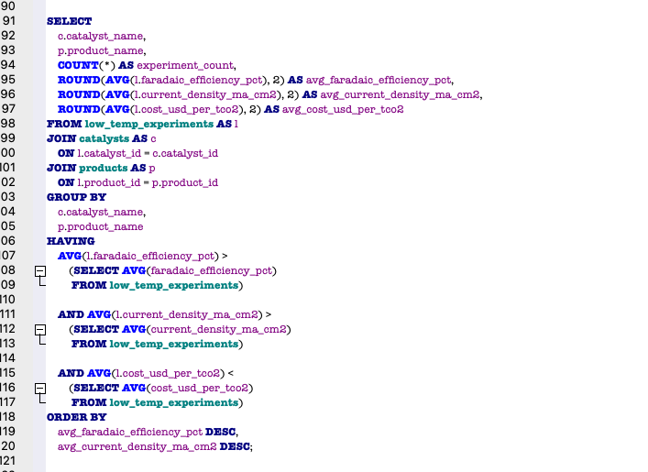
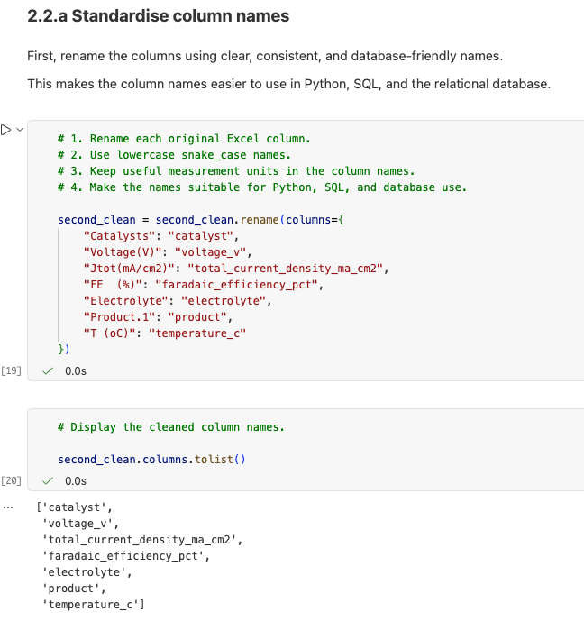
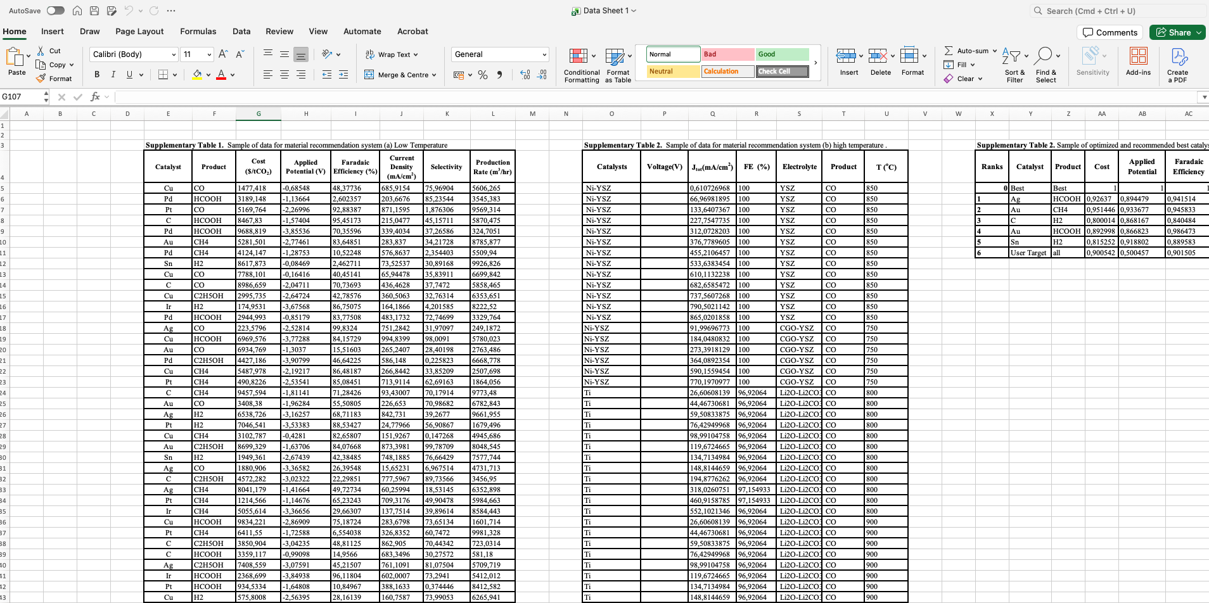
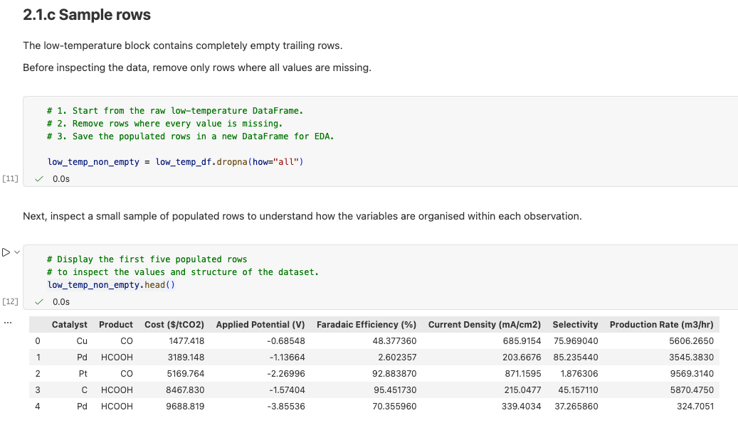
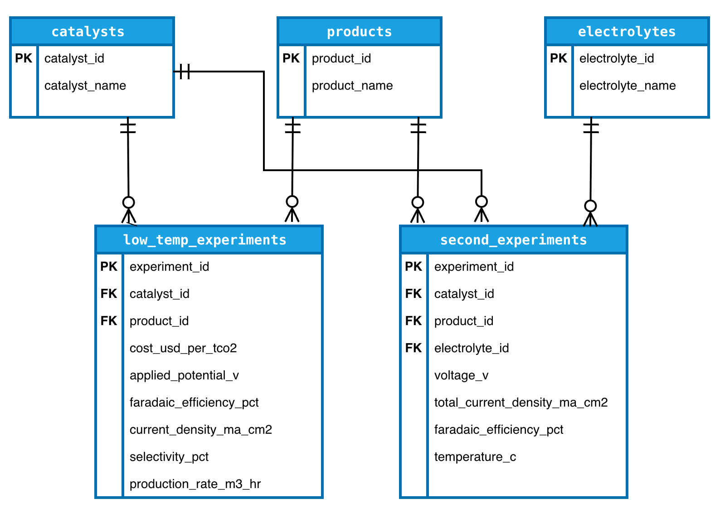
From Raw Data to SQL Analysis
How raw literature data became a structured database for analysis
Explore
Prepare
Build Database
Analyse
Understand the raw data and identify issues.
Clean, standardise, and transform the data.
Create related tables, keys, and SQLite database.
Use SQL and visualisation to answer the research questions.
Before standardization
8
Inspect data structure
Check missing values and duplicates
Standardise names and formats
Preserve meaningful missing values
Create clean, database-ready data
Create 5 related tables
Define primary and foreign keys
Build and verify in SQLite
Query the database
Compare systems
Turn results into visual insights
Raw data → prepared data → relational database → SQL insights

Slide 6
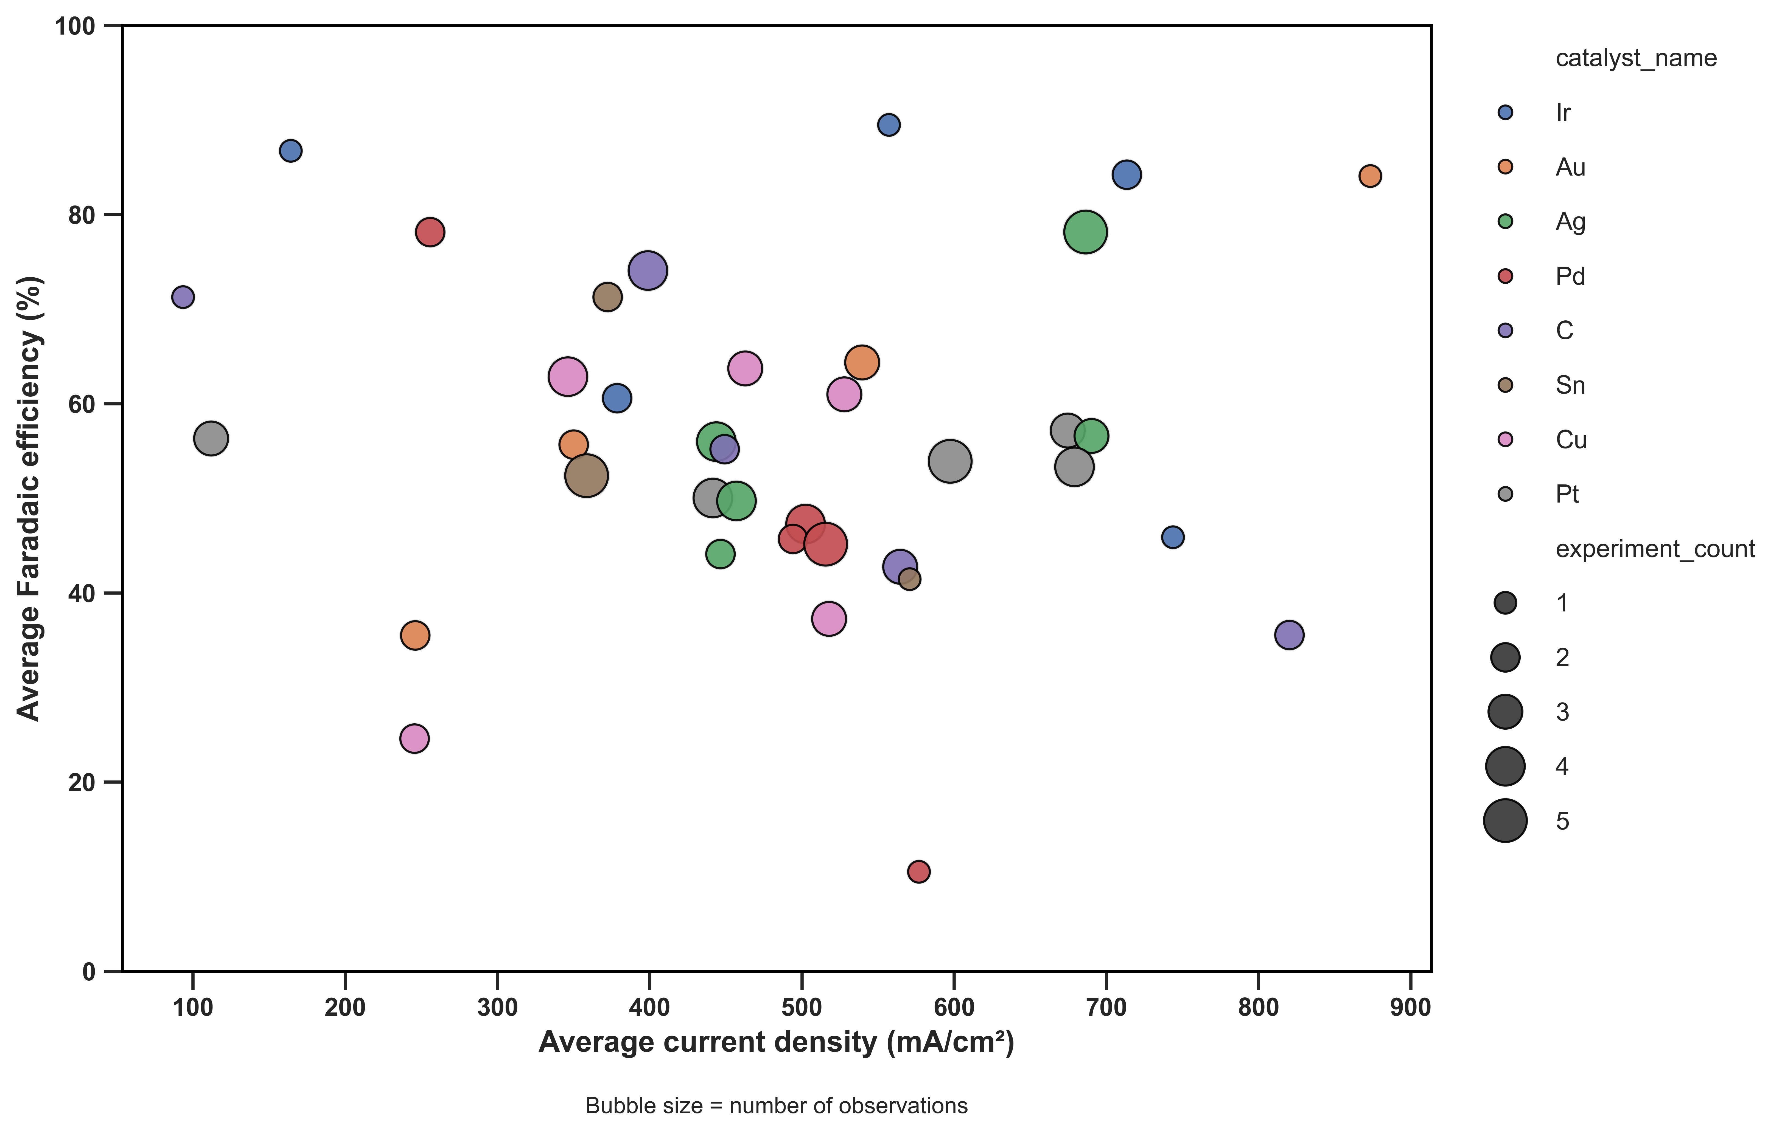
Finding 1: Performance Depends on More Than One Metric
How does performance vary across catalyst–product combinations?
FE and current density vary widely
High FE does not always mean high current density
Some averages are based on few observations
No single metric is enough to identify the best system.
Catalyst–product combination = catalyst + product produced (eg. Ag-CO)

Slide 7
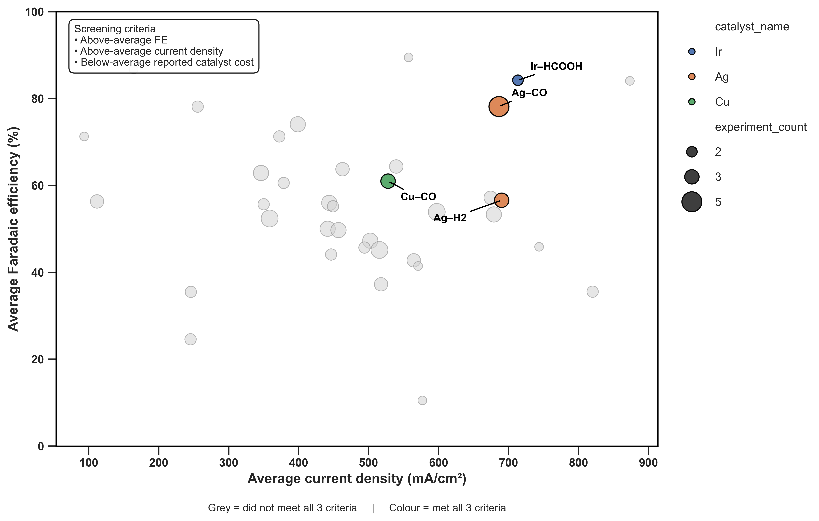
Key Finding 2: Screening Narrows the Choices
Which combinations perform well across all three criteria?
Only 4 combinations met all three criteria
Ir–HCOOH had the highest FE among the four, with high current density
Ag–CO combined better performance with more supporting observations
Performance and cost screening reduced the choices to 4 systems.
HCOOH = Formic acid
CO = Carbon monooxide

Slide 8
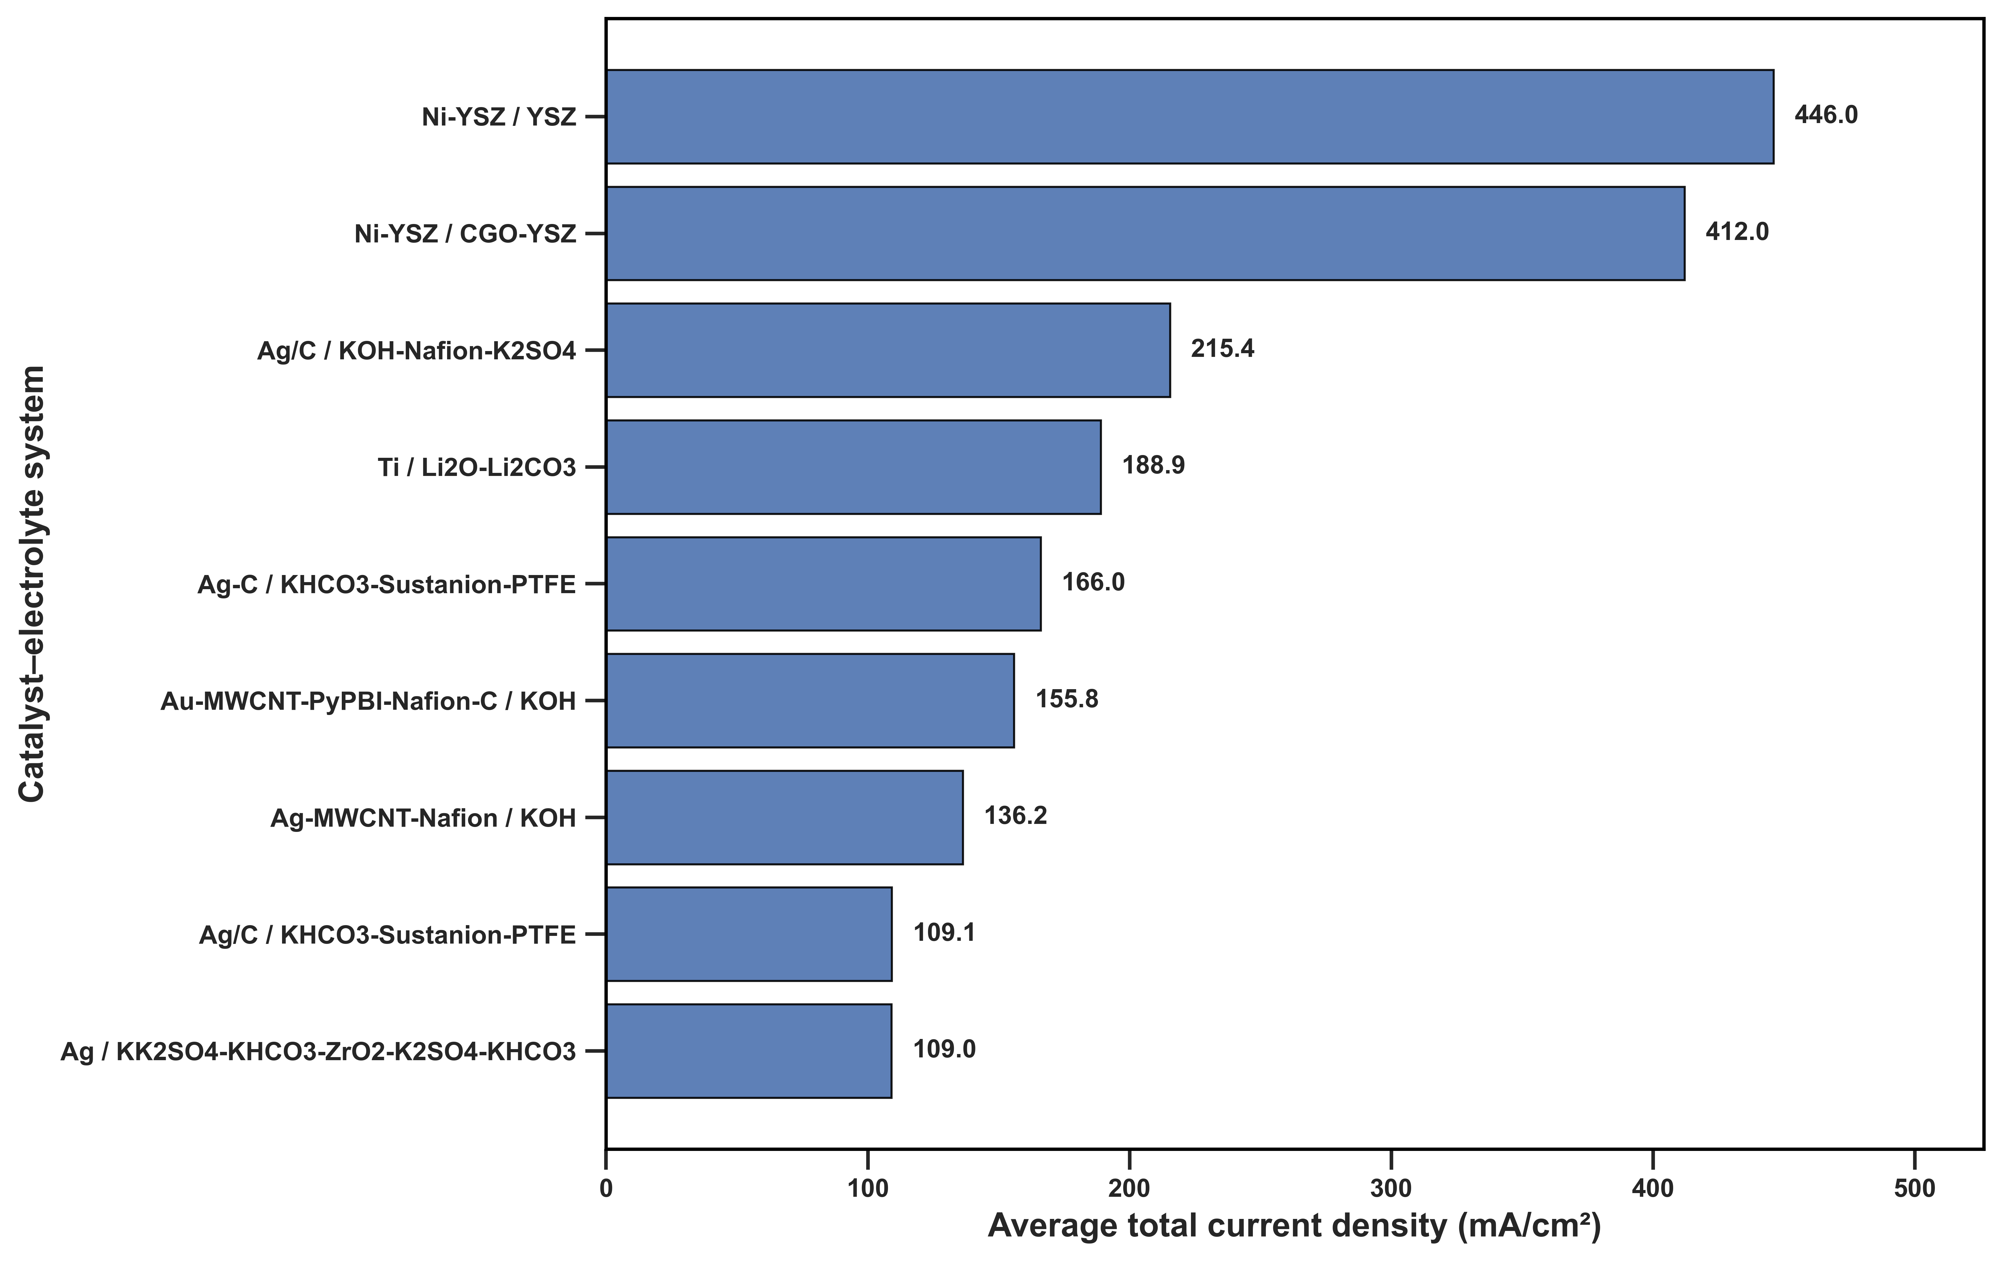
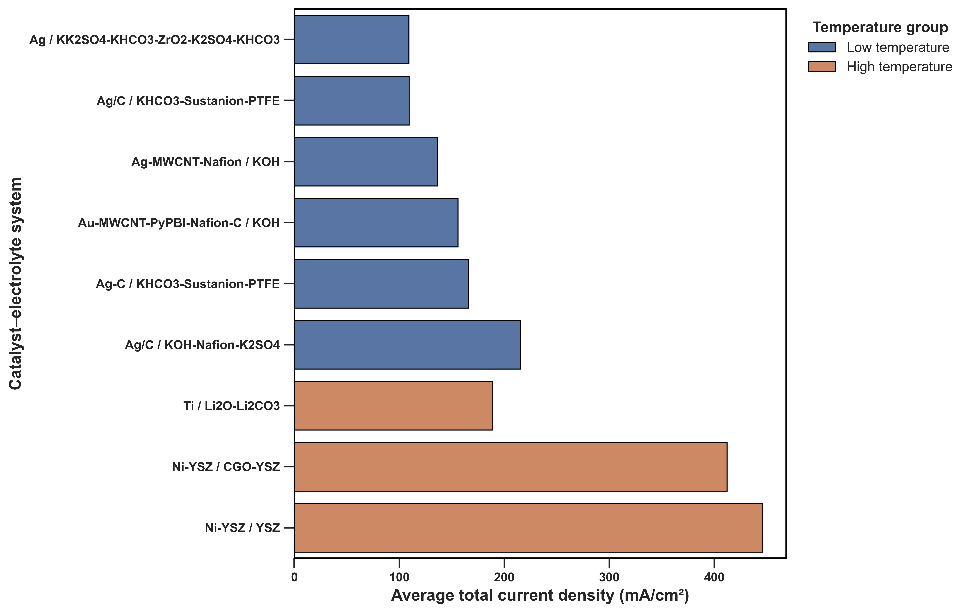
Finding 3: The Whole System Matters
Catalyst–electrolyte performance
Systems by temperature group
How do catalyst, electrolyte, and temperature relate to current density?
Ni–YSZ/YSZ and Ni–YSZ/CGO–YSZ had the highest average current densities
The same catalyst showed different performance with different electrolytes
Catalyst, electrolyte, and operating conditions must be considered together

Slide 9
Conclusions
Performance must be judged using several metrics
Only a few systems remained promising after performance and cost screening
Catalyst, electrolyte, and operating conditions must be interpreted together
Data-driven screening can turn a large CO₂RR dataset into a smaller set of promising systems for further study.

Slide 10
Limitations and Next Steps
Limitations
The studies used different experimental conditions
Some groups have only a few data points
Voltage and FE were not reported together in the second dataset
Next Steps
Add more studies with similar experimental conditions
Compare full data ranges, not only averages
Explore simple statistical and machine-learning models
More consistent data will allow better comparisons and more reliable predictions.

Slide 11


Thank you
Questions?
Bright Jaato
Data Science & Machine Learning
From complex CO₂RR literature to structured, data-driven insight

