Slide 1
NSURE FIRE POLICY ISSUANCE SYSTEM
TEAM MEMBERS :- FACULTY GUIDE:-
Mythily. D Mrs.Kothai. P
Samyuktha. H INDUSTRY GUIDE:-
Sowmiya. S Mrs.Yukthika

Slide 2
PROBLEM STATEMENT
A fire insurance policy covers the financial loss which insured may suffer due to destruction or damage to property or goods, caused by fire, during the insured period in current financial year and up to agreed amount.
NSure Fire Insurance project is going to be a product – oriented software solution deals with business and personal property in Insurance with various coverage.

Slide 3
ABSTRACT
Fire can devastate a business. It can severely damage premises and destroy expensive equipment. Protecting the business with fire insurance lets client rebuild or repair damages quickly, bounce back and get back to being profitable as soon as possible.
Client needs to implement latest technology for making the system still more beneficial to cover the core areas like integrated client information, Policy & Underwriting Administration, Endorsement features & Renewal alerts, Rule Engine for setting up business/government rules, Agent portal and Direct Sales portal for clients to purchase policy directly.
The system is planned to be built using Java technology (Angular JS 4 [with TypeScript] & Spring), Jasper Reports and OracleSQL as database, the system to be developed has to integrate with ongoing maintenance changes without modifying business data and should also minimize the risks.

Slide 4
LITERATURE REVIEW
Existing Insurance System:
United India Insurance Company Ltd.
Drawbacks of existing methods
Tarrification process
Implementing Non-motor detariffication process in :
Web services
Direct Sales portal
Agent portal
Non-motor De-Tariffication – Is liberalisation of Non-motor Insurance Tariff (introduced during July 2017).

Slide 5
Modules
Module1
HOHH - HOUSE OWNER / HOUSE HOLDER
Module2
FMD - FIRE MATERIAL DAMAGE
Module3
Home Care

Slide 6
Cont..
HOUSE OWNER / HOUSE HOLDER(HOHH)
This transaction will allow the user to issue new business Covernote for Fire House Owner/House Holder in which Houseowners (Buildings) & Householders (Contents) can be covered.
FIRE MATERIAL DAMAGE
This transaction will allow the user to issue new business Covernote for Fire Material Damage in which Material Damage can be covered, for Consumer Insurance Contracts (Insurance wholly for purposes unrelated to the Insured's trade, business or profession - to reinstate the asset lost or damaged). This cover is for buildings and machinery where no deduction is made for wear and tear in the event of a claim.
HOME CARE
Covering home, contents, personal effects and family liability all under a single policy which allows insured to choose the type of coverage according to your actual requirements.

Slide 7
PROCESS
Quotation
New Business
Peril/Warranty details
Renewal
Endorsement
Enquiry and Reporting
Finally:
Refer Risk Processing by Admin
Receipt & Payment
CoverNote Generation
Each module have same process but differ in the logical aspect.

Slide 8
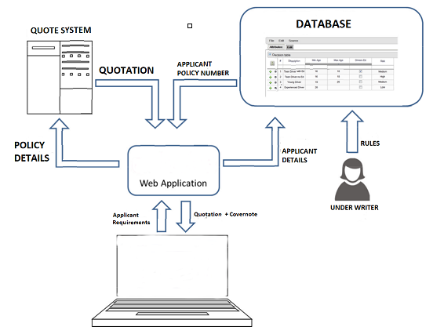
ARCHITECTURE DIAGRAM

Slide 9
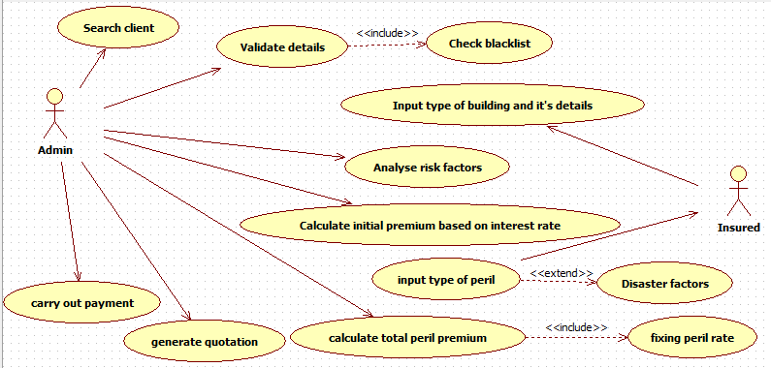
USE CASE

Slide 10
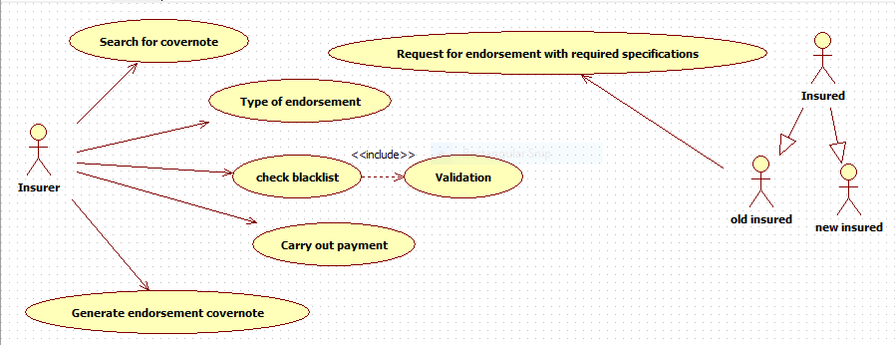
Endorsement

Slide 11
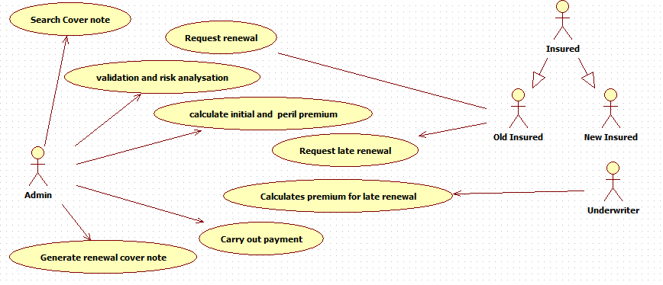
Renewal

Slide 12
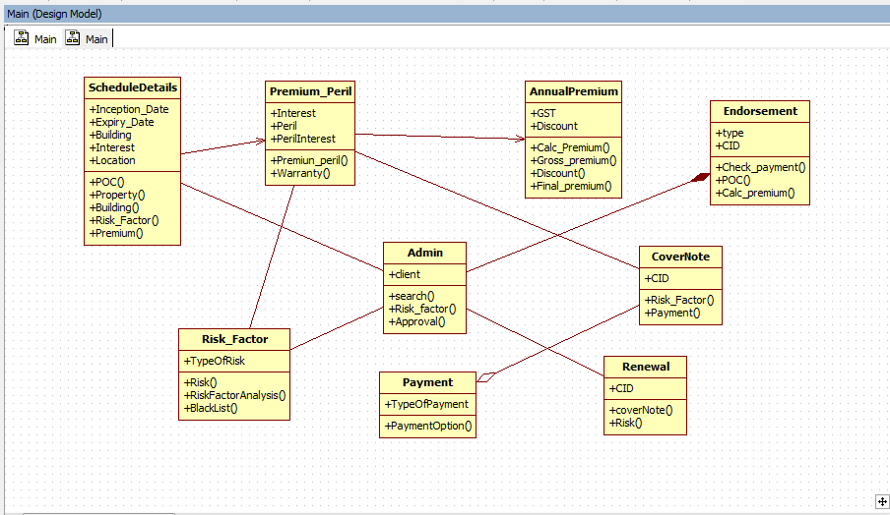
CLASS DIAGRAM

Slide 13
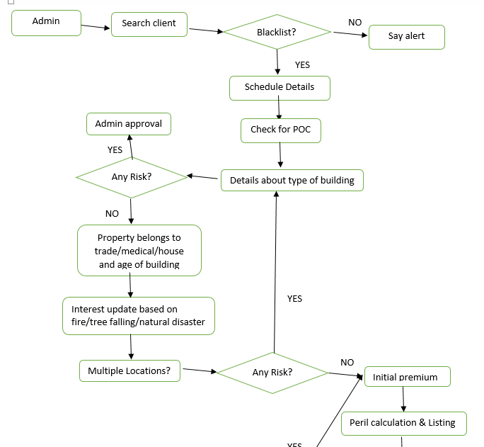
ENTITY RELATIONSHIP MODEL

Slide 14
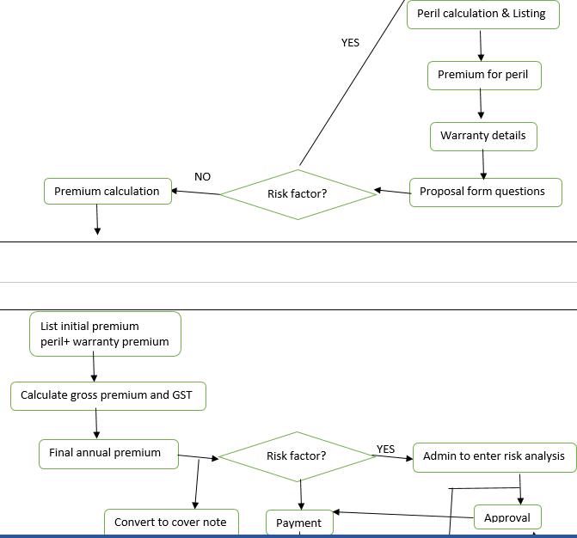
Contd..

Slide 15
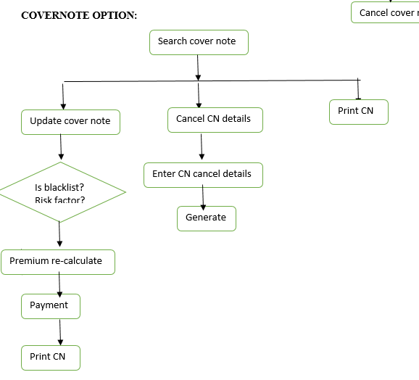
Contd..

Slide 16
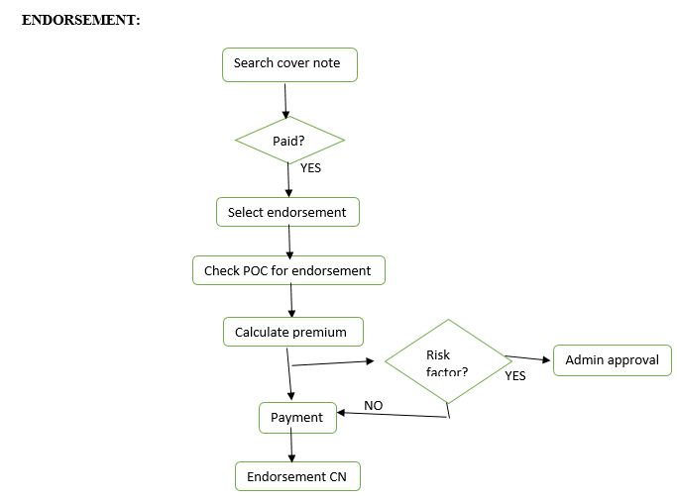
Contd..

Slide 17
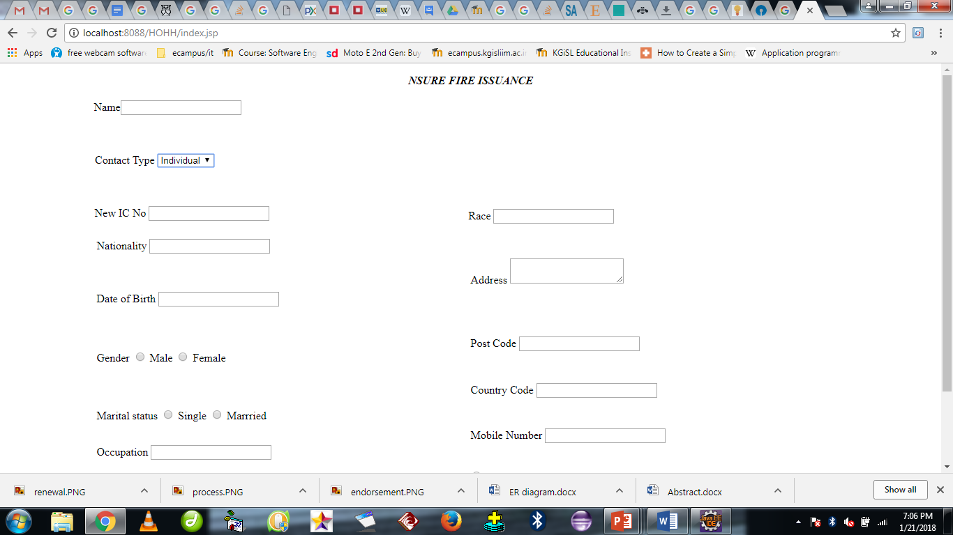
Screenshots of modules under progress

Slide 18
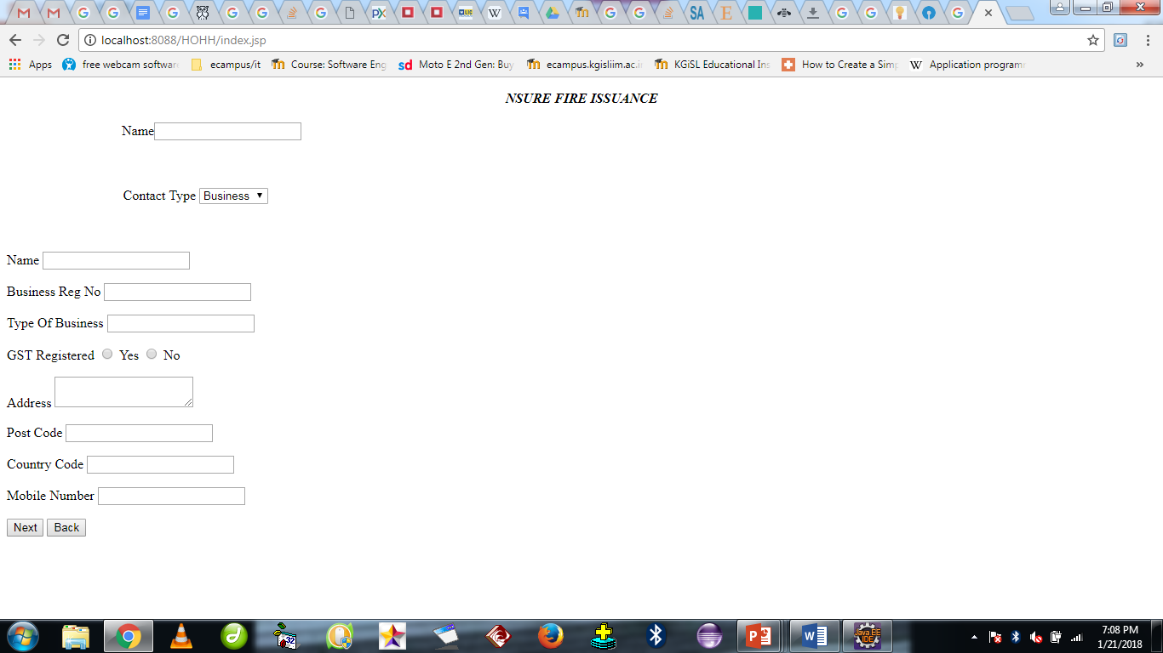

Slide 19
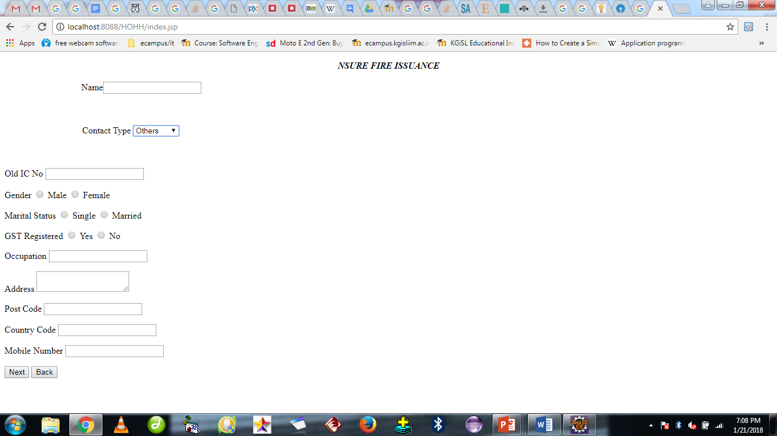

Slide 20
Conclusion
Interactive front end is achieved with angular JS.
Data grid is used to access, modify and transfer extremely large amounts of geographically distributed data for research purpose.

Slide 21
QUESTIONS????..

Slide 22
THANK YOU!.

