Slide 1
Computer Task

Slide 2
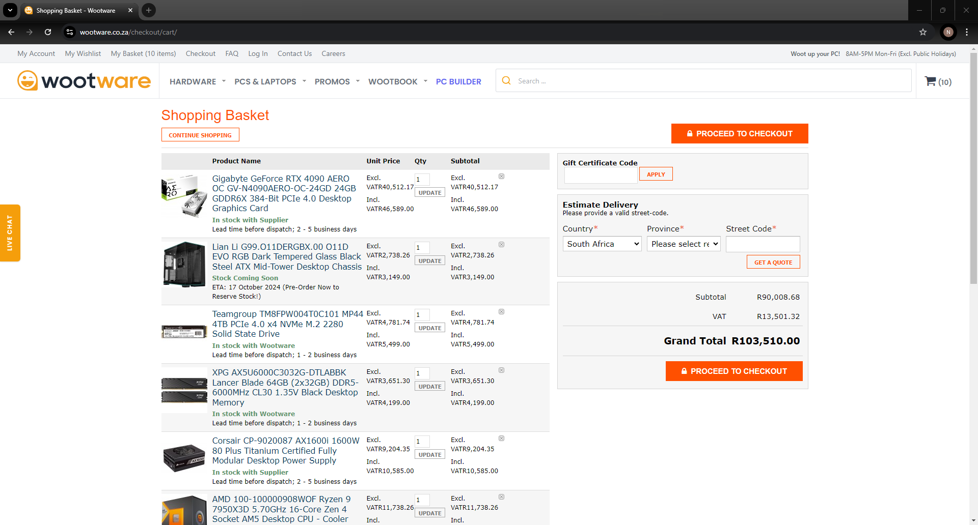

Slide 3
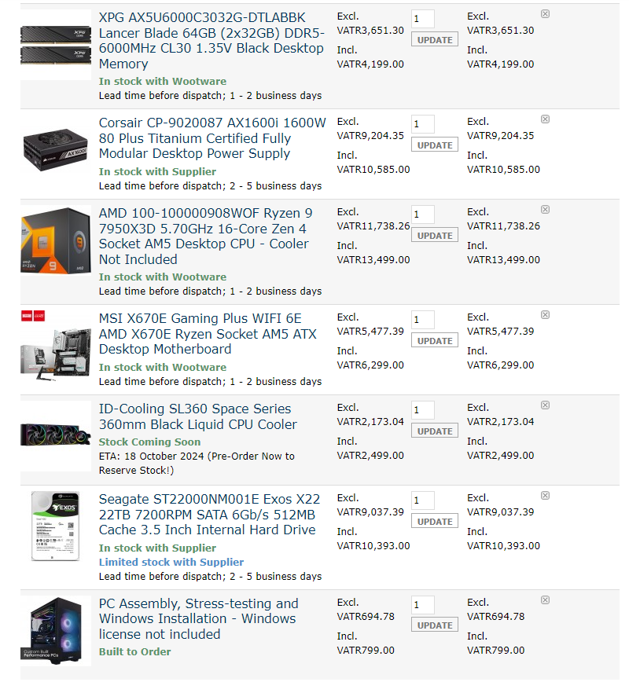

Slide 4
Section 2: iPad
Model: iPad 9th Generation
Processor and processor speed: A13 Bionic processor, 3852
Memory: 3GB
Storage: 64GB
Operating system: 17.6.1
Screen resolution: 2160 x 1620
Camera type: 12mp ultra wide
Usb port: usb c

Slide 5
Section 3:
Phone- entertainment, iPad-schoolwork, TV-entertainment
Duolingo-helps me learn german, tiktok- entertainment, Netflix- entertainment

Slide 6
Section 4:
Apple iOS- Apple
Android OS- android
Symbian OS- symbian

