Slide 1
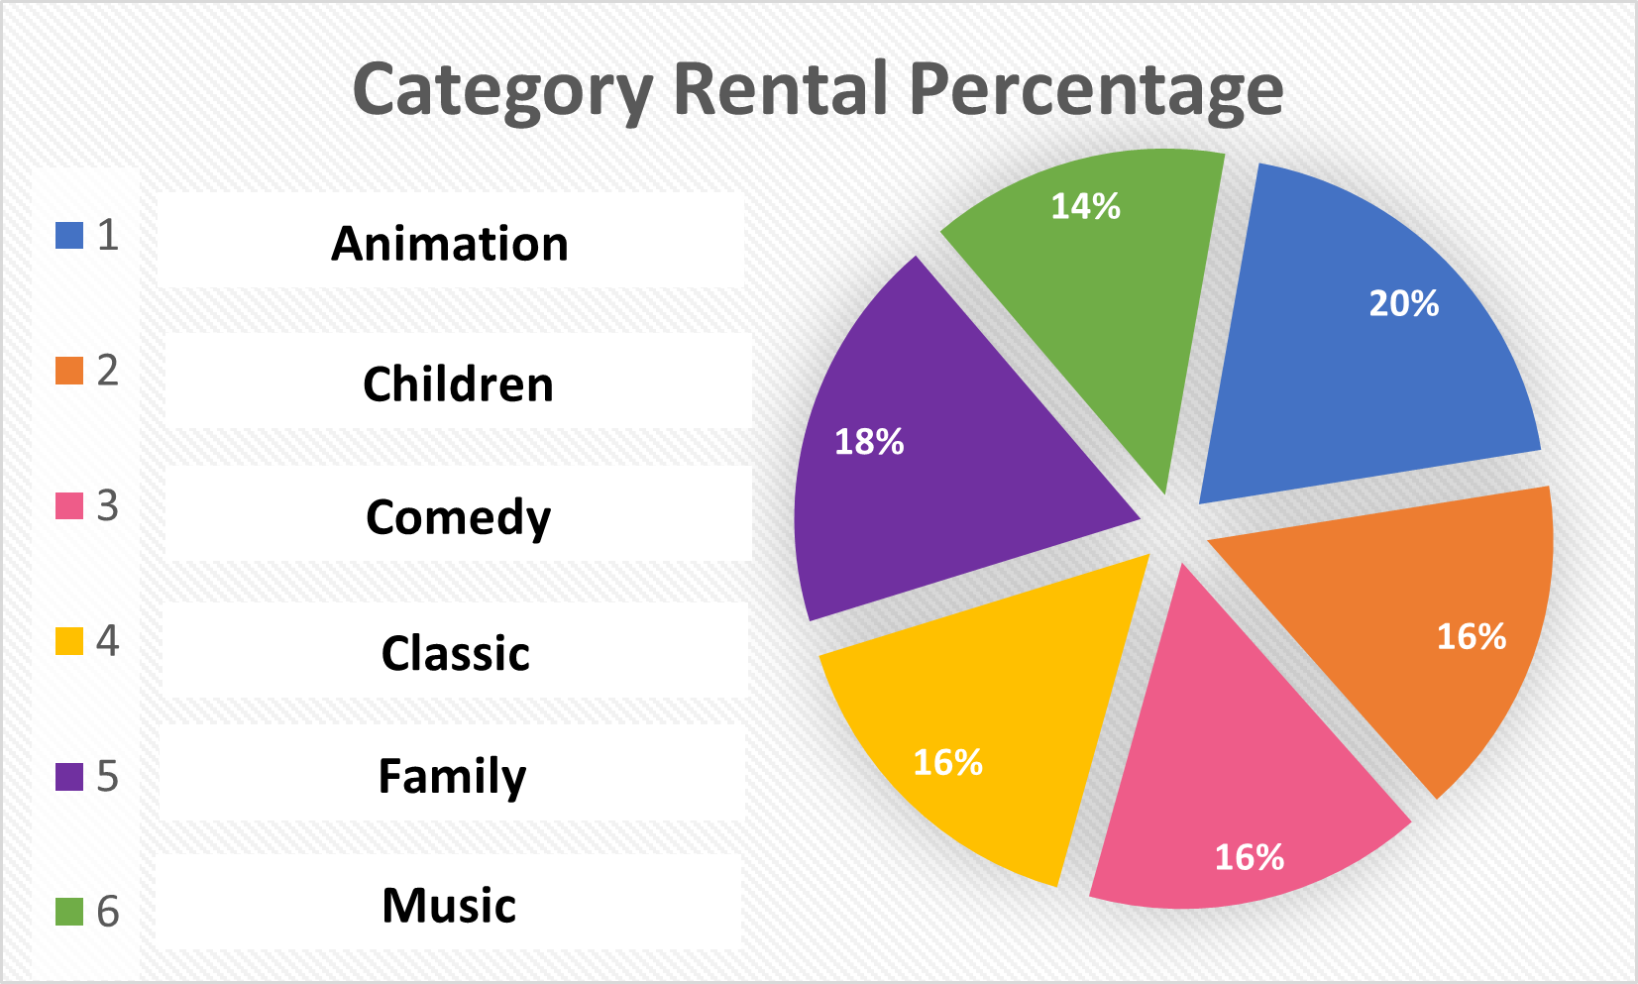
Which family-friendly movie category is rented out most?
Animation is the most famous of all family-friendly movies, while Musicals are the least famous of all these movies.
However, it can be seen that the data range lies between 14 – 20 % for all categories, with 3 categories sharing the same or similar rental frequencies.

Slide 2
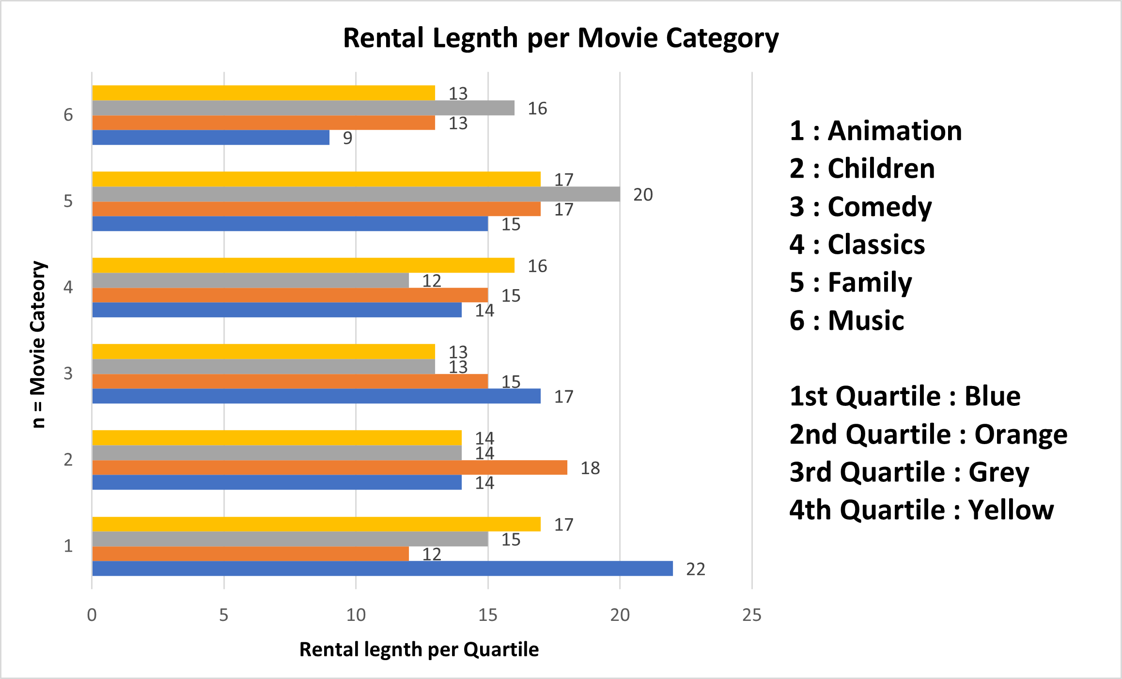
Which family-friendly movie category is rented out the longest across all movies?
The length for which these movie categories are rented is represented by quartiles: 1 – 4, with 1 being shortest and 4 being longest.
The rental duration in quartiles varies significantly per movie category, and across all movie categories.
Animation & Family movies are rented out the longest, while Musicals & Children movies are rented out the shortest.

Slide 3
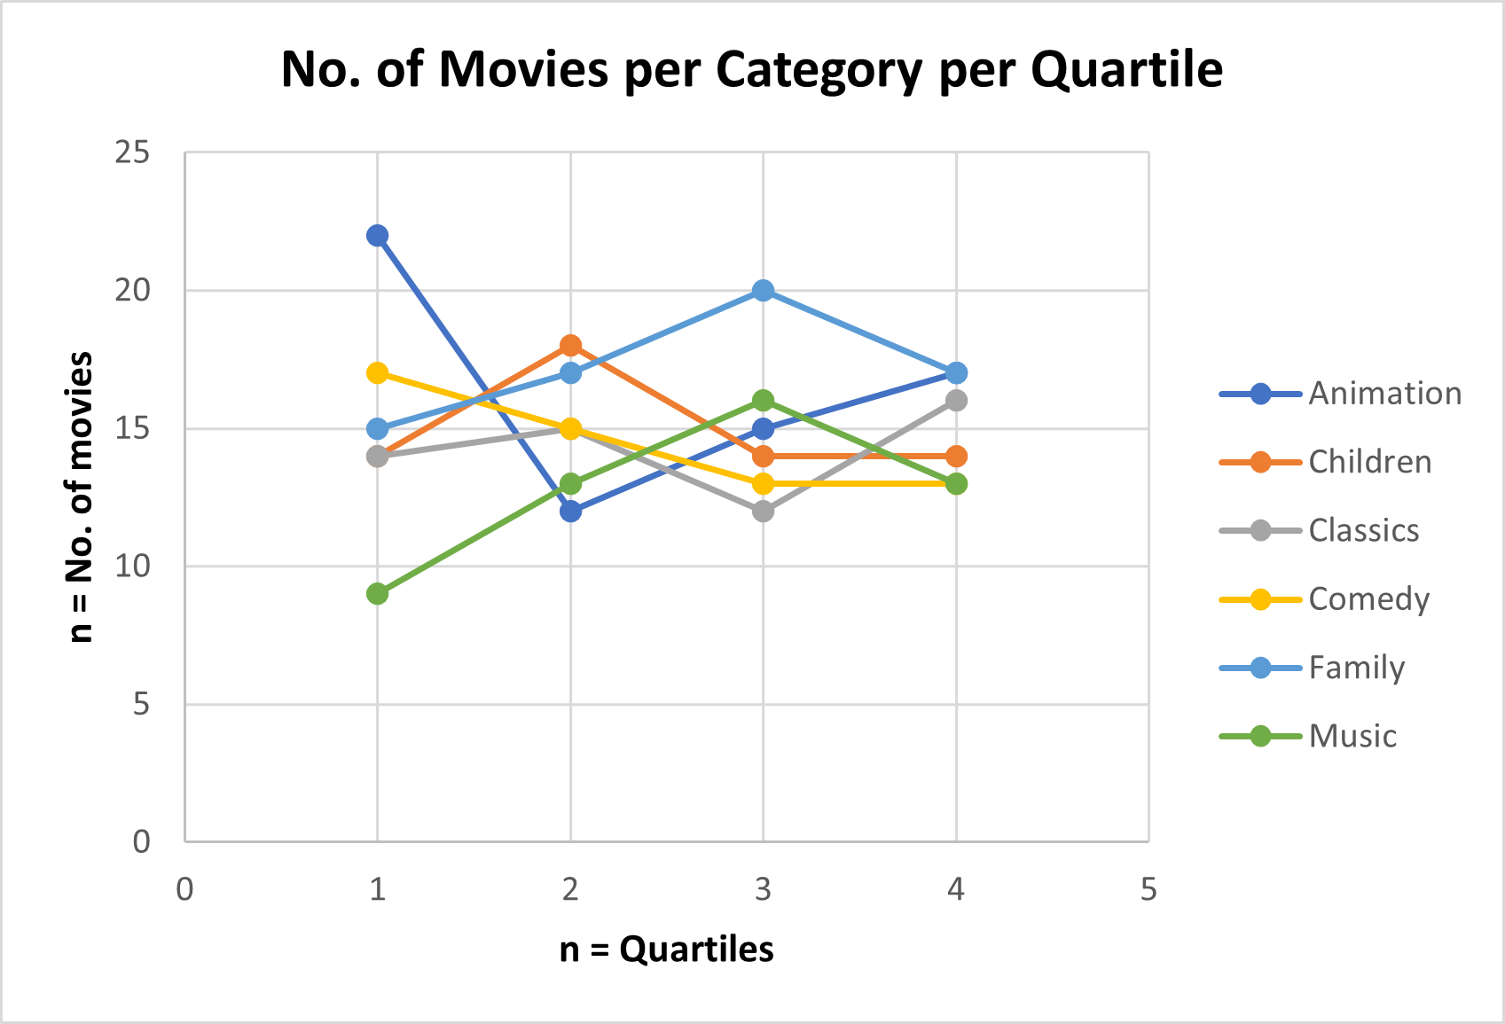
How many family-friendly movies are in each quartile per category?
At first glance, the data presented looks fairly variable, but analyzing each quartile, we can see that the no. of movies per category for each category are sorted from highest to lowest.
The 1st Q is dominated by Animation, the 2nd Q is dominated by the Children category, the 3rd Q is dominated by the Family category, and the 4th Q is dominated by Animation & the Family category.

Slide 4
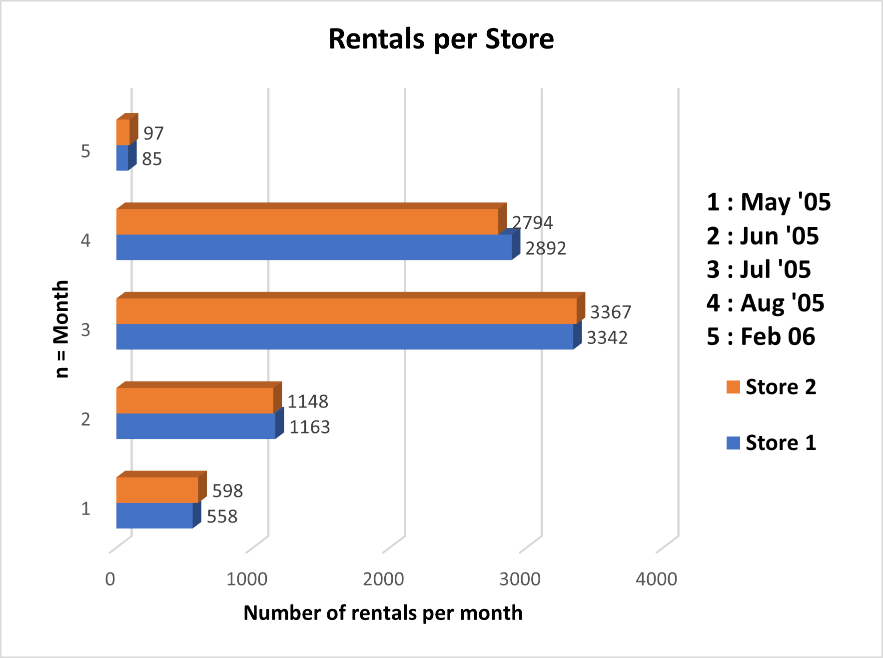
Which store completes the most rentals by month in each year?
The number of rentals fluctuate heavily across the given months, with Jul (2005) recording the most rentals, and Feb (2006) the least.
Rentals completed for stores 1 & 2 are very similar, with store 2 having the most rentals over May, Jul, and Feb, while store 1 leads for June and August.
Overall, store 1 has the most rentals completed.

