Slide 1


CryptoFarm
A Better Sustainable Tomorrow

Slide 2
Our Solution
Crypto Farm aims to educate people about the modern day finance space of Cryptocurrencies.
Combining concepts of Farming, Gaming and Financial Technology, Crypto Farm offers a fun and intuitive approach to learning cryptocurrency trading.

Slide 3
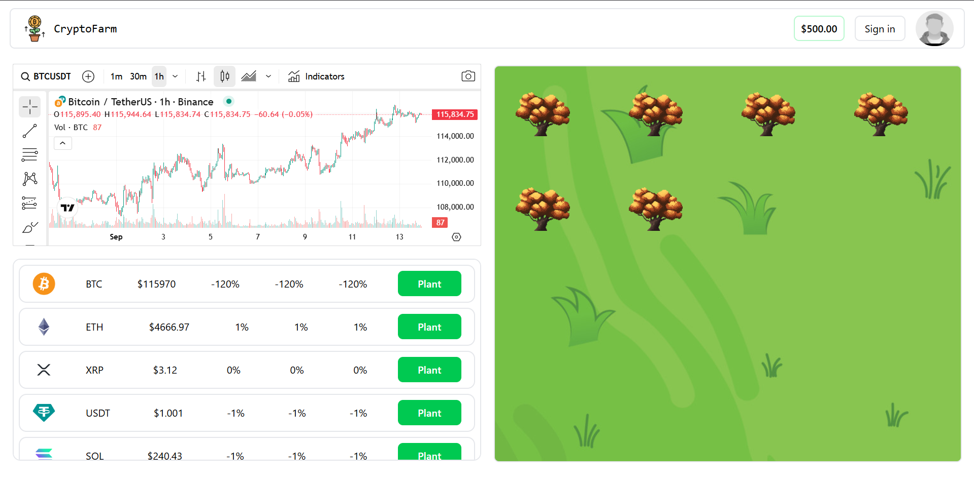
Offering an intuitive user interface, We aim to make financial technology more available for every one
With a simple click of a button, you get to plant your tree, and watch it grow.
As the tree grows it signifies the growth in your earnings.
This offers a better understanding to financial growth.
Making us aware that your decisions are your financial future.

