Slide 1


GEOG 178/258:
Conceptual Modeling and Programming for the Geo-Sciences
Week 1: January 8th, 2019
mike johnson

Slide 2
Instructor: Krzysztof Janowicz
Lecture/Lab: Thursdays 12:00 – 2:50
Ellison 3620
Office hours:
Ellison 4830
Monday 10:30am – 11:30am
jano@ucsb.edu
Week
1
Logistics
TA: Mike Johnson
Section: Tuesday 2:00 – 3:50
Ellison 3620
Office hours:
Ellison 1715
Thursday 3:00-5:00 pm
jmj00@ucsb.edu
Section Website:
https://mikejohnson51.github.io/geog178

Slide 3
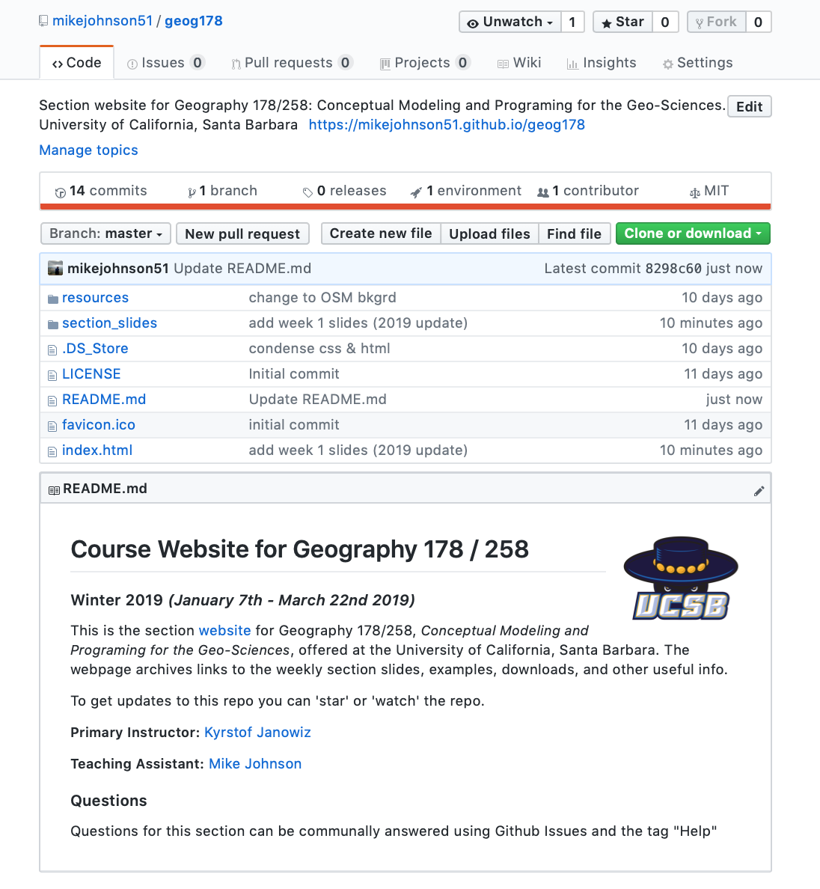
Getting started with GitHub
Section repository:
https://github.com/mikejohnson51/geog178
Reasons for this:
* build familiarity (for you as developing programmers),
* force getting started with version control, open coding
* host a class community,
* longevity of material,
* improve group work in second half of class,

Slide 4
Getting started with GitHub
This is all optional and not needed to complete the class but will hopefully make your life easier in the long run…
Make a GitHub account at: https://github.com
Find the class repository searching for ‘geog178’
‘Star’ to be easily found and to easily find the repo
‘Watch’ to be notified of changes such as new issues, new content, ect.
‘Fork’ to make a copy of the repo in your own account

Slide 5
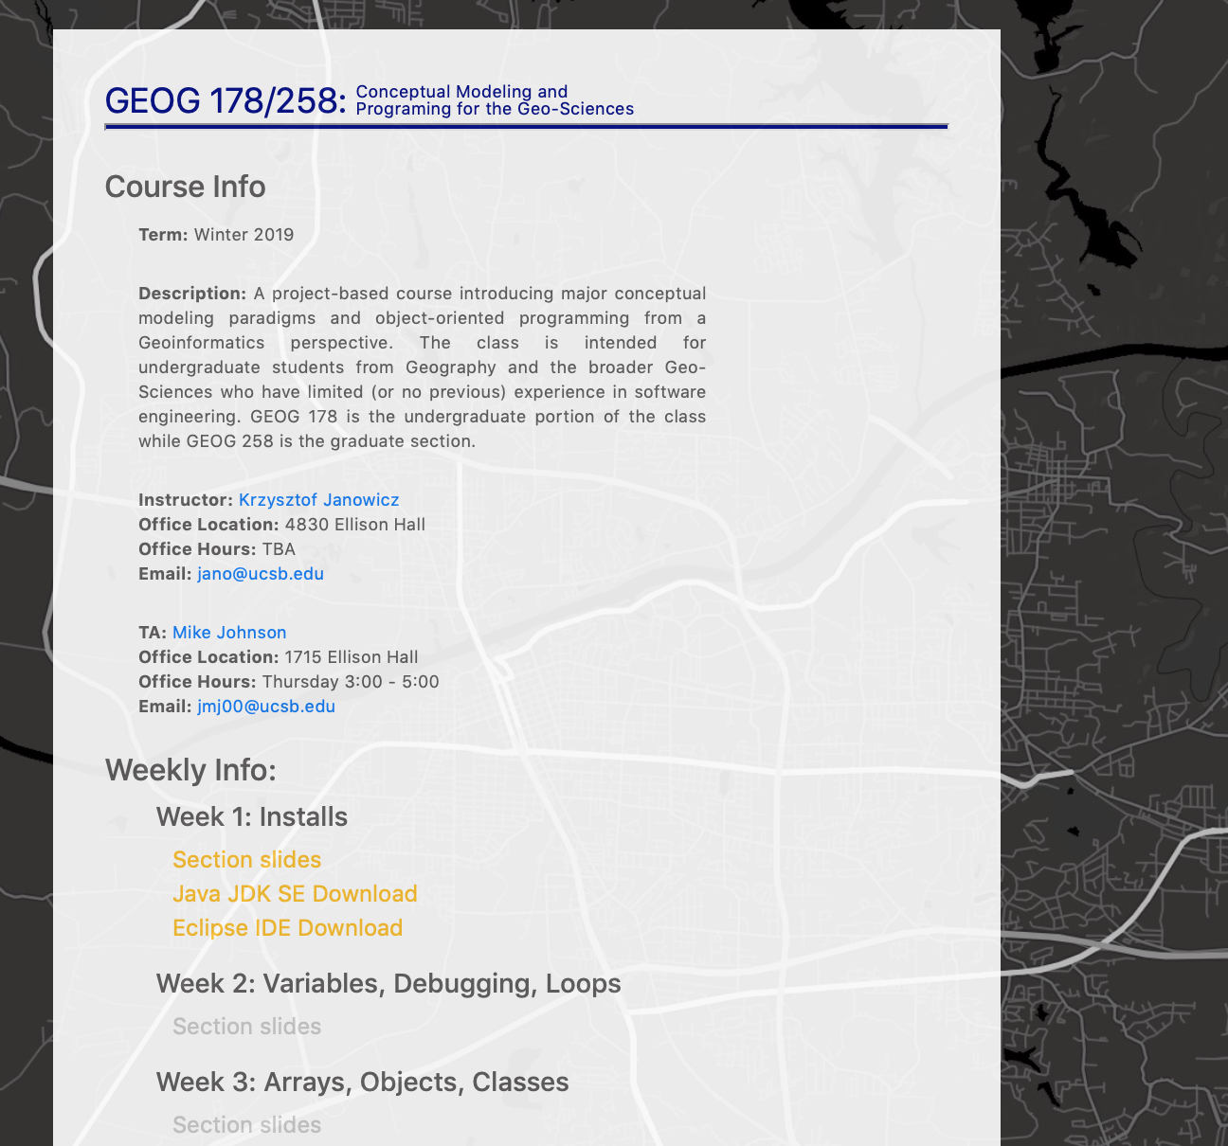
Getting started with Github
All GitHub repo’s can host a static website…
Ours is here: https://mikejohnson51.github.io/geog178

Slide 6
1. Introduction to the Eclipse IDE…

Slide 7
Writing, compiling and executing a Program
There are two methods for compiling and running a Java Program
Week
1
Using a text editor such as Atom or Notepad, and
your Terminal (Mac) / Powershell (Windows)
This is the approach the textbook takes
Using a dedicated platform such as Eclipse
That is the approach we will use in this class
Getting Started with Eclipse
This is a IDE which stands for an Integrated Development
Environment
IDE’s provide tools for coding, building, running and debugging applications
https://mikejohnson51.github.io/geog178

Slide 8
Setting up a Workspace
Suggestions:
Week
1
On your flash drive create a new folder called
Getting Started with Eclipse
GEOG_178
In that folder create a sub-folder called
Week0
And one another called
Week1
https://mikejohnson51.github.io/geog178

Slide 9

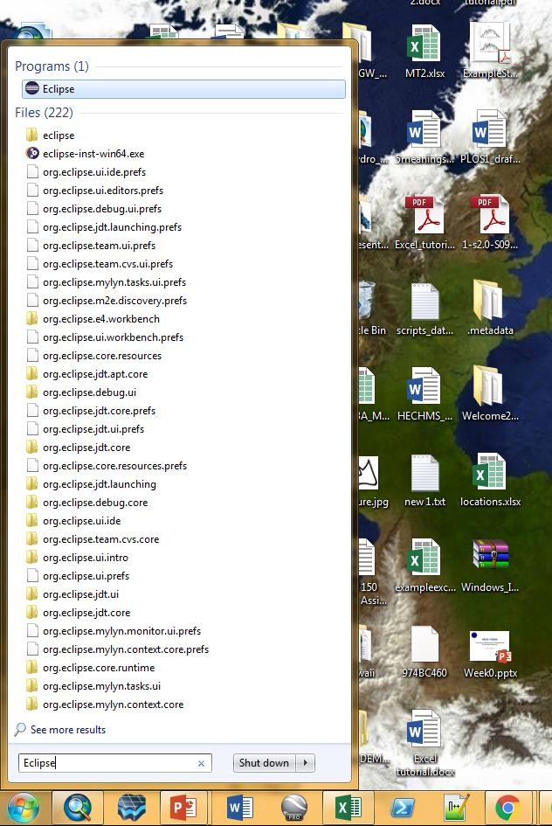
Opening Eclipse in the Lab
On the lab machines, hit the home button
Type ‘Eclipse’ in the search bar
Click on the Eclipse Program File
Week
1
Getting Started with Eclipse
https://mikejohnson51.github.io/geog178

Slide 10
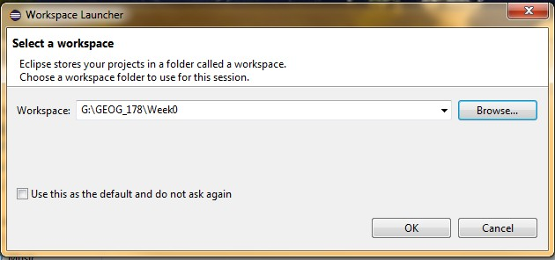
Starting a New Project:
When you launch Eclipse it will ask you to define a
workspace.
Week
1
A workspace is where your source code and output will be stored
Getting Started with Eclipse
Direct your workspace to Week0 using the ‘Browse…’ button
Hit ‘OK’ when you are done.
https://mikejohnson51.github.io/geog178

Slide 11
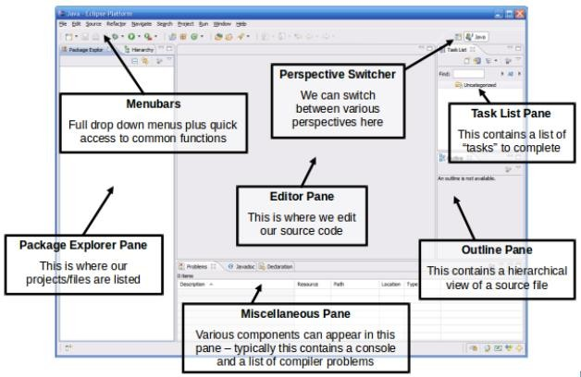
IDE Components:
When your workspace is loaded, you will be presented with the following interface:
Week
1
Getting Started with Eclipse
https://mikejohnson51.github.io/geog178

Slide 12
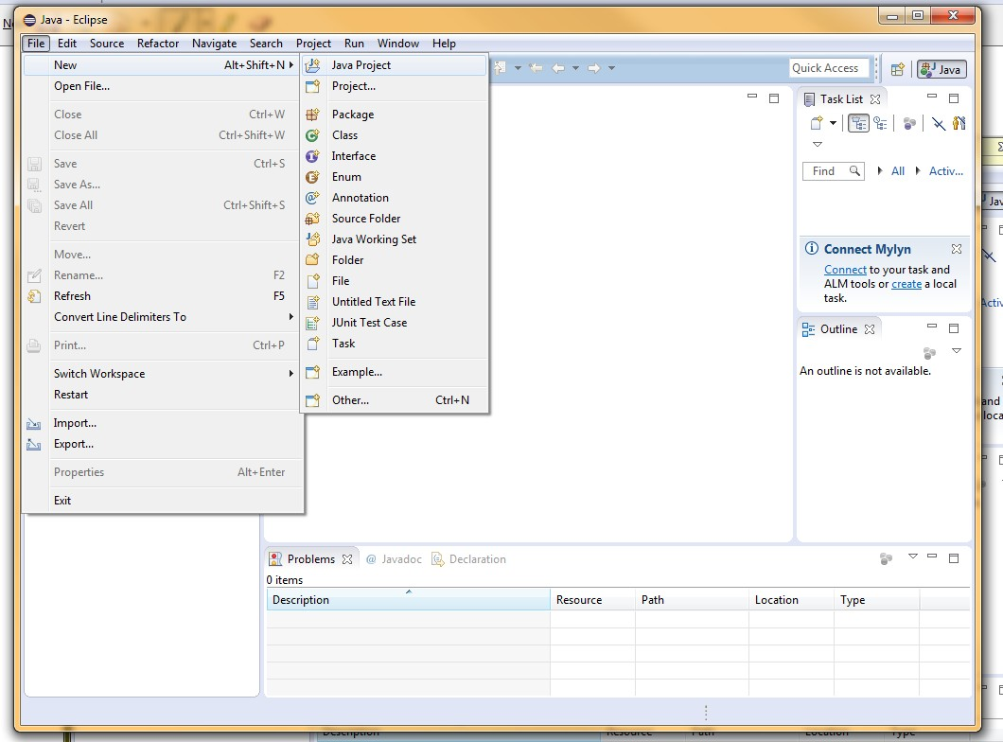
Create a new project
All code in Eclipse needs to live under a project
To create a project: File → New → Java Project
Week
1
Getting Started with Eclipse
https://mikejohnson51.github.io/geog178

Slide 13
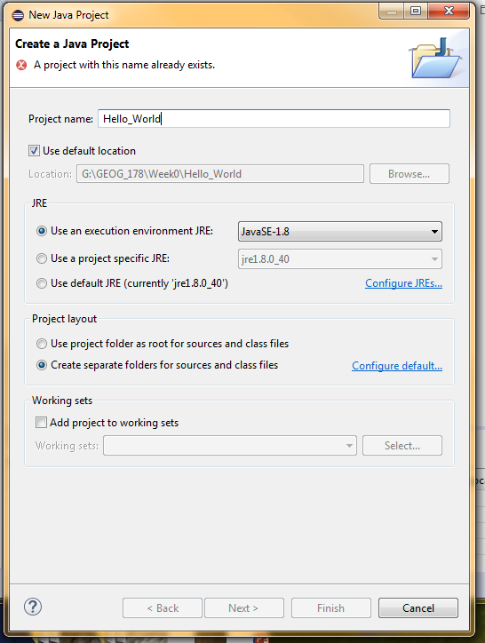
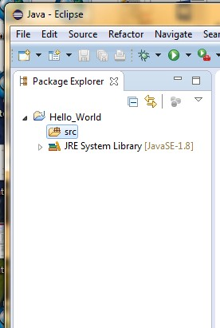
Create a new project
Enter a Name for the Project (Hello_World)
Click “Finish”
The new Project will appear in the Package
Explorer
Week
1
Getting Started with Eclipse
https://mikejohnson51.github.io/geog178

Slide 14
Create a new class
You will now create your first class within the Java Project
Week
1
Getting Started with Eclipse
https://mikejohnson51.github.io/geog178

Slide 15
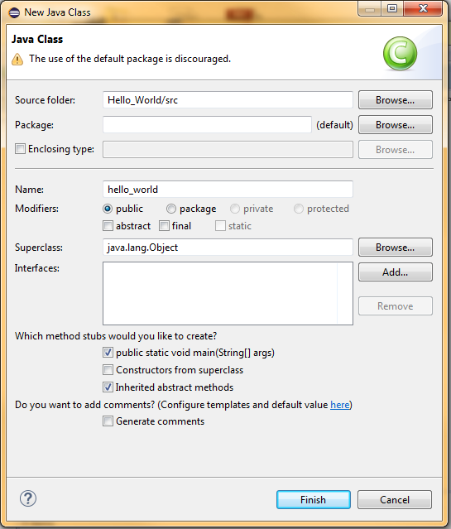
Create a new Class
Enter a Name for the class (hello_world)
You can also specify:
package
Week
1
Superclass
Whether or not to include a main
Etc..
Getting Started with Eclipse
Fill in necessary information
Click “Finish”
https://mikejohnson51.github.io/geog178

Slide 16
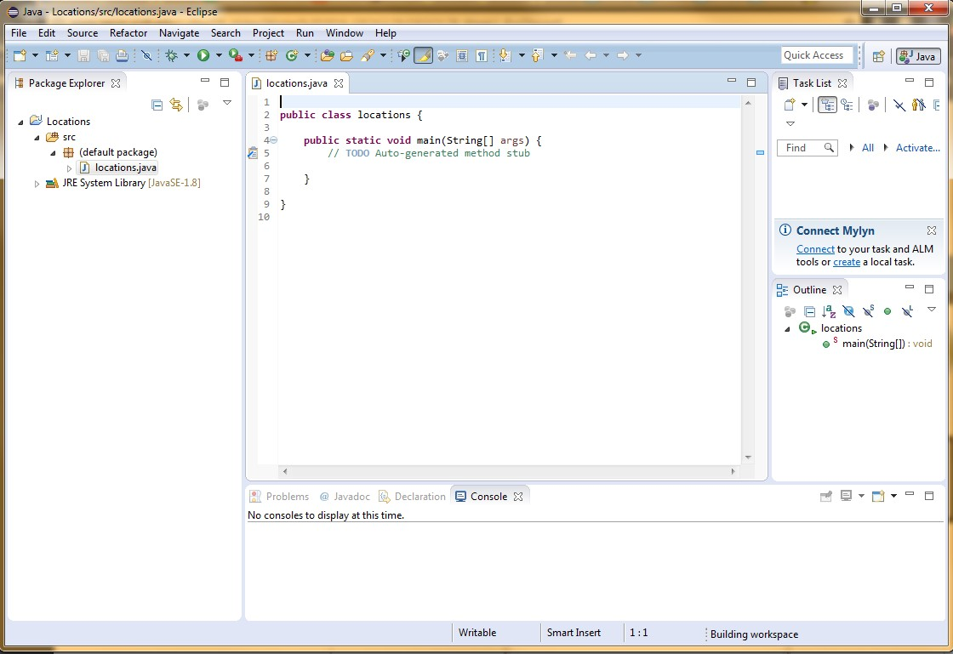
Interface:
You should see the following
Source is loaded into the editor panel, already stubbed out
Week
1
Getting Started with Eclipse
Directory structure for package and actual java file created automatically
Source is displayed in hierarchical fashion listing each method name
Be sure to always have your file name match the public class name!

Slide 17
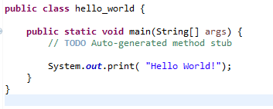
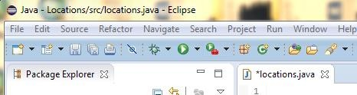
Enter Basic Command
In your program type the command
System.out.print(“Hello World!”);
It should look like this:
After typing the code, hit the ‘run’ button:
You should see the following output!

Slide 18
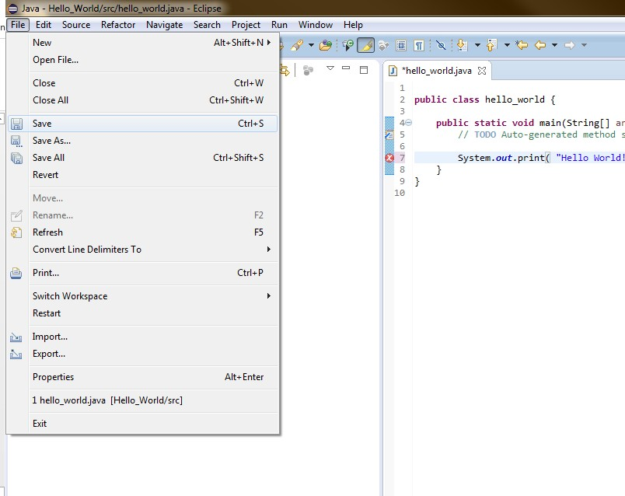
Saving your Program
Running your program will automatically save it
In cases where you want to save manually go:
File → Save
https://mikejohnson51.github.io/geog178

Slide 19
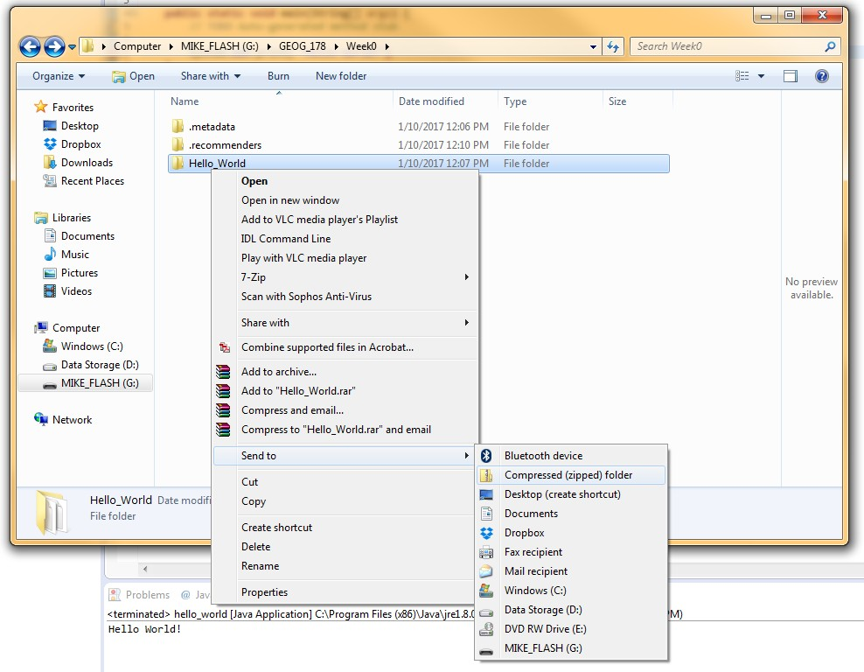
Zip Program Folder
Program files can be zipped to make them smaller and easier to share!
ON WINDOWS:
Go to your flash drive → GEOG_178 → Week0
Right Click on the Folder ‘Hello_World’
Click ‘Send To’ → ‘Compressed (zipped) folder

Slide 20
Zip Program Folder
ON MAC:
Go to your flash drive → GEOG_178 → Week0
Right Click on the Folder ‘Hello_World’
Click ‘Compress “Hello_World”
You now have a zipped folder that will be easier to share with others!
https://mikejohnson51.github.io/geog178

Slide 21
2. Getting set up on your machines…

Slide 22
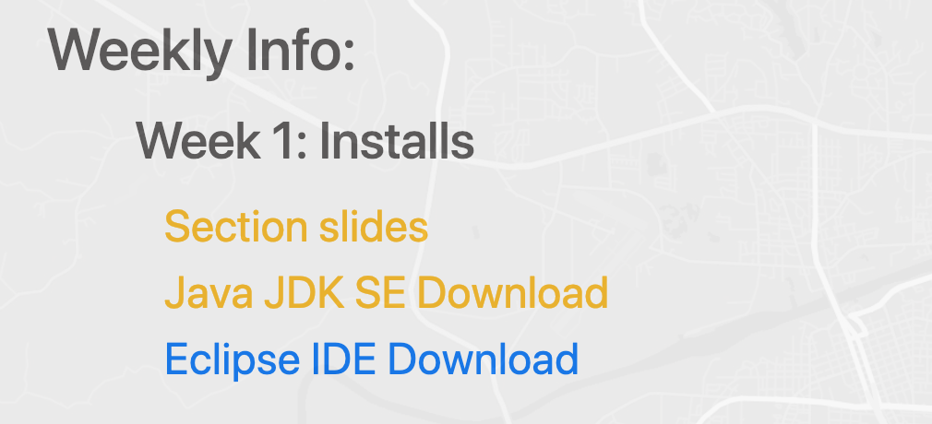
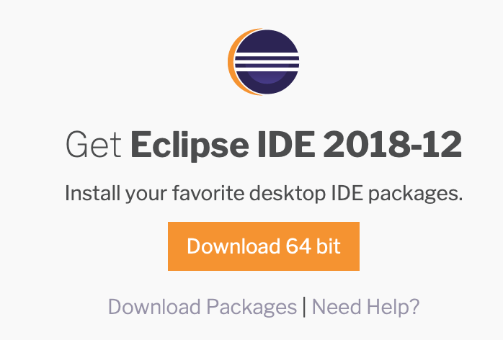
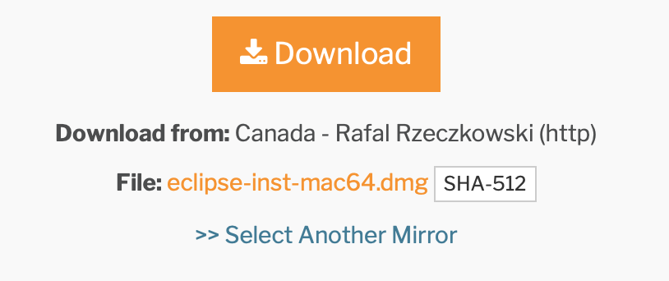
Necessary Downloads:
1. To get set up on a personal machine, you need the Eclipse Program files. They can be found here:
https://www.eclipse.org/downloads/
Or through the section website:
2. From the Eclipse main page download the zip file from the series of download buttons:
Week
1
Getting Started with Eclipse
https://mikejohnson51.github.io/geog178

Slide 23
Installing
From the unzipped download folder try and install Eclipse
On Windows → select the ‘eclipse-inst-win64.exe’ file
On Mac → select the ‘eclipse-inst-mac64.tar.gz’ file
Follow all instructions
…. Does it Error Out???
Eclipse is written in Java so you may need to download the Java SE JDK** if it is not already on your machine
Week
1
Getting Started with Eclipse
**JDK: Java Development Toolkit which includes JRE (Java Runtime Environment), an interpreter/loader (java), a compiler (javac), an archiver (jar) and a documentation generator (javadoc)
https://mikejohnson51.github.io/geog178

Slide 24
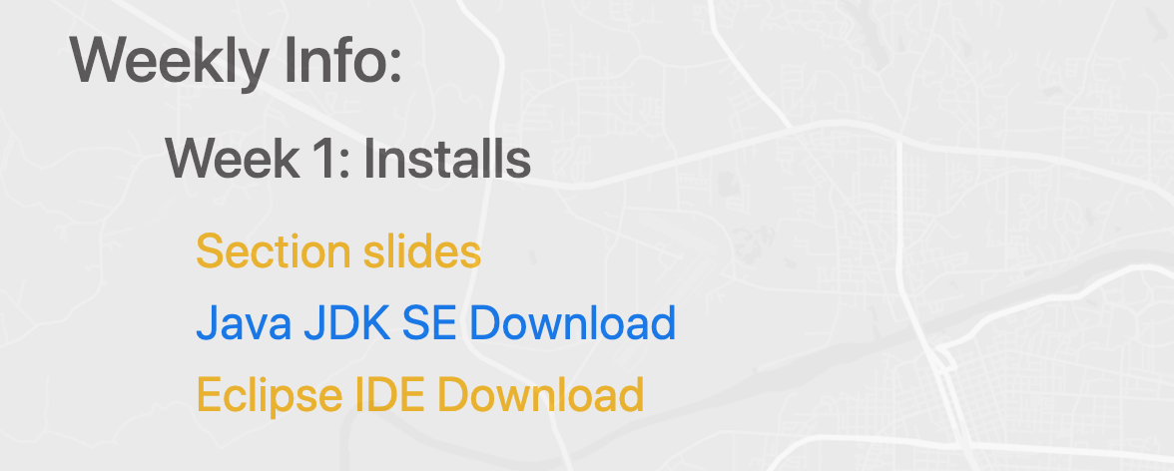
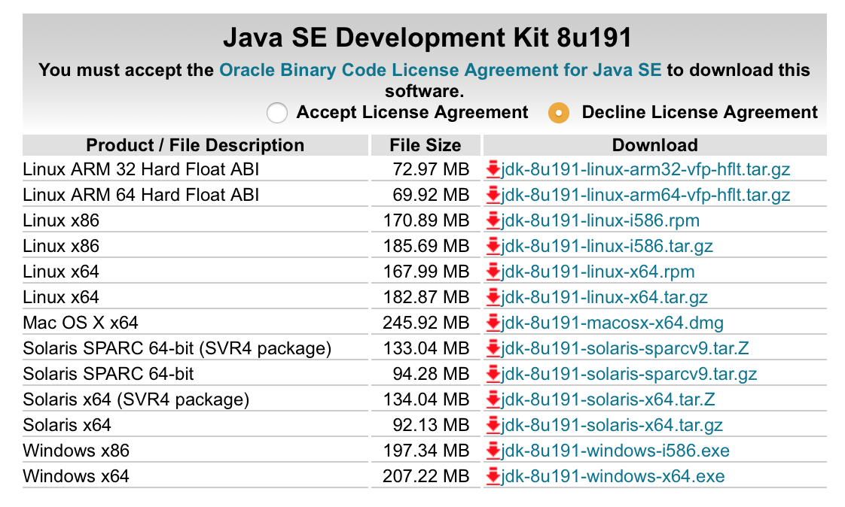
Installing Java JDK
1. The Java SE JDK download can be found here:
https://www.oracle.com/technetwork/java/javase/downloads/jdk8-downloads-2133151.html
Or on the section webpage:
2. Be sure to accept the License Agreement and download:
Week
1
Getting Started with Eclipse
3. Unzip, follow all instructions, and then install Eclipse again …
https://mikejohnson51.github.io/geog178

Slide 25
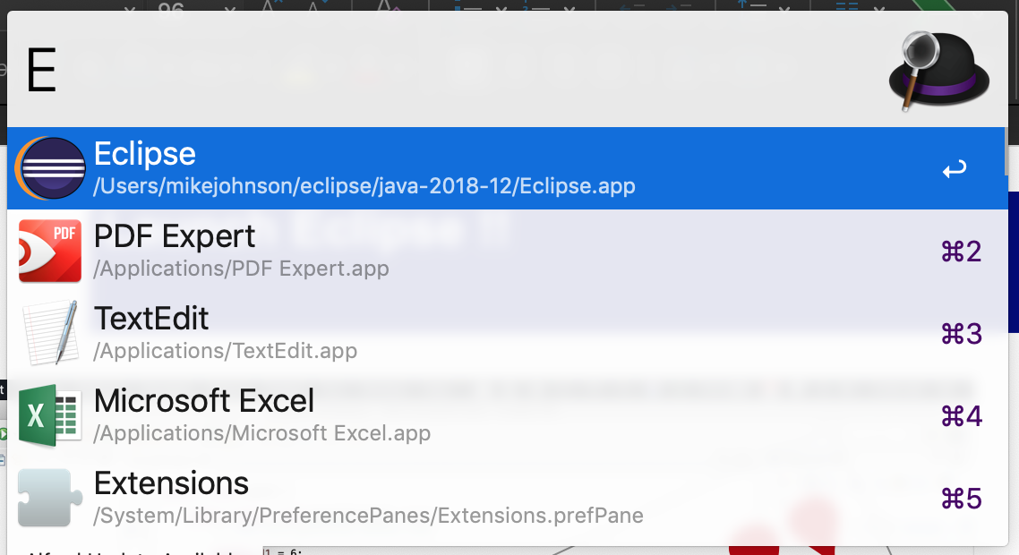
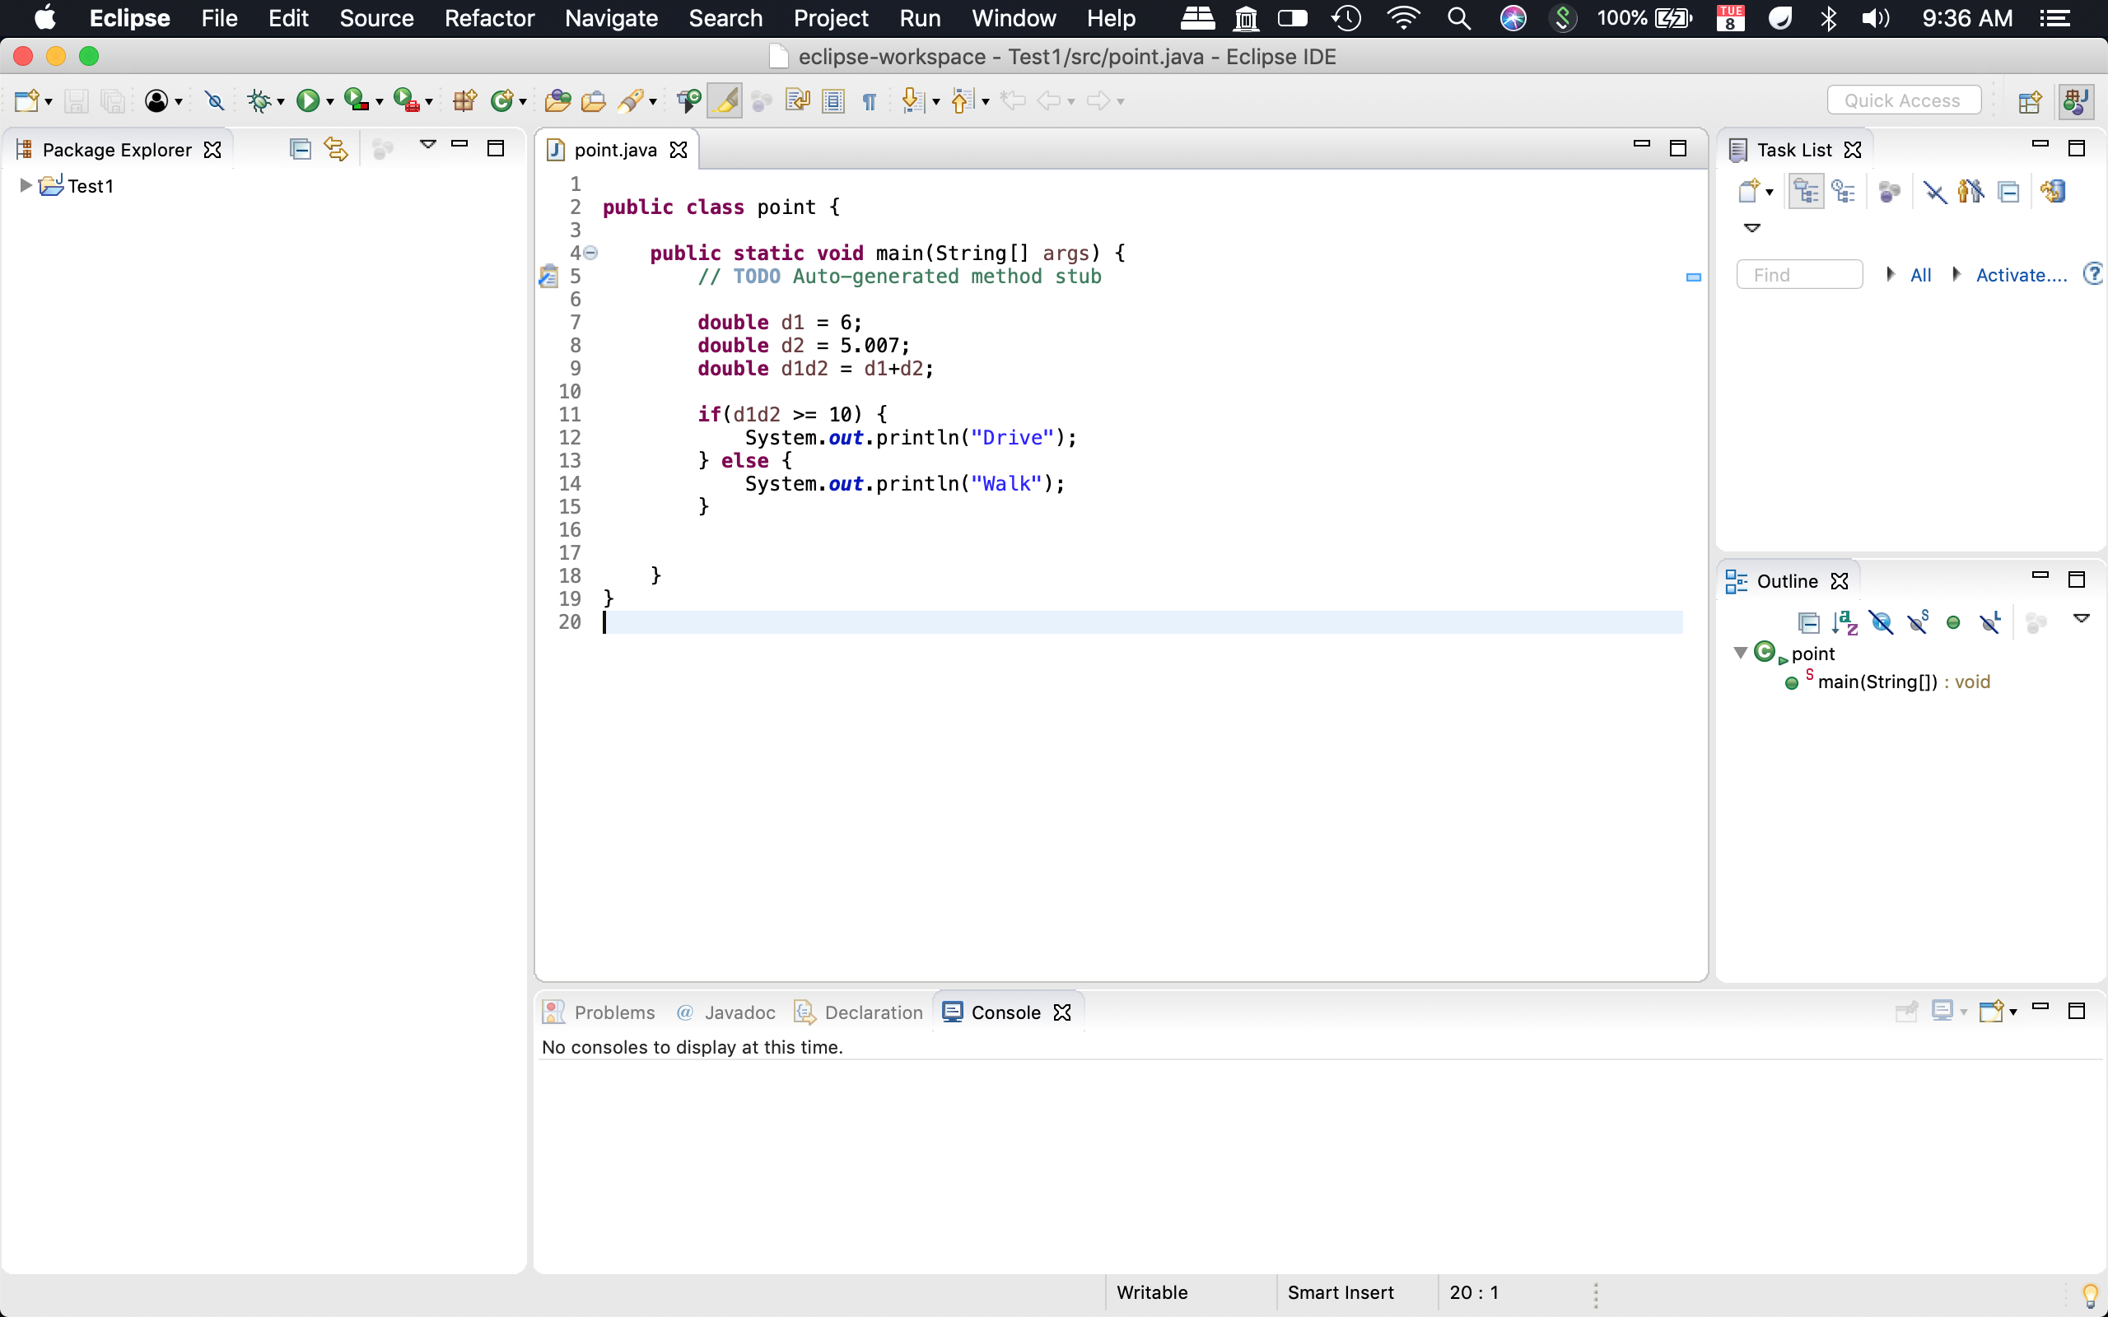
Launch Eclipse !!
SUCCESS !!
https://mikejohnson51.github.io/geog178

Slide 26
Bonus
Read here to learn how to connect a GitHub account/repo to Eclipse:
https://stackoverflow.com/questions/21473308/integrating-eclipse-and-github
https://www.youtube.com/watch?v=ptK9-CNms98
Check out GitHub Desktop for a GUI interface: https://desktop.github.com
See you Thursday at 12:00 noon!

