Slide 1

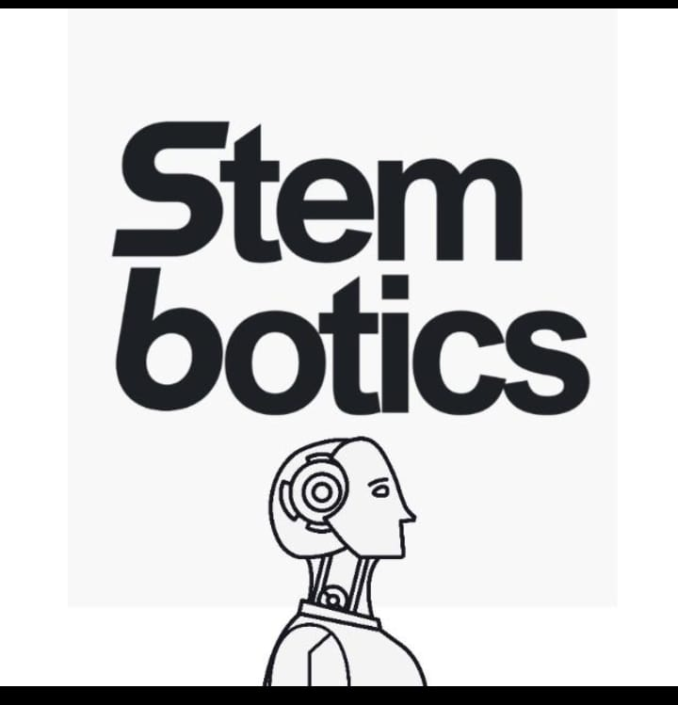
ROBOTICS FOR everyone: EMPOWERING THE African CHILD THROUGH ROBOTICS AND AUTOMATION
Submitted to: Afrikatikkun South Africa Submitted by: Thelumusa Mthethwa, Rolan Ablant, Amahle Makhoba

Slide 2
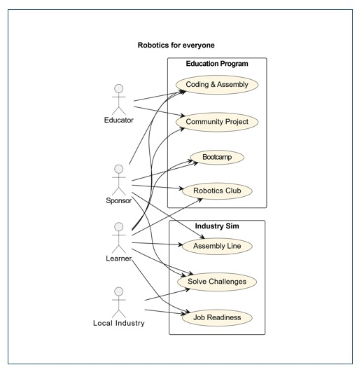
Use case diagram
This use-case proposal presents an opportunity for you to drive sustainable social impact through the deployment of a 6DOF robotic arm and a focused robotics education initiative. This initiative will empower young girls and boys, particularly in underserved communities, by equipping them with future-proof skills in robotics, coding, and automation

Slide 3
Background & Need
South Africa is entering the Fourth Industrial Revolution (4IR), but South African children remain underrepresented in STEM fields. Exposure to robotics at an early stage can change this trajectory. Simultaneously, industries are adopting automation but face a shortage of locally trained talent capable of designing, operating, and maintaining such systems.

Slide 4
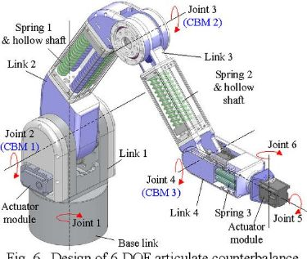
The 6DOF Robot: Technical Overview
A 6DOF (Six Degrees of Freedom) robot mimics the human arm with movements along six axes, enabling tasks such as picking, placing, assembling, and rotating objects. It is widely used in:
Manufacturing
Medical technology
Warehousing and logistics
Stem research

Slide 5
Educational use case
Objective: Teach robotics and automation fundamentals to South African youth via bootcamps and school programs.
Activities:
Host Robotics-for-Everyone bootcamps
Establish school-based robotics clubs
Train educators in basic robotics and programming
Curriculum includes:
Robot assembly
Coding (Arduino & Python)
Real-world tasks (e.g. sorting waste, drawing, automation simulations)

Slide 6
OUTCOMES
Spark interest in STEM careers
Develop local South African talent in tech
Bridge the gender gap in robotics and engineering

Slide 7
INUSTRY SIMULATION USE CASE Demonstrate how 6DOF robots are applied in real industry scenarios to build career readiness.
Activites
Use the robot to simulate warehouse sorting, production-line assembly, and 3D object manipulation
Involve students in solving real-world industrial challenges
Objectives
Prepare students for industrial automation roles
Support local businesses with trained entry-level talent
Position Stembotics as a leader in future workforce development

Slide 8
Community & Social Impact
Empowerment of the South African Youth: Breaks social and cultural barriers around Africans in hardware tech.
Local Innovation: Students build solutions to local problems using robotics.
Job Creation: Opens up pathways for careers in robotics, automation, and engineering.
Educational Equity: Brings high-quality STEM education to under-resourced communities.

Slide 9
Your Value & Alignment This initiative aligns with Your goals of digital inclusion, youth empowerment, and community development. The program can feature:
Your-branded Robotics Labs
Annual Robotics Challenge for African Youth
Digital Ambassadors mentoring young learners

Slide 10
Budget & Support Needed
A detailed budget can be supplied, including hardware, training, facilitation, and logistics. Support can be both financial and infrastructural (e.g. digital hubs)

Slide 11
Thank you.

