Slide 1



SOFTWARE DESIGN II / SDN260S
FILE INTEGRITY
MONITOR
JAVA-BASED CRYPTOGRAPHIC
FILE INTEGRITY MONITOR
Java-Based Cryptographic File Integrity Monitor
Detecting and reporting file changes with SHA-256 hashing
Detecting and reporting file changes using SHA-256 hashing
GROUP 14 • FINAL PROJECT PRESENTATION • NOVEMBER 2026
GROUP 14 • FINAL PROJECT PRESENTATION • NOVEMBER 2026

Slide 2

SDN260S / GROUP 14
02 / 13
THE PROBLEM
Why file integrity matters
THE RISK
OUR RESPONSE
Files can be changed, replaced or deleted without immediate notice.
Record trusted SHA-256 hashes, rescan files and flag differences.
TRUSTED BASELINE → COMPARISON → AUDIT REPORT

Slide 3
SDN260S / GROUP 14
03 / 13
PROJECT OBJECTIVES
What the application delivers
01 DISCOVER
02 VERIFY
Recursive directory scanning
SHA-256 hashing and saved baselines
03 CLASSIFY
04 REPORT
Unchanged, modified, new, deleted
CLI + GUI, exports and error handling

Slide 4
SDN260S / GROUP 14
04 / 13
THREE CHECK-INS
From design to tested prototype
CHECK-IN 01
Problem analysis • UML • roles • plan
CHECK-IN 02
CLI • hashing • persistence • reporting
CHECK-IN 03
GUI • 9 passing tests • usability

Slide 5
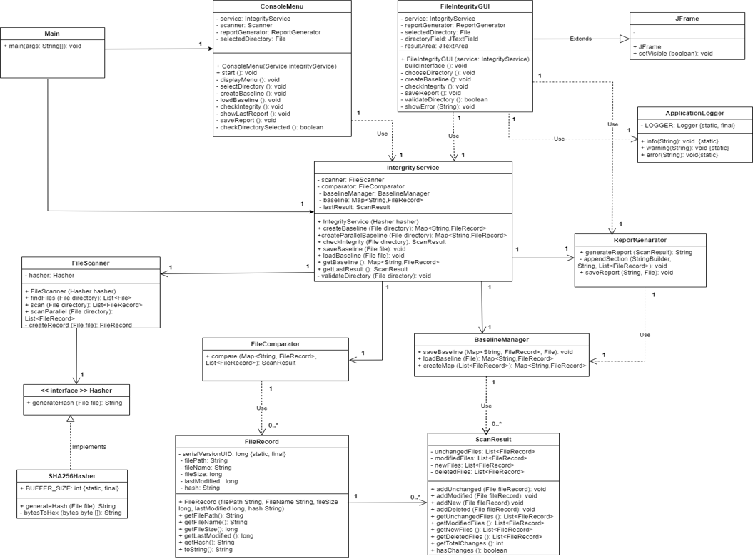
SDN260S / GROUP 14
05 / 13
SYSTEM DESIGN
How the Java classes work together
CORE COMPONENTS
Main → CLI / Swing GUI
IntegrityService → coordinates scanning
FileScanner + SHA256Hasher → records
BaselineManager → saves snapshots
FileComparator → classifies changes
ReportGenerator → exports results

Slide 6
SDN260S / GROUP 14
06 / 13
WORKFLOW
Five steps to verify integrity
1
SELECT A FOLDER
2
SCAN + HASH FILES
3
SAVE / LOAD BASELINE
4
RESCAN + COMPARE
5
DISPLAY / EXPORT REPORT

Slide 7
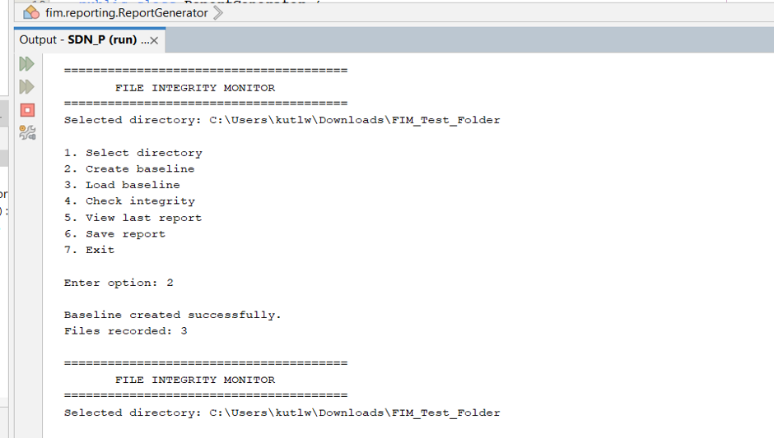
SDN260S / GROUP 14
07 / 13
APPLICATION DEMO
Command-line monitoring
WHAT TO SHOW
Choose a directory
Create and reload the baseline
Check integrity
View results and export a report

Slide 8
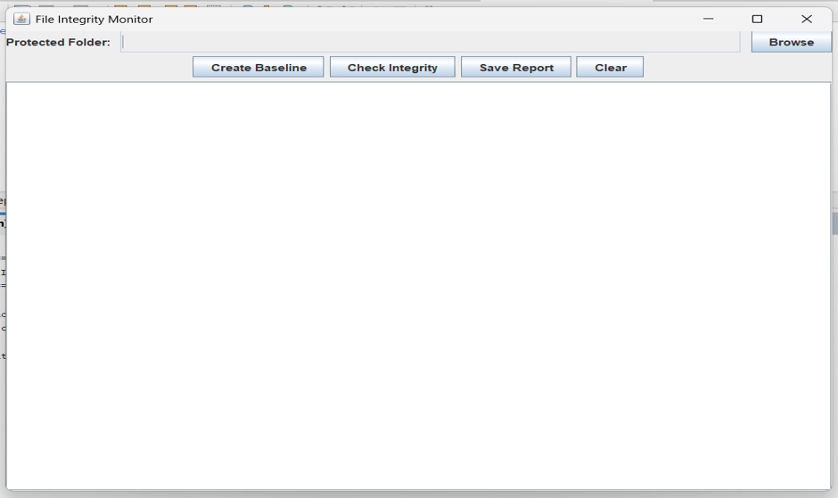
SDN260S / GROUP 14
08 / 13
USER EXPERIENCE
Simple graphical controls
SWING GUI
Browse for a protected folder
Create Baseline / Check Integrity
Save Report / Clear
Read status messages in one place

Slide 9
SDN260S / GROUP 14
09 / 13
TESTING EVIDENCE
Nine documented tests passed
09
09
03
TEST CASES
PASSED
UNCHANGED IN TEST
Startup • Baseline • Persistence • Export • Invalid paths • Added/deleted files • GUI validation

Slide 10
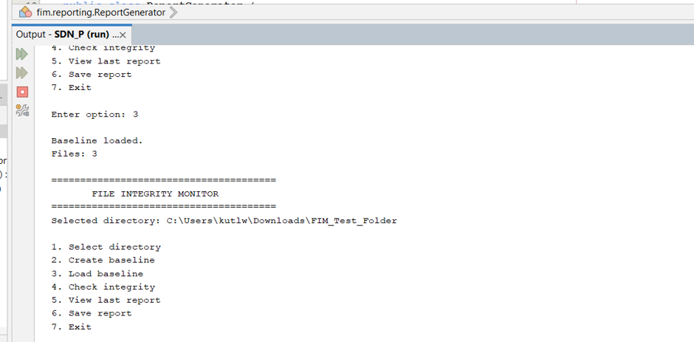
SDN260S / GROUP 14
10 / 13
TESTING EVIDENCE
Baseline persistence verified
BASELINE RELOADING
Saved baseline successfully loaded
3 monitored files restored
CLI displays the selected directory
Change detection was also tested separately.

Slide 11
SDN260S / GROUP 14
11 / 13
QUALITY & USABILITY
Reliability and practical challenges
WORKING SAFEGUARDS
CHALLENGES
Invalid folder paths trigger an error
GUI guides directory selection
Clear results and status reporting
Access-denied folders
Windows path parsing
Baseline integration across components

Slide 12
SDN260S / GROUP 14
12 / 13
GRADUATE ATTRIBUTES
Engineering beyond the code
GA2 / ENGINEERING PRACTICE
GA7 / RESPONSIBILITY
Object-oriented design
Recursion and Java collections
File I/O, interfaces and SHA-256
Responsible file management
Reusable modular architecture
Recognising prototype limitations

Slide 13
SDN260S / GROUP 14
13 / 13
CONCLUSION
A working foundation for integrity
PROJECT OUTCOME
WHAT’S NEXT
Working Java CLI and GUI
Persistent SHA-256 baseline comparison
File-change reports and export
Nine documented passing tests
More extensive testing
Better permissions handling
Automated monitoring

