Slide 1
Assignment 4 Presentation

Slide 2
ISJ107V | N Mathebula (216080254)

Slide 3
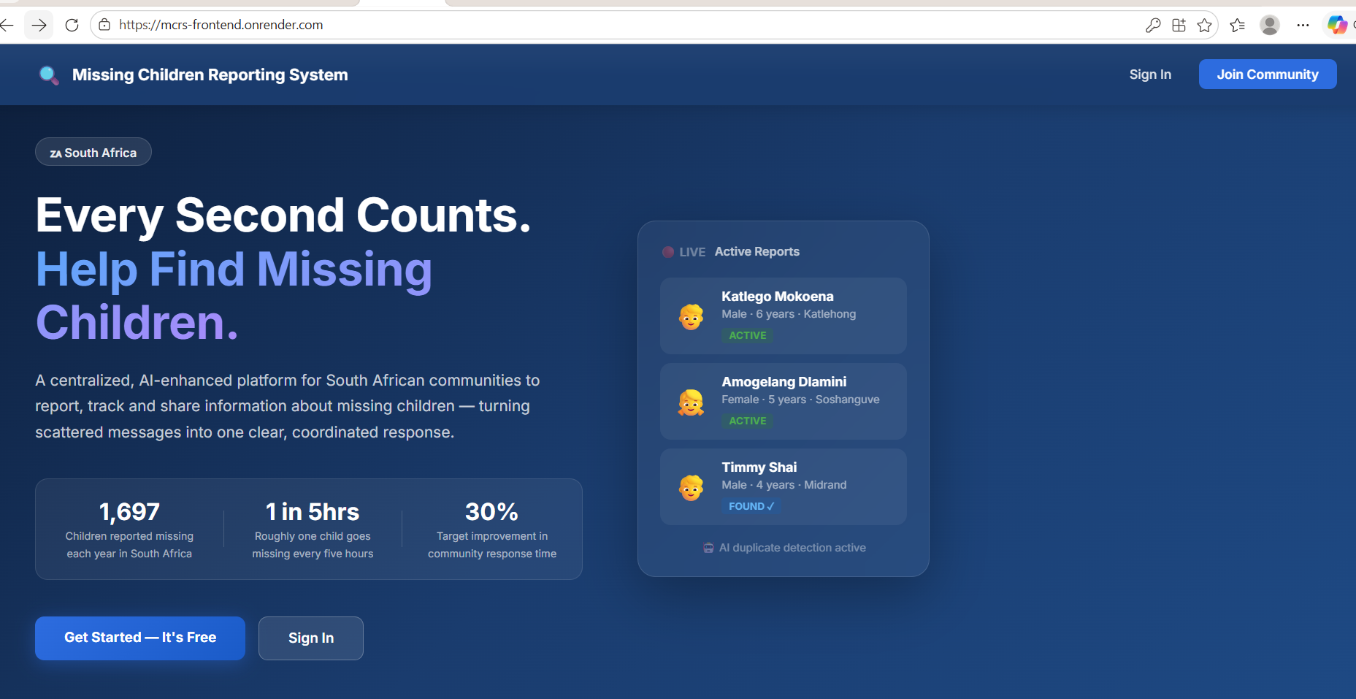
AI-Enhanced Community-Based Missing Children Reporting and Tracking System

Slide 4
Slide 1 - Title
AI-Enhanced Community-Based Missing Children Reporting and Tracking System
N Mathebula - 216080254 ISJ107V
Integrated Software Project - 2026 Tshwane University of Technology
Speaker notes: “Good day. My name is N Mathebula. My project is an AI-enhanced platform that helps South African communities report and track missing children, with artificial intelligence that automatically detects duplicate reports.”

Slide 5
Slide 2 - The Problem
In South Africa, about 1 697 children are reported missing every year - roughly one child every five hours.
Today, reports are scattered across social media, WhatsApp groups and word of mouth.
This fragmentation causes: - Slow spread of critical information - The same child reported many times in different words - No central place to see or analyse cases
Speaker notes: “The stakes are high and the current process is broken - information is scattered, response is slow, and the same child gets reported several times, wasting responders’ effort.”

Slide 6
Slide 3 - The Solution
A single, secure, community-based web platform that lets members: - Report a missing child, with a photo and full description - Alert every registered member instantly - Search, filter and share active cases - Automatically detect duplicate reports using AI - Mark a child as found and close the case safely
Speaker notes: “My solution replaces those fragmented channels with one platform. Everyone reports to the same place, everyone is alerted, and the system keeps the data clean using AI.”

Slide 7
Slide 4 - System Architecture
Four independent components, each hosted separately, communicating over secure HTTPS: - React frontend - the web app, also installable on phones as a Progressive Web App - Java Spring Boot backend - REST API, business logic and security - Python AI service - duplicate detection - PostgreSQL database - secure storage
The Java backend and the Python AI service communicate over a REST (HTTP/JSON) interface, demonstrating interoperability between two different technologies.
Speaker notes: “The system is built as four separate services on different machines that talk to each other over the internet. This satisfies the integrated, multi-component requirement and shows interoperability between Java and Python.” [Show the deployment diagram on this slide.]

Slide 8
Slide 5 - Emerging Technology: AI Duplicate Detection
The emerging technology is Artificial Intelligence using Natural Language Processing.
How it works: - Each report’s text is converted into numbers using TF-IDF vectorisation - Cosine similarity measures how alike two reports are - It runs automatically on every new report - Reports scoring 0.25 or higher are flagged as possible duplicates for an administrator to review - a human makes the final decision
Why not simple keyword matching? Because people describe the same child in different words, and exact matching would miss those near-duplicates.
Speaker notes: “This is the heart of the project. Standard keyword search can’t catch ‘blue shirt’ versus ‘wearing blue’. NLP text similarity can. The AI only suggests; a human admin confirms.”

Slide 9
Slide 6 - Key Features
Secure registration and login (JWT tokens, BCrypt password hashing)
Role-based access: separate community-member and administrator roles
Report submission with input validation and photo upload
Community-wide alerts (in-app and email)
AI duplicate detection with an administrator review panel
“I Found This Child” with safety guidance to contact SAPS on 10111
One-tap social sharing (WhatsApp, Facebook, X, Telegram, email)
Analytics dashboard showing trends by location, time and status
Speaker notes: “Here is the full feature set. I will demonstrate the main ones live in a moment, so I will move quickly here.”

Slide 10
Slide 7 - Results and Evidence
AI accuracy: 100% precision and 100% recall on a 20-pair test set at the 0.25 threshold
Live duplicate flags produced on the deployed system: 84.4% and 90.9% similarity on genuine duplicate pairs
A non-duplicate correctly scored only 14.6% (below the threshold, so not flagged)
Engineering decision: the similarity threshold was tuned from the planned 0.75 down to 0.25 after testing showed short report texts score low - an evidence-based refinement
Deployed live on the cloud as four separate services
Speaker notes: “My numbers: perfect precision and recall on the test set, and real flags of 84 and 90 percent on the live system. I also want to be honest that I changed the threshold from 0.75 to 0.25 based on my own testing - that is a real engineering decision, not guesswork.”

Slide 11
Slide 8 - Live Demonstration
Now moving to the live system.
Demonstration sequence: 1. Dashboard of active reports with photos 2. Submit a new report - including showing input validation 3. Submit a matching report to trigger the AI 4. Administrator reviews and confirms the AI-flagged duplicate 5. Mark a child as found, with the safety confirmation 6. Analytics dashboard
Fallback: identical system also runs locally on this laptop if the cloud is slow.
Speaker notes: “I will now switch to the live application.” [Switch to https://mcrs-frontend.onrender.com - this is the 10-minute demo.]

Slide 12
Slide 9 - Limitations and Next Steps
Free hosting tier stores uploaded images temporarily -> move to persistent cloud object storage in the final system
Text-only matching can miss duplicates worded very differently -> add fuzzy name/location and lightweight image matching; keep the admin review
Free-tier services sleep when idle (slow first request) -> use a paid always-on instance for the final live environment
Speaker notes: “No prototype is perfect. These are my three honest limitations and exactly how I would fix them for the final system.”

Slide 13
Slide 10 - Thank You
Thank you. I welcome your questions.
Live application: https://mcrs-frontend.onrender.com Source code: github.com/Ntwani14/child-tracking-ai-platform
Speaker notes: “Thank you. I am happy to answer technical questions about the design, implementation or testing decisions.” Be ready to explain: why Spring Boot + a separate Python service, why JWT and BCrypt, why the threshold changed from 0.75 to 0.25, why alerts go to all users, and why a human reviews duplicates instead of auto-deleting them.

