Slide 1

Innovations in Oral Care for Patients with Limited Dexterity​
Zehra Nuri
DNHY 210

Slide 2
GOAL
To highlight how innovative tools like the Samba Robotic Toothbrush and 3D-Printed Toothbrush Handles help people with limited dexterity maintain better oral hygiene and independence while informing dental professionals and caregivers of their benefits.​

Slide 3


Objectives​
To explain the common challenges faced by individuals with limited dexterity in their oral care routines. ​
To show how the Samba Robotic Toothbrush simplifies brushing by automating the process for people who struggle with traditional brushing. ​
To discuss how 3D-Printed Toothbrush Handles are tailored to users’ specific grip needs, improving ease of use​
To evaluate the effectiveness of these innovations in improving oral health and quality of life for patients with dexterity limitations.​

Slide 4
Limited Dexterity and Oral care challenges
From arthritis, carpal tunnel, and Parkinson’s disease to other conditions, many people face challenges that make oral hygiene care painful and difficult, making consistent oral care even harder.

Slide 5
Statistics​
Almost 45% of the global population has an oral disease, with rates nearly doubling among people with disabilities (WHO).​
Global Prevalence
61 million U.S. adults have a disability, including arthritis, Parkinson’s, and stroke effects, which impact dexterity and oral care (CDC).​
U.S. Adult with Limited Dexterity
Individuals with physical limitations are 2–3 times more likely to develop severe periodontal disease (Pocket Dentistry) .​
Periodontal Disease
65% of adults with physical limitations experience gingivitis, compared to 30% of the general population (Journal of Oral Health).​
Plaque and Gingivitis

Slide 6
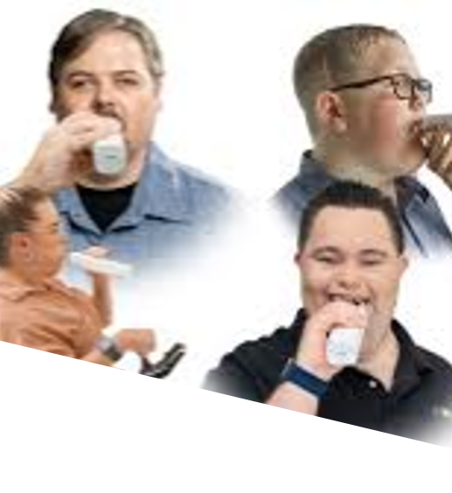
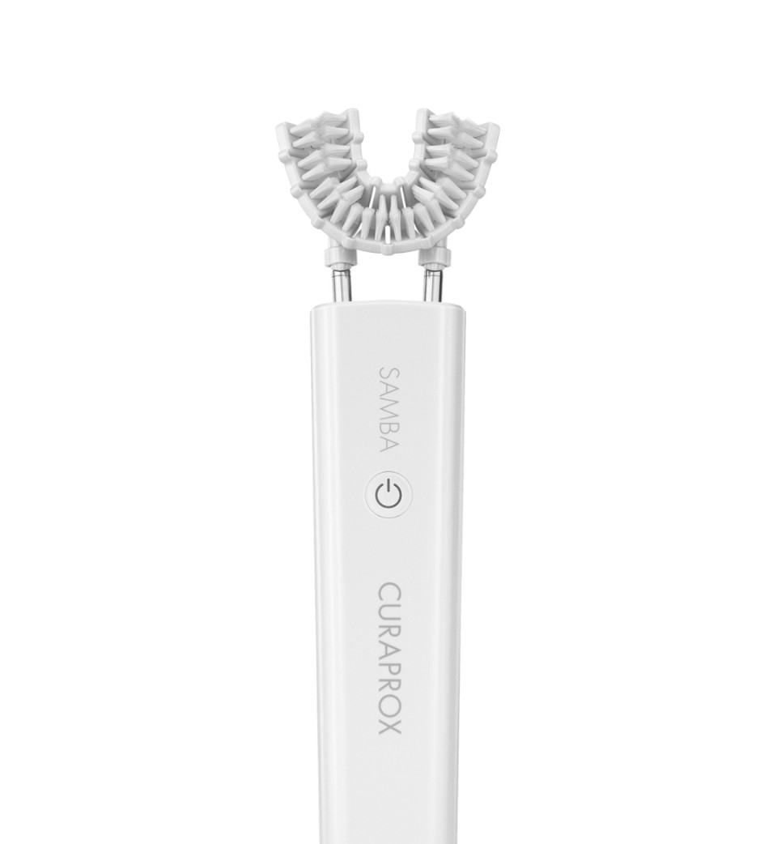
Samba Robotic Toothbrush​
Designed for ease of use, it supports individuals with dexterity or mobility limitations, ensuring that no one is left behind in achieving a healthier smile.
Automated Cleaning
Ease of Use
Independence in Oral Care
Gentle on Gums and Teeth
Time-Efficient

Slide 7


Samba Robotic Toothbrush​
Earned both Time Magazine's Best Inventions of 2023 and the Titan Innovation Award for its groundbreaking design.​
launched in the U.S. on September 7, 2023, and is available for purchase at www.samba.us for $299 ​

Slide 8
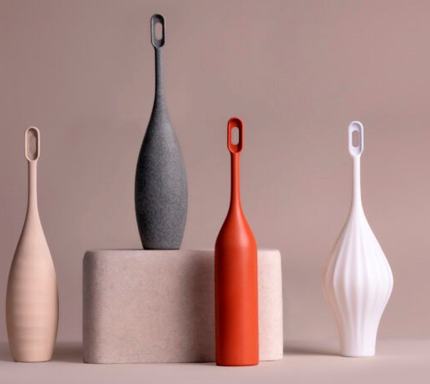
3D-Printed Toothbrush Handle​
Customized Design​
Personalized Fit​
Affordable & Accessible​
Capable of holding either a manual or electric toothbrush​

Slide 9
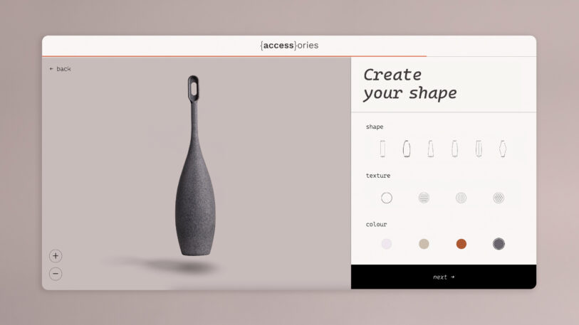
3D-Printed Toothbrush Handle​
Currently Protype Stage​
Approximately 10 handles have been tested and shipped to users for feedback​.

Slide 10
Conclusion​
The Samba robotic toothbrush and 3D-printed toothbrush handles provide essential solutions for people with limited dexterity. As they evolve, they have the potential to significantly enhance the quality of life for people with physical limitations, making oral care both more accessible and effective.​

Slide 11
References​
Centers for Disease Control and Prevention. (2024, July 31). FASTSTATS - disabilities or limitations. Centers for Disease Control and Prevention. https://www.cdc.gov/nchs/fastats/disability.htm ​
Milleman, K., Milleman, J., Bosma, M. L., McGuire, J. A., Sunkara, A., DelSasso, A., York, T., & Cecil, A. M. (2022, June 1). Role of manual dexterity on Mechanical and Chemotherapeutic Oral Hygiene regimens. Journal of Dental Hygiene. https://jdh.adha.org/content/96/3/35 ​
Samba robotic toothbrush. Samba Robotic Toothbrush. (n.d.-a). https://enjoy.curaprox.com/us/product/samba ​
Themes, U. (2020, July 18). 3: Oral hygiene instruction with limited dexterity. Pocket Dentistry. https://pocketdentistry.com/3-oral-hygiene-instruction-with-limited-dexterity/ ​
These toothbrush handles are custom designed for the 360 million people with Dexterity Issues. (n.d.). https://www.fastcompany.com/90896933/toothbrush-handles-designed-for-people-with-dexterity-issues ​
World Health Organization. (n.d.). Who highlights oral health neglect affecting nearly half of the world’s population. World Health Organization. https://www.who.int/news/item/18-11-2022-who-highlights-oral-health-neglect-affecting-nearly-half-of-the-world-s-population ​

