Slide 1
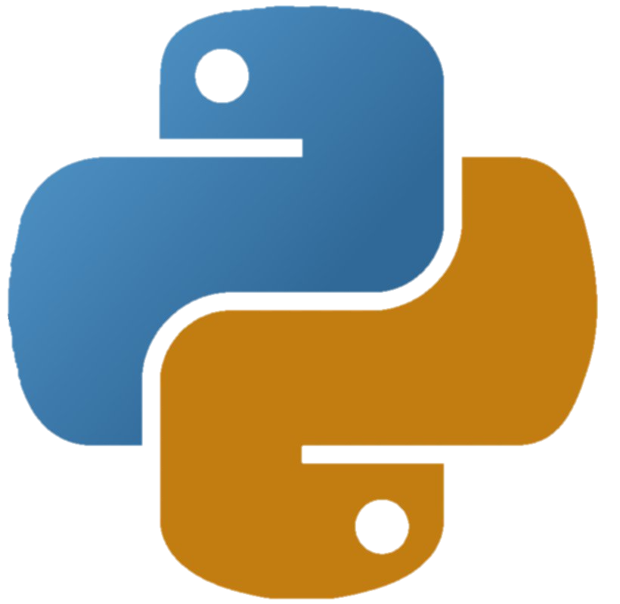
My Workflow in Python: Environments and Dev. Tools
My daily routines on developing Python scripts
我日常工作是如何配置Python环境/开发工具的
--by the friedBee

Slide 2
Pip vs. Conda: why I prefer conda over pip?
Pip:
Package Manager for Python based on PyPI
Hard to find environments (need virtualenvwrapper)
https://pypi.org/project/pip/
Conda:
Package Manager for Python, R, Ruby, etc.
Data Science oriented
List all environments
https://docs.conda.io/en/latest/
Also supports pip
Anaconda:
A software containing conda plus many softwares, targeted for data science users.
https://www.anaconda.com/products/enterprise

Slide 3

Conda/Anaconda Overview
A tour of Anaconda UI
A link for conda basic commands:
https://docs.conda.io/projects/conda/en/latest/user-guide/tasks/manage-environments.html
Demo
Use Terminal/Cmd:
list all environments
Activate/deactivate python env.
Access Anaconda’s software (e.g., Jupyter Notebook) using specified env.

Slide 4


Summary: Jupyter Notebook
Interactive programming
Expressive Markdown
Generate a nice tutorial
Demo:
Jupyter; Jupyter + text editor
Spyder:
provides a user interface similar to R Studio/Matlab

Slide 5

Sublime
Simple text editor (https://www.sublimetext.com/)
Program independently (don’t rely on IDE hints)
Extensive (lots of packages)
Can execute pythons as well as many other languages by access to the interpreter
Demo
Set up a same Python conda environment in Sublime

Slide 6

PyCharm: my choice of IDE
Developed by JetBrains
”Serious” program development
Very powerful tool
Demo:
Set up a project using the same environment we used before.

Slide 7
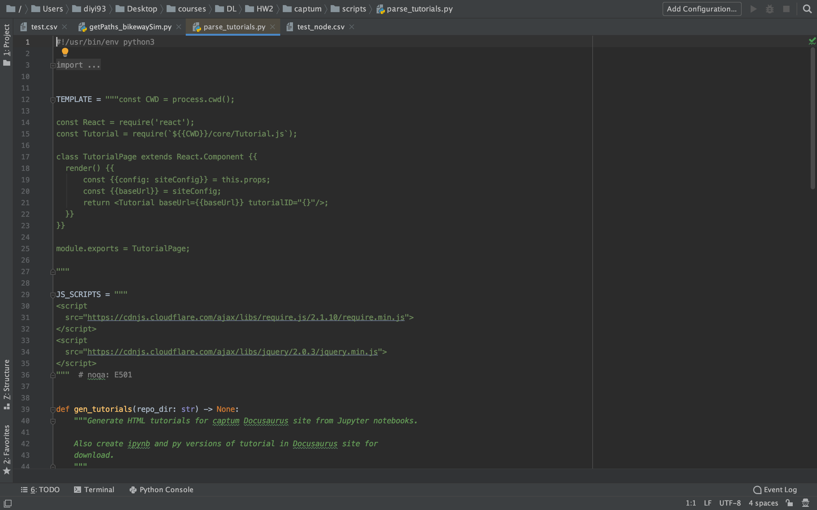
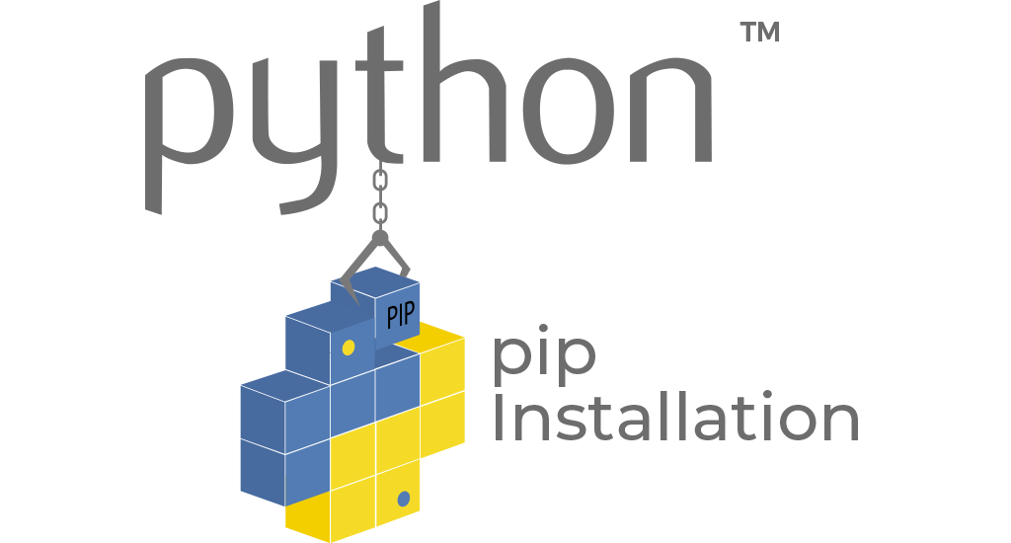
如何配置Python环境
什么是Pip/conda？
如何选择Python开发工具？

