Slide 1
TimekeeperWPF

Slide 2
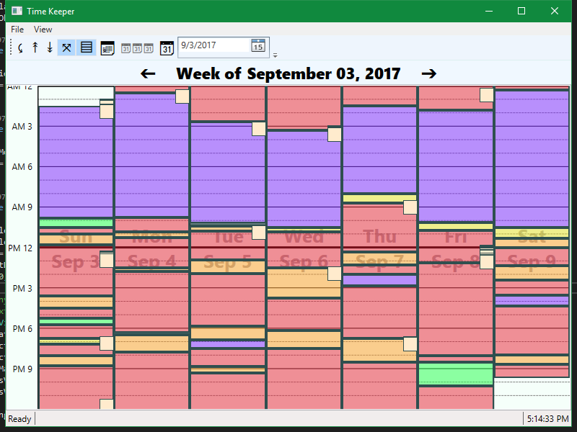
TimekeeperWPF

Slide 3
In this talk
Purpose
To expand my portfolio
To create something I need
Technology
Features
Planned Features

Slide 4
Technology
.NET Framework
Windows Presentation Foundation (WPF)
SQL Server
As the data store
Entity Framework (EF) ORM
To interact with the data as POCOS
Git
Version Control

Slide 5
The MVVM Pattern
Purpose:
Maintainability
Model
The data
View
What you see
ViewModel
The program logic

Slide 6
What it does
Allows user to easily keep track of tasks they’ve done
Take Notes
Displays Notes and Tasks on a Calendar View
At a glance you can determine how your time was spent

Slide 7
Features
Coded with high usage of object-oriented design
To promote clean code
Maintainability
Scalability
Reusability
Rich inheritance trees
24 Views
Typically 1 ViewModel for each View

Slide 8
Features
Navigation
Validations and Notifications
Custom Commands
Custom Controls
Custom Panels
Generous usage of Bindings
Styles, Templates, Themes
Animations

Slide 9
Future Plans
Many plans in the works
Automated planner
Data Analysis
Future Tasks
Suggestions
Filters
More themes
Graphs
Performance improvements
Continuous View
Simultaneous tasks
Collisions
States
Usability improvements
Right click menu
Edit from week View

Slide 10
Let’s see it in action

