Slide 1
Lending Club Case Study
Nikhil Kane

Slide 2
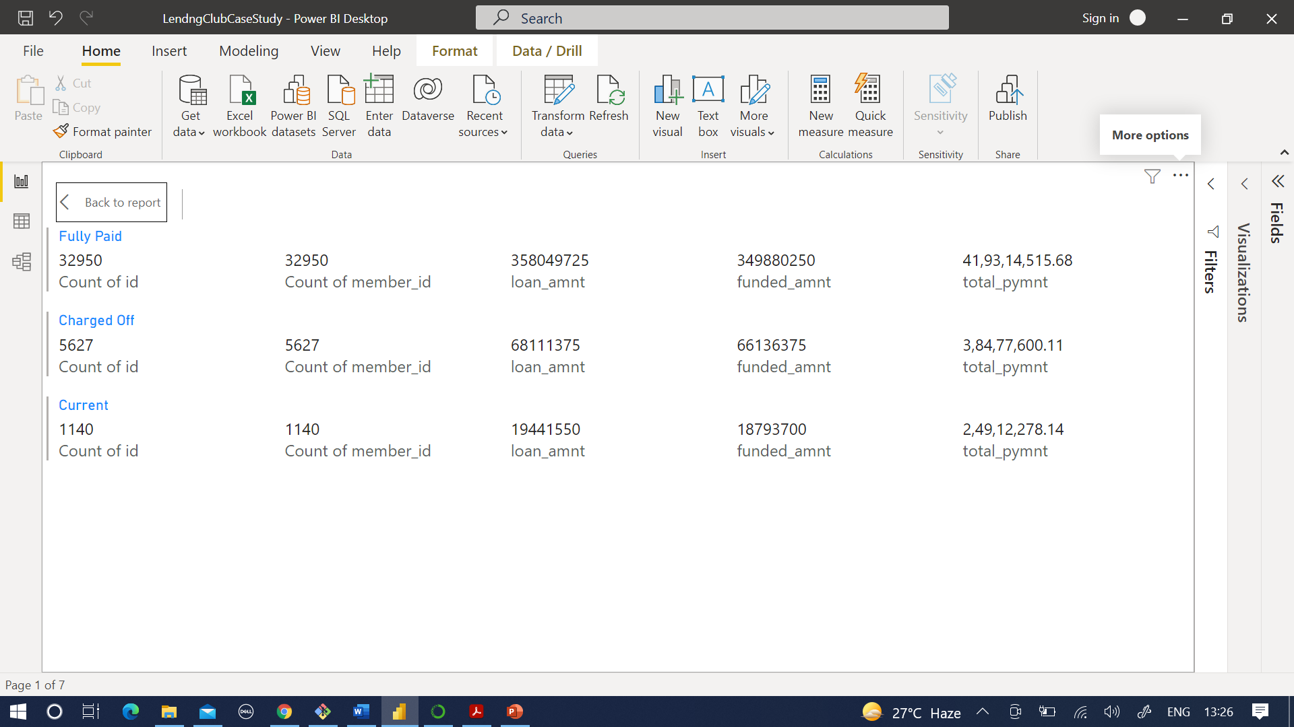
Overall Status of Loans
Status of Loans Disbursed
Cost-wise Status of Loans Disbursed

Slide 3
Assumptions for Analysis
14% of loans are defaulted
During comparison, any factor that has an effect higher than 14% is considered an influencer
Bivariate analysis was undertaken in two major categories viz. Aspects related to loan (eg Loan Amount, Installment, Term, etc) and Aspects related to individuals (eg Address, Employment Status, Open Accouts, etc)
Variables such as Int Rate, Installment, Annual Increment, etc have been binned for better ordered categorical analysis

Slide 4
Influence of Loan Aspects
Loan Amount
Loan Term
Loan Grade
Interest Rate

Slide 5
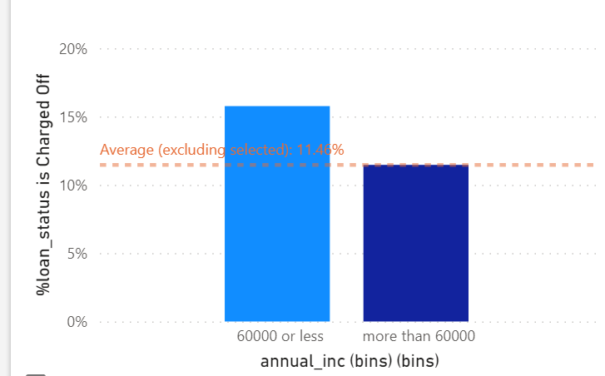
Influence of Individual/ Member’s Aspects
Loan Purpose
Address State of Member
Annual Increment

